Slide 1
Subsea Advanced Imaging Lab
Paul Roberts
May 5, 2026
Notes:
This abstract proposes the formation of a new lab (or focus area) at MBARI dedicated to advanced subsea imaging

Slide 2
Imaging at MBARI
Onboard quantification and decision making
Inter-Vehicle Coordination
Synoptic
Quantification
Mapping
Autonomy
Extending human perception
Measurement and quantification
Navigation, control, mapping, and tracking
ROV Cameras
AUV Cameras
Time Lapse Cameras
Machine Vision
Laser Imaging
Lightfield
Microscopy
Heterogenous Imaging
Camera Arrays
Lidar
Imaging Sonar
Notes:
As I presented a few years ago, MBARI has a long history of advancing imaging systems for three key application areas. These are:
Extending human perception
Measurement and quantification
Navigation, control, mapping, and tracking.
The perception component focuses on enabling human-like vision on a wide range of plantforms. These kinds of systems are ubiquitous at mbari and we are now leading the world in the development of these systems
Measuremnt and quantification focuses on deriving quantitative information from images. We have seen a major increase in measurement focused imaging systems since I joined MBARI 6 years ago, and we continue to build more
Navigation, control, mapping, and tracking are now adaping may of the designs from the perception side into heterogeneous sleds with imaging playing the primary, or a critical role in the real-time control and mapping products.

Slide 3
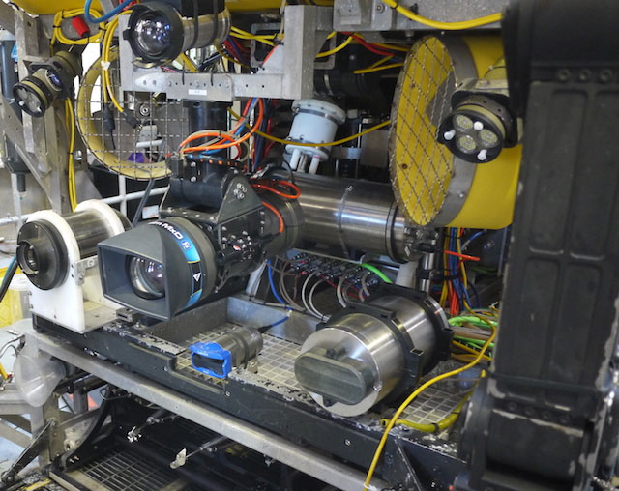
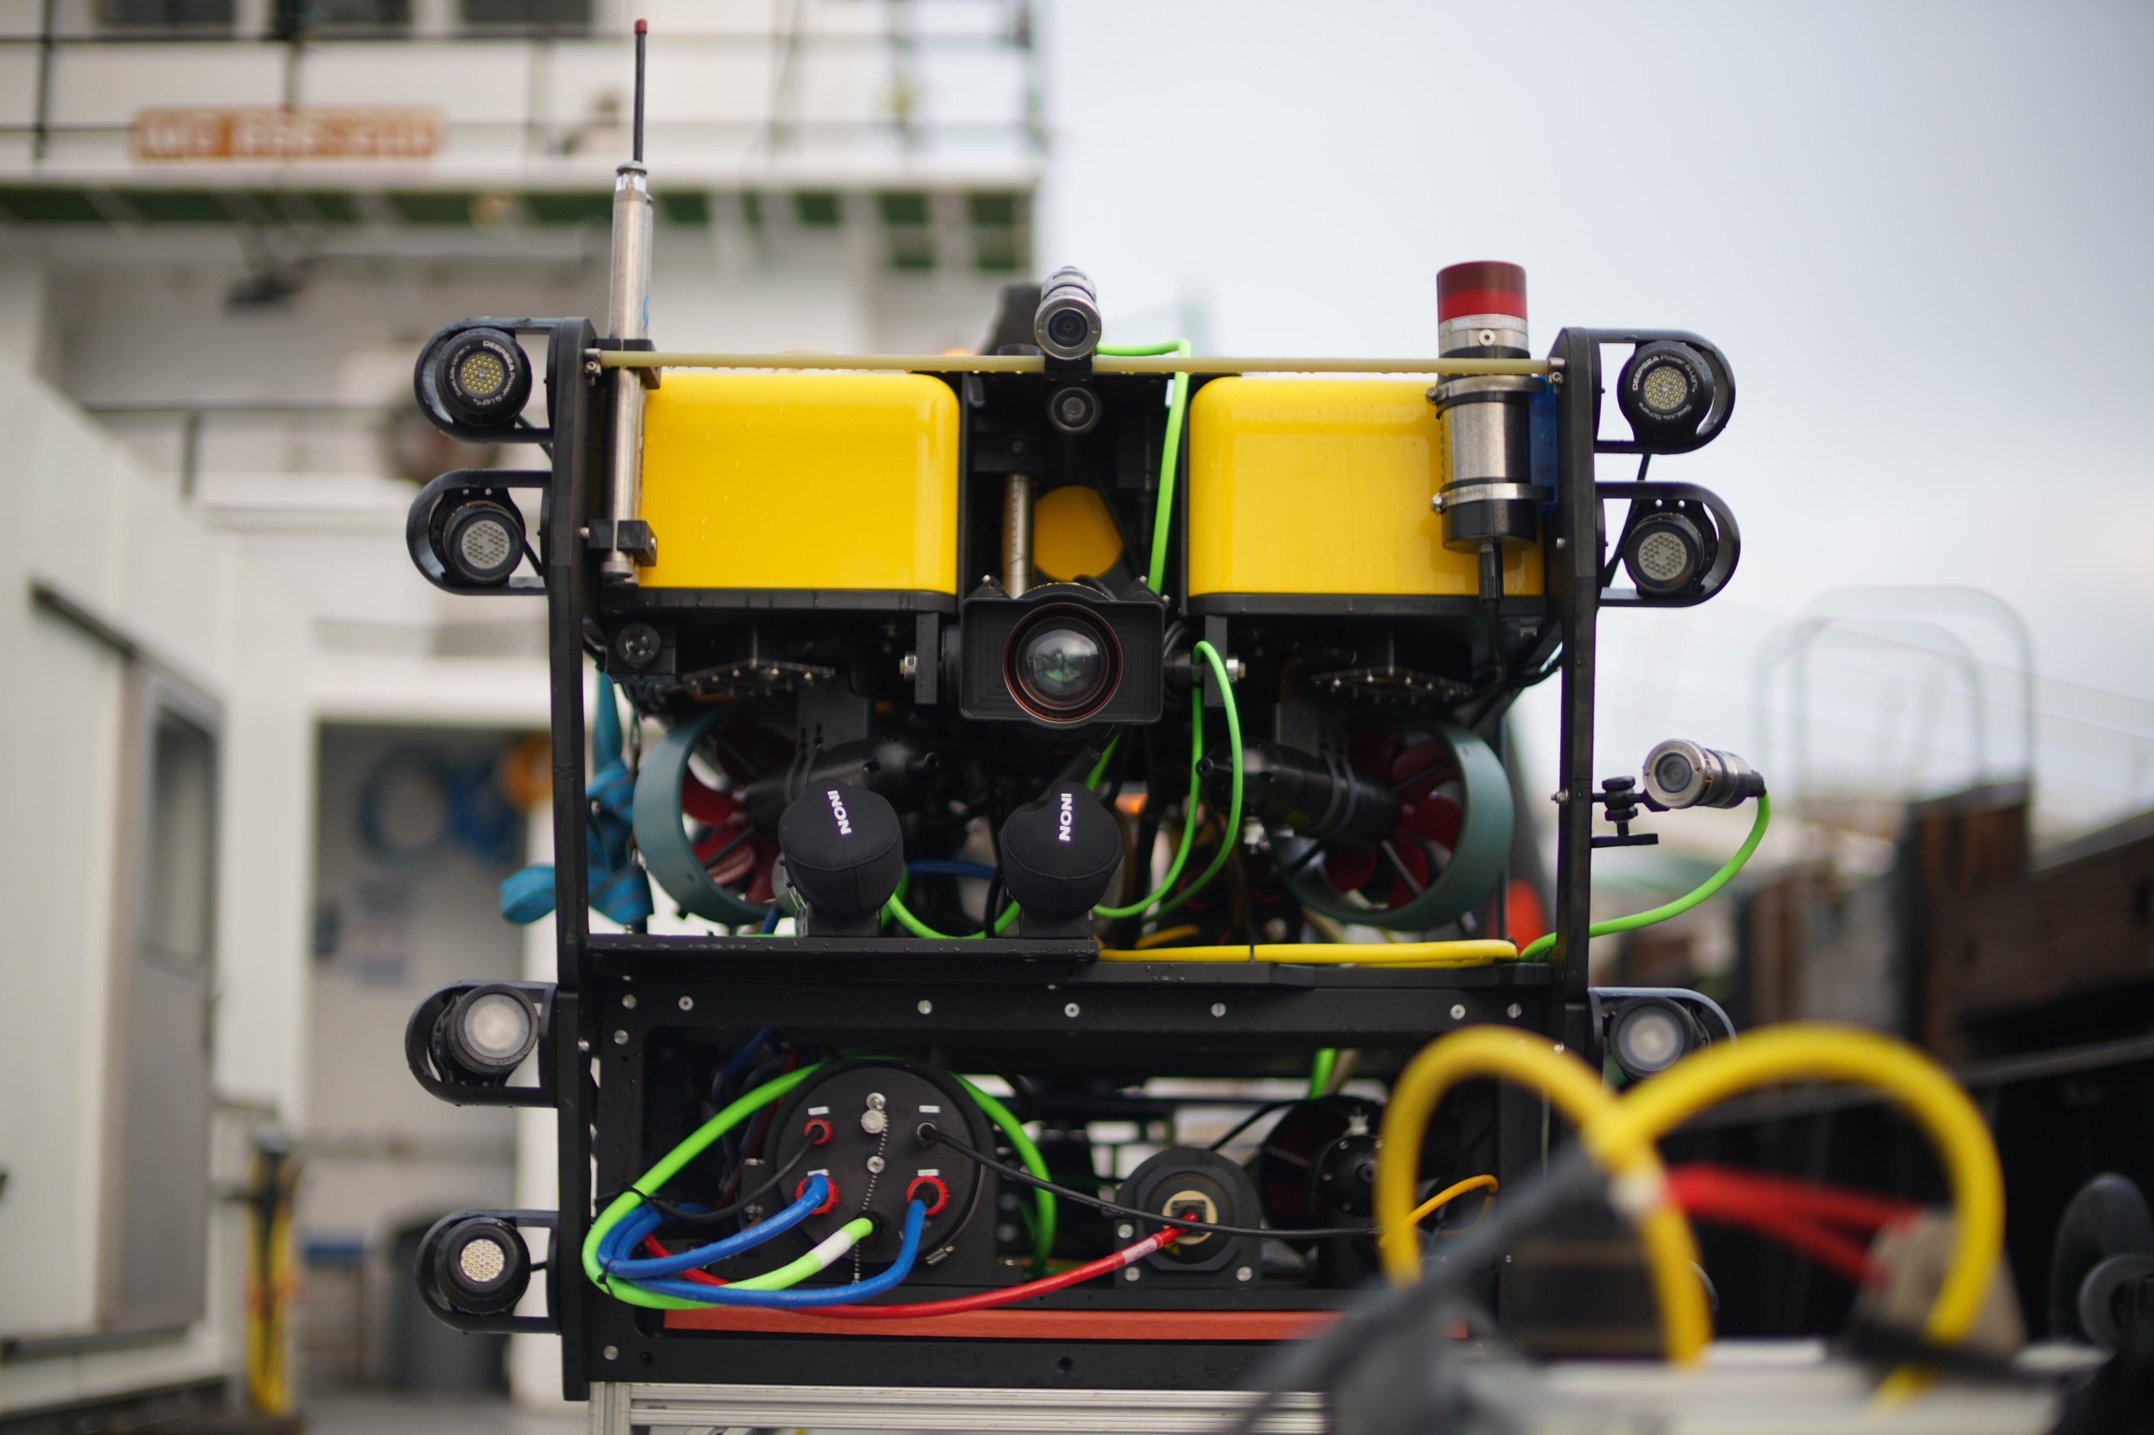
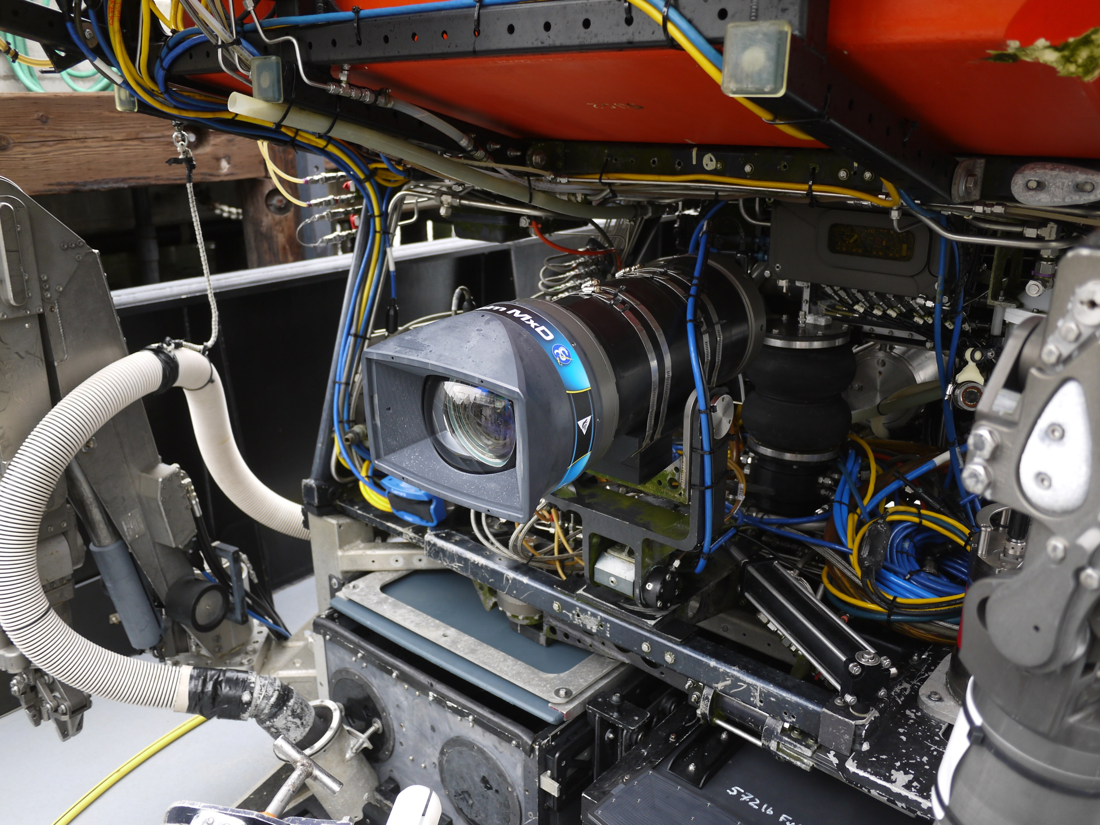
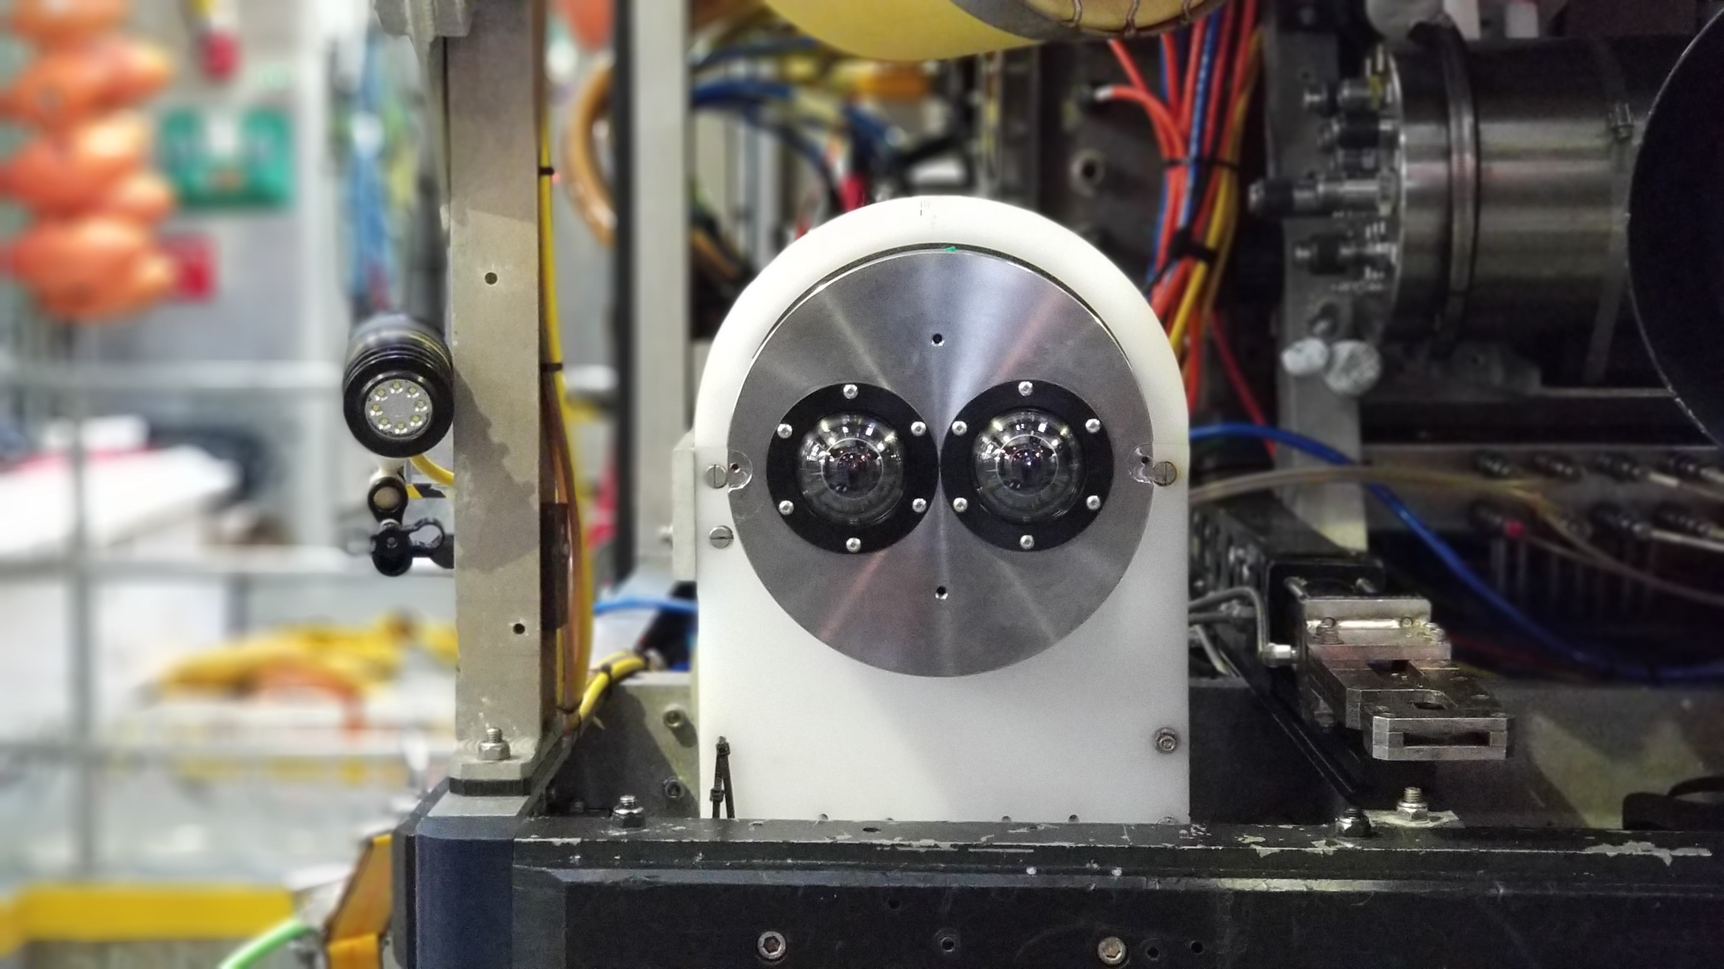
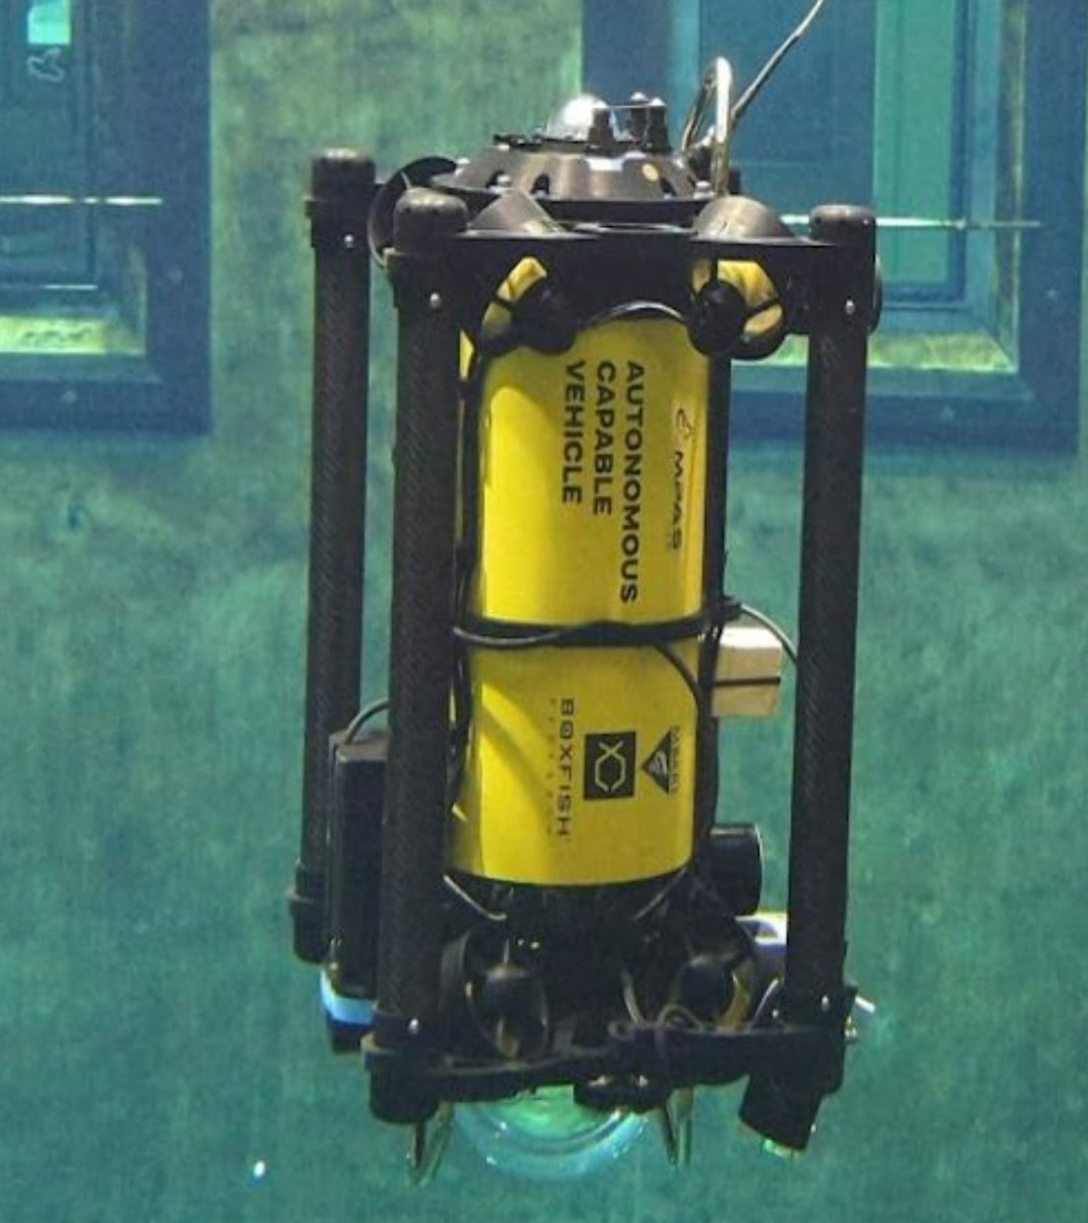
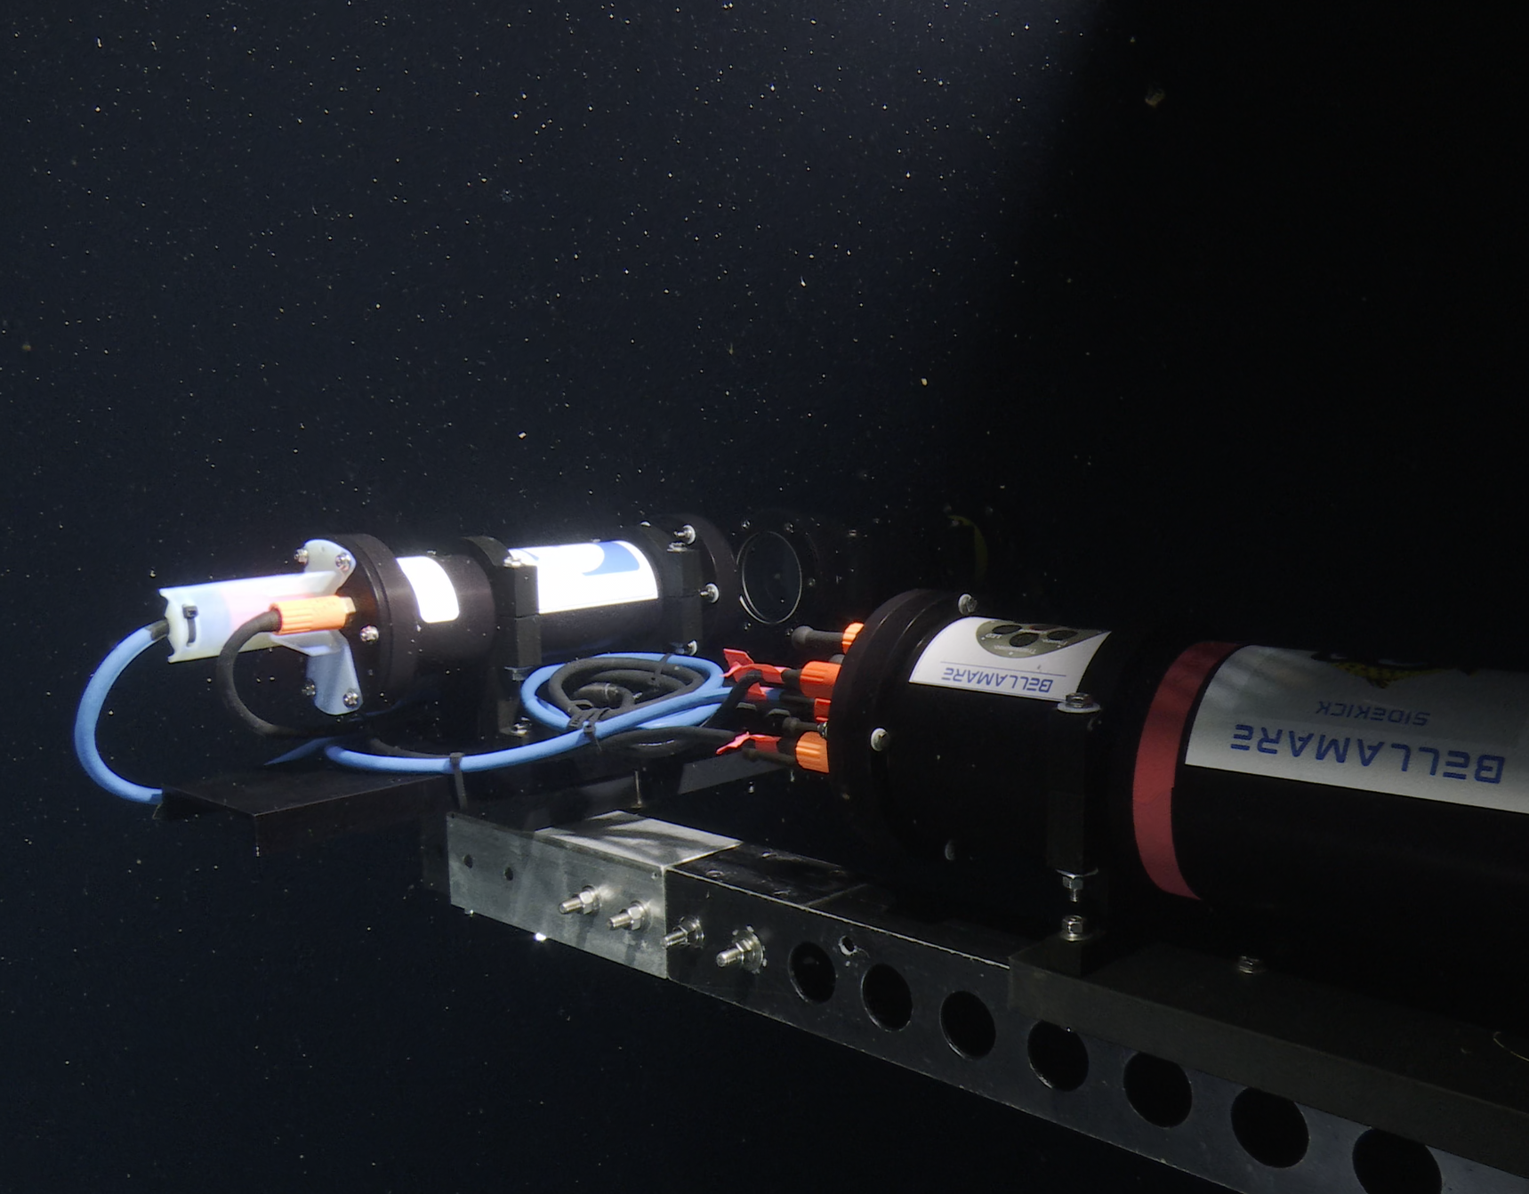
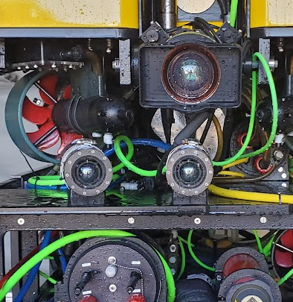
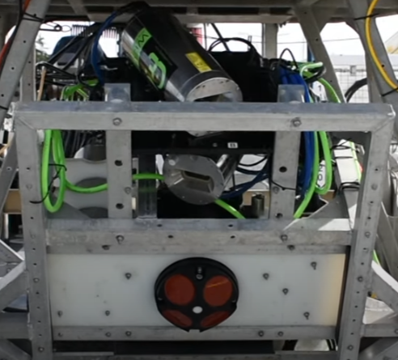
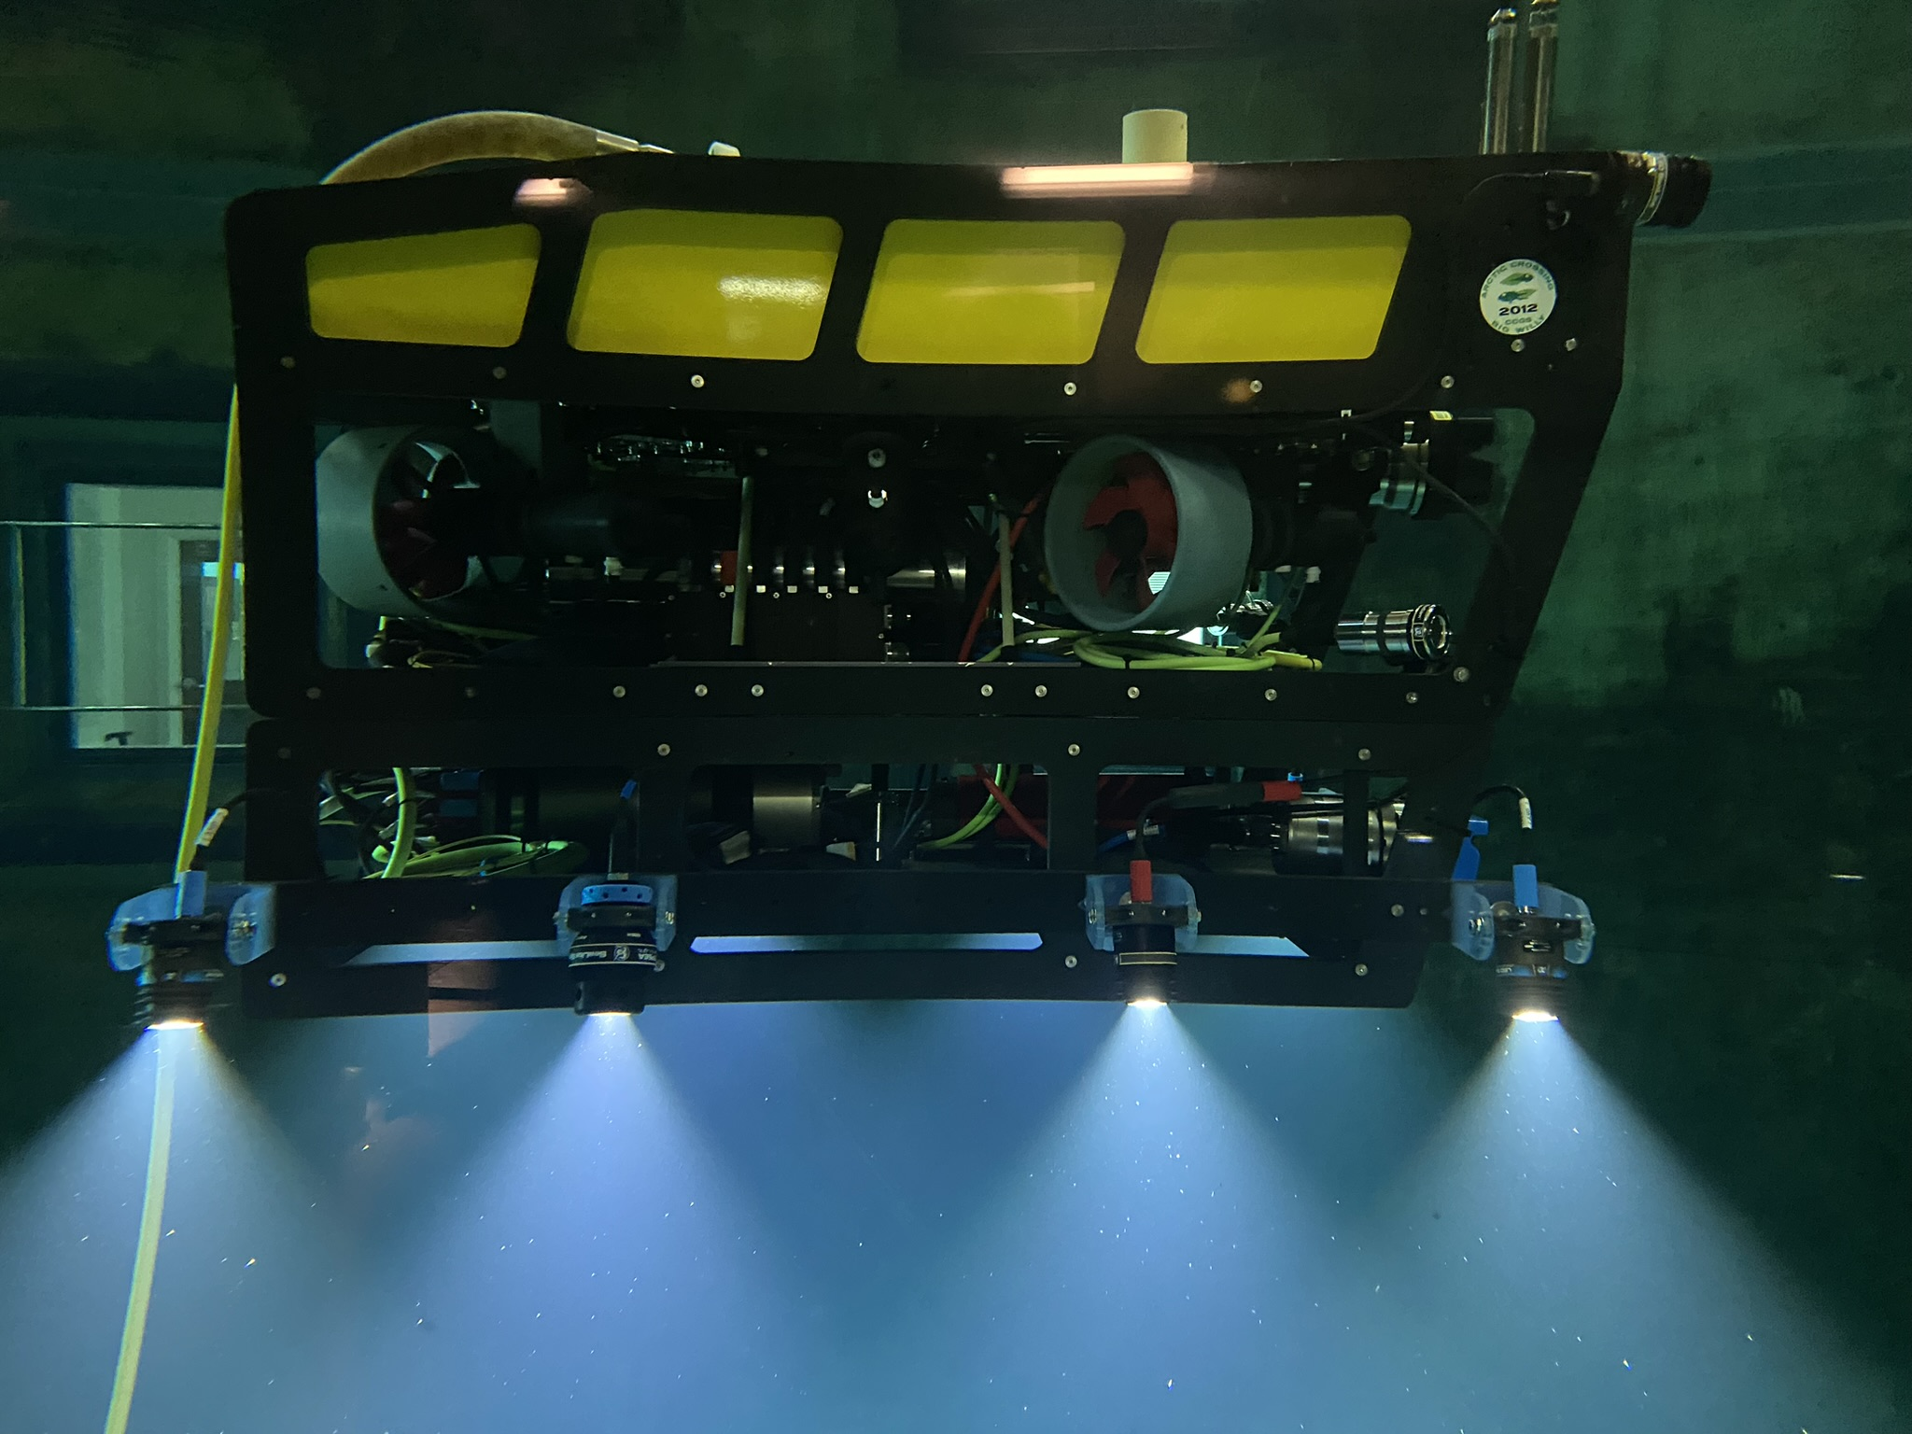
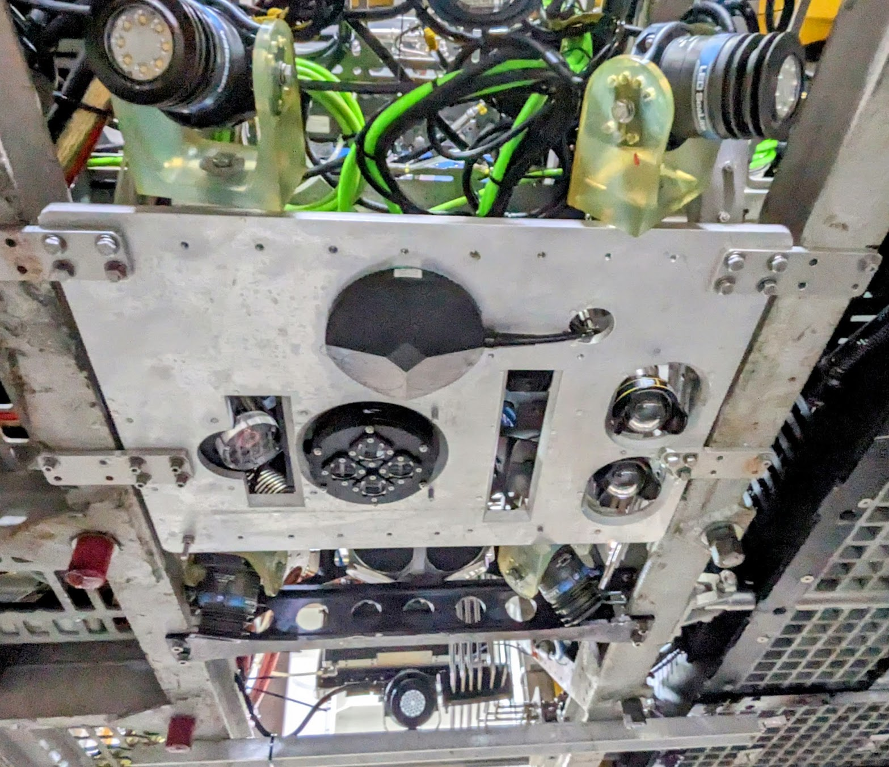
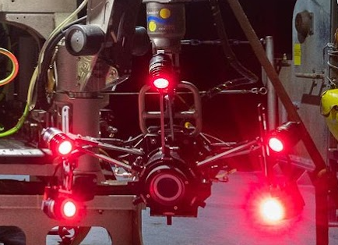
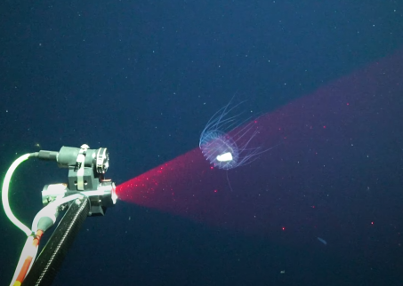
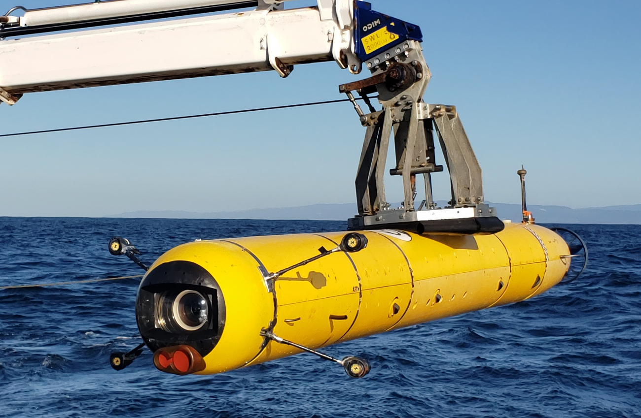
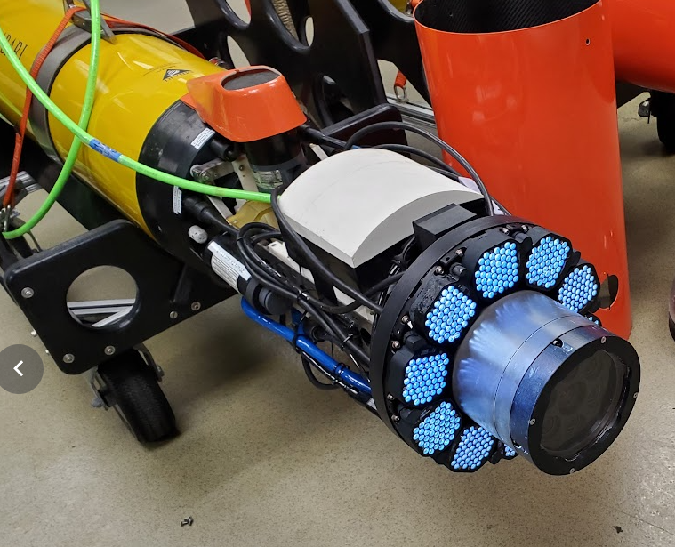
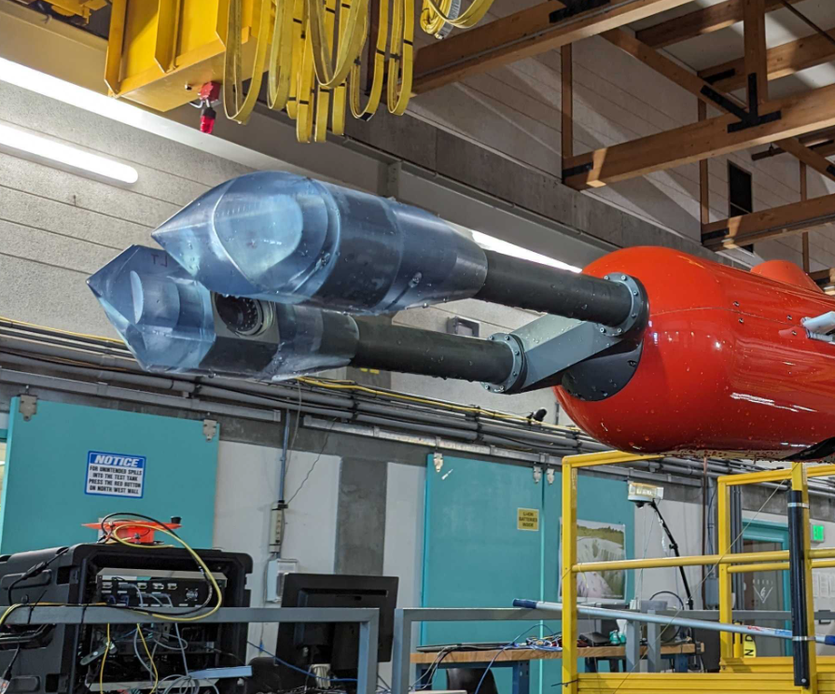
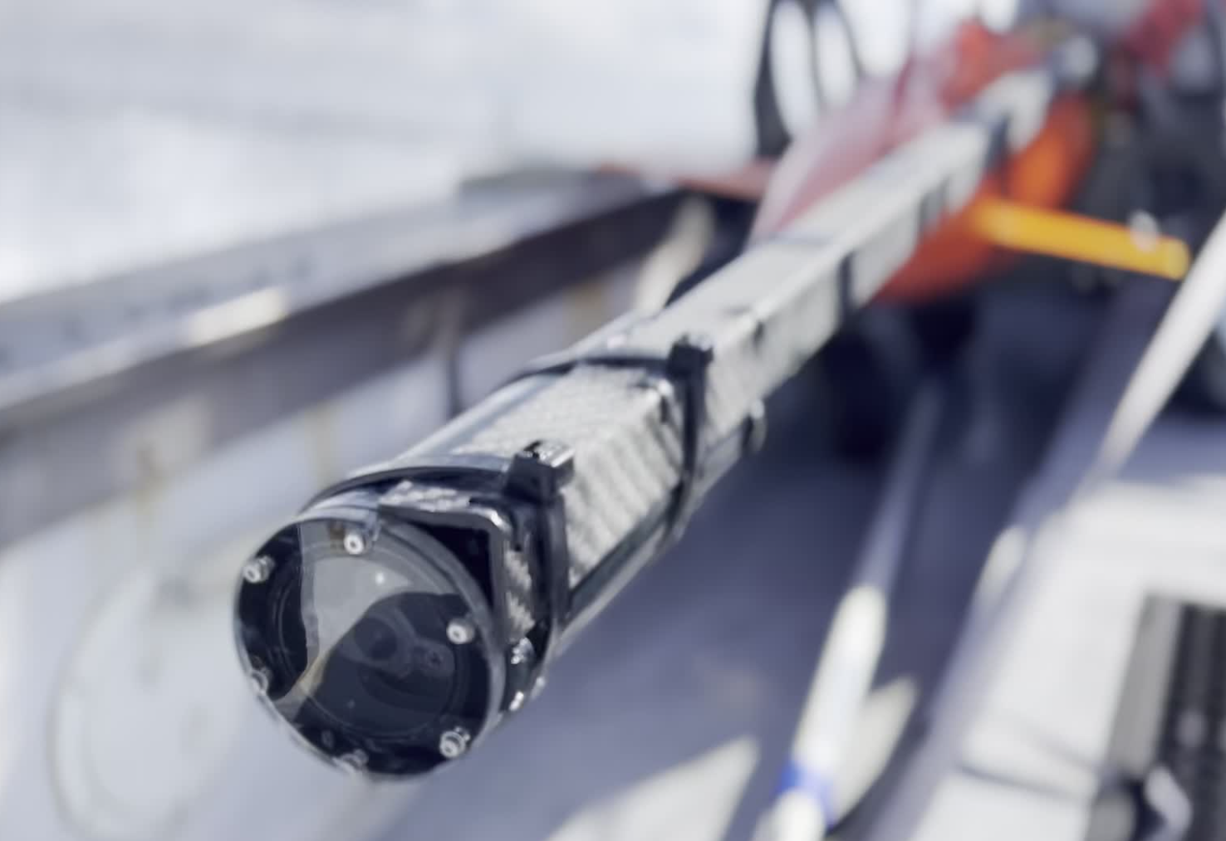
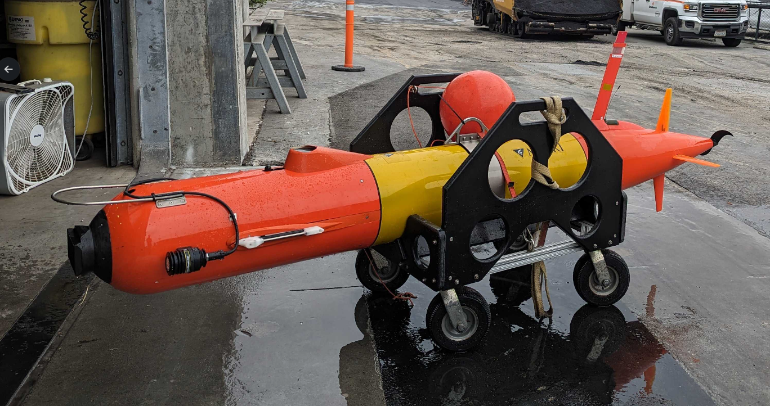
Notes:
Just to put the proliferation of imaging systems into a visual context, here’s a collage of many of the imaging systems under operation and deployment at MBARI. Far to many to go into detail here, but suffice it say, we have invested heavily in imaging and have perhaps the most advanced fleet of subsea imaging platforms in the world.

Slide 4
Goals for the Next 5 Years
Consolidation
Collaboration
Innovation
Notes:
So, where to go from here? With this abstract im proposing the formation of a lab with these three goals:
Consolidation
Collaboration
Innovation
I’ll go into more details about these goals in the next slides.

Slide 5
Consolidation
Align imaging-related projects at MBARI with shared resources and components where it would benefit the project outcomes
  Custom lenses for wide-angle, space constrained imaging projects
  High-intensity strobe illumination with standard power/trigger interfaces
  Hyper and multispectral illumination and sensors
  Miniaturized in situ microscopes
Notes:
Starting with consolidation, although there are many, many different imaging systems and platforms at mbari. They share common attributes that can potentially be elevated by consolidating development efforts.
I want to emphasize that this effort intends to prioritize consolidation on benefiting the project outcomes.
So here are some example areas for this effort:
Dome optics: Many of the system I showed previously currently use flat ports and off-the-shelf lenses without any optical correction

Slide 6
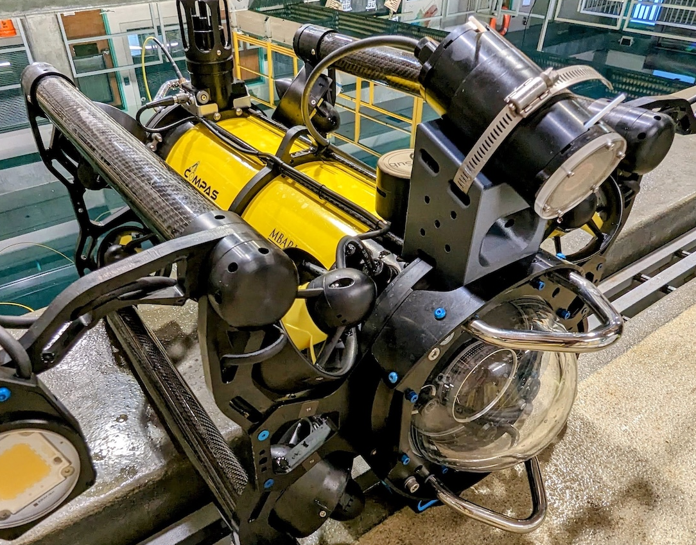
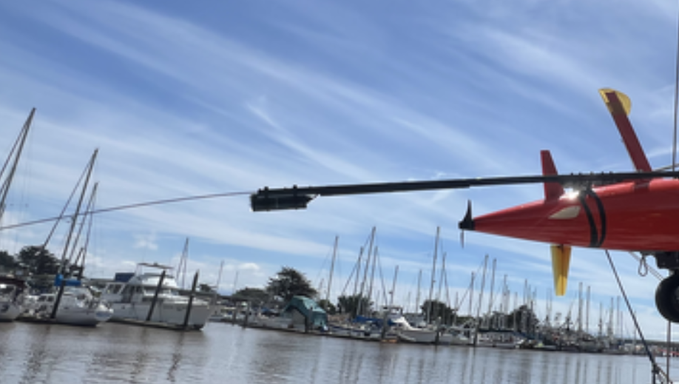
Advanced Optics and Viewports
Large platforms
(Ventana, Ricketts, Dorado)
Medium platforms
(MiniROV, LRAUV, LASS)
Small platforms
(Mola, Blue ROV, Defender, piscivore, most GP ROV cameras)
Large and heavy (100 lbs)
Professional 4k video
Suitable for BBC, Nat Geo, etc
Sets the standard in the field
2 liter bottle sized
Mixture of HD and 4k recording
Limited optics and correction
Soda can size or smaller
Mixture of HD and 4k recording
Limited optics, no correction

Slide 7
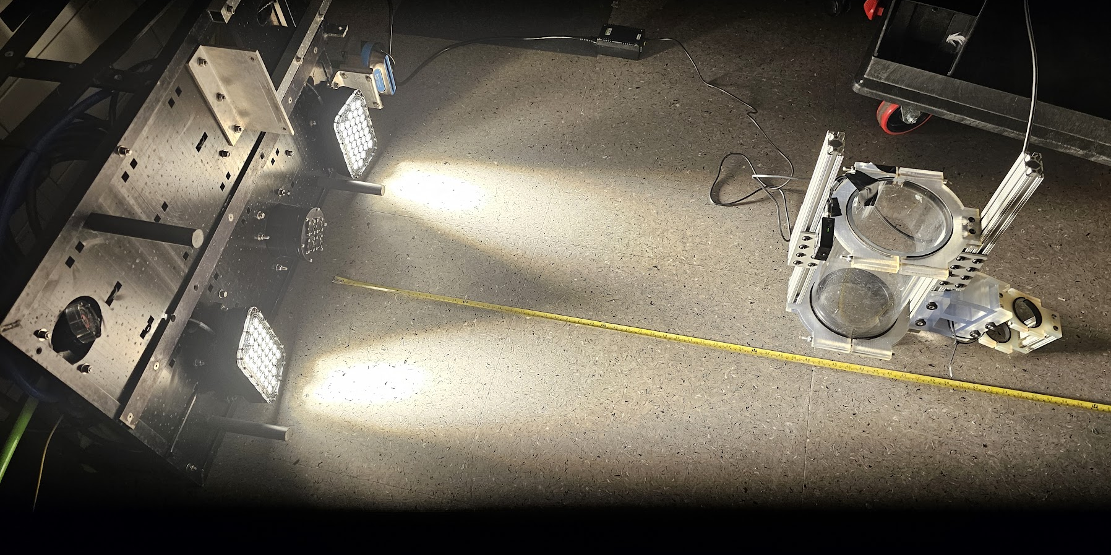
Strobe Illumination
  Replace Zenon with LED, where possible
    10 million lumen concept
  Synchronize image capture and illumination
    Freeze motion, save energy
  Tailor illumination to match application
    HSI strobes

Slide 8
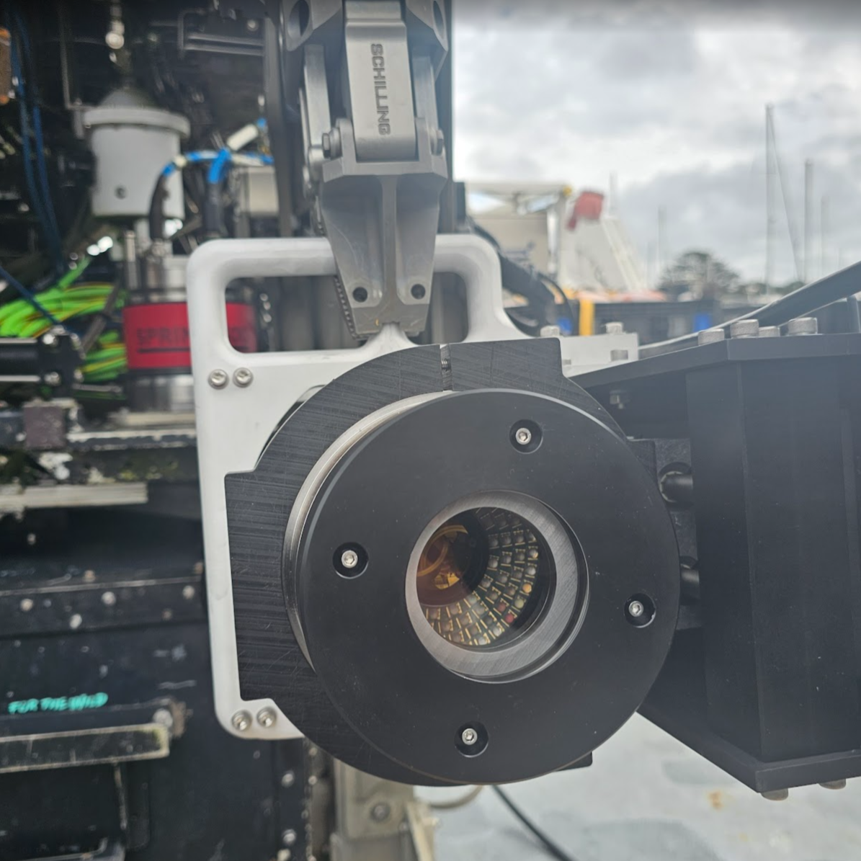
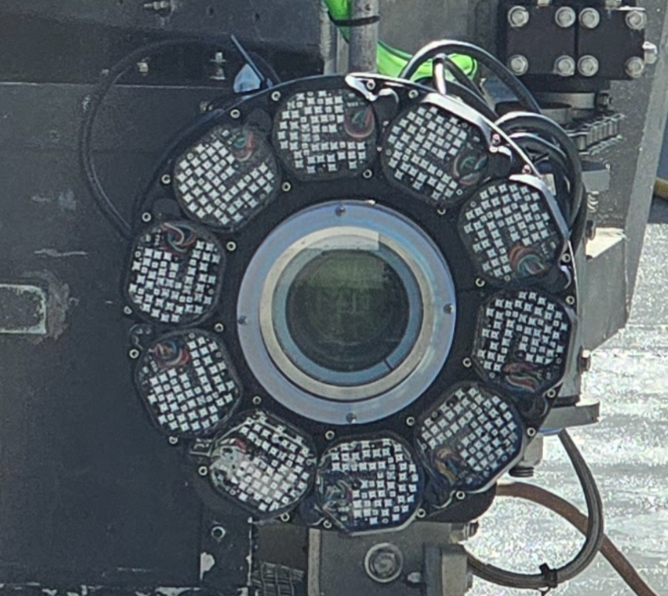
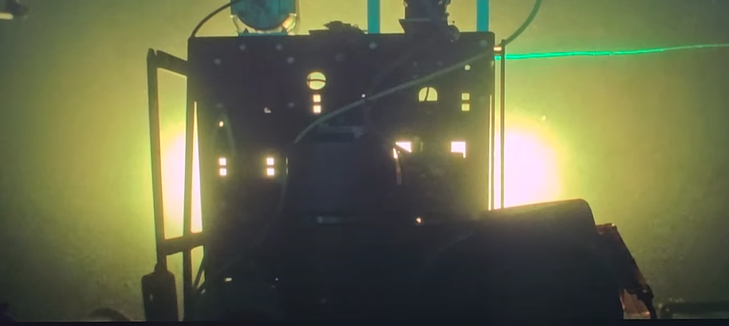
Multi/hyperspectral Imaging
Continue supporting multi/hyperspectral imaging developments
Standardize illumination modules
Test new multi/hyper spectral sensors

Slide 9
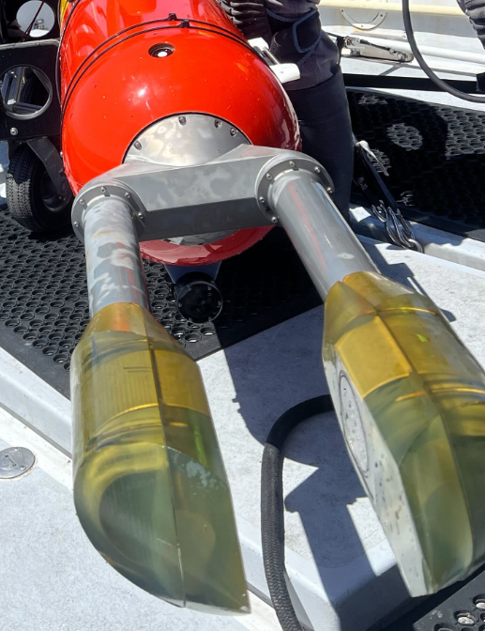
In Situ Microscopy
Consolidate lens/cameras/strobe across SINKER and Planktivore
Miniaturize optical and illumination system to enable deployment on new platforms

Slide 10
Collaboration
Leverage external collaborations to enable rapid deployment of advances in optics/sensors/cameras/lights across the institute

Slide 11








Miniature 4k Optics
Microscopy
Stereo imaging
MxD camera
Subsea housings
Optics
Spectral
imaging
Lidar
Optical Multibeam
Strobe Illumination
Stereo imaging

Slide 12
Innovation
Prototype an imaging system that leverages new technologies and bridges the gap between optical and acoustic imaging in the deep sea to see what lies beyond the reach of our traditional cameras and lights

Slide 13
The Challenge
See beyond the 3–5 m limit of most traditional imaging systems
Bridge the gap between mm resolution imaging with camera/lights, and 10’s of cm imaging with acoustics
Optical Imaging
Resolution (1/mm)
Acoustic Imaging
Range (m)

Slide 14
The Challenge
See beyond the 3–5 m limit of most traditional imaging systems
Bridge the gap between mm resolution imaging with camera/lights, and 10’s of cm imaging with acoustics
Planktivore (10 µm, 1 cm)
MxD (2 mm, 4 m)
Scanning Lidar (5 mm, 10 m)
Resolution (1/mm)
CodaOctopus or SaS (2 cm, 30 m)
Kongsberg EM124
(50 m, 4000 m)
Range (m)

Slide 15
Concept
Hemispherical 3D imaging
Monocentric optics improve collection efficiency and allow scanning without moving large lens (scanner at aperture)
SPAD event sensor gives time-of-flight imaging of laser pulse returns and 1 megapixel single-photon imaging at 1 kHz
Pulsed laser sources in the visible range (400–700 nm)

Slide 16
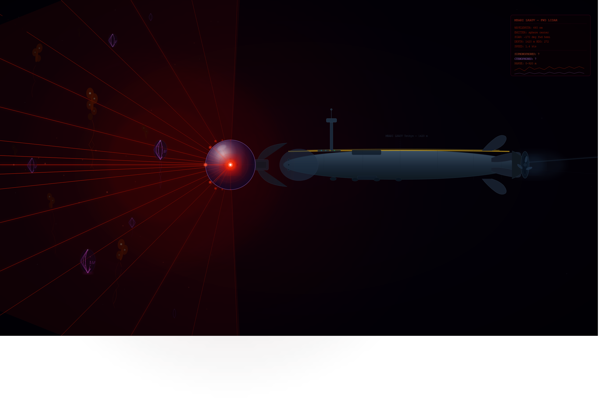
Laser Eye

Slide 17
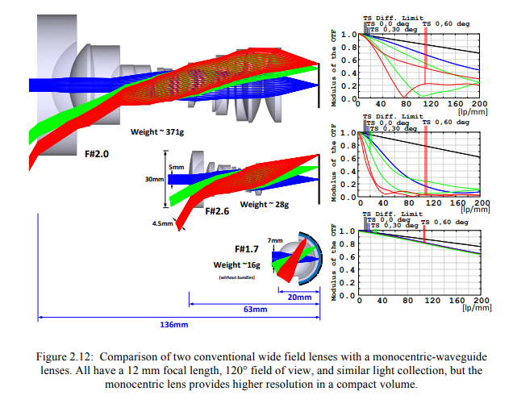
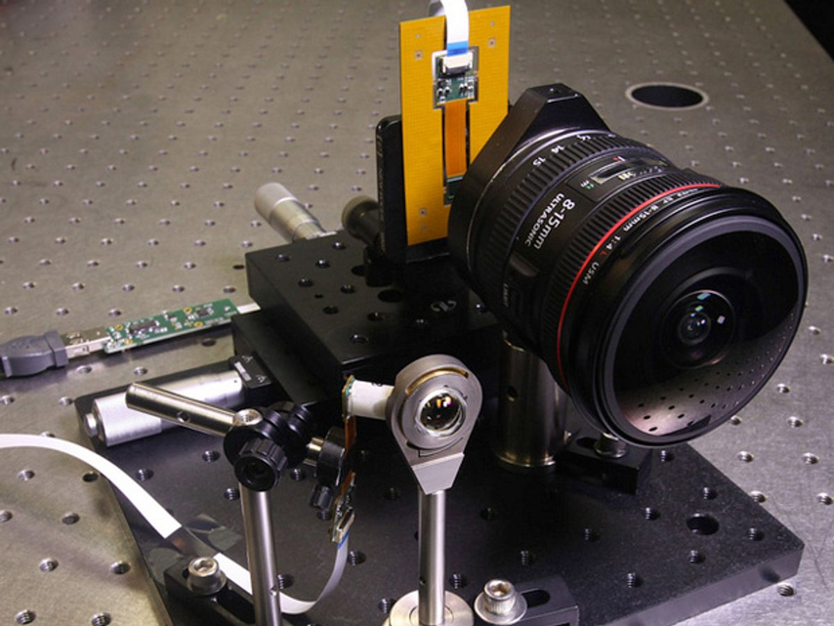
Monocentric Optics
Permalink: https://escholarship.org/uc/item/0m64873s
"Panoramic monocentric lens imaging, PhD Thesis 2014, UCSD

Slide 18
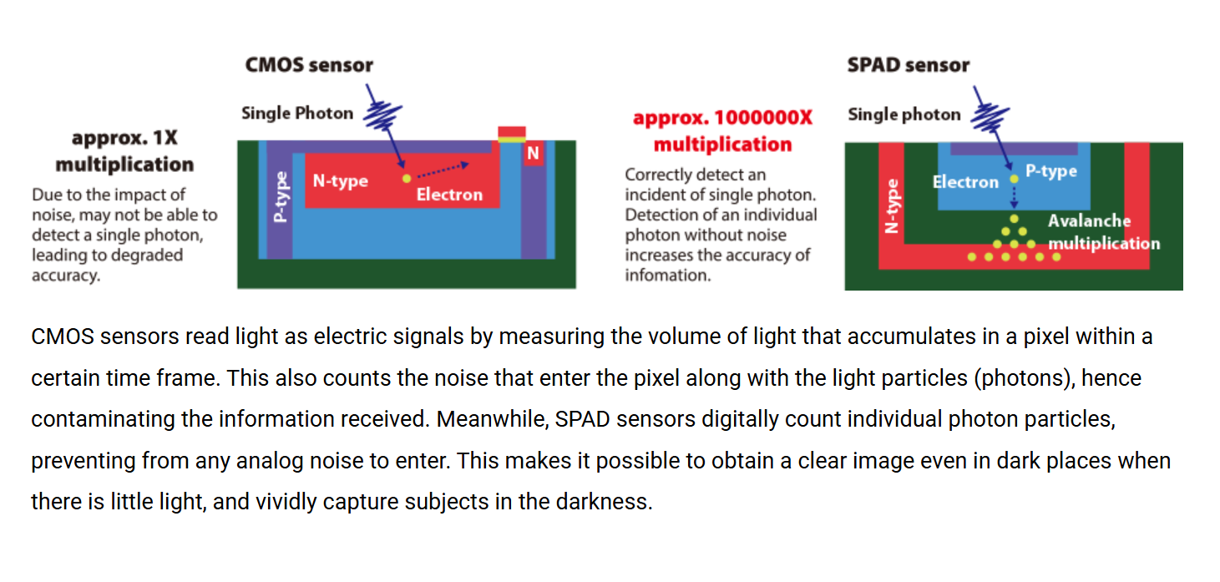
SPAD Sensors
https://global.canon/en/technology/spad-sensor-2023.html

Slide 19
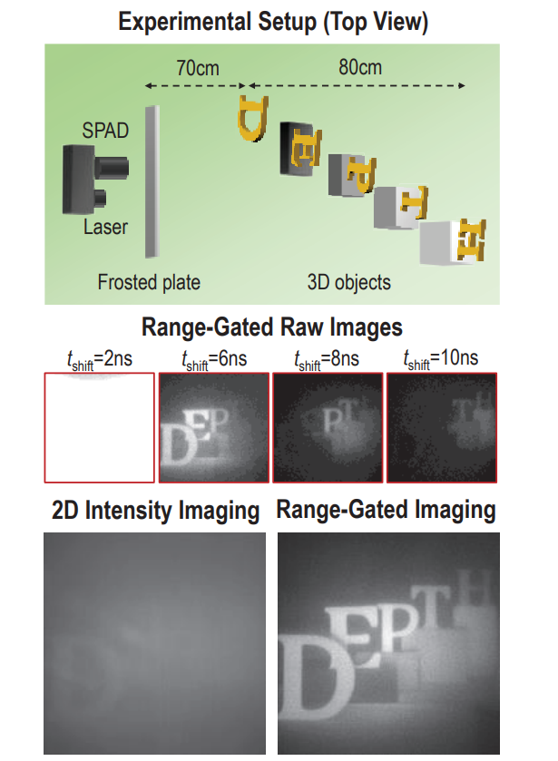
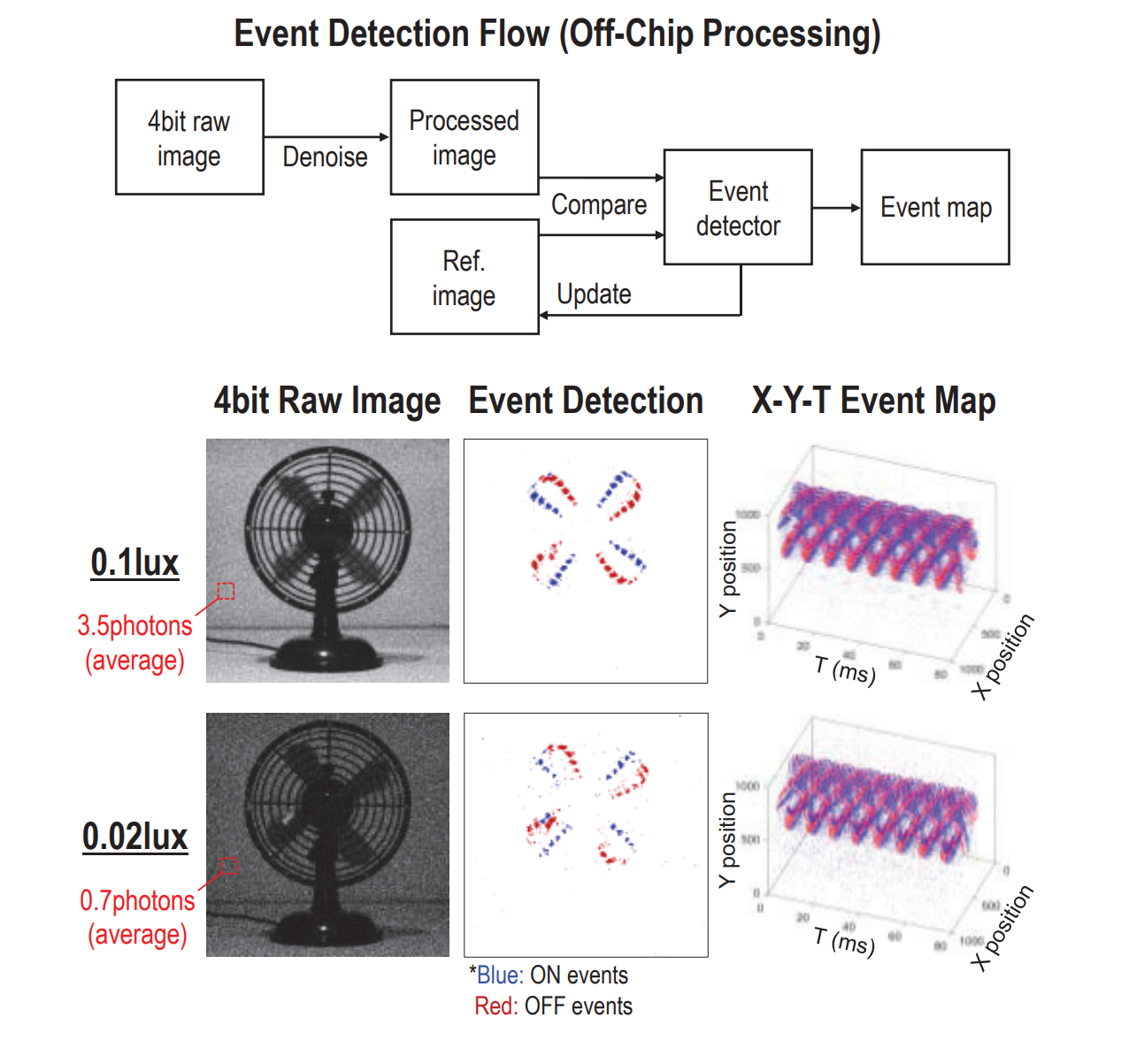
Canon’s Latest SPAD Sensors
DOI: 10.1109/VLSITechnologyandCir46783.2024.10631424
"3D-Stacked 1Megapixel Time-Gated SPAD Image Sensor with 2D Interactive Gating Network for Image Alignment-Free Sensor Fusion,"

Slide 20
Concept
Glass Dome
Monocentric Lens Elements
2D Scanning Prism
Tip/Tilt and 360 rotation
Pressure Housing
Beam/Image Splitter
Pulsed Laser Source
SPAD Receiver

Slide 21
Use Cases
Dense hemispherical imaging for timelapse on fixed platforms
Sparse hemispherical imaging with targeted high-resolution scanning on slow moving platforms
Fast cylindrical scanning on AUVs
Passive bioluminescence imaging
Passive pan/tilt telephoto imaging in low-light

Slide 22
Impact
Elevate existing imaging projects
Maintain MBARI at the forefront of subsea imaging
Develop a fundamentally new kind of imaging system to see beyond our current optical limits

Slide 23
Timeline and Milestones
2027
2028
2029
2030
2031
$100k, 1 FTE
Document and organize projects into focus areas
4k optics prototype
Strobe module prototype
Lidar concept design
$100k, 1 FTE
4k optics development
Strobe module development
Lidar preliminary design
$150k, 1 FTE
4k optics deployment
Strobe module deployment
Lidar preliminary design
$200k, 2 FTE
Multi/hyperspectral prototype
Microscope prototype
Lidar prototype construction
$100k, 1 FTE
Multi/hyperspectral deployment
Microscope prototype
Lidar prototype deployment

Slide 24
Specific Plans for 2027
Consolidation: $50k
  Continue miniature 4k optics design and prototyping
  Prototype general purpose strobe modules to support LASS, CoMPAS, and Bioinspiration Lab
Collaboration: $10k
  Maintain existing collaborations through monthly meetings
  Start new collaborations
Innovation: $50k
  Concept optical design for lidar system
  Purchase demo kits for SPAD receiver
  Prototype 2D scanning approaches

Slide 25
Thanks!

Slide 26
Extras

Slide 27
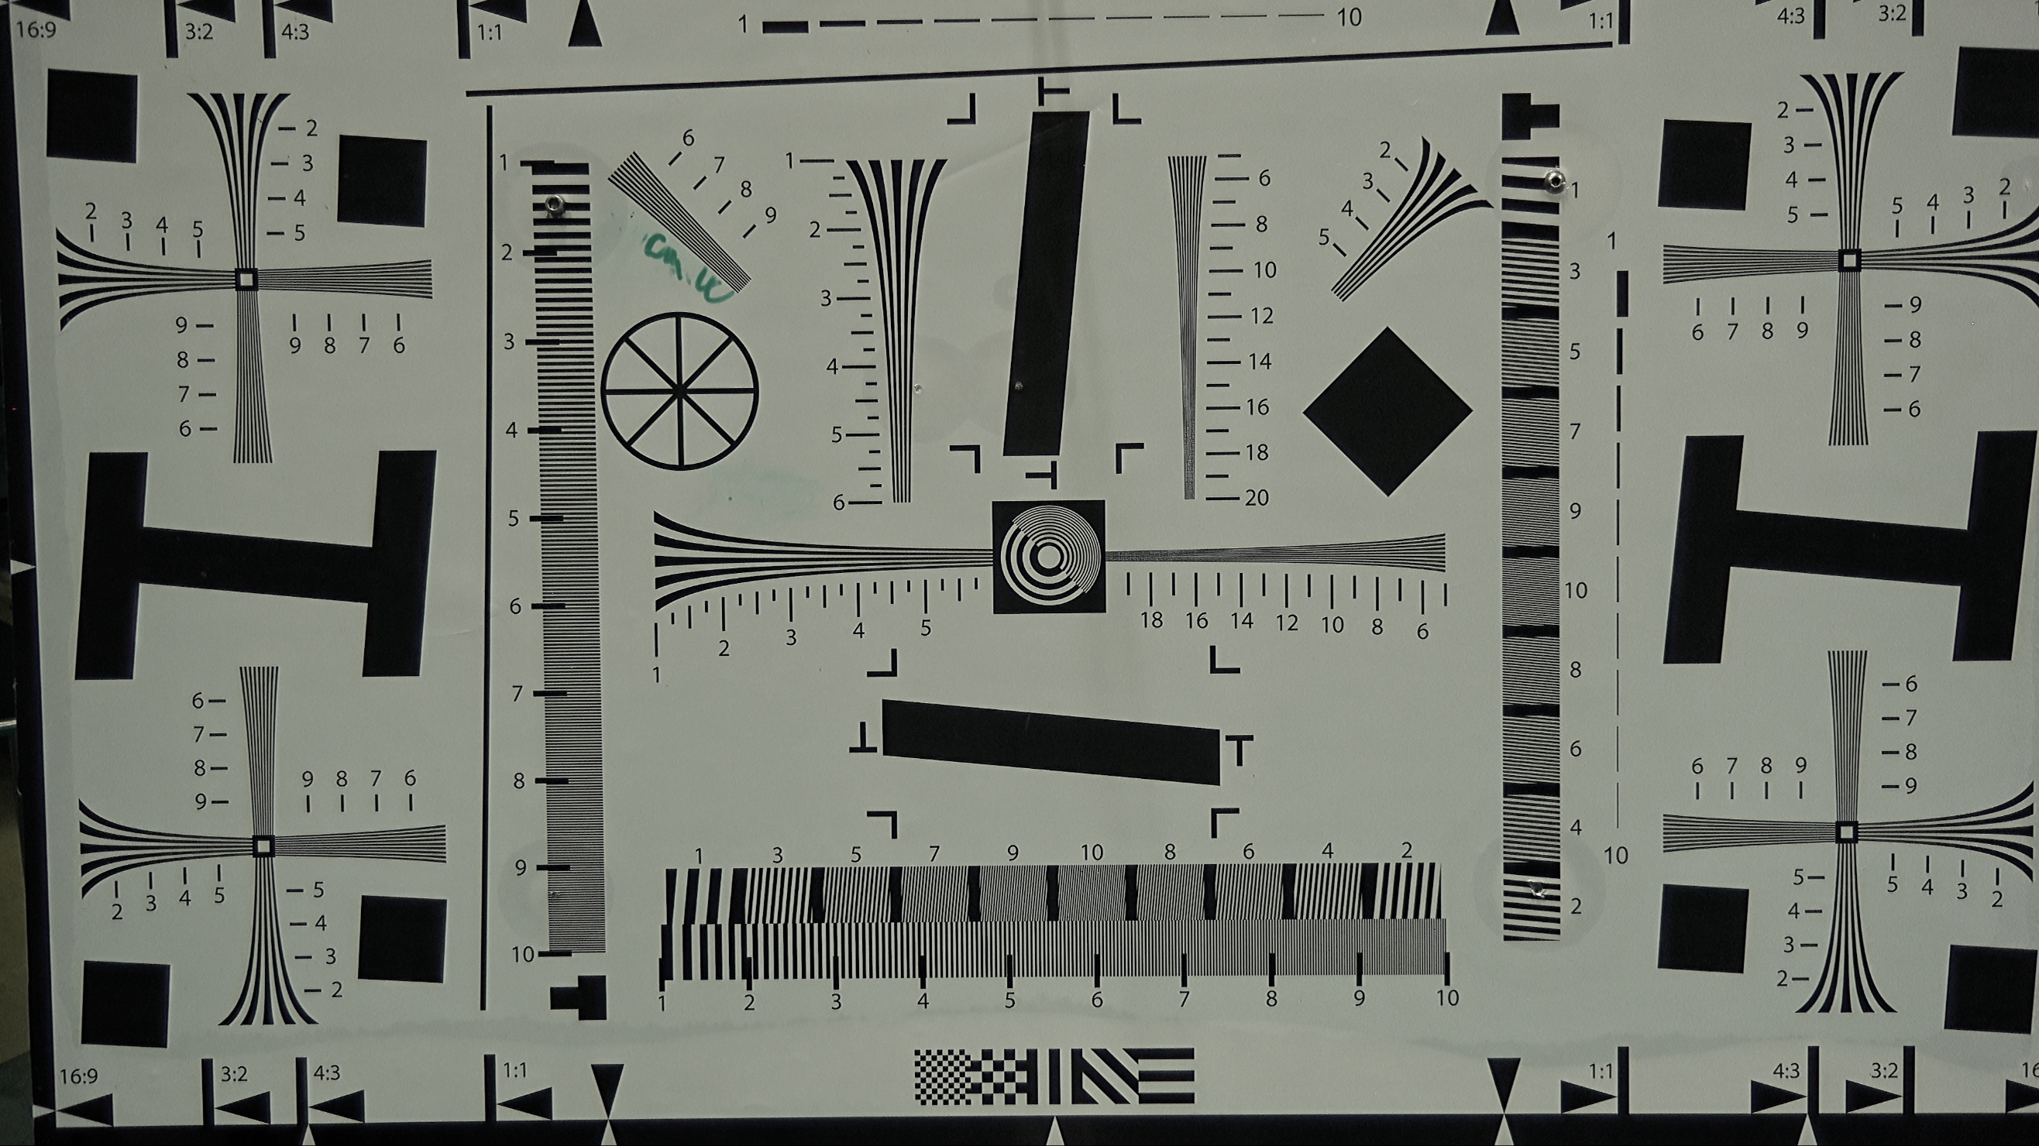
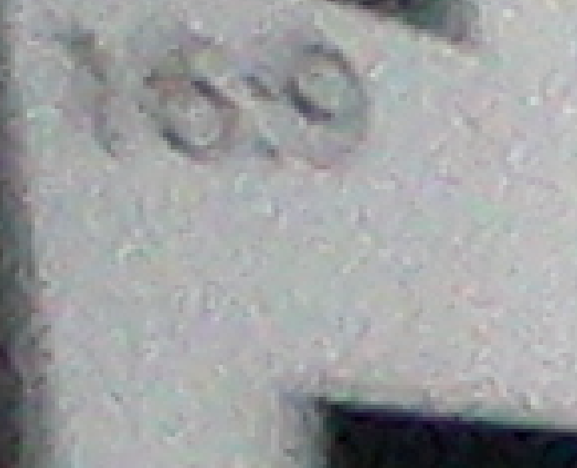

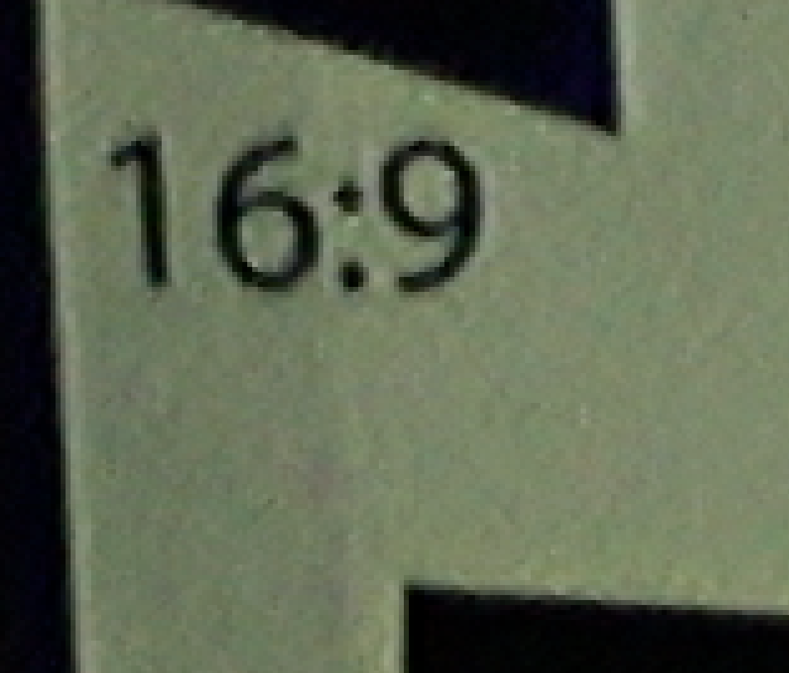
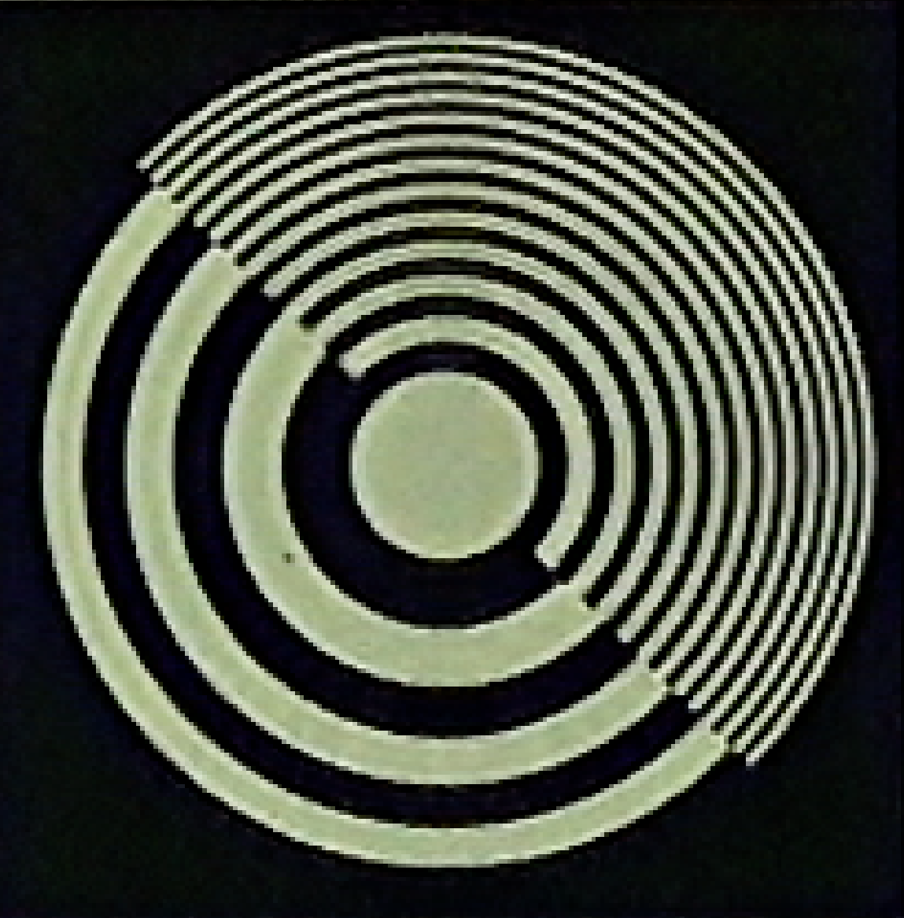
Optics make a big difference
Insite Pacific Mini-Zeus
Sony FCB-ER8300 Block Camera
DeepSea Apex
Sony FCB-ER8300 Block Camera

Slide 28
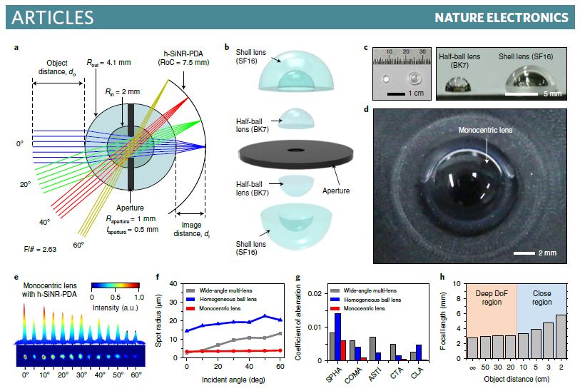
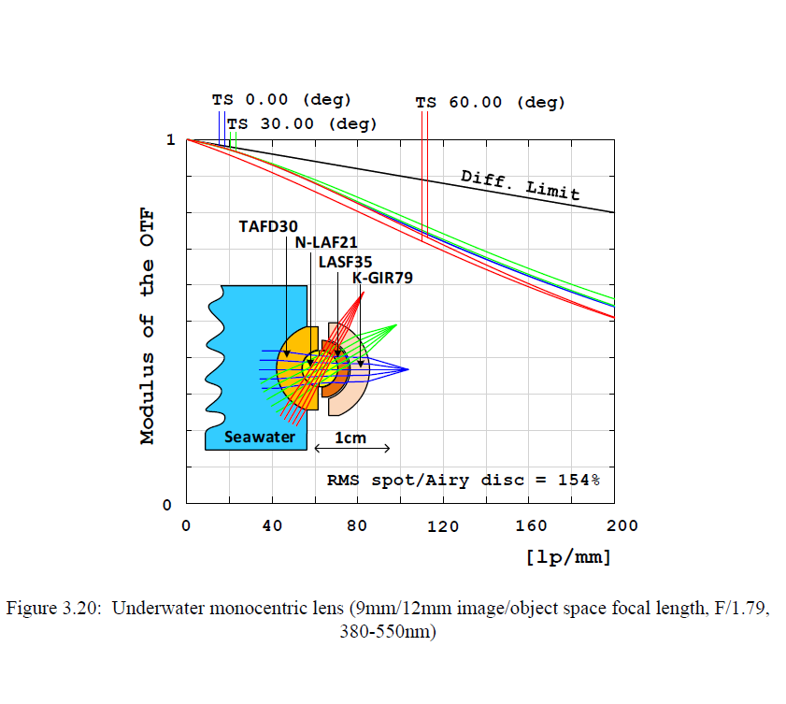
Monocentric Optics
DOI: 10.1038/s41928-020-0429-5
"An aquatic-vision-inspired camera based on a monocentric lens and a silicon nanorod photodiode array”
Permalink: https://escholarship.org/uc/item/0m64873s
"Panoramic monocentric lens imaging, PhD Thesis 2014, UCSD

Slide 29
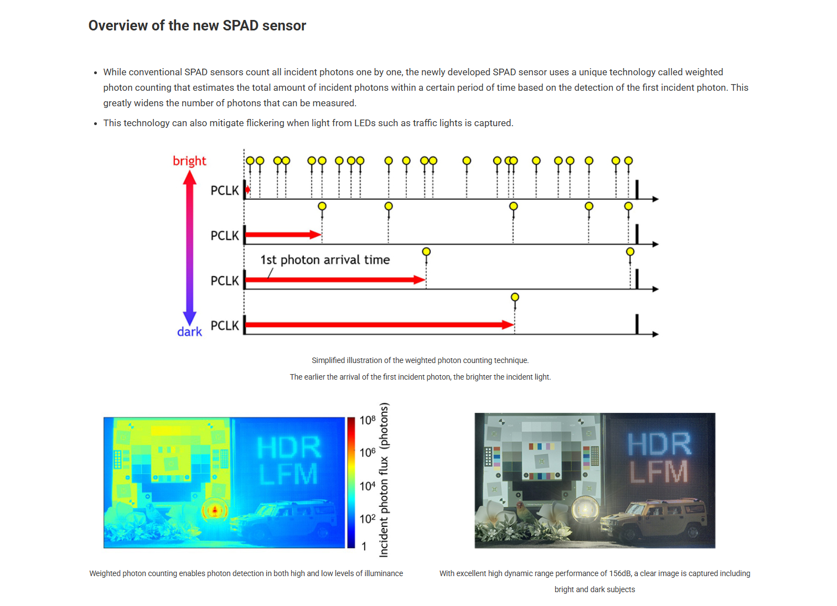

Slide 30
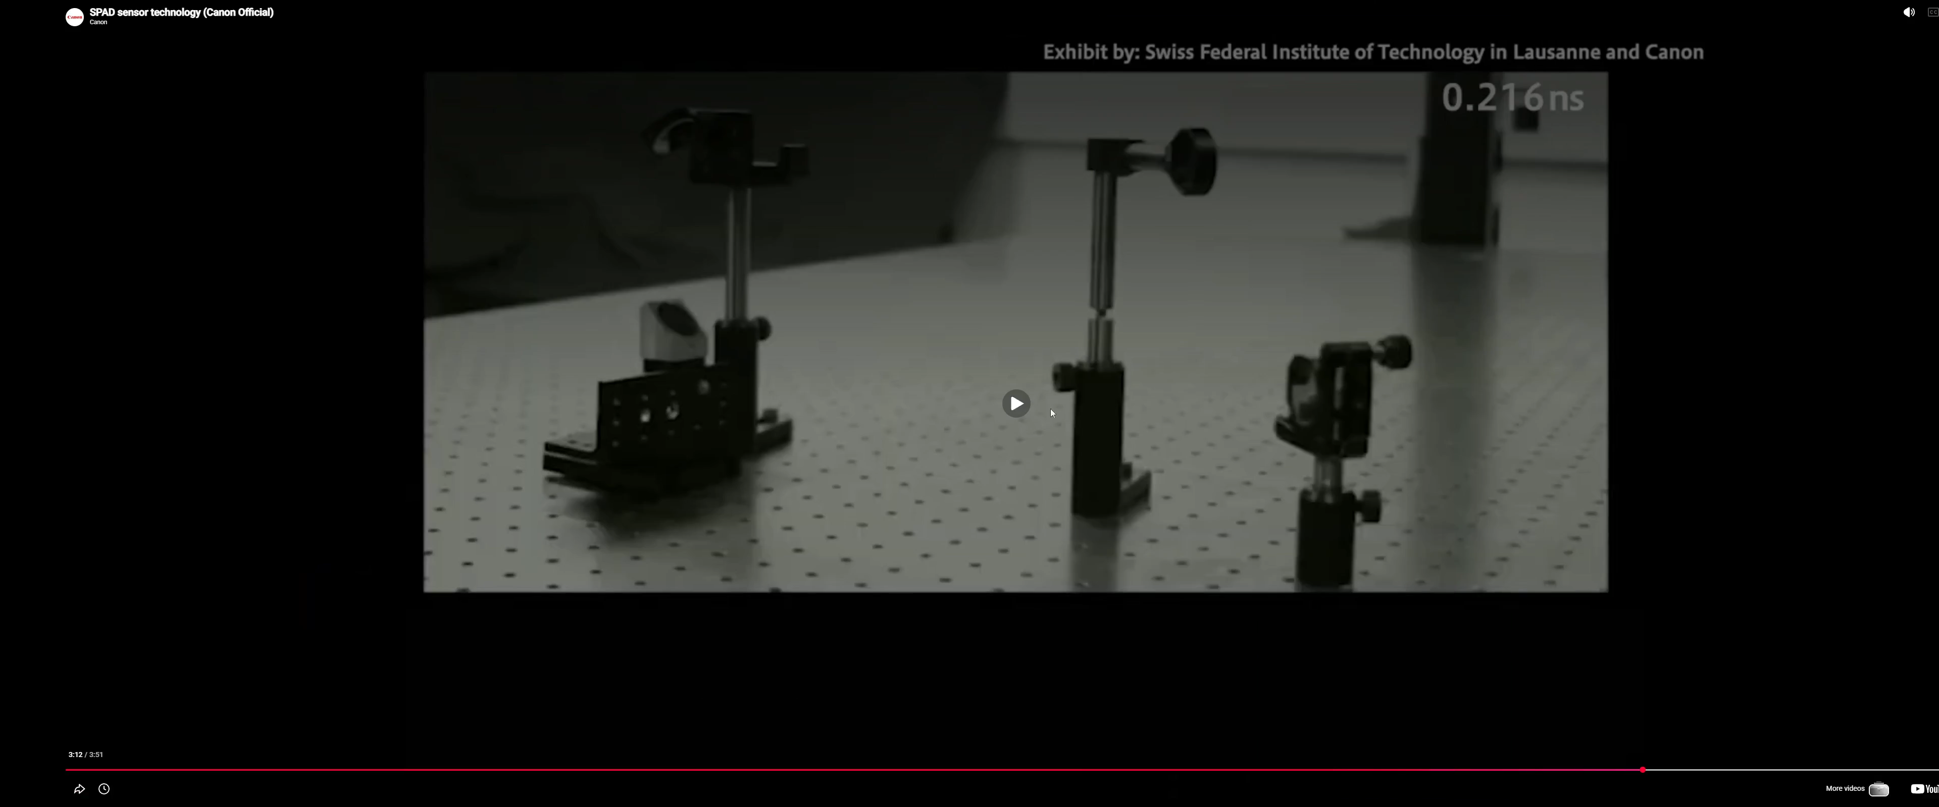

Slide 31
The Challenge
See beyond the 3-5 m limit of most traditional imaging systems
Send light only where we are imaging, not all around us
Bridge the gap between mm resolution imaging with camera/lights, and 10’s of centimeter imaging with acoustics
Planktivore (10um, 1cm)
MxD (2mm, 4m)
Resolution (1/mm)
CodaOctopus or SaS (2 cm, 30 m)
Kongsberg EM124
(15 cm, 4000 m)
Range (m)

Slide 32
The Light Bubble
Illuminated Volume
Camera Field of View
Illuminate a large volume
Image only a tiny fraction of the illuminated volume
Most of the light does not contribute to forming an image
Imaged Volume
Platform
(ROV/AUV)

Slide 33
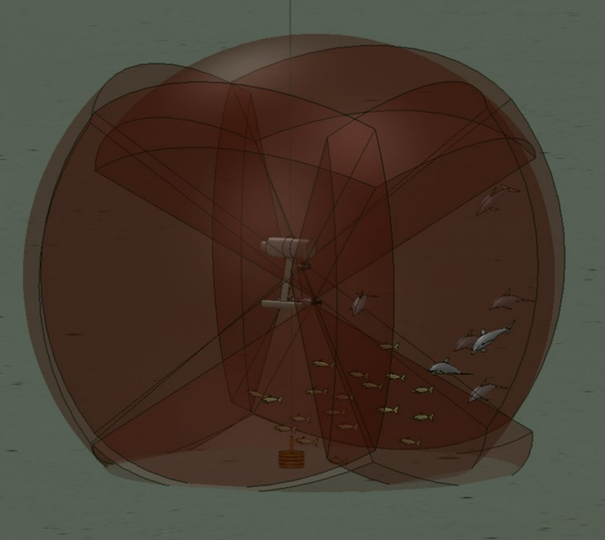
Closest Example: Harbor Branch UMSLI
“Eye-safe” pulsed laser, 10 nJ, 638 nm, 100 kHz
PMT receivers
6 transmitters, 6 receivers
Both sparse and dense scanning
DOI: 10.1109/OCEANSE.2017.8085029
"Undersea LiDAR imager for unobtrusive and eye safe marine wildlife detection and classification," OCEANS 2017”

Slide 34
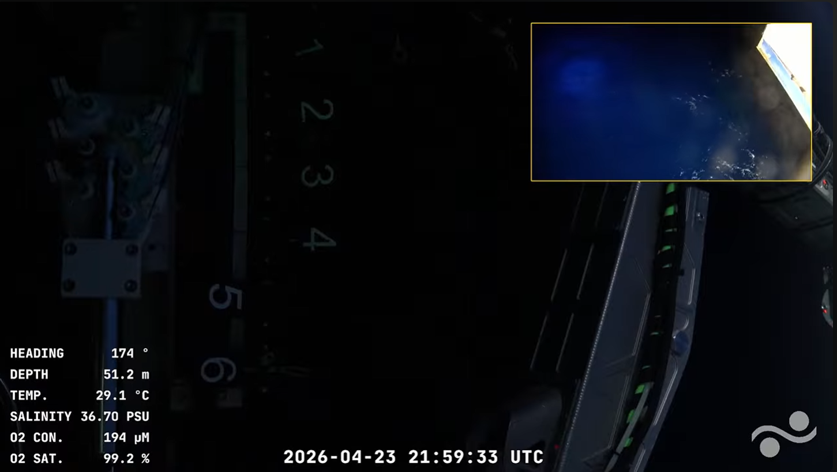

Slide 35
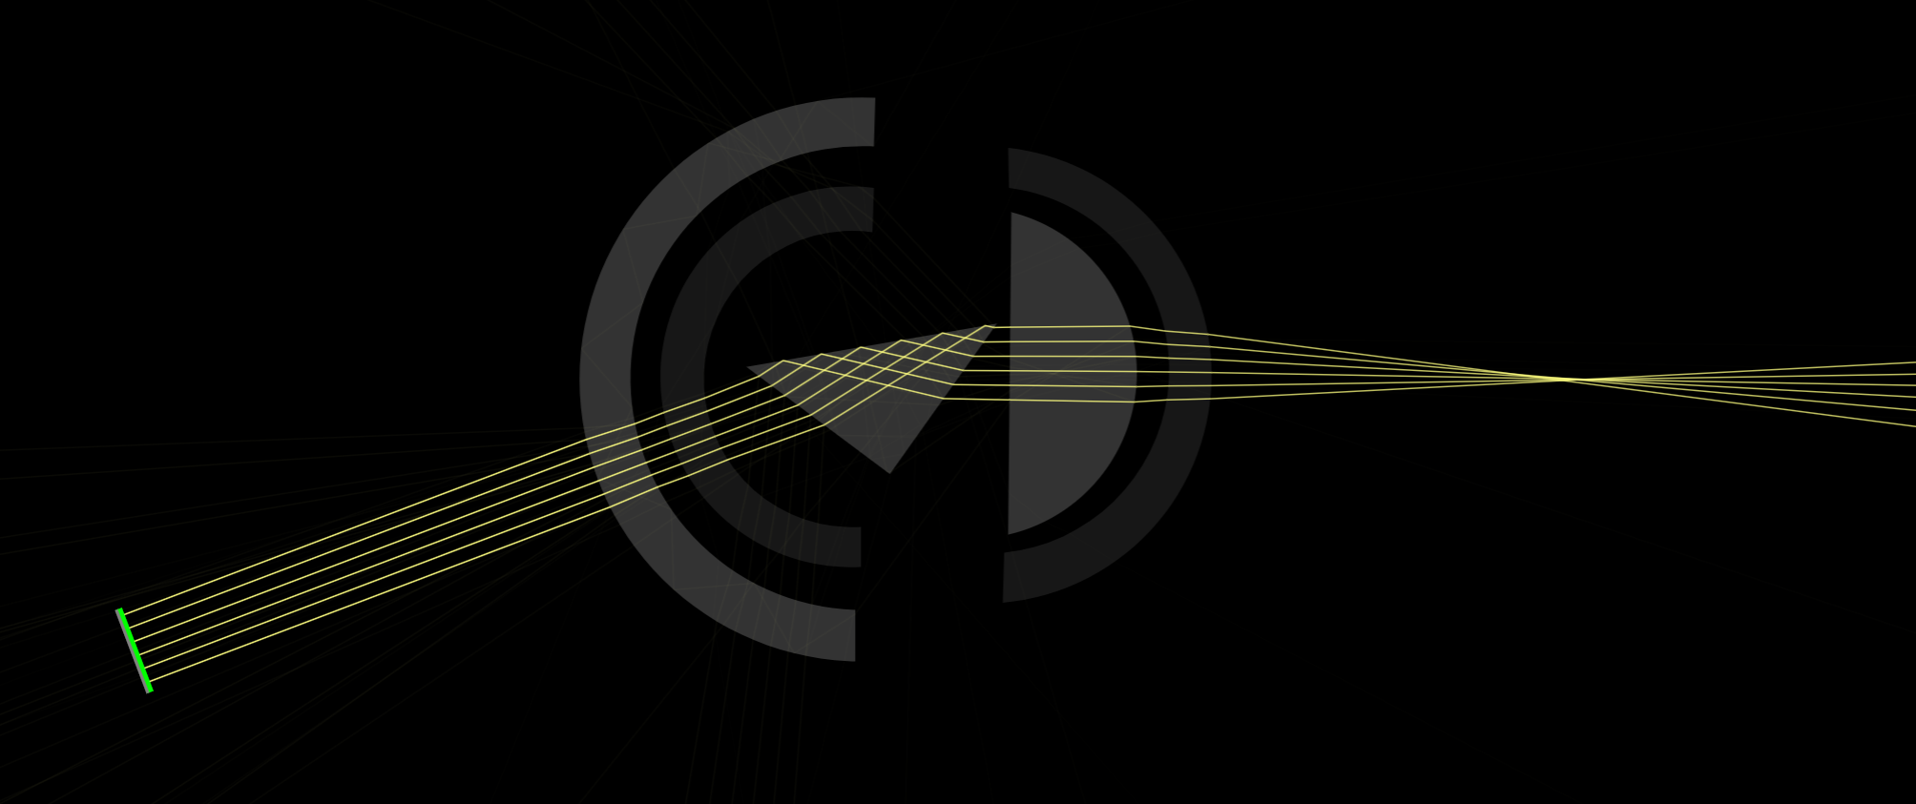
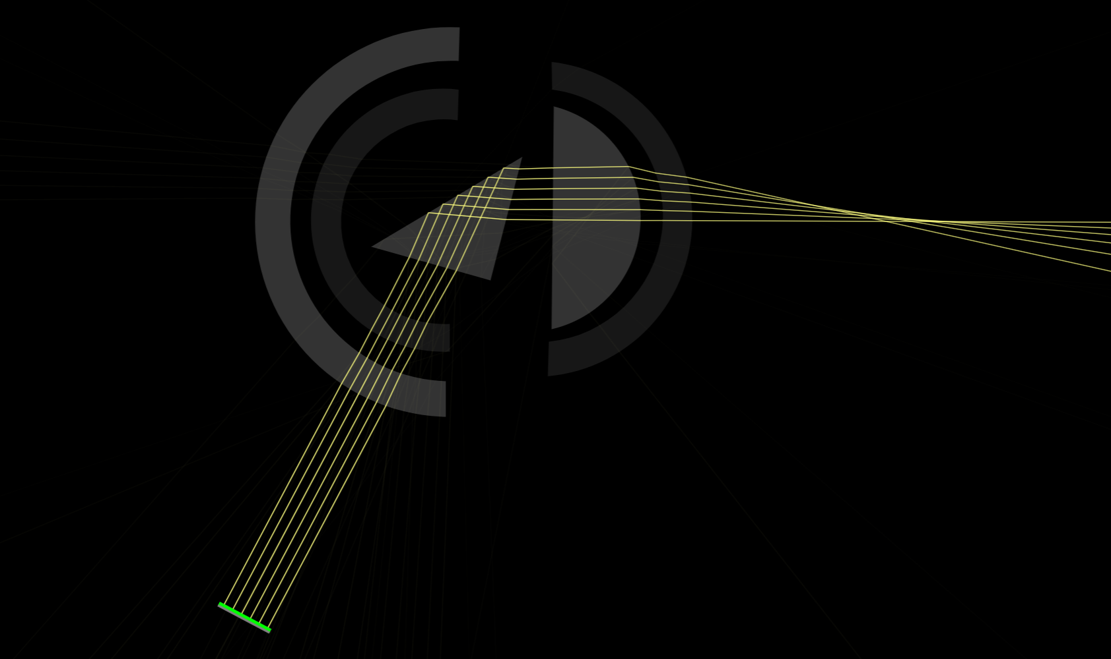
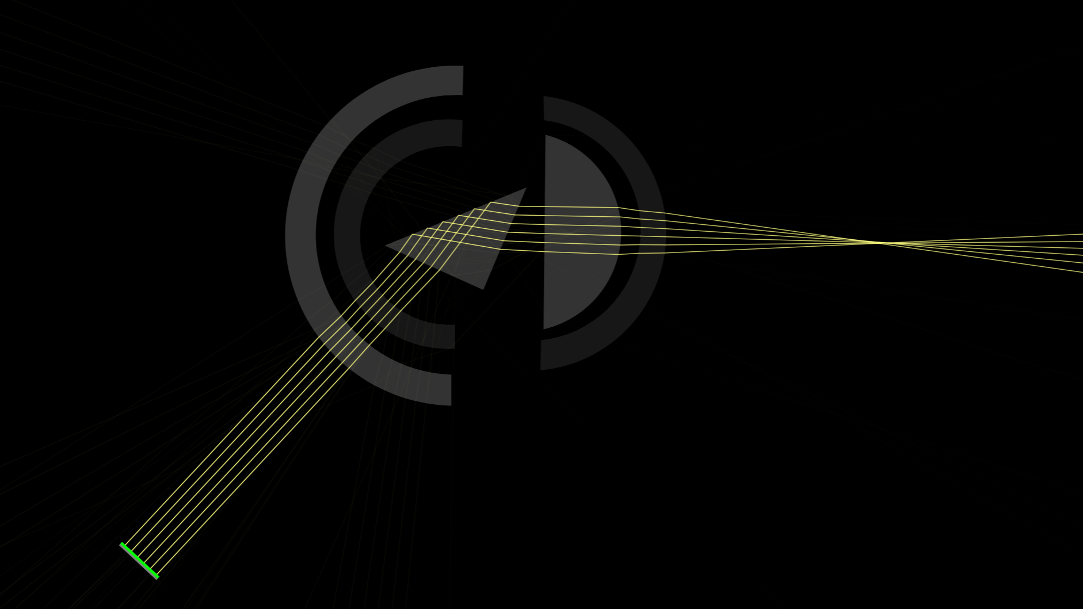
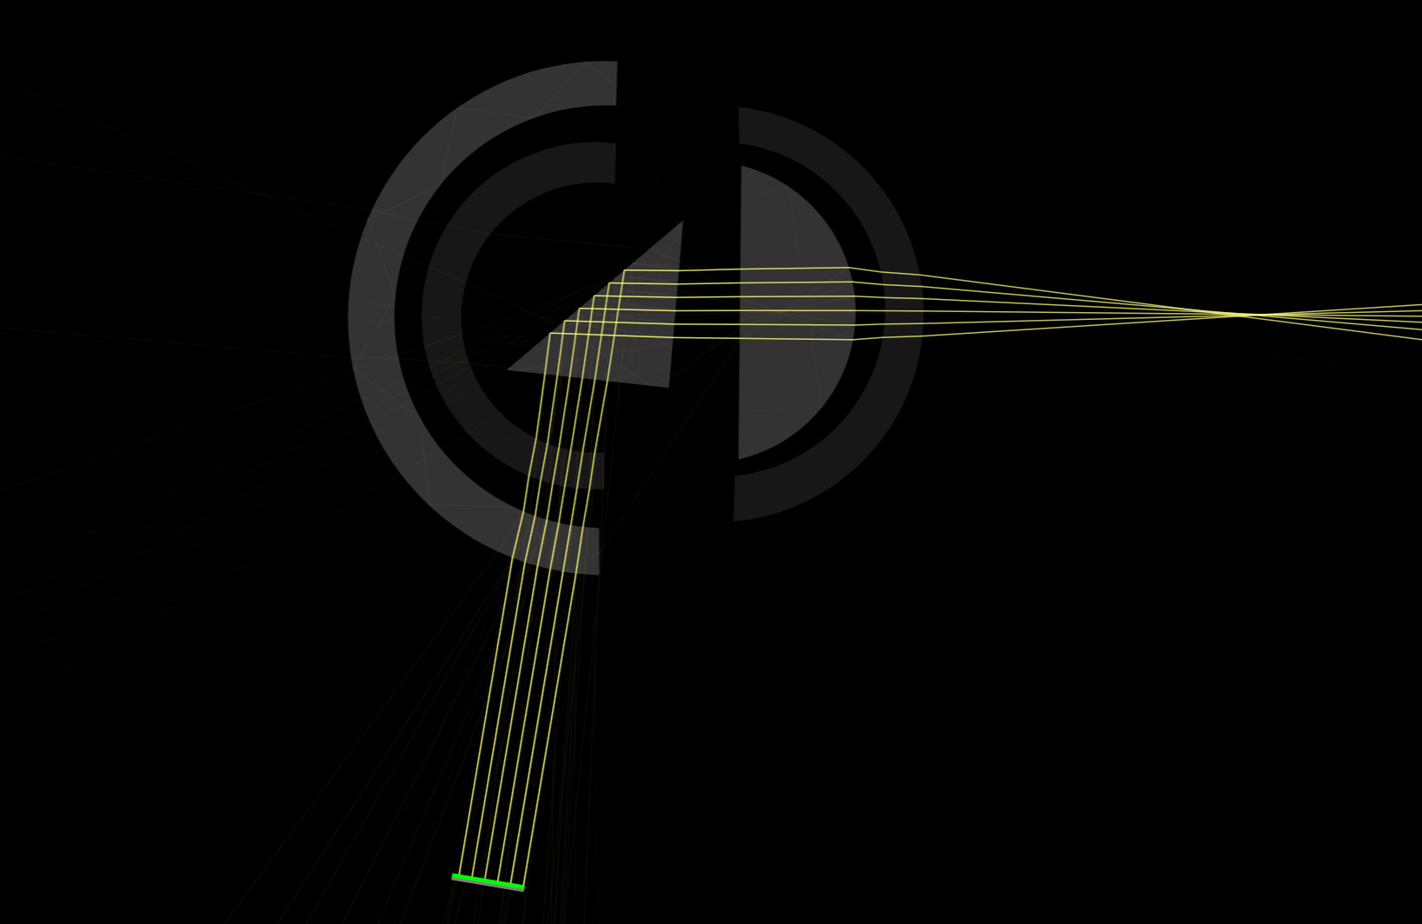

Slide 36
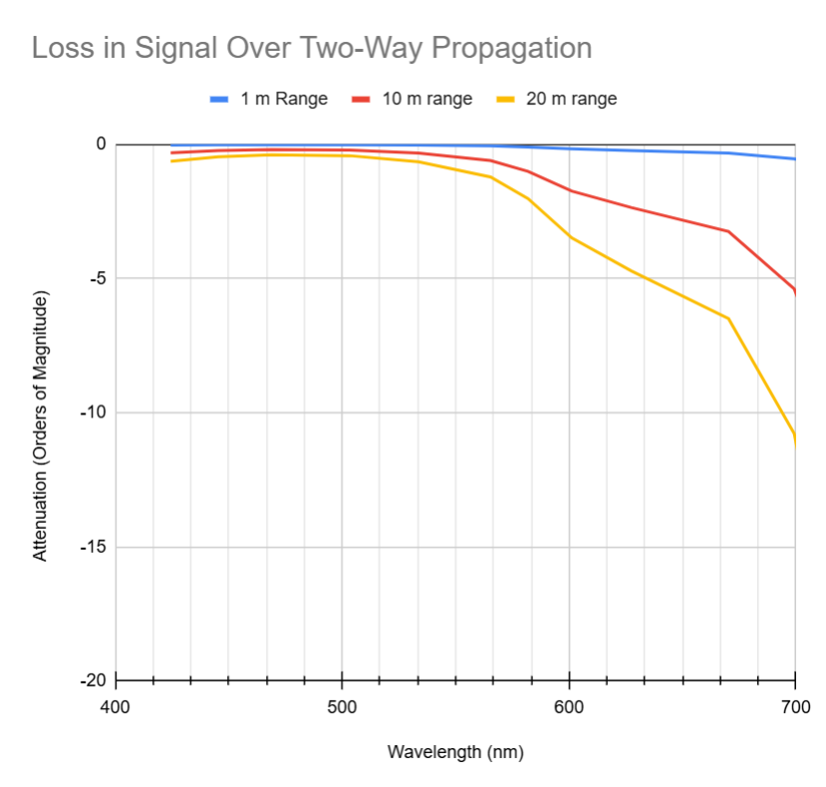
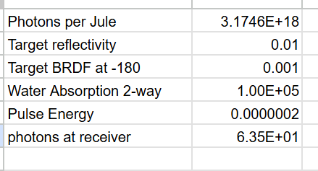
Light budget
Two-way attenuation vs. wavelength
630 nm laser pulse with 200 nJ pulse energy
Weak target (1% reflection, 0.1% 180 deg BRDF)
63 photons received

