Slide 1
Notes:
1

Slide 2
CoPilot
The Power to Navigate

Slide 3
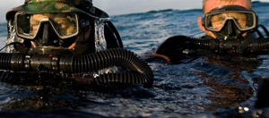
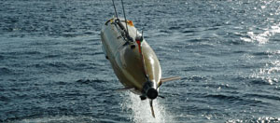
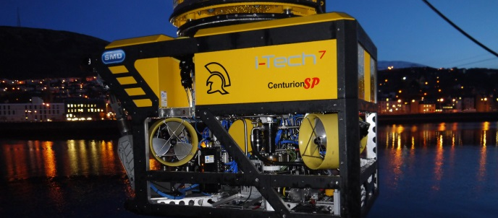
SeeByte Summary
Smart software for unmanned maritime systems and sensors
Offices in Edinburgh, Southampton, UK and San Diego, US
Serving over 20 navies across the globe
Providing solutions to the oil and gas domain
Adding value to hardware through expert software engineering
Working in partnership with leading sensor and vehicle vendors
SeeByte is appraised at CMMI® Level 2
SeeByte is a subsidiary of Battelle

Slide 4
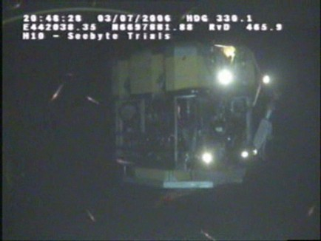
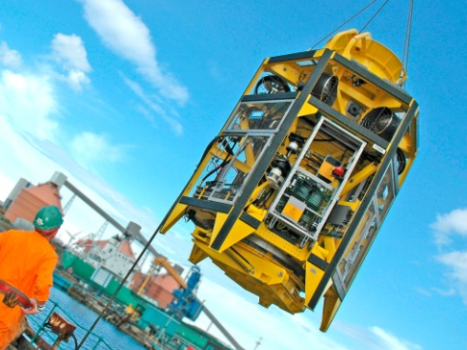
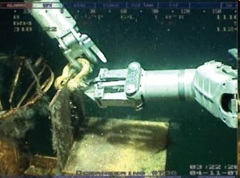
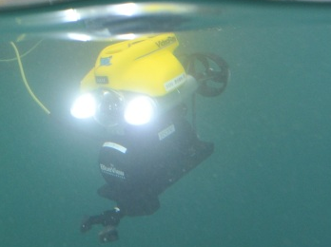
CoPilot
An introduction:
Offering easy-to-use plug-and-play software that makes piloting an ROV a much simpler task.
Enabling semi-autonomous, pre-programmed ROV sorties with current and tether effects no longer posing a challenge. CoPilot also provides automated sonar tracking and movement relative to a target.

Slide 5
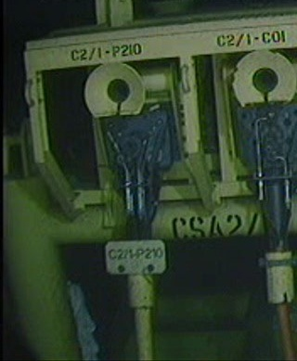
CoPilot
Business benefits:
Construction Support
  Faster operations: Get the ROV there in half the time! Using intuitive tools piloting is about knowing where to go, not how to get there.
  Safe and reliable operations: When the ROV is in the critical path make sure it’s where it’s meant to be, doing what it’s meant to be doing.
CoPilot is capable of carrying out transit operations (moving from one location to another in the field) in less than half the time than is possible using conventional means.

Slide 6
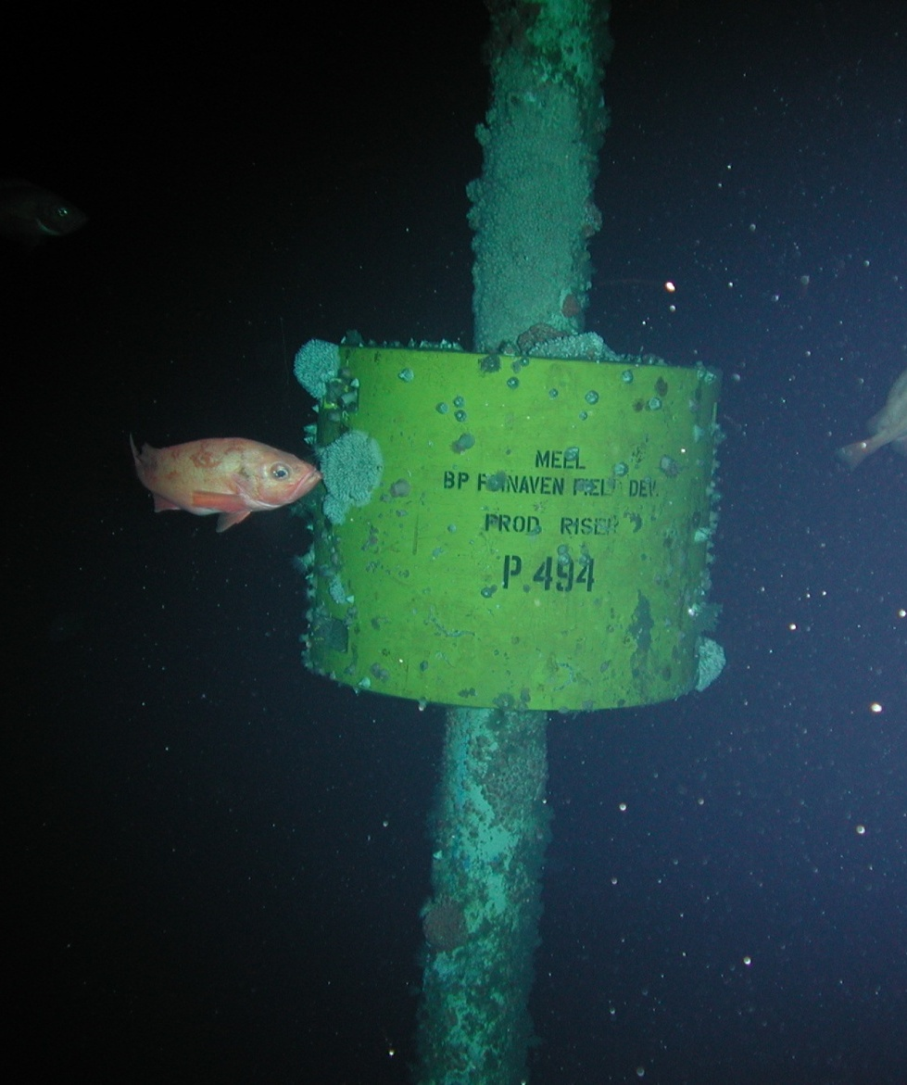
CoPilot
Business benefits:
Inspection, Repair and Maintenance (IRM)
  Faster operations: Improve the speed of inspections by at least 20%. Improve repair and maintenance operations with a more stable platform.
  Safe and reliable operations: Keep to a riser and never lose track.
CoPilot can be relied to take still picture of riser buoyancy modules at least as much as five times faster than conventional means. Each of the pictures is right first time, every time.

Slide 7
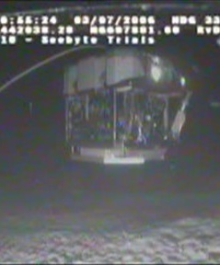
CoPilot
Business benefits:
Survey
  Better information: Greater ROV stability leads to higher quality data. Keep the ROV on course and get the data you paid for.
  Better plans: pre-plan the survey and have the ROV automatically follow it. Leave no room for error.
An ROV equipped with CoPilot maintains excellent heading and position control even when in transit. The performance of the ROV far surpasses the performance of an ROV pilot (up to 10 times better). This means you will be getting a good distribution of data points all over your survey area, no need to interpolate or extrapolate.

Slide 8
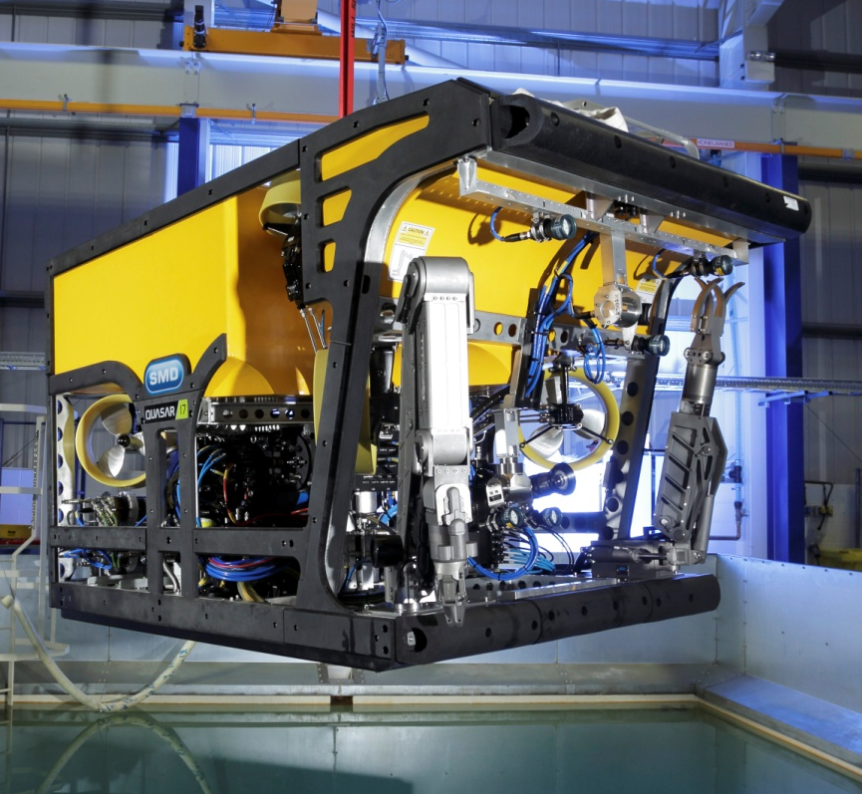
CoPilot
Improved operations:
Task | CoPilot | Unassisted Pilot*
Still Pictures | 30 sec | 10 min
Transit for 17m | 50 sec | 2 min
Manipulator Shackle | 2 min | 20 min
Docking | 2 min | 5 min
Improve your bottom line performance

Slide 9
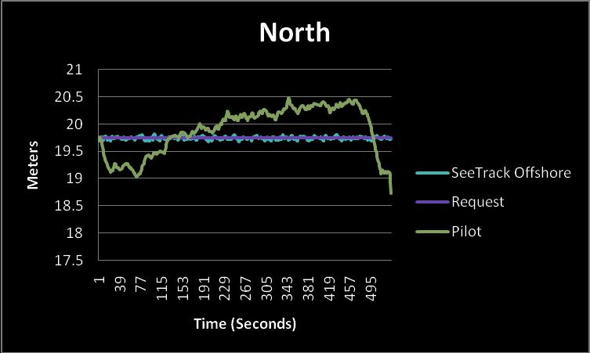
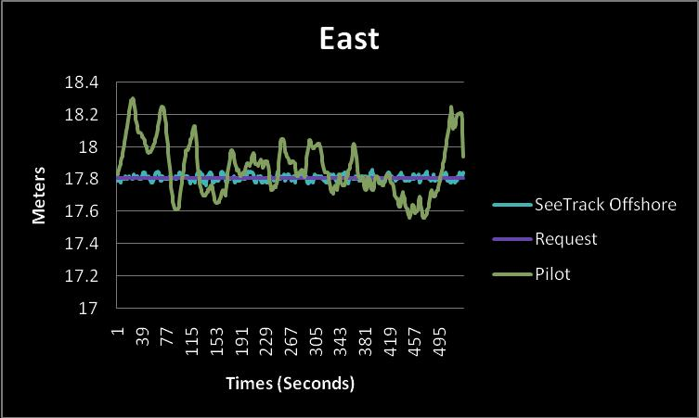
CoPilot
Improved performance:
 | North (meters) |  | East (meters) |  | Depth (meters) |  | Heading (degrees)
 | SeeTrack | Pilot | SeeTrack | Pilot | SeeTrack | Pilot | SeeTrack | Pilot
Std | 0.0251 | 0.4336 | 0.0174 | 0.1681 | 0.0690 | 0.1752 | 0.4548 | 3.3436
Mean | -0.0050 | 0.1430 | 0.0002 | 0.0593 | 0.2820 | 0.3718 | -0.2253 | -4.2526
“Fantastic for Survey Tasks”

Slide 10
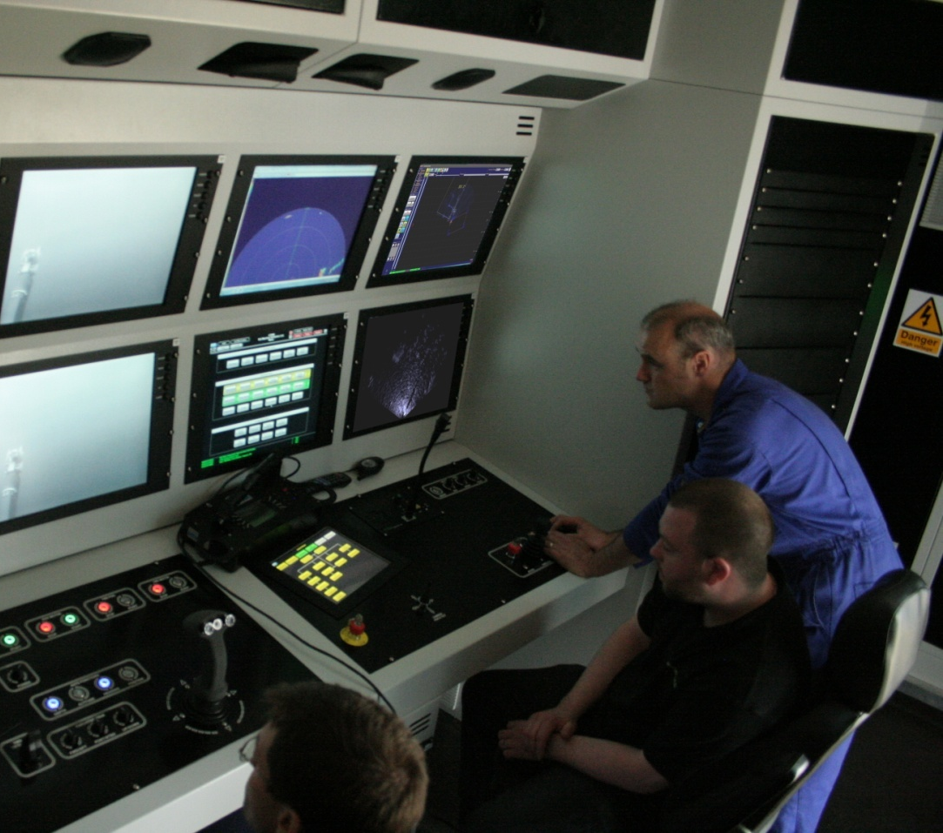
CoPilot
Features:
Point-and-click interface for positioning
Widest-ranging selection of additional modules available in the market
Survey and tracking

Slide 11
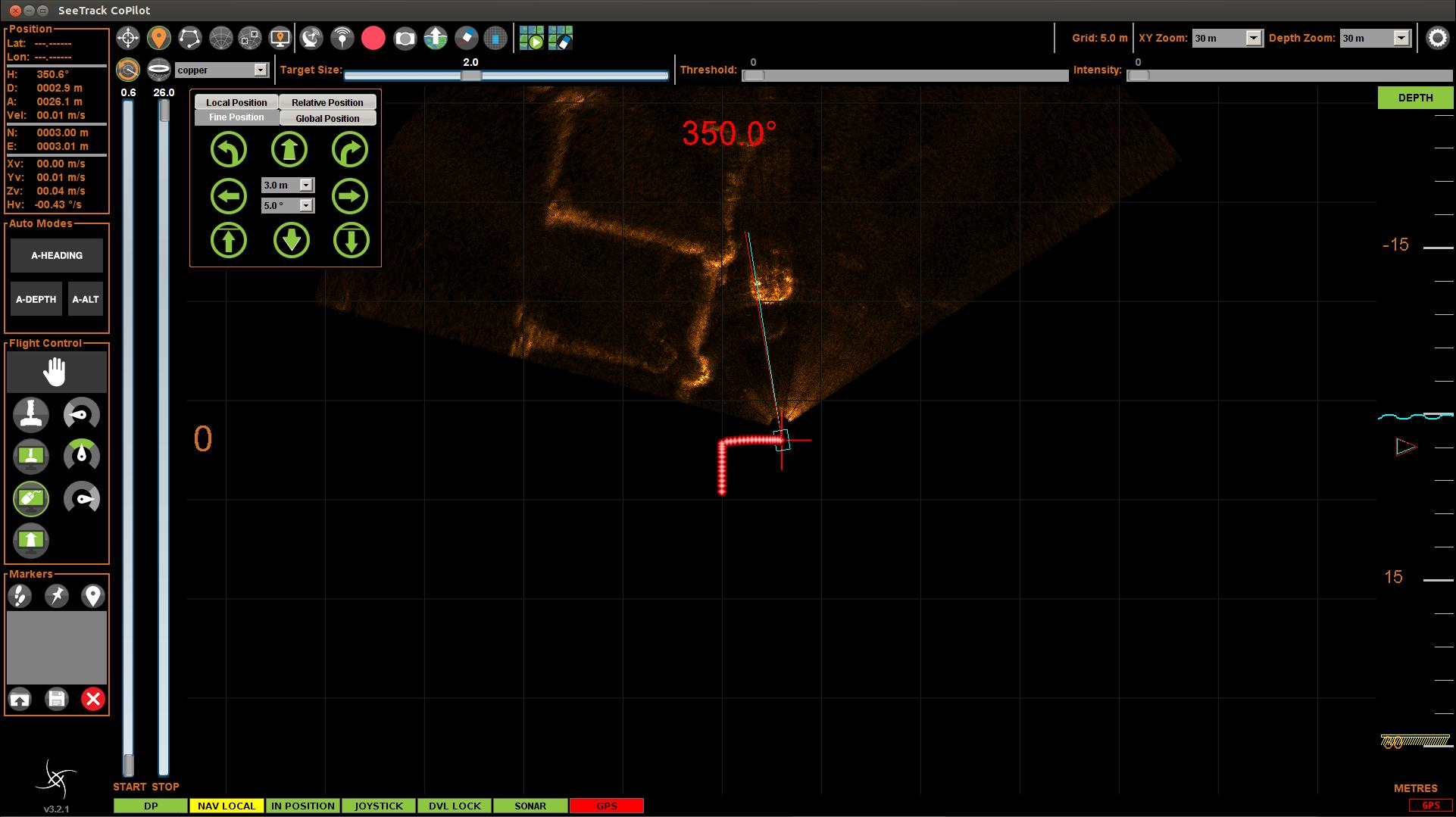
CoPilot
Features:
Use sonar data to navigate
Precise Nudges
Choose your speed
ROV in centre of Screen
Choose your altitude/depth

Slide 12
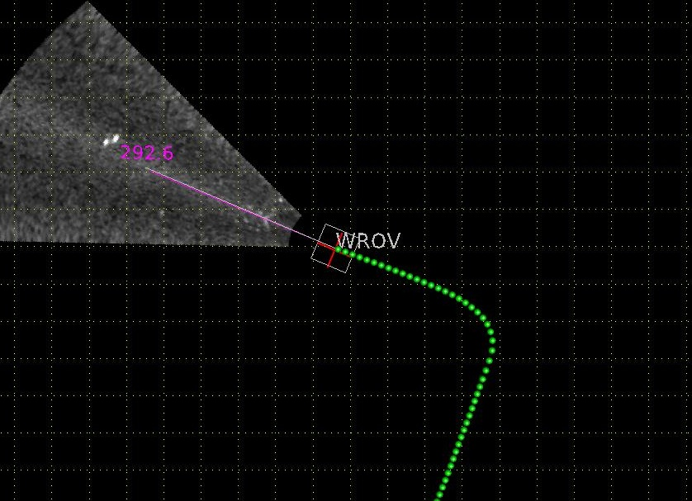
Left click to travel to that position
(including directly on sonar image – great in low vis)
Keep track of where you have been
Right click to change heading

Slide 13
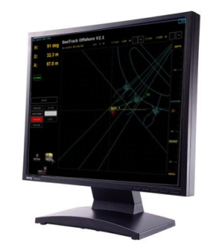
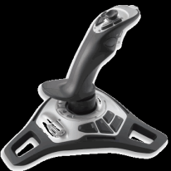
CoPilot
What is dynamic positioning?
CoPilot
Surface
Control
Imaging Sonar
Control
Joystick
Teledyne DVL
Depth
DP Computer
Heading
Absolute
Reference
Reference
Systems
ROV Control
Propulsion
System

Slide 14
CoPilot
What is dynamic positioning?
Dynamic Positioning is manoeuvring the ROV precisely in either:
  Absolute Coordinates (fixed point over the bottom)
  Relative Coordinates (relative to a moving object or a fixed structure)
CoPilot offers 5 flight modes to achieve FULL ROV DP
MBI Sonar Track | Cruise-Control | Survey-Control | Mid-water DP | Station-Keeping

Slide 15
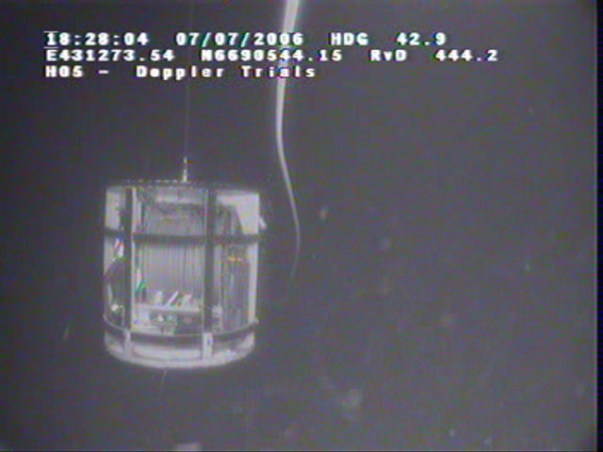
CoPilot
What is dynamic positioning?
Object Relative Positioning
MBI Sonar Track | Cruise-Control | Survey-Control | Mid-water DP | Station-Keeping

Slide 16
CoPilot
What is dynamic positioning?
Keep constant Velocity Vector
MBI Sonar Track | Cruise-Control | Survey-Control | Mid-water DP | Station-Keeping

Slide 17
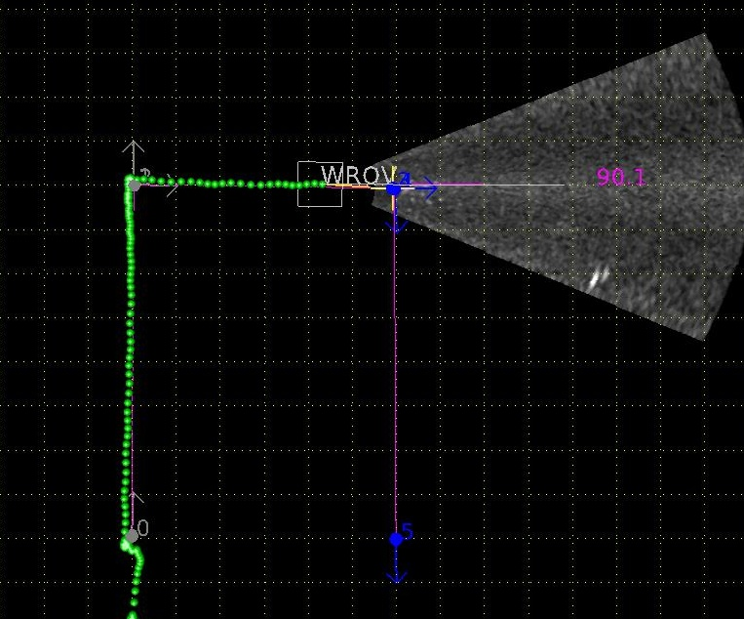
CoPilot
What is dynamic positioning?
Cartesian Motion
MBI Sonar Track | Cruise-Control | Survey-Control | Mid-water DP | Station-Keeping

Slide 18
CoPilot
What is dynamic positioning?
All the above with no DVL Lock
Imaging Sonar
Imaging Sonar
Teledyne DVL
INS
Depth
Depth
Heading
Heading
Absolute
Reference
Absolute
Reference
MBI Sonar Track | Cruise-Control | Survey-Control | Mid-water DP | Station-Keeping

Slide 19
CoPilot
What is dynamic positioning?
Keep constant Position and Orientation
MBI Sonar Track | Cruise-Control | Survey-Control | Mid-water DP | Station-Keeping

Slide 20
CoPilot
Interface requirements
Input:
Doppler for tracking seabed movement
Heading and depth sensor from vehicle
Multibeam Imaging Sonar
Output:
Plug into ROV joystick port, can switch between pilot and CoPilot
Failsafe pilot override

Slide 21
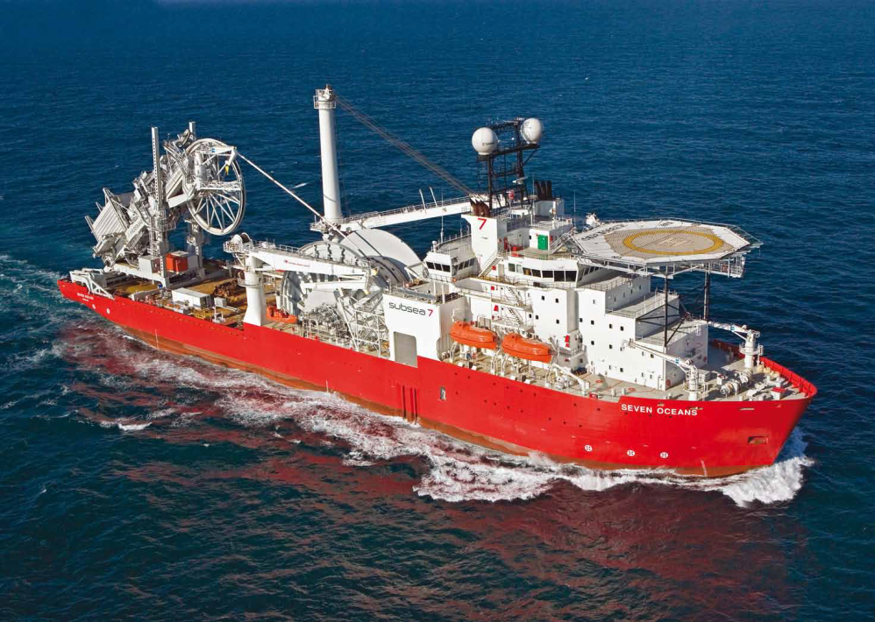
CoPilot Retrofit
Fitted on widest range of ROV brand
Input:
    DVL
    Multibeam Sonar
Output:
    Full DP
Achievements:
    First Commercial Implementation of MBI Sonar Track

Slide 22
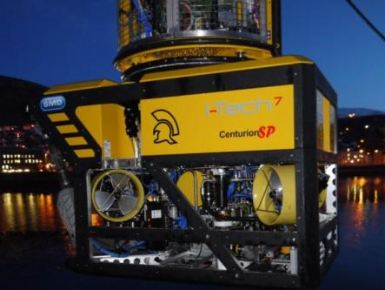
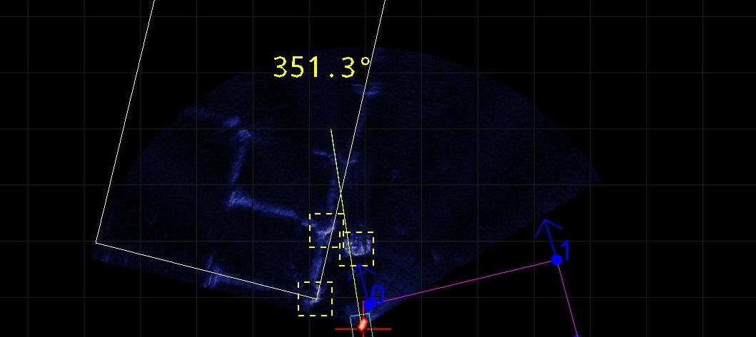


SMD DVECS-S
Automating hydraulic work-class ROV operations
SMD entered into an excusive agreement to integrate SeeByte's CoPilot with SMD's work-class ROVs. Since 2003 SMD have designed and manufactured over 140 complete work-class ROV systems into every region in the world for oil and gas, oceanographic, salvage and renewable markets.

Slide 23
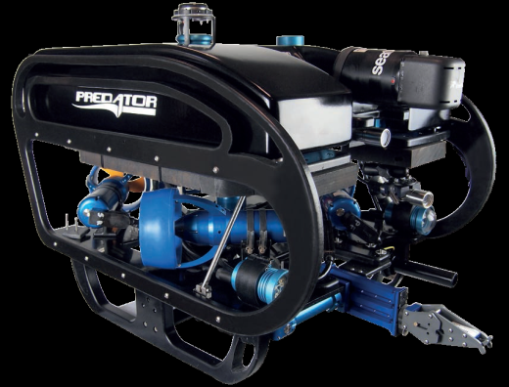
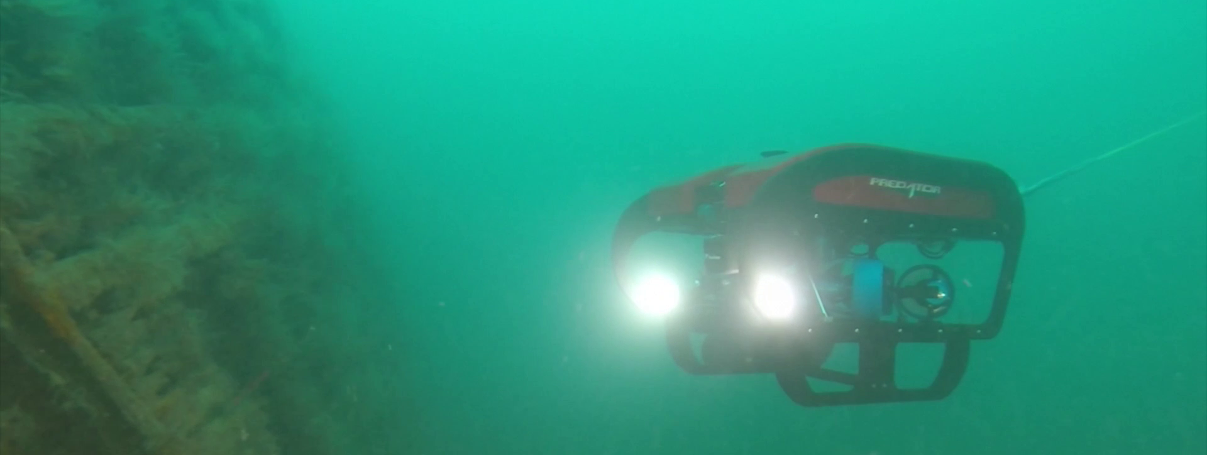

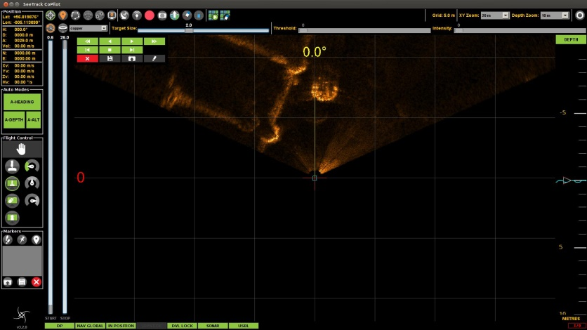
Seatronics Predator ROV
Rental and sales of observation ROVs with SeeTrack CoPilot
Seatronics Predator ROV customers use CoPilot the most capable ROV DP system available in the market to simplify their ROV control and improve their operations.

Slide 24
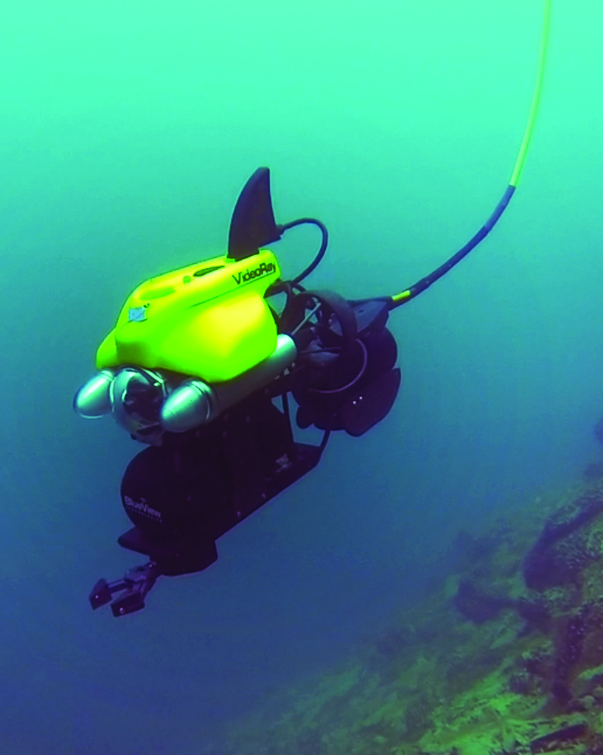

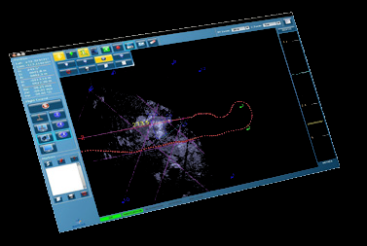
VideoRay CoPilot Products
Automating one man portable ROV inspections and surveys
VideoRay and SeeByte offer Autonomous Control for one man portable ROVs. The ROV is capable of following predetermined waypoint trajectories and hovering in a desired location for extended periods of time. Fantastic tools for surveys and inspections.

