Slide 1
IMU Daughter Board
Design for BEDS

Slide 2
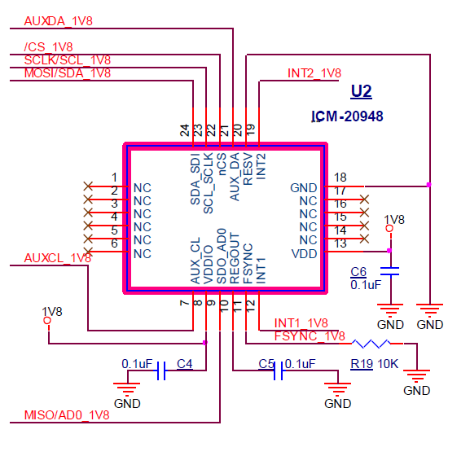
Steps to Spinning Daughter Board
IMU board design notes
  Level shifters for SPI (3.3V for PIC, 1.8V for IMU)
  VDD: 3.3V or 1.8V (doesn’t matter)
  No reset so FW control of VDD would be nice
  VDDIO requires 1.8V, does not act as reset
  Two interrupt lines
    INT2 to INT_IMU to RD1
    INT1 to IMU_IO1 to RA15
  See also Invensense SmartMotion Hardware User Guide p14
OK
OK
OK
OK
OK

Slide 3
Parts
ICM-20948
MAX337EEUD level shifters

Slide 4
Current setup

Slide 5
Why Was IMU More Difficult than Expected?
FrankenSystem needed for DevKit use with BEDS board for different voltages.
IMU is capable but requires special FW from Invensense, unclear documentation.
IMU Dev Kit
MCU: modified code
3.3V ->
1.8V
<-
Invensense
IMU ICD-2049
Mirror
CS
CS
SPI
Don’t use
SPI
CS
5V
BEDS board
PIC32
Pressure sensor
EN

Slide 6
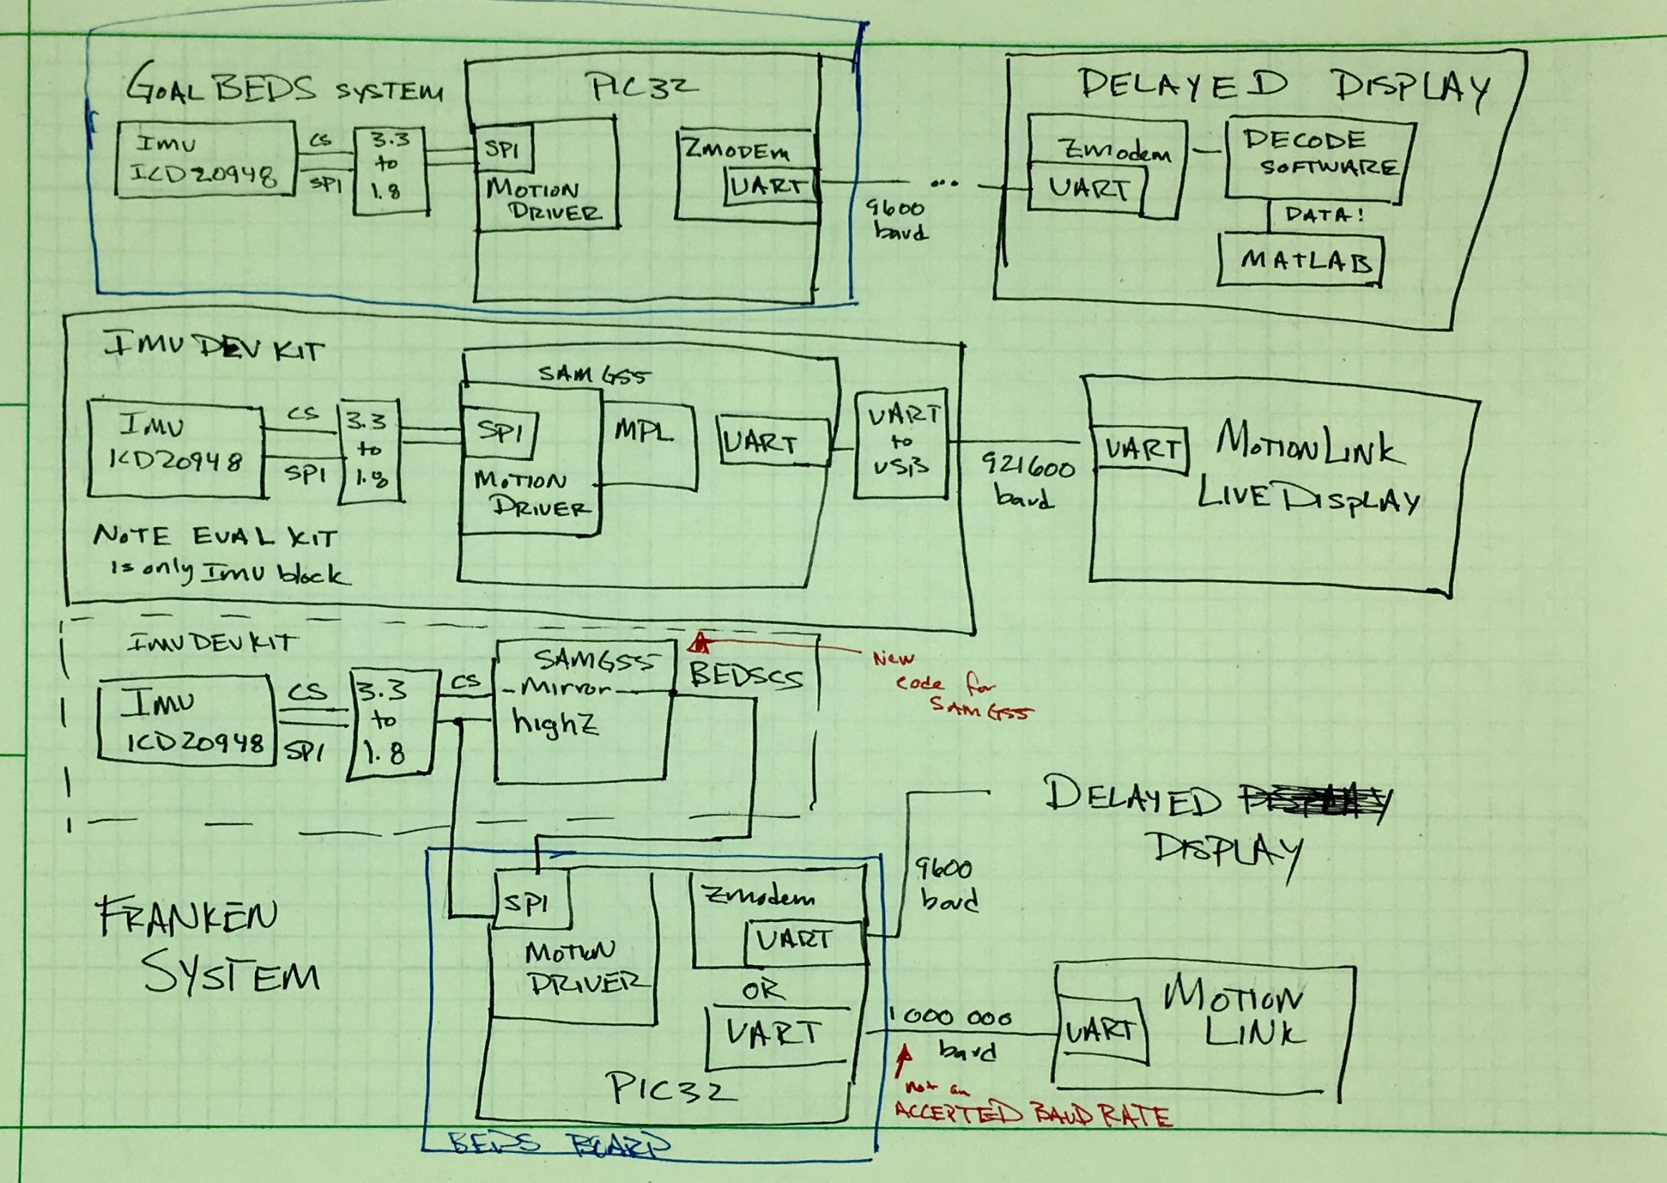
Why Was IMU Hard?
FrankenSystem needed for DevKit use with BEDS board for different voltages.
IMU is capable but requires special FW from Invensense, unclear documentation.

Slide 7
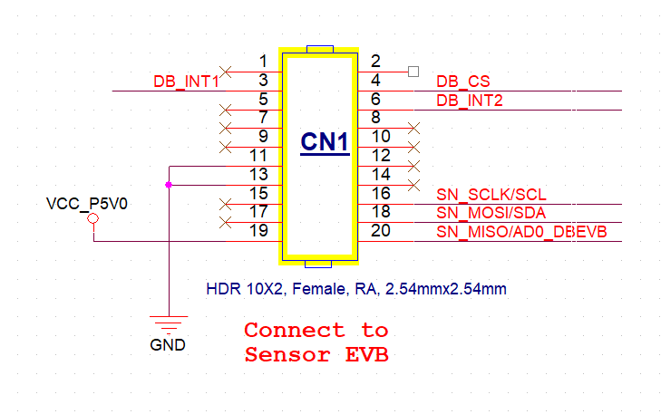
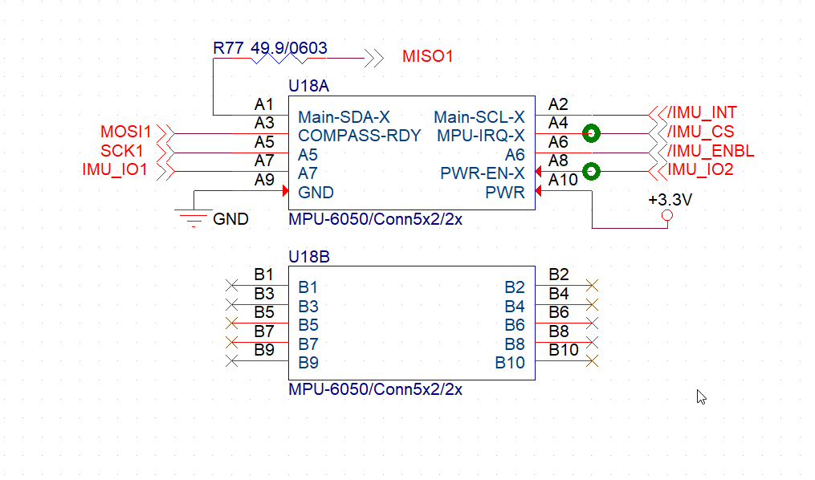
TDK/ Invensense
DK-20948 Development Kit
MBARI 10020895-MOB3 Mother Board Assembly
6-channes of level shifting
3.3V signals
1.8V signals
+5V from lab power supply
One
reserved signal
Proposed addition
8 wires connected to CN1
Controls VDD (1.8) on ICM-20948 and MAX3378EEUD Level Shifters Tri-State input signal
Red wires: Logical Elegance prototype configuration

Slide 8
ICM-20948:
  Built-in temperature sensor

