Slide 1

What is the resistance of this axial resistor?

Slide 2
334K
What is the capacitance of this radial capacitor?

Slide 3
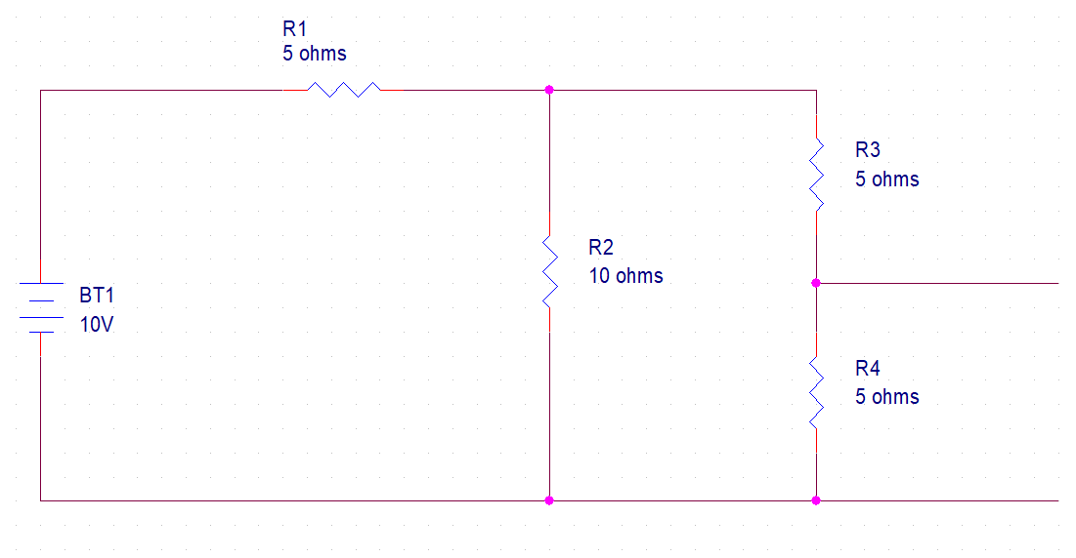
What is the total current is flowing through this circuit? What is the voltage at V1
I-Total
+
V1
-

Slide 4
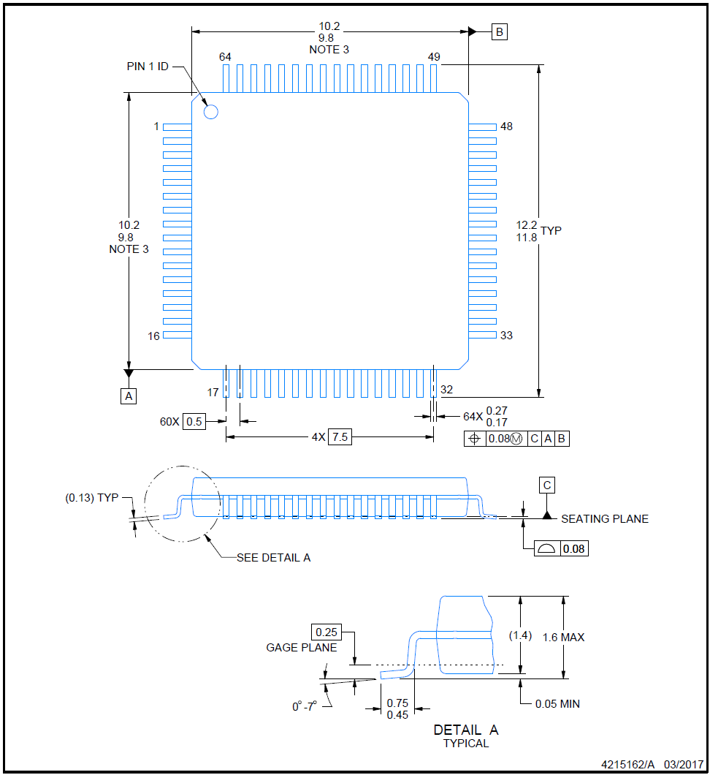

Slide 5
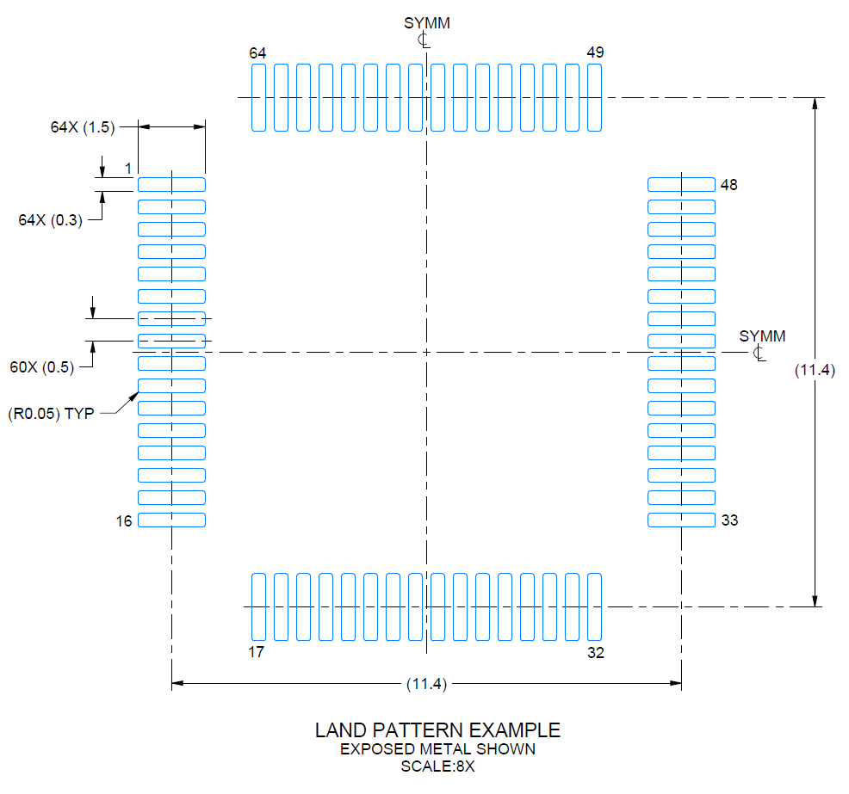
Calculate the coordinate of the center of pin 17’s land pad relative to location 0,0.
0,0

Slide 6
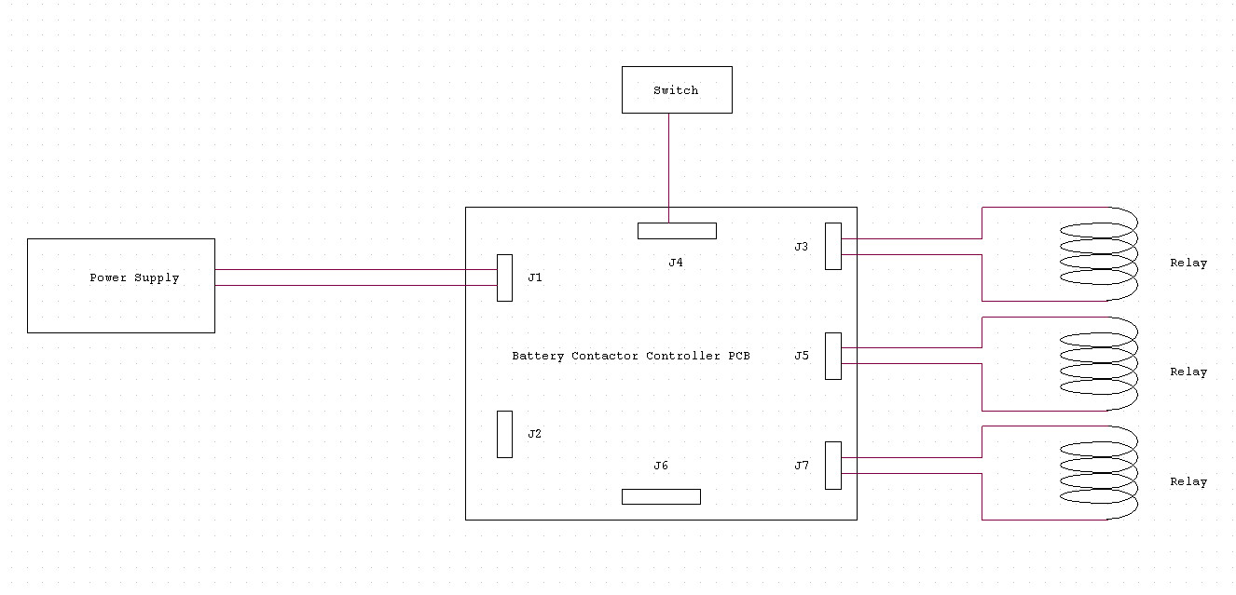
Here is the setup to test this newly assembled PCB.
The PCB design has been built and tested functional.

Slide 7
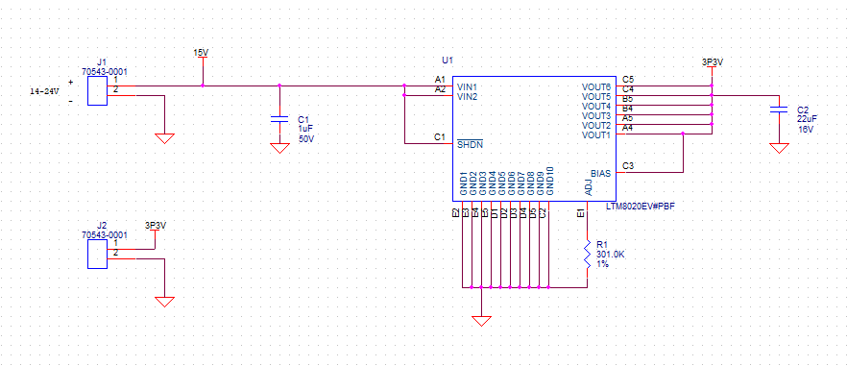
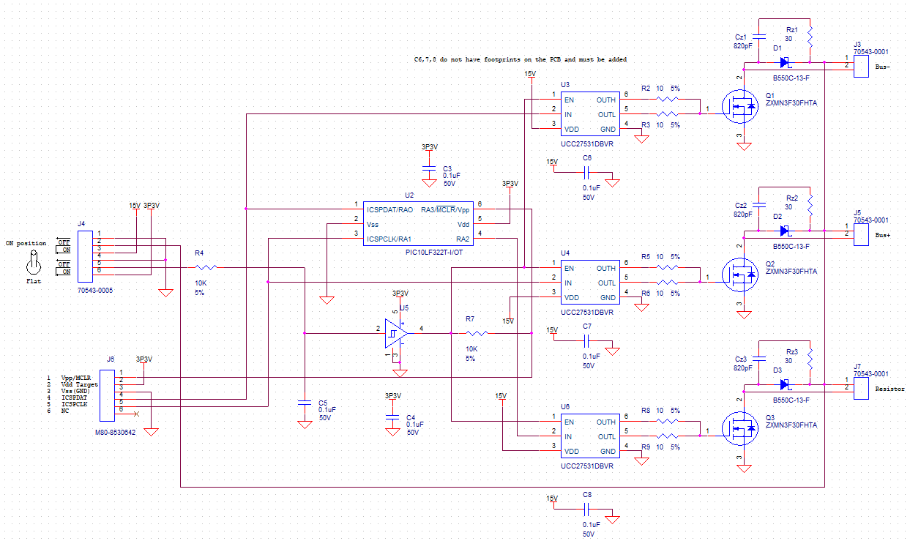
This is the schematic of the PCB. When power is supplied to J1 using a programmable power supply, it is noticed that the voltage immediately drops to 0V and the current rises to the programmed current limit. How would you go about troubleshooting the test setup and/or circuit?

Slide 8
An engineer needs a cable with 6 wires fabricated. He dropped off this schematic and the 2 connectors.
The lab you work in has a huge inventory of wire to use.
What two pieces of information did he neglect to include?
What do the two X’s on pins 5 and 6 indicate?

