Slide 1
Video Strategic Plan Graphics
…the 10 year Plan
DRAFT

Slide 2
The Four Chapters of the Strategic Plan
The video data store.
The conversion of the existing video library.
The removal of the annotation processing backlog.
  What sources to routinely annotate?
The conversion of the main ROV cameras to 4k resolution.

Slide 3
Calculation Assumptions
All figures are in 2019 dollars.
All Titan computer installation and maintenance costs are included as fixed costs.
NOT included:
  Human resources
  Electricity
  Building costs
Computer hardware purchase amortization = 5 years.
Computer robotic tape system amortization = 10 years (expansion space 5 years).
Robotic tape expansion will not require additional building space.
Data storage will include current usage + proposed requests for additional storage space.
Total ROV main camera footage is 1500 hours per year (easily changed variable).
LTO-8 tape costs will stay the same as current (should go down).
Do not scale with storage volume!

Slide 5
Estimates of Volumes from Video Data Sources

Slide 6
Estimates of Volumes from all Non-Video Data Sources

Slide 7
Video files are bit dense but there is technical help using LTO Tape and data storage magic!
LTO-8 cost shown is full fixed annual costs for hardware + maintenance + backup + tape. D5 is tape and backup tape cost only.

Slide 8
Titan Network Store Storage Costs - Annual

Slide 9
Titan Network Store Expansion Costs - Annual

Slide 10
Titan Network Store Annual Costs
The storage tape cost is the majority of the initial expense. After the first year the annual storage costs are fixes costs + backup.

Slide 11
Titan Network Store Annual Costs
First 15.5 Petabytes = $ 12.87 per Terabyte annually
Next 21.5 Petabytes = $ 1.33 per Terabyte annually!

Slide 12
File Based Video - File Storage Costs
During the last two years MBARI had transitioned to file based video data storage.
  Old system – proprietary tape drives and tape stock ($135 per hour of HD).
  New system – industry standard tape and servers (~$8.52 per hour of HD*).
    Lower cost.
    Allows network transport and viewing of video data.
MBARI Titan network share system can easily support storing and serving current and future growth of HD video streams.
  Including upgrade to 1920x1080 60p. (upgrade from current 1080 60i = 2X more data)
  Master level = Apple ProRes 422 HQ level codec.
  Mezzanine level = H.264 Codec (~10:1).
* Includes tape, backup and fixed costs. 2nd + year reduced to $2.77 per hour annually.

Slide 13
Current HD System – Keep all HD Video at Master Level
Video Clip Quality:
Master
Mezzanine
Offsite Backup Tape Archive
198 GB + /hour
All Master and Mezzanine Level HD Video Files
Master and Mezzanine Level File Capture & write LTO tape (MBARI M3 System)
On site Titan Disk and Tape store
HD Camera
198 GB + /hour
All Master and Mezzanine Level HD Video Files
X 2 ROV’s !
Shipboard
On-shore

Slide 14
All Data + HD ROV Cameras (1080 60p) + Converting Archive to Files
Expansion Space:
Annual Fixed Cost on and off-line = $0.70 per Terabyte Capacity ($16k per year + tape)
Current Space:
Annual Fixed Cost on and off-line = $12.24 per Terabyte Capacity ($188k per year + tape)

Slide 15
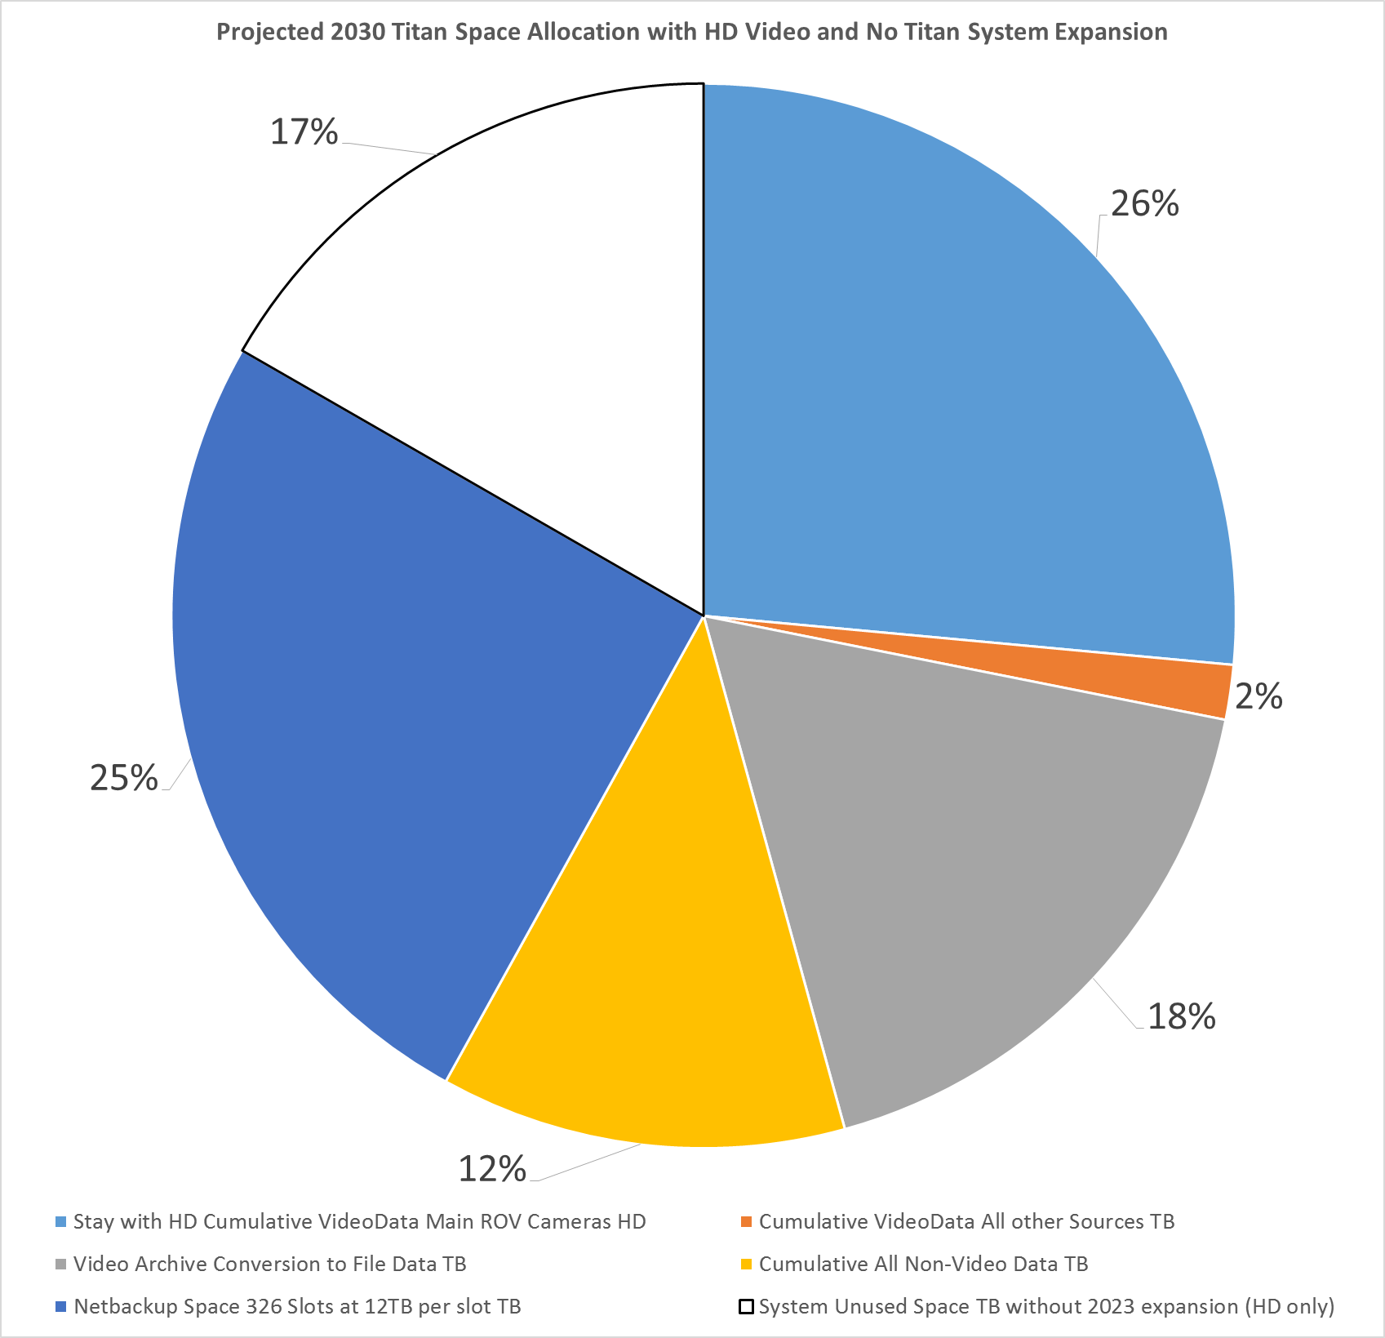
Video Storage Relative Storage Volumes – Keep HD
The video streams from MBARI’s ROV’s generate about 1500 hours of video per year. This volume completely dominates the video streams at MBARI from all other sources because each ROV’s dives 150+ days per year for 7+ hours a day. The volume and cost of non-ROV video streams is very low. For example if we store all ROV HD video, in 10 years the Titan data store is projected to look like this:
ROV Video
All non-ROV Video (i2MAP, EyeRIS, Benthic Imaging, etc.)

Slide 16
What Happens if we Upgrade to 4K Main Cameras?
4K video at 60 frames per second (4096 x 2160 60p) is a “huuuge” amount of data.
  Master level Apple ProRes Codec 422 HQ is about 848 Gigabytes per hour.
  Mezzanine level H.264 or H.265 Codec is around 10:1 or 85 Gigabytes/hr.
The MBARI Titan network share system has the capacity to support 4K video acquisition on MBARI’s main vehicles for at least 10 years.
Over a period of time the video data would grow to be by far the largest data share at MBARI.
Are there ways to reduce the 4K total video data volume while preserving the value of video data thereby lowering the resource and capital cost?

Slide 17
Cost Models for Handling 4K Video Data from the MBARI ROV’s
To examine possible strategies for reducing the cumulative data storage requirements for 4K video four different technical approaches and their respective cost models were examined:
Model A – Keep all 4K video data at the Master (and Mezzanine) level.
Model B – During annotation flag 15 minute clips for keeping in 4K, otherwise transcode to LT level.
  Requires extra labor and computing time ($).
  LT Clips can still be edited.
  All off-site backups are still 4K and could still be retrieved if necessary.

Slide 18
Four Different Cost Models for Handling 4K Video Data from the MBARI ROV’s, continued..
Model C – While recording on the ships, select recording (Codec) format.
  Master = Apple ProRes HQ (848 GB per hour) + Mezzanine.
  LT level = Apple ProRes LT (394 GB per hour) + Mezzanine.
  Once selection is made backups and on-line video will only be in the selected mode.
Model D - During annotation flag 15 minute clips for keeping in 4K, otherwise discard 4K and only retain Mezzanine level.
  Cost model assumes LTO tape can be re-used.
  Mezzanine level difficult to edit (inter-frame encoding).
  All off-site backups are still 4K and could still be retrieved if necessary.

Slide 19
Cost Model A – Keep all 4K Video at Master Level
Video Clip Quality:
Master
Mezzanine
Offsite Backup Tape Archive
848 GB + /hour
All Master and Mezzanine Level 4K Video Files
Master and Mezzanine Level File Capture & write LTO tape (MBARI M3 System)
On site Titan Disk and Tape store
4K Camera
848 GB + /hour
All Master and Mezzanine Level 4K Video Files
X 2 ROV’s !
Shipboard
On-shore

Slide 20
Cost Model B – Annotation Selects 4K Video at Master Level, All Else Transcode to ProRes 422 LT
Video Clip Quality:
Master
Mezzanine
ProRes LT
Offsite Backup Tape Archive
848 GB + /hour
All Master and Mezzanine Level 4K Video Files
Master and Mezzanine Level File Capture & write LTO tape (MBARI M3 System)
Temp File Store
485 GB + /hour ? *
Onsite Titan Disk and Tape store
4K Camera
Some Master Else LT and Mezzanine Level 4K Video Files
X 2 ROV’s !
Shipboard
On-shore
* At 20% 4K HQ and 80% 4K LT

Slide 21
Cost Model B – Annotation Selects 4K Video at Master Level, All Else Transcode to ProRes 422 LT
Video Clip Quality:
Master
Mezzanine
ProRes LT
Temp File Store
Make 4K selects in 15 minute clip blocks during annotation.
Transcode all else to ProRes 422 LT and recycle tape stock
Onsite Titan Disk and Tape store
Some Master Else LT and Mezzanine Level 4K Video Files
Q: Feasible to recycle (reformat) tapes? YES
Q: What are the appropriate tools and processing for transcoding? YES Labor?
Q: How to re-use tape? Model assumes re-use. FLAG AS BLANK AND RE-WRITE

Slide 22
Cost Model C – Real-time Selects 4K Video at Master Level, All Else ProRes 422 LT
Video Clip Quality:
Master
Mezzanine
ProRes LT
Offsite Backup Tape Archive
~ 485 GB + /hour ? *
Some Master Else LT and Mezzanine Level 4K Video Files
Master OR 422LT and Mezzanine Level File Capture & write LTO tape (MBARI M3 System)
On site Titan Disk and Tape store
4K Camera
~ 485 GB + /hour ? *
Some Master Else LT and Mezzanine Level 4K Video Files
X 2 ROV’s !
Shipboard
On-shore
* At 20% 4K HQ and 80% 4K LT

Slide 23
Cost Model D – Annotation Selects 4K Video at Master Level, All Else Mezzanine (H.265?) Only
Video Clip Quality:
Master
Mezzanine
Offsite Backup Tape Archive
848 GB + /hour
All Master and Mezzanine Level 4K Video Files
Master and Mezzanine Level File Capture & write LTO tape (MBARI M3 System)
Temp File Store
Onsite Titan Disk and Tape store
4K Camera
X 2 ROV’s !
Some Master Else Mezzanine Level 4K Video Files
Shipboard
On-shore

Slide 24
Cost Model D – Annotation Selects 4K Video at Master Level, All Else Mezzanine (H.265?) Only
Video Clip Quality:
Master
Mezzanine
Temp File Store
Flag 4K selects in 15 minute clip blocks during annotation.
Delete all else 4K keeping Mezzanine level only and recycle tape stock
Onsite Titan Disk and Tape store
Some Master Else Mezzanine Level 4K Video Files
Q: Feasible to recycle (reformat) tapes? YES
Q: How to re-use tape? Model assumes re-use. FLAG AS BLANK AND RE-WRITE.

Slide 25
20% Master Level Kept
cumulative storage cost difference is $716,000 after 10 years in 2019 dollars
Pre-2018 D5 Tape Annual Cost

Slide 26
20% Master Level Kept
$716,000

Slide 27
Change % kept at Master Level?
20% Master Level Kept
5% Master Level Kept
Not very sensitive to % Master kept. Why? LT is still 50% of HQ data, converted archive, other video, backup costs remain constant.

Slide 29
Model A Storage Volumes with All Data + 4K ROV Cameras
Expansion Space:
Annual Fixed Cost on and off-line = $0.70 per Terabyte Capacity ($16k per year + tape)
Current Space:
Annual Fixed Cost on and off-line = $12.08 per Terabyte Capacity ($188k per year + tape)

Slide 30
Video Only Storage Cost Comparison – Model A, keep all 4K vs staying with HD
1080 60p video
4028 60p video
Pre-2018 D5 Tape Annual Cost
Pre-2018 D5 Tape Annual Cost

Slide 31
Model B Storage Volumes with 20% 4K Annotation Selects, Transcode 80% to LT + Mezzanine
Expansion Space:
Annual Fixed Cost on and off-line = $0.70 per Terabyte Capacity ($16k per year + tape)
Current Space:
Annual Fixed Cost on and off-line = $12.08 per Terabyte Capacity ($188k per year + tape)

Slide 32
Model B - Video Only Storage Costs with 20% 4K Selects 80% LT + Mezzanine
Pre-2018 D5 Tape Annual Cost
Pre-2018 D5 Tape Annual Cost

Slide 33
Model B

Slide 34
Model C - Video Only Storage Costs with 20% 4K Selects 80% LT + Mezzanine CHECK GRAPH DATA
Pre-2018 D5 Tape Annual Cost
Pre-2018 D5 Tape Annual Cost

Slide 35
Model D Storage Volume Projection with 20% 4K Annotation Selects + Mezzanine
Expansion Space:
Annual Fixed Cost on and off-line = $0.70 per Terabyte Capacity ($16k per year + tape)
Current Space:
Annual Fixed Cost on and off-line = $12.08 per Terabyte Capacity ($188k per year + tape)

Slide 36
Model D - Video Only Storage Costs with 20% 4K Selects 80% Mezzanine
Pre-2018 D5 Tape Annual Cost
Pre-2018 D5 Tape Annual Cost

Slide 37
Model D - Video Only Storage Costs with 20% 4K Selects 80% Mezzanine vs. Model A – Keep All 4K Video
Pre-2018 D5 Tape Annual Cost
Pre-2018 D5 Tape Annual Cost

Slide 38
Pre-2018 D5 Tape Annual Cost

Slide 39
Pre-2018 D5 Tape Annual Cost

Slide 40
Model A – 2030 Video Only Storage Costs with keep all 4K
New video tape cost

Slide 41
Model D – 2030 Video Only Storage Costs with 20% 4K Selects 80% Mezzanine
New video tape cost

Slide 42
New video storage LTO tape cost

Slide 43
2030 Storage Costs Model A, keep all 4K vs Model D, 4K selects

Slide 44
Calculations – Video File Accumulation
previous years accumulation
new HQ + Mezzanine accumulation
Calculate video storage accumulation model A: =C5+$E$21
previous years accumulation
% in 4k HQ + Mezzanine
% in 4k LT + Mezzanine
Calculate video storage accumulation model B:
=(D5+($D$30*$F$22)+((100%-$D$30)*$F$21))
previous years accumulation
% in 4k HQ + Mezzanine
% in 4k LT + Mezzanine
Calculate video storage accumulation model C: =(E5+($D$30*$F$22)+((100%-$D$30)*$F$21))
previous years accumulation
% in 4k HQ + Mezzanine
% in Mezzanine Only
Calculate video storage accumulation model D: =(F5+($D$30*$F$22)+((100%-$D$30)*($D$22*$D$27)))

Slide 45
Calculations – Annual Storage Cost HD and Model A
fixed cost TB
backup cost TB
Tape + backup tape cost
total accumulation
new accumulation
Calculate video annual cost HD only: =((B4-B3)*$K$21)+(B4*($J$23+$J$24))
fixed cost TB
backup cost TB
Tape + backup tape cost
total accumulation
new accumulation
First 15 Petabytes
Calculate video annual cost 4K model A: =((C5-C4)*$L$21)+(C5*($K$23+$K$24))
fixed cost < 15 TB
fixed cost > 15 TB
backup cost TB
Tape + backup tape cost
total < 15 TB accumulation
backup cost TB
total > 15 TB accumulation
new accumulation
Expansion after 15 Petabytes
Calculate video annual cost 4K model A: =((C11-C10)*$L$21)+($C$10*($K$23+$K$24))+((C11-$C$10)*($K$26+$K$27))

Slide 46
Calculations – Annual Storage Cost Model B
Up to 15 Petabytes
Model B annual cost
Total online HQ & Mezz accumulation < 15TB fixed cost
New HQ backup accumulation
New HQ online accumulation
Transcoding new HQ to LT annual cost
Backup tape cost
tape cost
Annual backup cost
=((C5-C4)*$K$21)+((D5-D4)*$K$21)+(C5*$K$24)+(D5*$K$23)+((C5-C4)*((100%-$D$30)*ConvertingVideoArchive!$B$21))
Expansion after 15 Petabytes
Model B annual cost
Total online HQ & Mezz accumulation < 15TB fixed cost
Total online HQ & Mezz accumulation > 15TB fixed cost
Transcoding HQ to LT annual cost
New HQ backup accumulation
New HQ online accumulation
Backup tape cost
tape cost
Annual backup cost
=((C11-C10)*$K$21)+((D11-D10)*$K$21)+(C11*$K$24)+($D$10*$K$23)+((D11-$D$10)*$K$26)+((C11-C10)*((100%-$D$30)*ConvertingVideoArchive!$B$21))
Calculate video annual cost 4K model B: uses model A accumulation for backup cost and B accumulation for processed cost.

Slide 47
Calculations – Annual Storage Cost Model C
fixed cost TB
backup cost TB
Tape + backup tape cost
total accumulation
new accumulation
Up to 15 Petabytes
Model C annual cost
=((E5-E4)*$L$21)+(E5*($K$23+$K$24))
fixed cost < 15 TB
fixed cost > 15 TB
backup cost TB
Tape + backup tape cost
total < 15 TB accumulation
backup cost TB
total > 15 TB accumulation
new accumulation
Expansion after 15 Petabytes
Calculate video annual cost 4K model C: =((E11-E10)*$L$21)+($E$10*($K$23+$K$24))+((E11-$E$10)*($K$26+$K$27))

Slide 48
Calculations – Annual Storage Cost Model D
Up to 15 Petabytes
Model D annual cost
Total online HQ & Mezz accumulation < 15TB fixed cost
New HQ + Mezz backup accumulation
New HQ & Mezz online accumulation
Backup tape cost
tape cost
Annual backup cost
=((C5-C4)*$K$21)+((F5-F4)*$K$21)+(C5*$K$24)+(F5*$K$23)
Expansion after 15 Petabytes
Model D annual cost
Total online HQ & Mezz accumulation < 15TB fixed cost
Total online HQ & Mezz accumulation > 15TB fixed cost
New HQ + Mezz backup accumulation
New HQ + Mezz online accumulation
Backup tape cost
tape cost
Annual backup cost
=((C11-C10)*$K$21)+((F11-F10)*$K$21)+(C11*$K$24)+($F$10*$K$23)+((F11-$F$10)*$K$26)
Calculate video annual cost 4K model D: uses model A accumulation for backup cost and D accumulation for processed cost.

Slide 49
Calculations – Annual Storage Cost of Archival Footage
Up to 15 Petabytes
Archival footage annual cost
New tape + Backup tape cost
On-line fixed cost
On-line fixed cost
New accumulation
Total on-line accumulation
Annual backup cost
=((I10-I9)*$L$21)+(I10*($K$23+$K$24))
Expansion after 15 Petabytes
Archival footage annual cost
New tape + Backup tape cost
On-line accumulation < 15TB fixed cost
Total on-line accumulation > 15TB fixed cost
New accumulation
Total on-line accumulation
Annual backup cost
New accumulation
Annual backup cost
=((I11-I10)*$L$21)+($I$10*($K$23+$K$24))+((I11-$I$10)*($K$26+$K$27))

Slide 50
New Section – Converting Video Archive

Slide 51
Converting Video Archive

Slide 52
Cost Model A – Keep all 4K Video at Master Level
Video Clip Quality:
Master
Mezzanine
Offsite Backup Tape Archive
848 GB + /hour
All Master and Mezzanine Level 4K Video Files
Master and Mezzanine Level File Capture & write LTO tape (MBARI M3 System)
On site Titan Disk and Tape store
4K Camera
848 GB + /hour
All Master and Mezzanine Level 4K Video Files
X 2 ROV’s !
Shipboard
On-shore

Slide 53
Questions…
Want to advocate for 4K? Which science users would be the best advocates to lead the charge on justifying 4K?
What are the top 10 VARS referencing science papers?
What strategies could be used to reduce the accumulation of massive 4K data volumes over time?
  Save “highlights” only?
    By annotator or science request?
  Automate saving?
    1 minute before and after an annotation?
  Other ideas?
How good is the 4K Mezzanine level going to be? Better than HD?

Slide 54
OLD SLIDES FOLLOWING

Slide 55
Stay With Same O’le HD Format* for ROV’s (no Titan expansion needed)
*1920 X 1080 60p using ProRes HQ CODEC

Slide 56
All Data Shares with Titan Expansion

