Slide 1
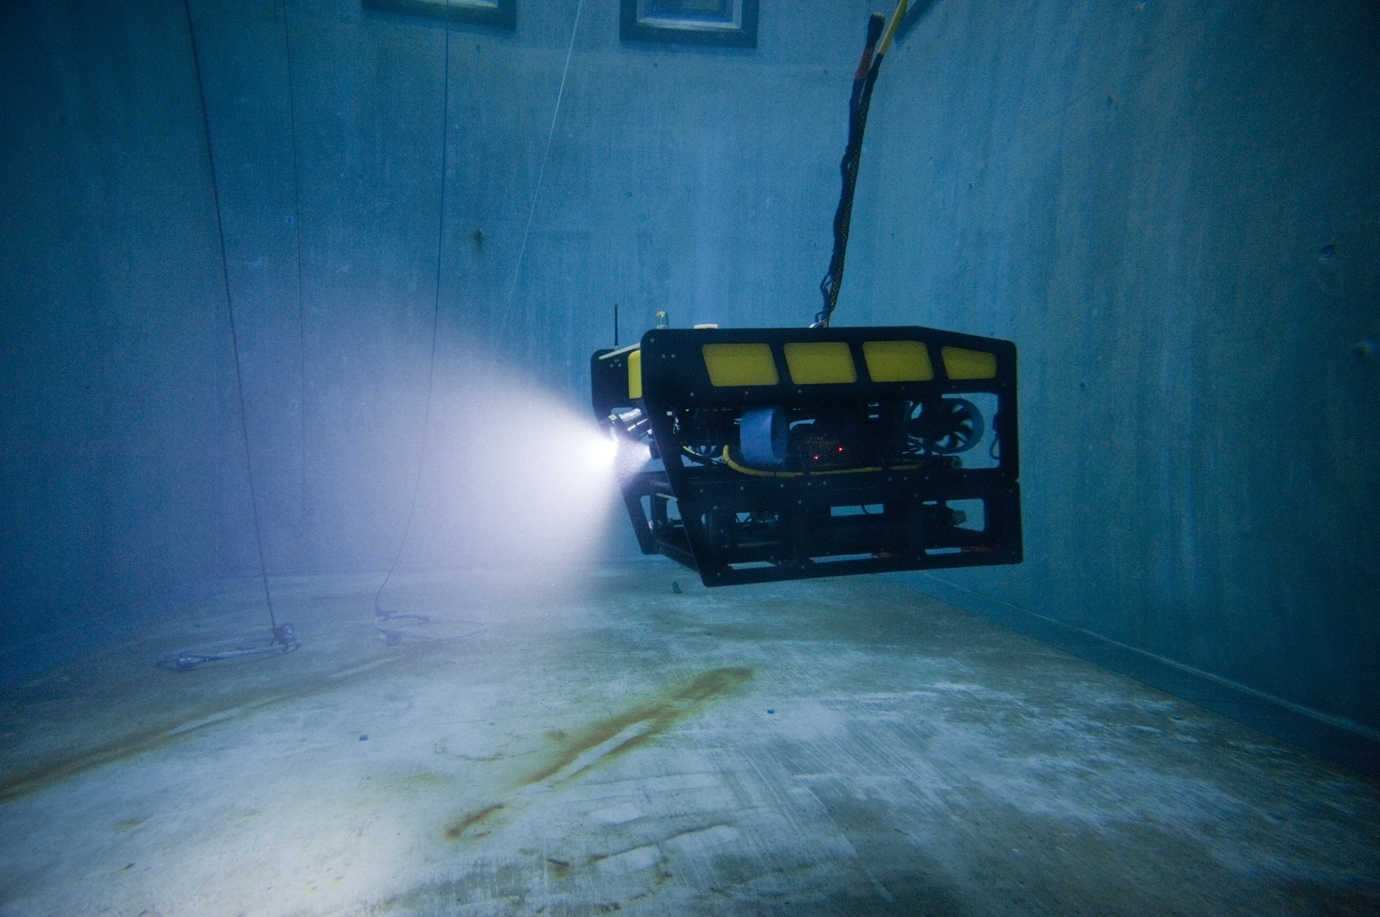
370000: Mini ROV Support

Slide 2
Mini ROV Status
2015 Deployments
  Robison GOC on Western Flyer
  GOC on Rachel Carson
  DPIV on Rachel Carson
  Nature Conservancy on Donna Kathleen
  Robison Midwater cruise on Western Flyer
  DPIV/Jelly Track on Umbra
  DPIV Rachel Carson
Proposed Deployments
  Paull Arctic cruise 2016
  Haddock Hawaii expedition 2017-2018
  DPIV Rachel Carson
Notes:
The MiniROV is becoming more

Slide 3
Proposed Work for 2016
Precision Control/ Data Sharing
Data Logging and Archiving
Video Annotation and Archiving
Vehicle Maintenance

Slide 4
Precision Control/Data Sharing
Incorporate protocol for flexible sharing of real time data
Integrate latest station keeping and navigation software
Improvements could benefit:
  Jelly-tracking algorithm development
  High-quality habitat surveys
  Test platform for new AUV control software (Ocean Imaging)

Slide 5
Data Logging and Archiving
Goal: to come up with a universal way to log dive data that is compatible with existing MBARI data storage/mining applications
  Add dive information to currently logged data
  Automatic transfer post-cruise to permanent storage
  Data files will be easily retrievable by dive number from VARS or other application

Slide 6
Video Annotations and Archiving
Add VARS capability to fly-away system
Create means to export VARS annotations from fly-away system to VARS database
Develop method for indexing into saved video using time code
Sync video to other metadata post-cruise

Slide 7
Vehicle Maintenance
Continue to modify vehicle to support each new application and expedition
Increase vehicle robustness and reliability by performing maintenance and purchasing adequate spares

