Slide 1
Molecular Ecology of Marine and Aquatic Organisms
Principal Investigator: Bob Vrijenhoek
Project Manager: Shannon Johnson
Technician: Julio Harvey
Lead Engineer: Mike McCann

Slide 2
Projects
1) MB³: Molecular Biodiversity at the Benthic Boundary
2) SIMZ: Sampling and Identifying Marine Zooplankton
3) Succession Planning

Slide 3
Molecular Biodiversity at the Benthic Boundary
Relationship to Strategic Plan: Exploration and Discovery, Ecosystem Dynamics
  (baseline knowledge for design and management of sanctuaries and preserves)
Primary goal: compare connectivity and diversity of species inhabiting deep-sea habitats along N. America’s western margin
  focus on studies of connectivity for vesicomyid clams, Idas mussels, siboglinid tubeworms, and gastropods from Gulf of California and Southern California hydrocarbon seeps.
  contrast estimated rates of dispersal and genetic diversity with hydrothermal vent species.
  obtain fresh specimens of clams and tubeworms for genomic marker development to compare with recently collected specimens from Pescadero Basin
Changes: none
Ship time: add 3 dive days to Clague expedition to Axial Seamount
Engineering time: none

Slide 4
Vent metapopulations
2010
2013
subdivision due to ridge offsets, currents, etc.
individual vent populations are highly ephemeral
are seep metapopulations more stable?
need to know more about evolutionary rates
Monterey
SoCal
Ensenada
Gulf of California

Slide 5
Project-2: SIMZ
Relationship to Strategic Plan: Ecosystem Dynamics, Ocean visualization
    (ocean health and productivity)
Goals: explore new technologies for autonomous sampling and molecular identification of marine plankton (fits within larger CANON goals and complements MBON program)
Accomplishments:
  Yanwu Zhang — improved algorithms for autonomous sampling
  Hans Thomas and AUV team — 20 sample bottle capacity
  Mike McCann — development and integration of STOQS database
  Molecular Ecology team (Shannon Johnson and Julio Harvey) — implementation of Next Generation Sequencing

Slide 6
Project-2: SIMZ
Goals:
  develop STOQS to integrate molecular data with size-frequency spectra obtained with LISST-100 and LOPC
  explore feasibility of PCR-free methods for library generation
Ship time: two 2-day Carson expeditions during prime upwelling season (e.g., April)
  test sample-to-sample variance among Gulper bottles
  test methods for integrating temporal offsets between Gulper sample and intake streams for LISST-100 and LOPC
Engineering time: Mike McCann, Danelle Cline, and Yanwu Zhang
DMO time: involvement of Hans Thomas in redesigning intake for LISST-100 and LOPC

Slide 7
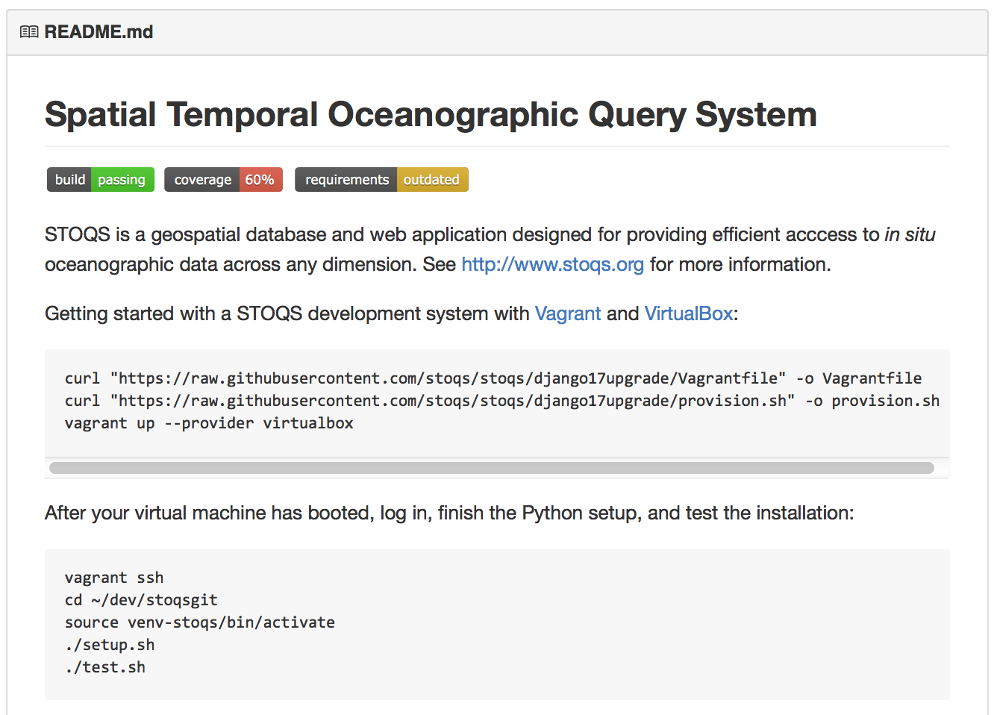
STOQS
STOQS – continuous integration on GitHub to support molecular work

Slide 8
HTS of PCR amplicons
Samples examined for 28S rRNA and mitochondrial COI sequences
Acartia copepods
COI worked poorly
28S didn’t work at all

Slide 9
PCR-biases: Calanus copepods
COI worked poorly
28S worked well

Slide 10
PCR-primer biases:
No truly universal primers without amplification biases
  Priming binding variation among taxa
  Bias against GC-rich sequences
  target stability (storage issues)
  etc., etc.
Problems
  poor species identification capacity
  course resolution of biological diversity
  it is not quantitative
  increased turn-around time in sample processing and analysis
  reduced sampling scales and/or frequencies
Solutions
  reduce number of PCR cycles
  reduce PCR annealing temperatures
  increase degeneracy of primers (can generate false positives)
  PCR-free HTS methods

Slide 11
PCR-free Metabarcoding methods
Microbes: Huse et al. 2008 PLoS Genet 4:e1000255
Caparaso et al. 2011 ISME J 6:1621—1624
Deep-sea meiofauna: Lecroq et al. 2011 PNAS 108:13177–82
Insects: Yu et al. 2012 Methods Ecol Evol 3:613–623

Slide 12
Will they be quantitative?
potential exists for relative abundance estimation
need to know size frequency distributions of target organisms

Slide 13
Project-3: Succession Planning
January: initiate NSF-funding collaboration with Greg Rouse to curate and transfer frozen and preserved vent and seep samples to Scripps/UCSD Museum
  Scripps to hire part-time worker (budgeted at ~$30k)
  my working collections will remain at MBARI until retirement
NSF-funded vent samples already transferred to:
  Robbie Young (NOC, Southampton, UK
  Yong-Jin Won (Ehwa Womens University, Seoul, Korea)
  Haibin Zhang (Sanya Inst. of Deep-Sea Science & Engineering, Sanya, China)
  Shana Goffredi (Occidental College, Pasadena, CA)

