Slide 1
901303
Cytometer technology for autonomous platforms
Tom O’Reilly
Denis Klimov
Francisco Chavez

Slide 2
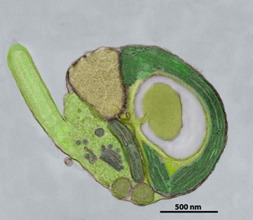
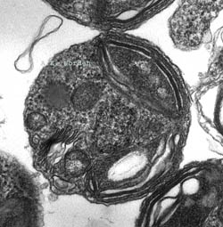
Project goals and activities
Look at available and emerging cytometers, microscopes potentially compatible with AUV, ASV
Collaborate with instrument developers and users
Evaluate instruments in lab, at sea
Develop bench-top test bed
Formulate implementation path
  Science use cases
  Buy-vs-build

Slide 3
Project team
Denis Klimov: Electrical/optical engineering
Francisco Chavez: Science applications
Tom O’Reilly: Project manager, software
Worden, Scholin, Chavez labs

Slide 4
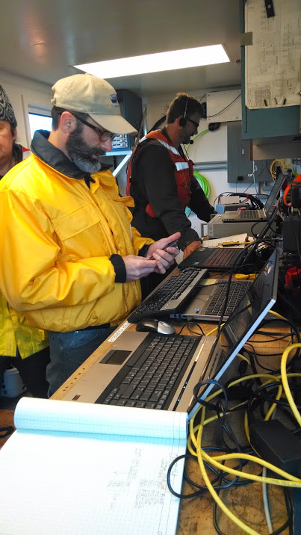
2014
Borrowed, evaluated, compared multiple instruments onboard Rachel Carson, in the lab
Bench-top cell phone, fluorescent microscope test-beds
Presented results at project update, 11/2014
Cytometer/microscope evaluations aboard the Carson

Slide 5
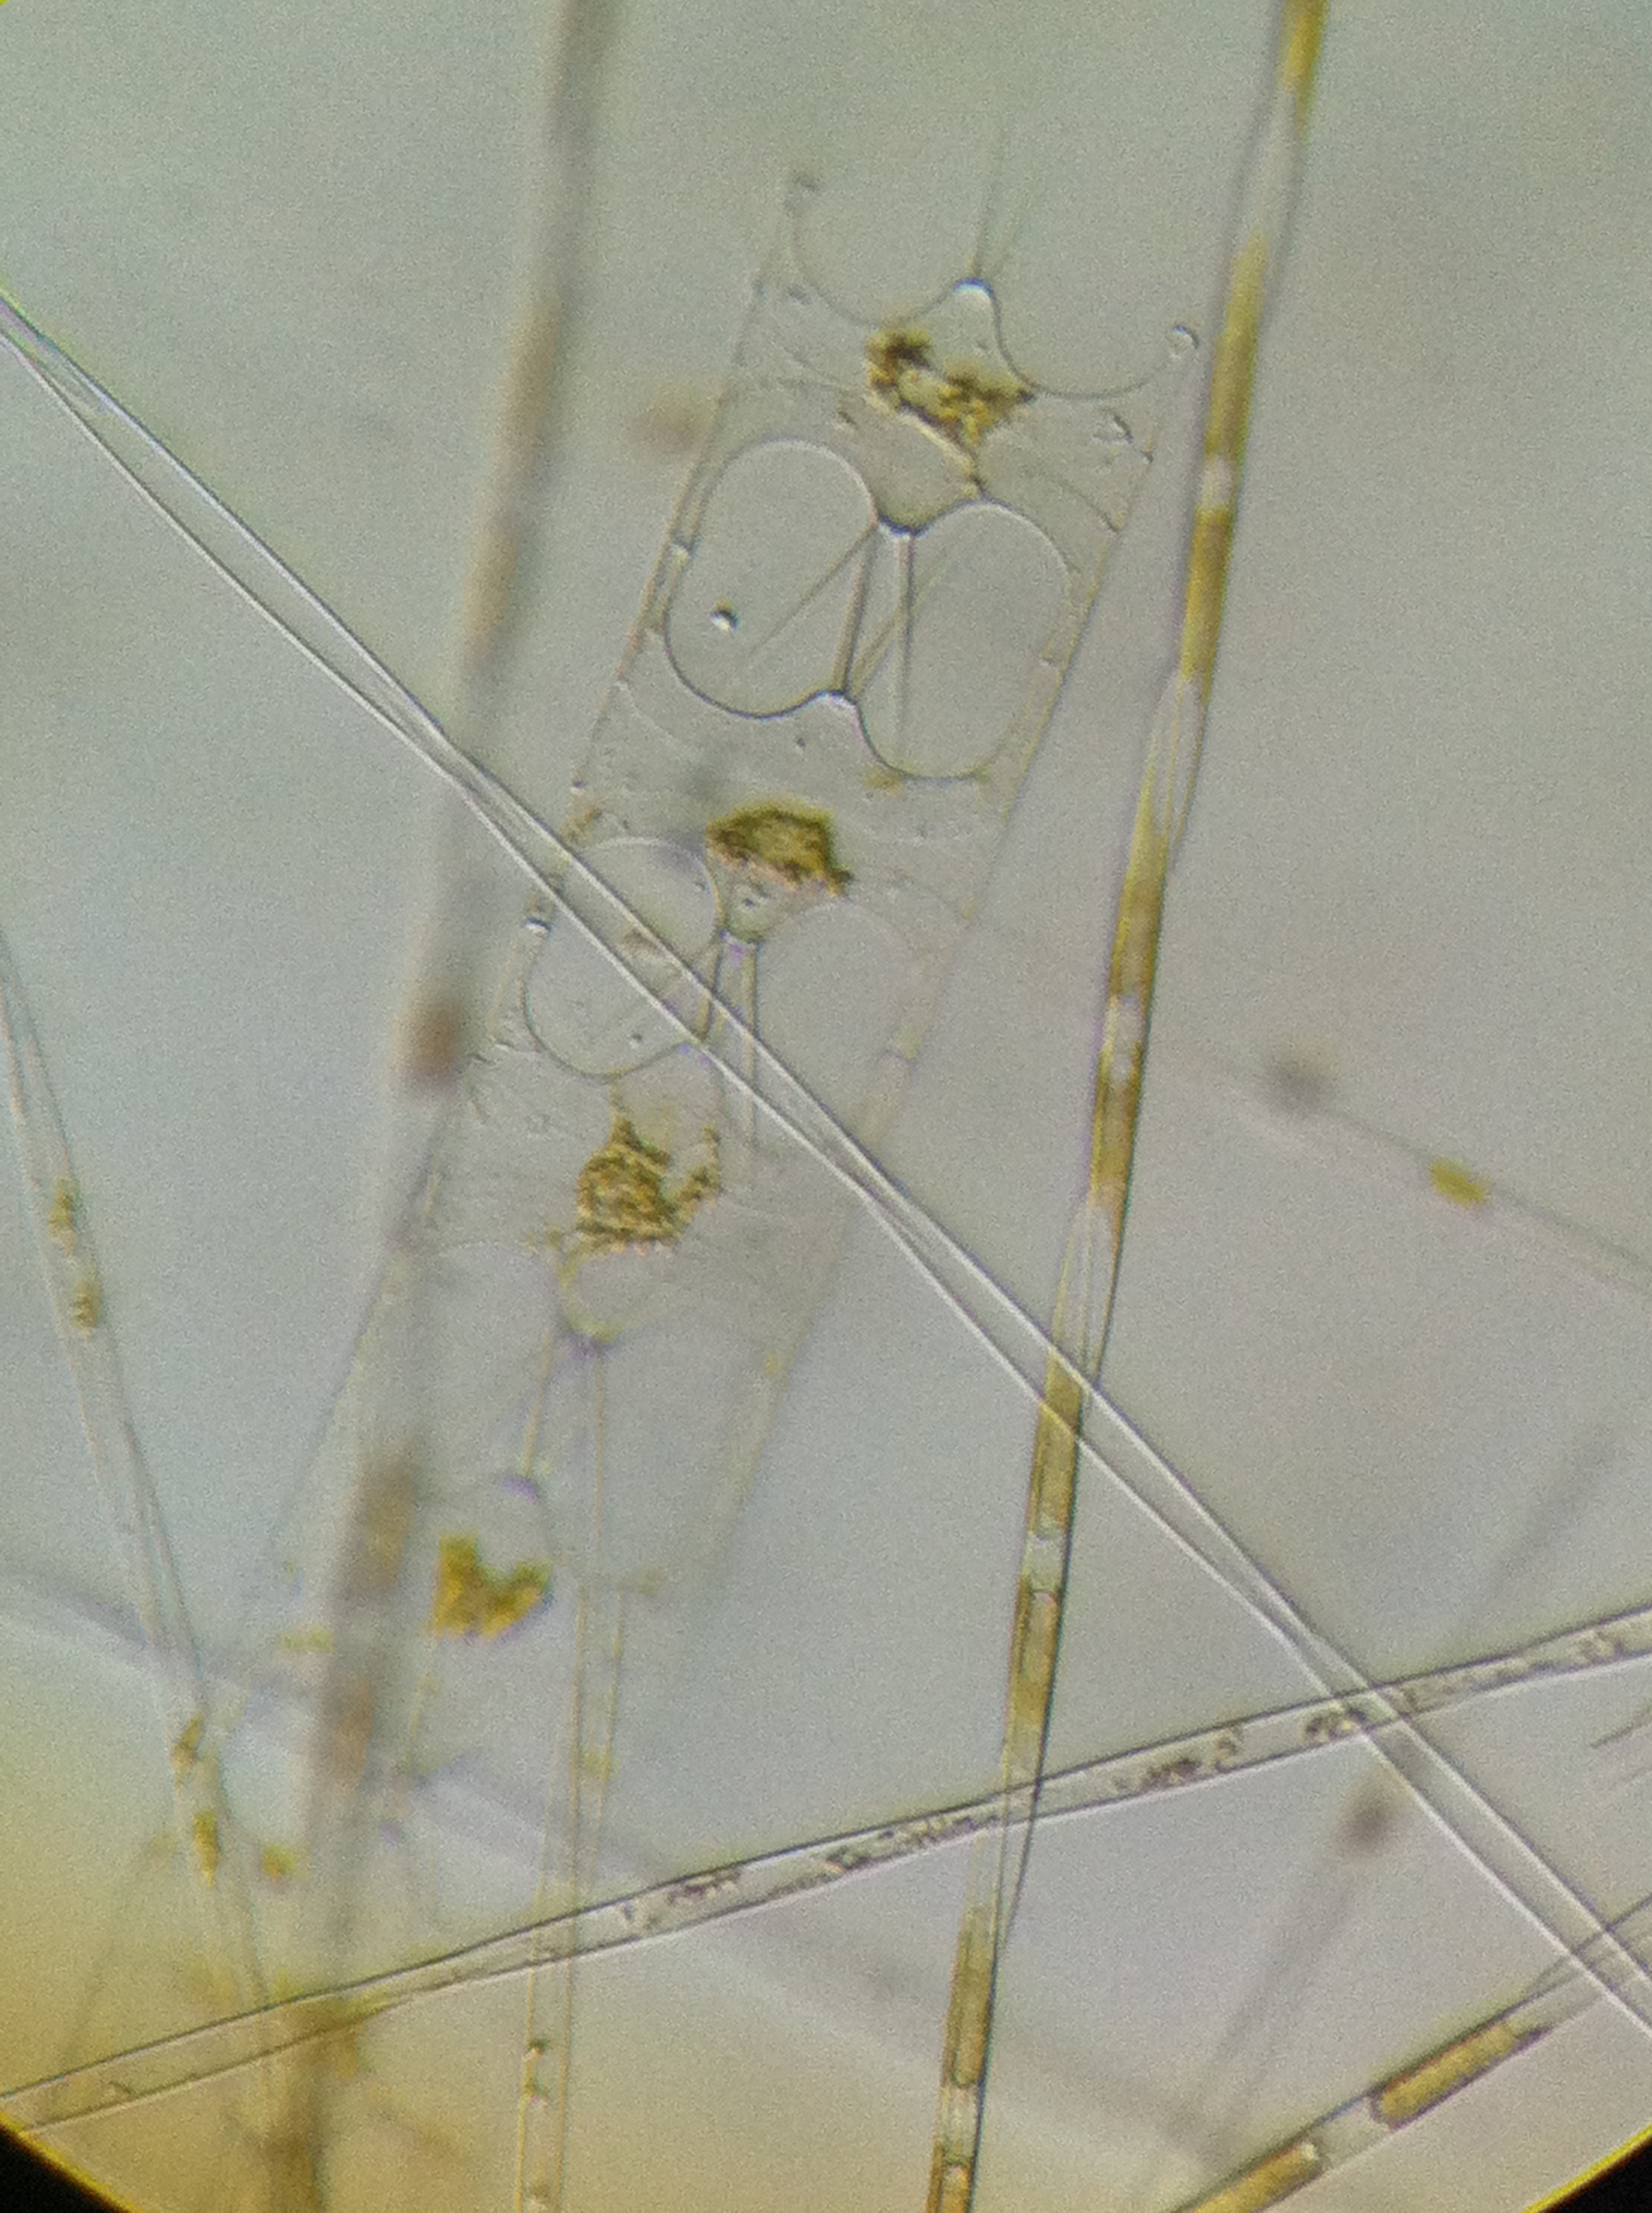
2015
Collaborating with Jupiter Research Foundation, Wave Glider microscope
Publication with Dr Peter Lopez (NYU)
Refine test-bed microscopes
Complete analysis of 2014 instrument comparisons
Evaluate CellScope (UCB, SCCWRP)
Evaluate improved 4Deep Submersible Microscope
CellScope: pseudo nitzschia
(photo: A. Gellene, USC)
Notes:
Instrument comparisons - Improved Seaflow calibration, new Submersible Microscope hardware/software

Slide 6
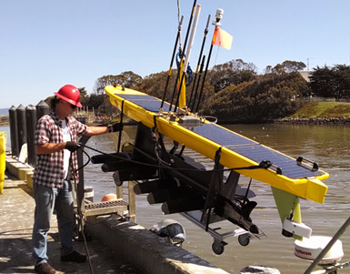
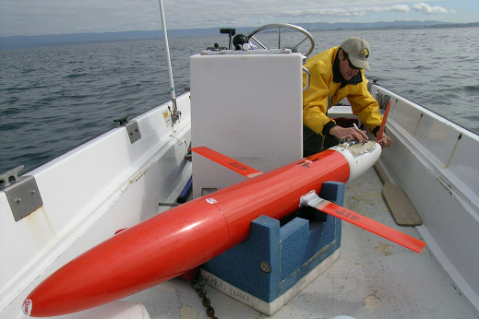
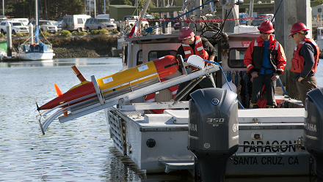
MTS Journal article (TechSurge issue)
Invited by Peter Lopez (Flow Cytometry and Cell Sorting Center, NYU School of Medicine)
  Lopez, O’Reilly, Klimov (2015), “Cytometers set sail with sea-going mobile robots”, Marine Technology Society Journal, volume 49, no 3
Unplanned, opportunistic activity
  Some 2015 deliverables likely not delivered this year
Notes:
Lopez participated in MTS Ocean Sensors TechSurge workshop 2014 with Bellingham. Lopez was invited MBARI seminar speaker in 2014.

Slide 7
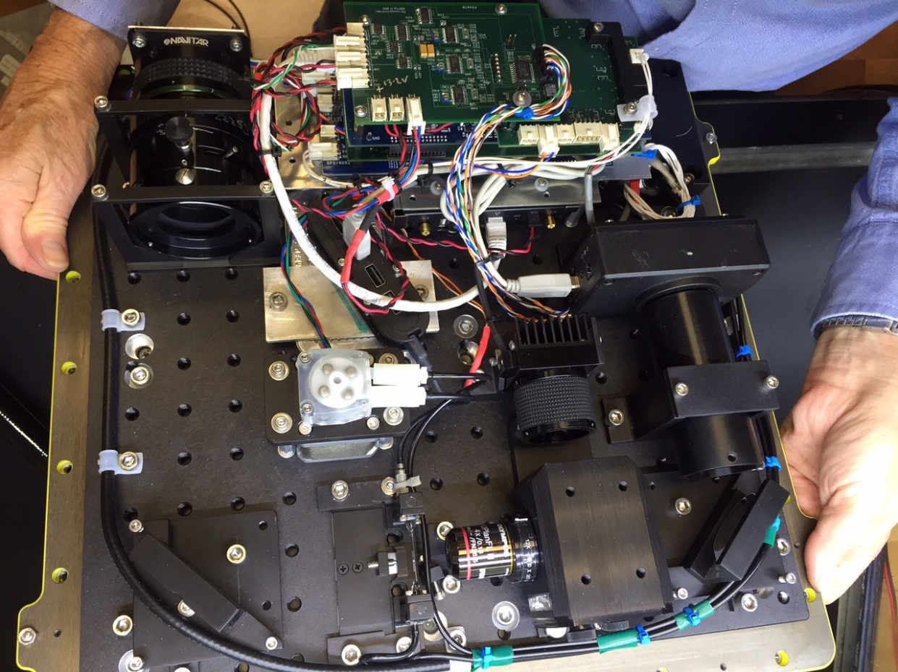
JRF WG microscope
Coordinated meetings,
discussions with JRF
Technical advice to JRF
  Fluorescence imaging, optics
  Sample preparation, etc.
Science application advice
  Discussions with scientists
  Scholin, Chavez, Vrijenhoek
  labs
  Sampling at depth, statistics, image analysis, etc.
Discussed plans for 2016 collaboration

Slide 8
Application scales
0.1 um
1 um
10 um
100 um
1000 um
particle size
Worden
Scholin, Ryan
Vrijenhoek, Haddock
Chavez
PipeCyte - funded
Mobile IFCB - funded
Emerging AUV/ASV cytometer/microscopes
PSI-FI
WG microscope
Submersible microscope
Notes:
PipeCyte has 3-year NSF funding
PSI-FI apparently being commercialized in China

Slide 9
MBARI 2016 mobile cytometer/microscope workshop
Instrument and vehicle experts discuss latest developments
  Instrument designs
  Science applications
  Adaptive sampling with AUV
  Instrument demos?
Sosik and Swalwell are enthusiastic about this
~2-3 days, 10 guests

Slide 10
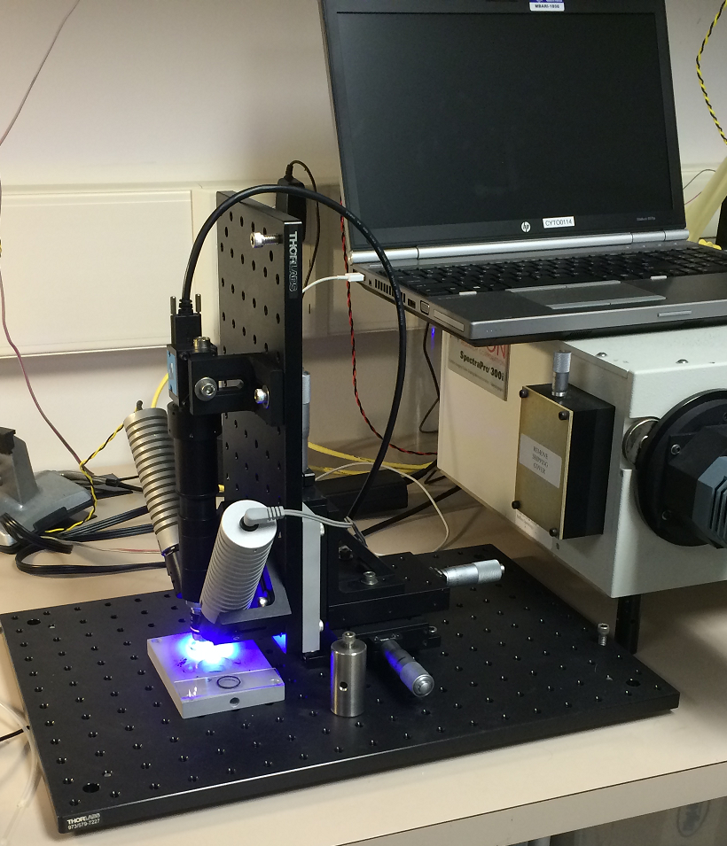
Proposed 2016 plan
Host mobile cytometer workshop at MBARI
Survey cell image identification software (e.g. IFCB)
Refine functional prototype
  Cell phone fluorescent microscope
  (low cost, size, power)
  Sample flow design, lighting, software
Monitor developments, possible collaborations
Some activity might be subsumed by
JRF collaboration project
Bench-top fluorescent microscope prototype
Notes:
Functional prototype – not ready for deployment (no pressure vessel, vehicle interfaces).
E.g. some of Klimov’s time could be spent studying feasibility of submersible WG microscope

Slide 11
Questions?

Slide 12
Synergy with JRF collaboration project
Might develop test-bed with JRF
MBARI has strong interest in subsurface sampling – instrument integration with AUV

Slide 13
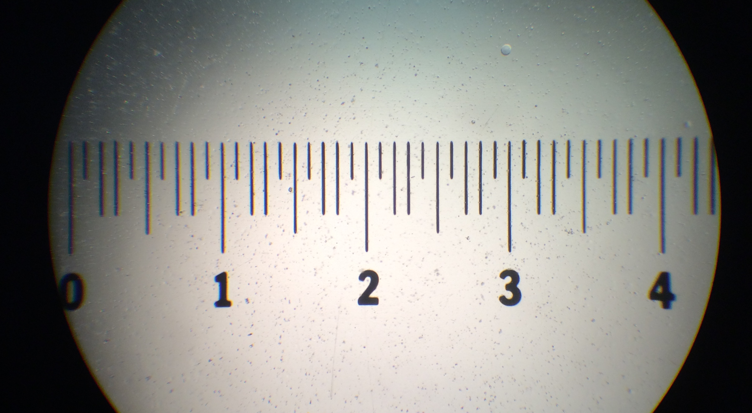
Cell phone microscope (4x objective)
Fine scale in 100 μm increments

Slide 14
Testbed
Blue LED
Imaging Source cameras:
BW and Color 1600x1200
Lens tube
White LED
X-Y-Z stage
Base plate
Microscope objective

Slide 15
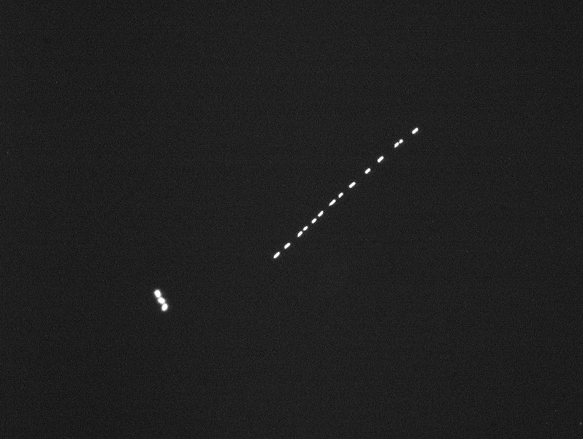
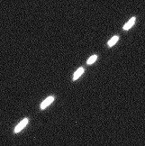
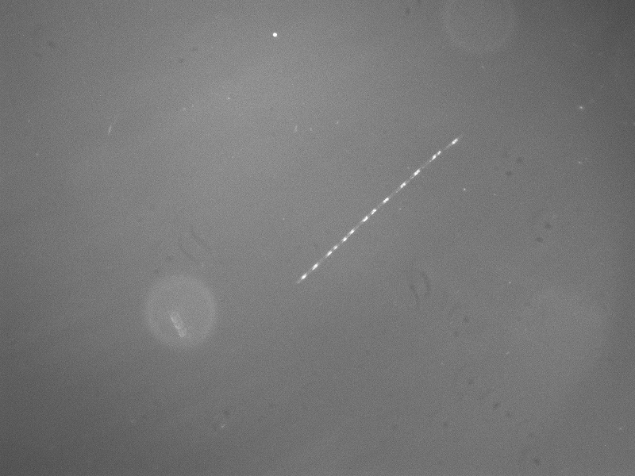
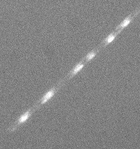
Testbed: BW imaging, slide
Fluorescence
Samples courtesy of Holly Bowers
160 x 160 um region
4x objective
1600x1200 pixel, 1 um / pixel
RG630 filter
BW camera: all pigments – one color
160 x 160 um region
“White” light

Slide 16
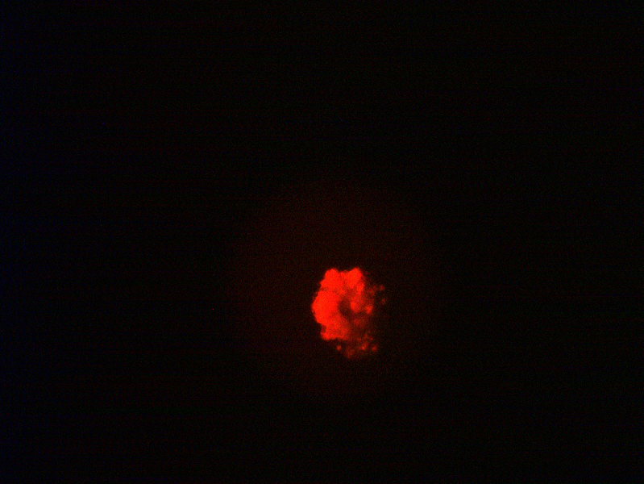
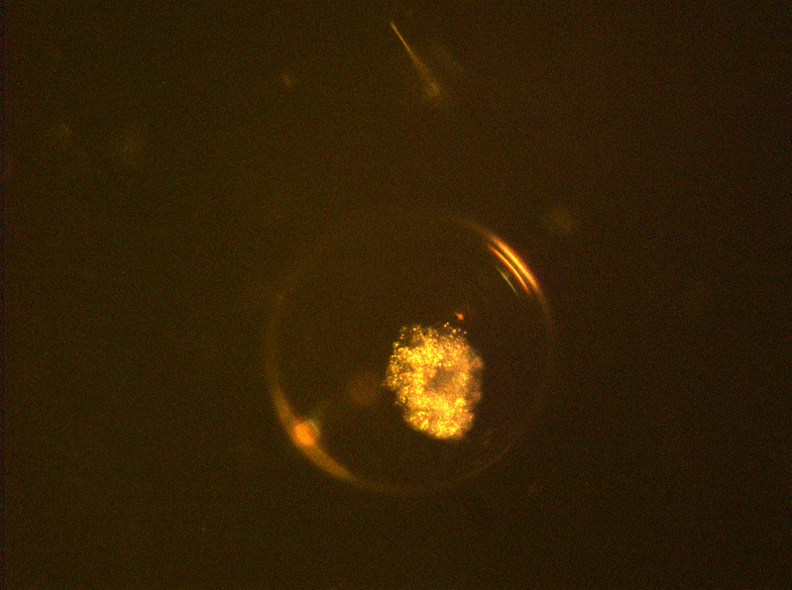
Testbed: color, net tow sample
Fluorescence
Samples courtesy of Julio Harvey
10x objective
1600x1200 pixel, 0.4 um / pixel
Delvie 2422 filter
Color camera: ID pigment group
Multiple cells per slide, each in its own bubble!
White light

Slide 17
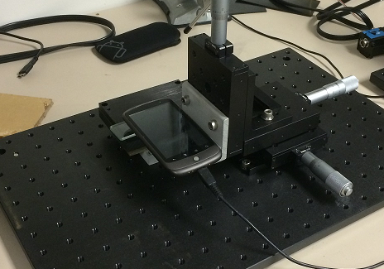
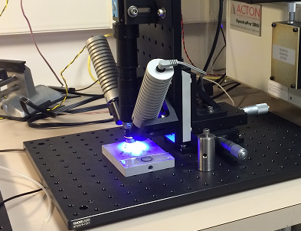
Comparison
microscope components
Includes processing platform
Better camera control
Compact, low power
Access to image trigger signals
Single camera?
Multi-camera architecture
Limited control of camera
Use of microscope objectives
Cell phone obsolescence
Need processor board
“Cell phone level”
Entry level
High end

Slide 18
Next steps
Have some idea
Energy: sensitivity, power, exposure
Architecture
  Software: image processing
  Flow cell design
  Processing platform
Capability ⬄ requirements
  Search for middle ground
  Multidisciplinary team
Running out of time this year
Very important

Slide 19
Bench top test bed
Smart phone microscope

Slide 20
Some emerging mobile instruments
PipeCyte flow cytometer (Swalwell/UW)
  NSF funding (3 years)
Psi-Fi light-sheet imaging cytometer
  Commercial venture underway?
Mobile Imaging Flow Cytobot (Sosik/WHOI)
  Integration with Wave Glider, other mobile platforms
Wave Glider Microscope (JRF)
  MBARI/JRF collaboration project in 2016?

