Slide 1
Integrated acoustic tracking and communication system for multi-platform operations
MBARI Internal Proposals
abstract presentation
2015-07-07

Slide 2
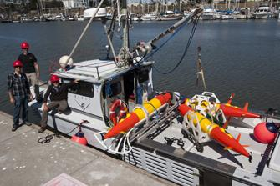
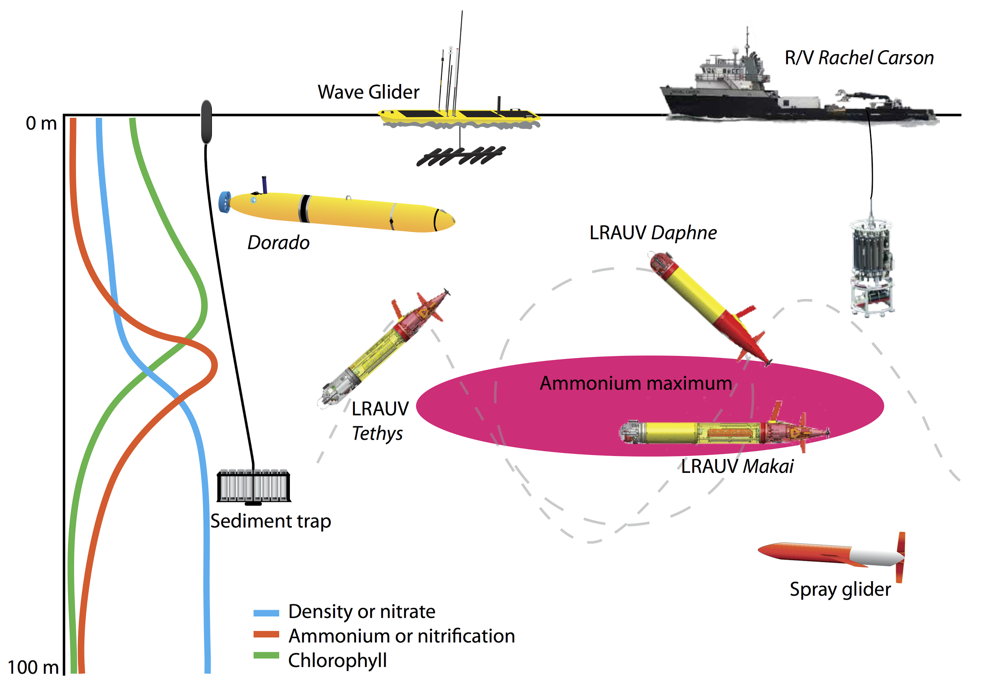
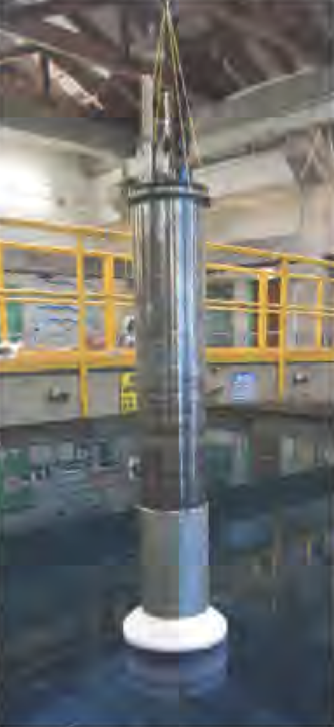
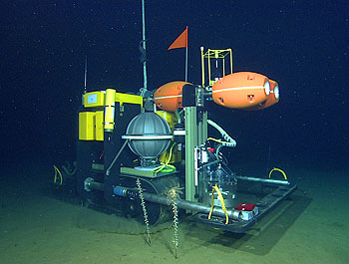
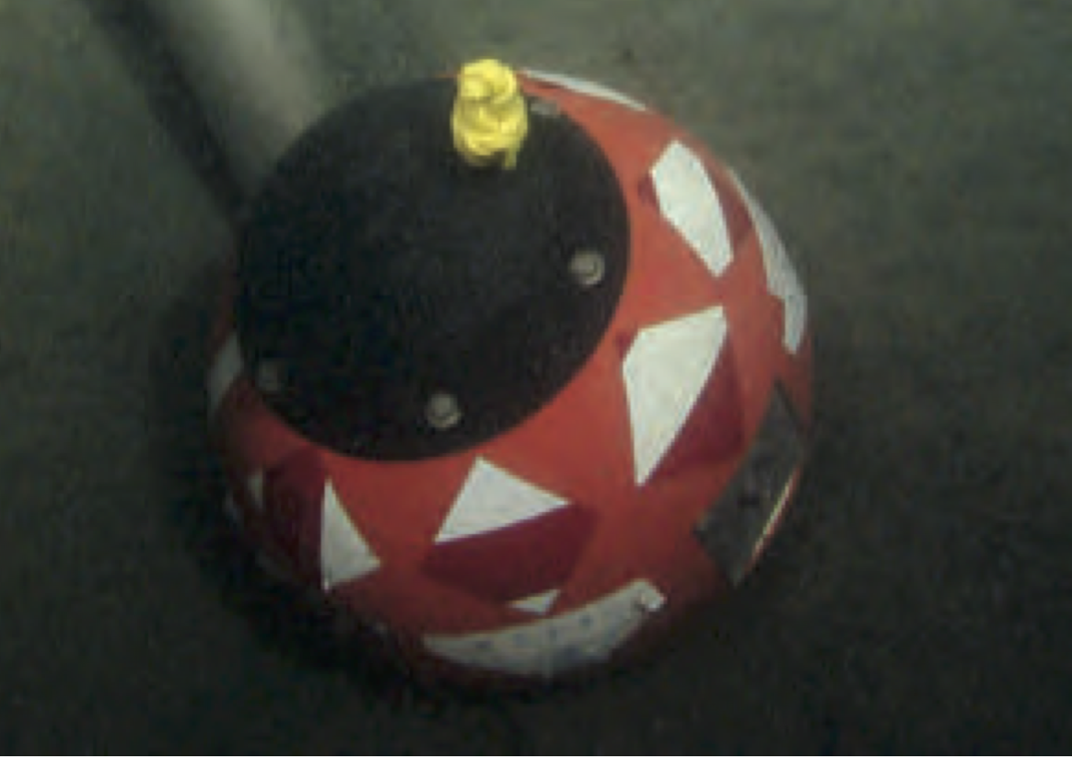
motivation:
coordinated and cooperative operations
CANON Fall 2014 experiment schematic from MBARI 2014 Annual Report at http://www.mbari.org/news/publications/ar/2014ann_rpt.pdf
BEDS & CPF photos from MBARI 2013 Annual Report at http://www.mbari.org/news/publications/ar/2013ann_rpt.pdf
R/V Paragon & Benthic Rover photos from MBARI website at http://www.mbari.org
Notes:
I’m approaching this first from the perspective of CANON with LRAUV and wave glider operations, because that’s where we’ve done some of the work so far.
Our initial basic work has been focused on enabling LRAUVs and wave gliders to track each other using the Benthos DAT USBL.
Complementary extension to HotSpot project.

Slide 3
prerequisite to cooperative operations between autonomous platforms
To effectively execute a cooperative task, team members need:
to know where each other are
to be able to exchange information
Right now we primarily do this through satellite and cellular links on the surface, and often with a human in the loop.

Slide 4
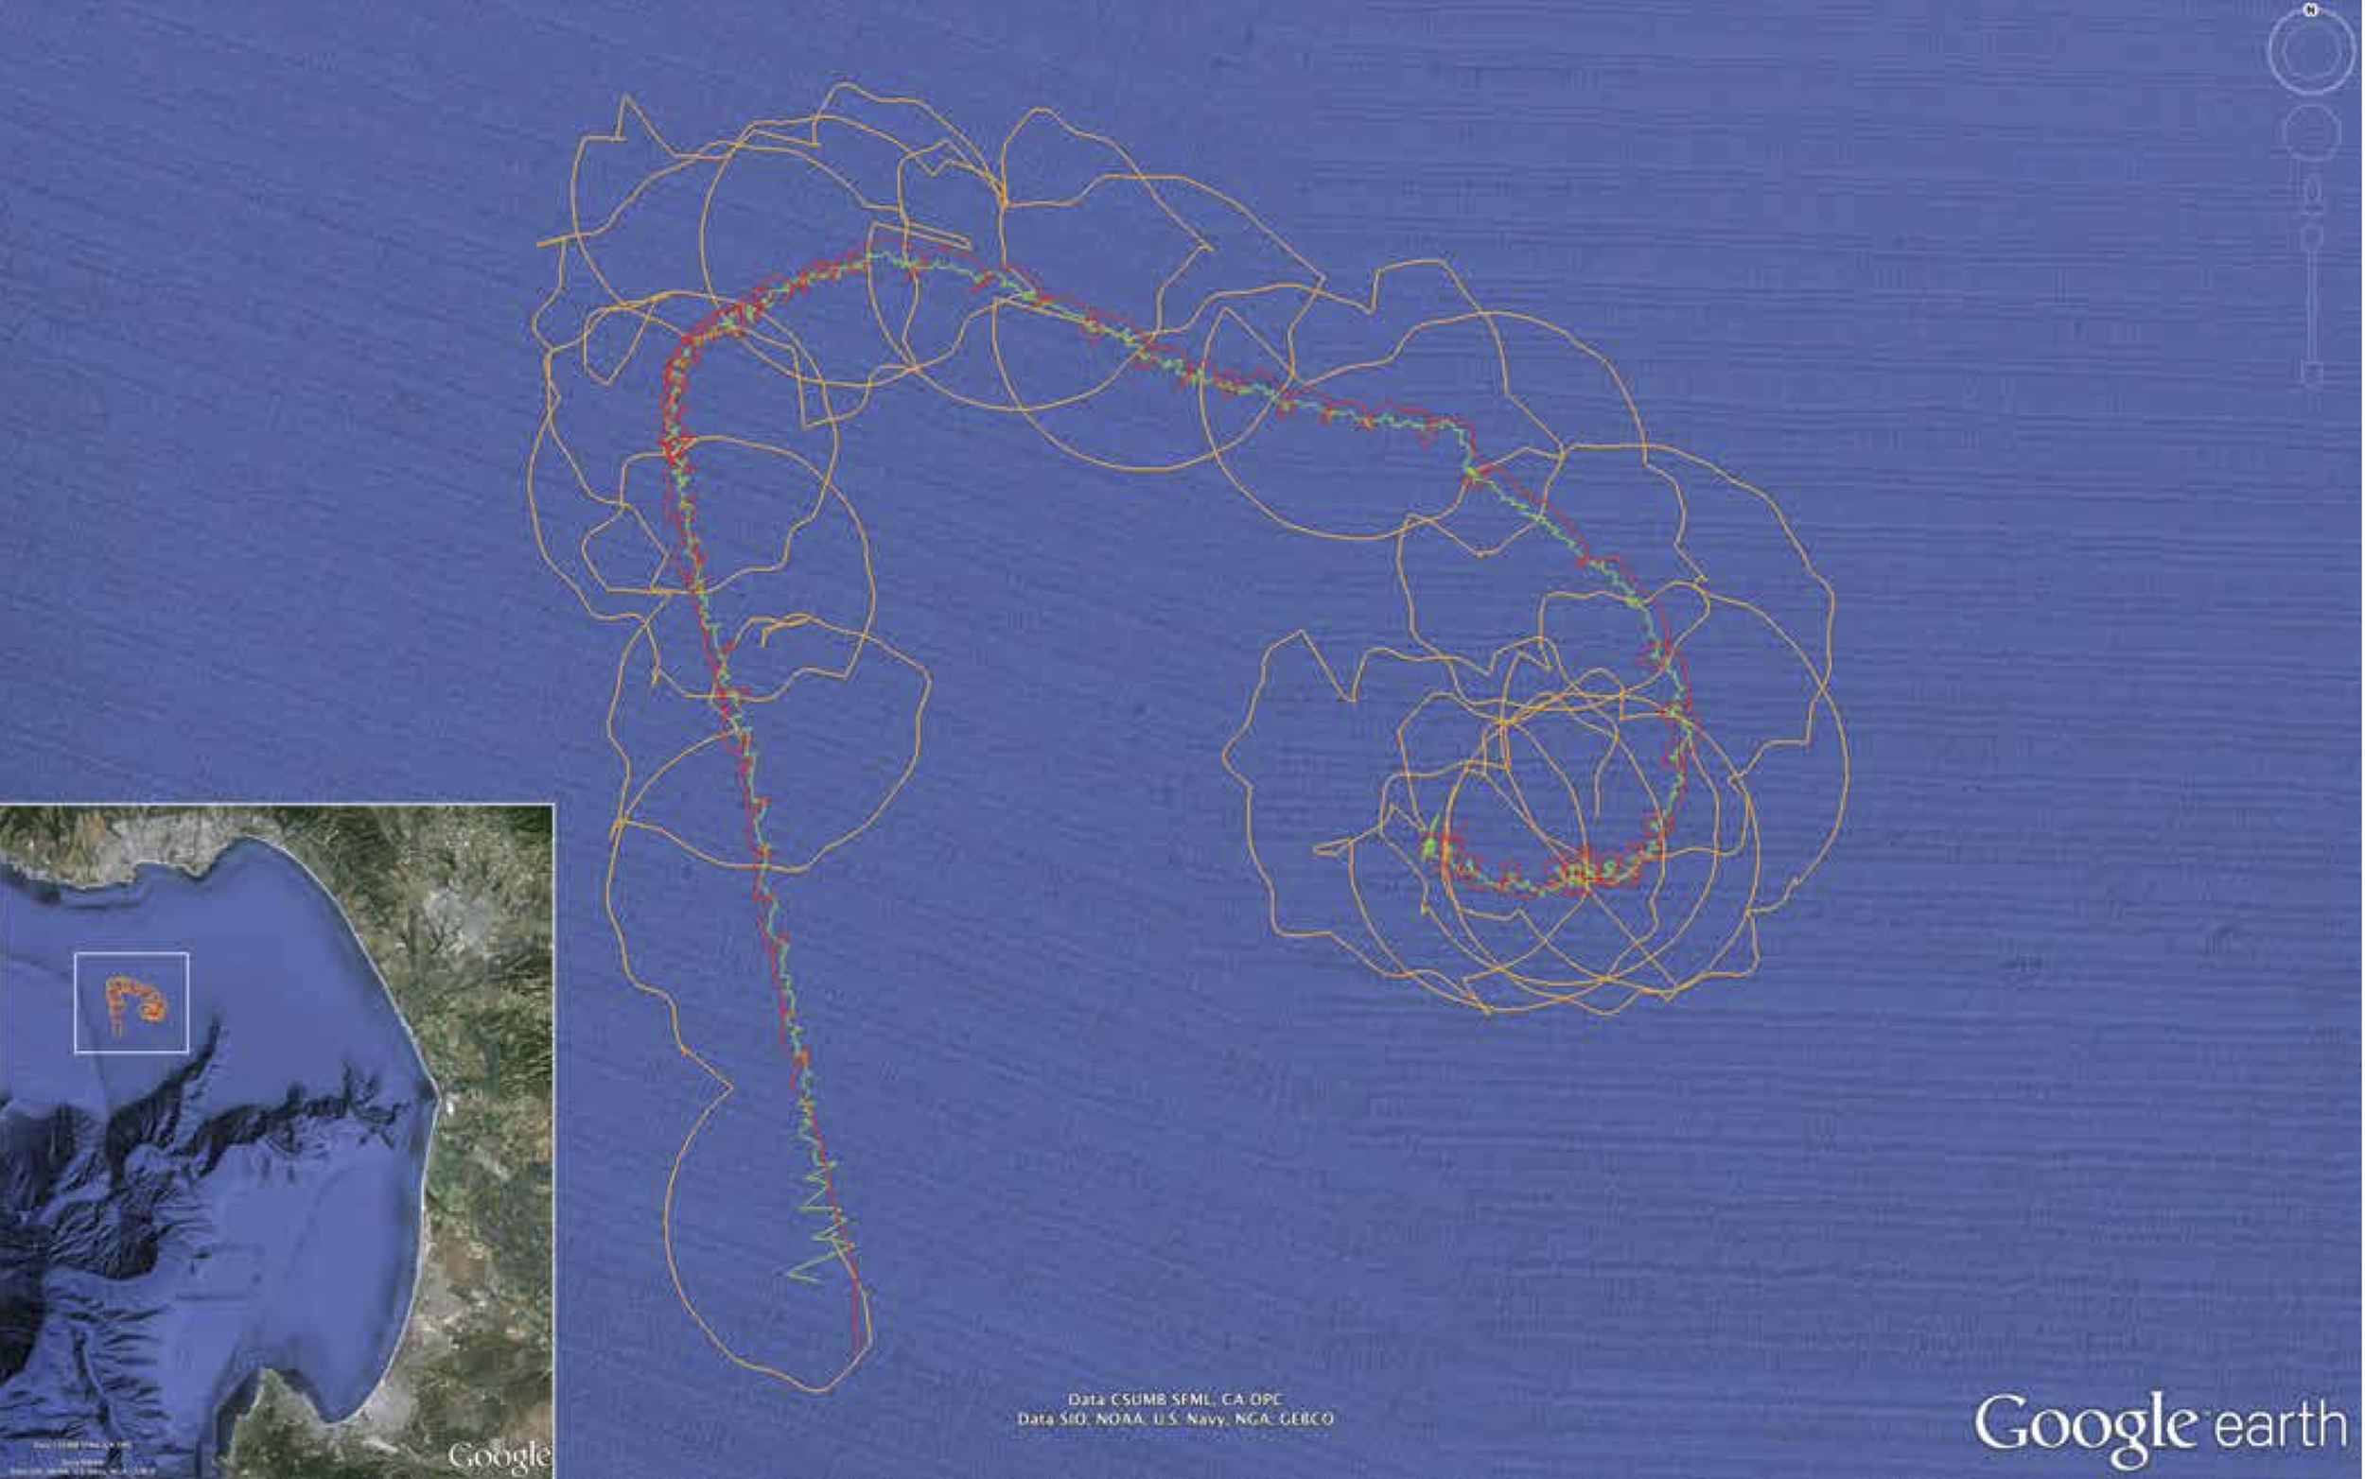
where are we right now?
basic tracking
no real communication
proof-of-concept sensor integration
rewrite software for each platform
We can already do a lot with just what we have.
CANON Fall 2014 experiment illustration from MBARI 2014 Annual Report at http://www.mbari.org/news/publications/ar/2014ann_rpt.pdf

Slide 5
where do we want to be?
Tracking
integrated, portable hardware package
  minimize and calibrate offsets and misalignments between components
  mountable on wave glider, R/V Paragon, surface buoy, etc.
portable software
  stop rewriting basic USBL solution for each platform
  start leveraging more sophisticated approaches and keeping track of uncertainty
Communication
get human out of the loop
leverage existing open-source frameworks where possible
  evaluate gobysoft & DCCL
avoid screen-scraping
  evaluate Benthos MMP
enable other platforms
  evaluate Micromodem
  (users include WHOI, JHU, NPS, U Michigan)

Slide 6
how will we get there?
Hardware
Required:
Benthos MF DAT
dedicated GPS
MEMS IMU (e.g., VectorNav)
embedded computer (e.g., BeagleBone Black)
Desired:
Benthos LF DAT
WHOI Micromodem
chip-scale atomic clock

Slide 7
how will we get there?
Software
Localization toolkit:
Generalize observations required for each solver.
Provide basic USBL and range-only solvers.
Input & output using well-defined open-source middleware (e.g., LCM, ZeroMQ).
Release open-source, then start working on more sophisticated solvers.
Communication toolkit:
Interface description, type specifications, and services to ease working with low-rate, high-latency acoustic channel.
Evaluate gobysoft & DCCL.
May also extend to SBD Iridium communication.

Slide 8
activities in 2016
acquire necessary hardware
design and build integrated package
test integrated package on wave glider
define generalized observations for tracking
demonstrate USBL and range-only solvers
evaluate gobysoft & DCCL
demonstrate vehicle status broadcasts between LRAUV and wave glider

Slide 9
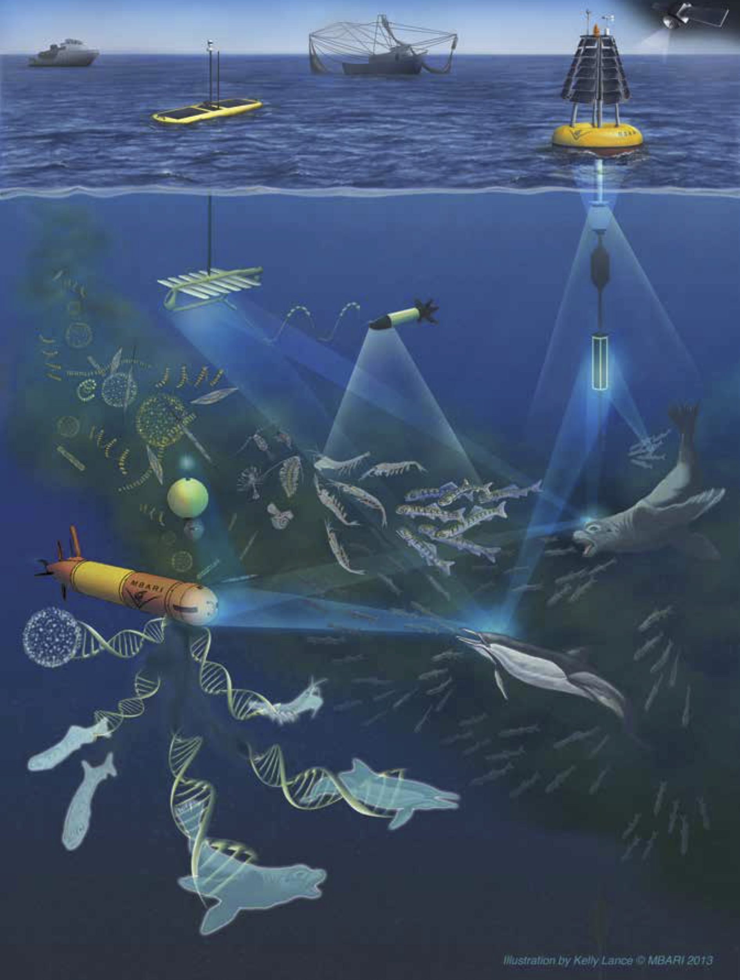
should this be a separate project?
The goal is really to cut across several platforms and projects to provide a key engineering capability to enable marine science at MBARI.
Marine Biodiversity Observation Network illustration from MBARI 2014 Annual Report at http://www.mbari.org/news/publications/ar/2014ann_rpt.pdf
BEDS & CPF photos from MBARI 2013 Annual Report at http://www.mbari.org/news/publications/ar/2013ann_rpt.pdf
R/V Paragon & Benthic Rover photos from MBARI website at http://www.mbari.org

