Slide 1
Park-n-Fly AUV proposal
Project team:
Alana Sherman
Brett Hobson
Hans Thomas
Ken Smith
Crissy Huffard
Kathy Dunlop

Slide 2
Overview
Autonomy from ship-based measurements – key to success of long time-series studies
  Critical goal of ITS
  Two internally funded projects, I2MAP, LRAUV
Existing benthic surveys miss most benthopelagic community – critical component of BBL carbon cycle
  Bioacoustics, best technology to count these fauna
  Wide-swath multi-beam sonars, ideal instruments
Seasonal and event response benthic surveys needed to address spatial/temporal patchiness

Slide 3
Bottom line
A resident AUV that can perform scheduled and event response benthic surveys at 4km depth with yearly servicing is needed.

Slide 4
Table 1. Comparison of existing and proposed AUVs
 | EXISTING |  | PROPOSED
Vehicle | LRAUV | I2MAP | Deep AUV
Depth rating | 300m | 1500m | 4000m
Power Duration | Weeks | Days | Year
Range | 1000km | 100km | 100km
Sensors | CTD, O₂, Fluorometer | CTD, O₂, Fluorometer | CTD, O₂, Transmissometer
Camera system | Under development | Video w/lights | Still w/strobes
Acoustic backscatter | Under development | EK15 | Multibeam (200kHz)
Total onboard energy | 6kwhr(rech)/ 11kwhr(primary) | 10kwhr | 20kwhr

Slide 5
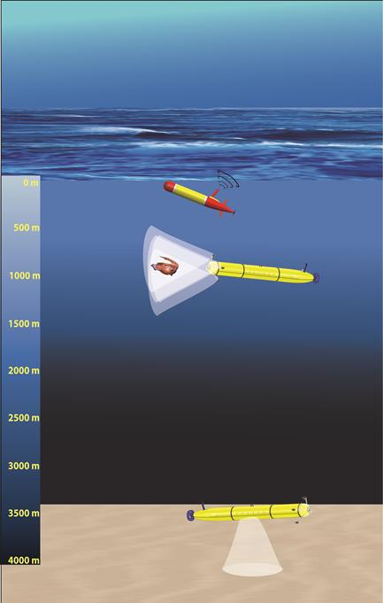
Figure 1. Existing and proposed AUVs

Slide 6
Proposed capabilities of Park-n-Fly AUV
Working depth to 4000 m for 1 yr deployments
Bottom photo-transect period (48 hrs over 12 mo) seasonal plus event triggered transects (SES)
Benthopelagic acoustic backscatter transect period (concurrent with photo-transects)
Record CTD/O₂ data on each transect
Park and sleep on sea floor
Communicate with shore (Wave Glider Acoustic gateway)
Emergency scuttling (float drop-park on seafloor)

Slide 7
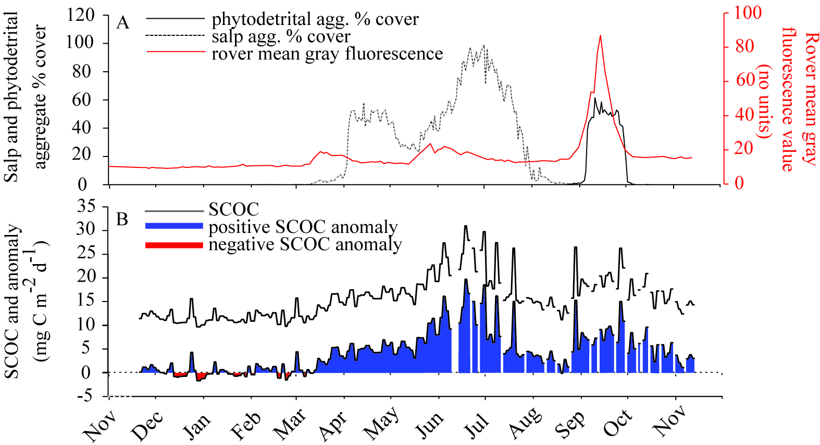
Scientific Justification
26-year time series at Sta. M reveal significant daily to weekly changes in benthic community and environment.
2011
2012

Slide 8
Why is a mobile platform needed?
Seasonal or event triggered surveys not feasible using ship-based facilities
Ecological patchiness at scale of 10 m -1 km, require survey coverage not feasible with stationary assets
System flexibility, modify frequency vs spatial coverage

Slide 9
Proposed development
Slightly modified Dorado AUV
New Rechargeable battery packs w/ shutdown feature
Existing Downward-looking still camera/strobe system
  Existing VARS analyses, processing
Existing Downward-looking multi-beam sonar
  Echoview analyses, processing
Inertial navigation system or acoustic baseline (running same trajectory for each transect)

Slide 10
Proposed development
Existing Wave Glider acoustic gateway for comms (status reports, triggering)
Event triggering of surveys from SES
Mechanical docking to anchored riser
Acoustic homing to riser (existing USBL and controllers from AUV docking)
Emergency anchoring watchdog system with float release (faults while not docked result in parking on seafloor, requiring ROV recovery)

Slide 11
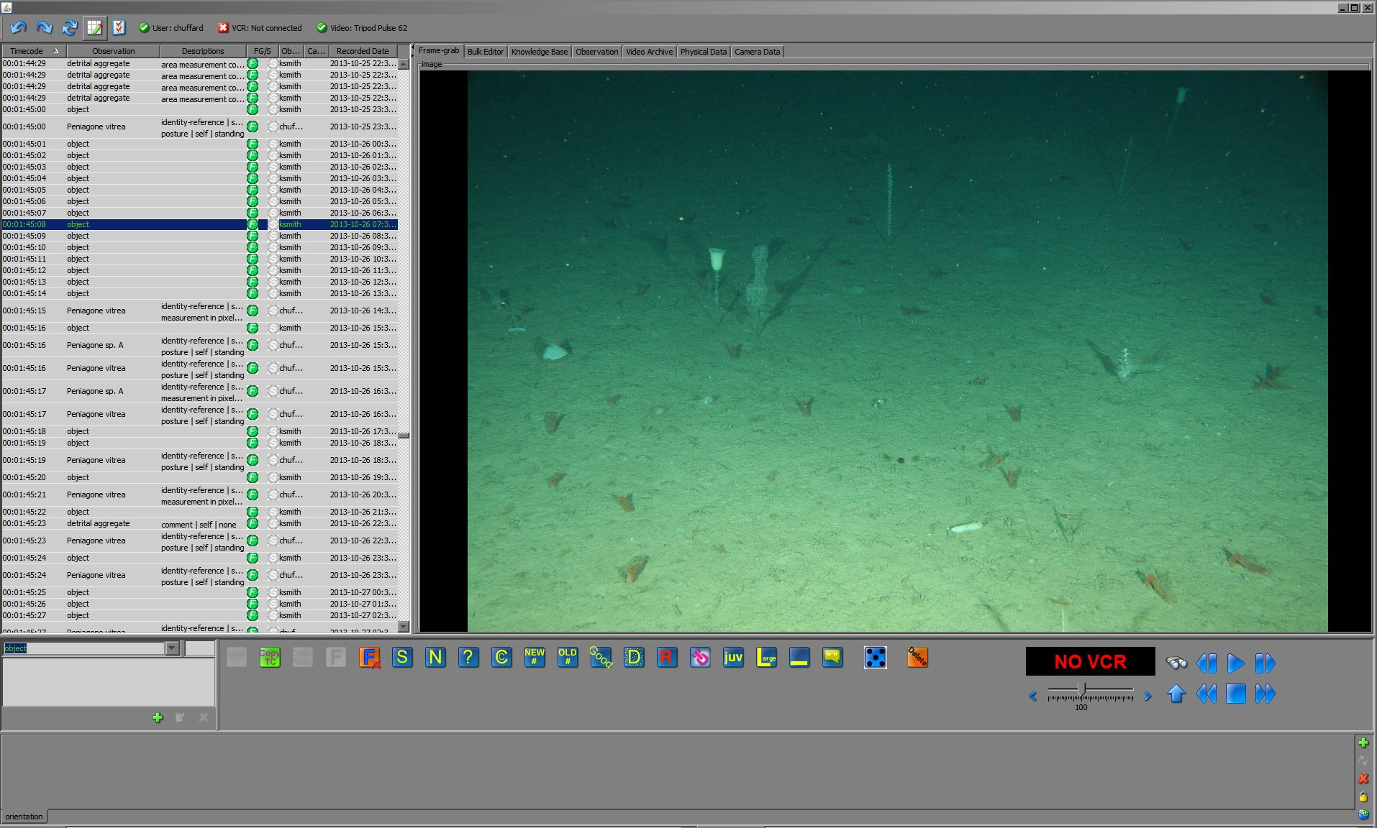
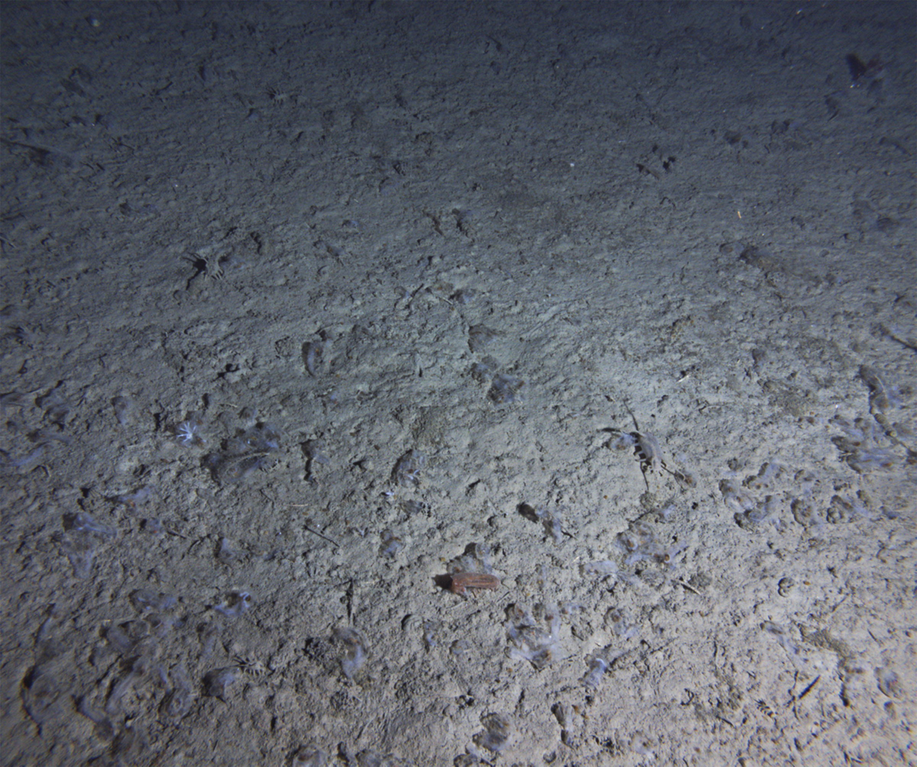
Data products and analysis:
Transect photo images
Use VARS to measure:
Detrital aggregate area
Animal identification
Animal size
Animal density
Annotation:
Work toward automation
Subsample for now
Create library for machine
Learning (Video TAG)
Screenshot of VARS used to annotate benthic images

Slide 12
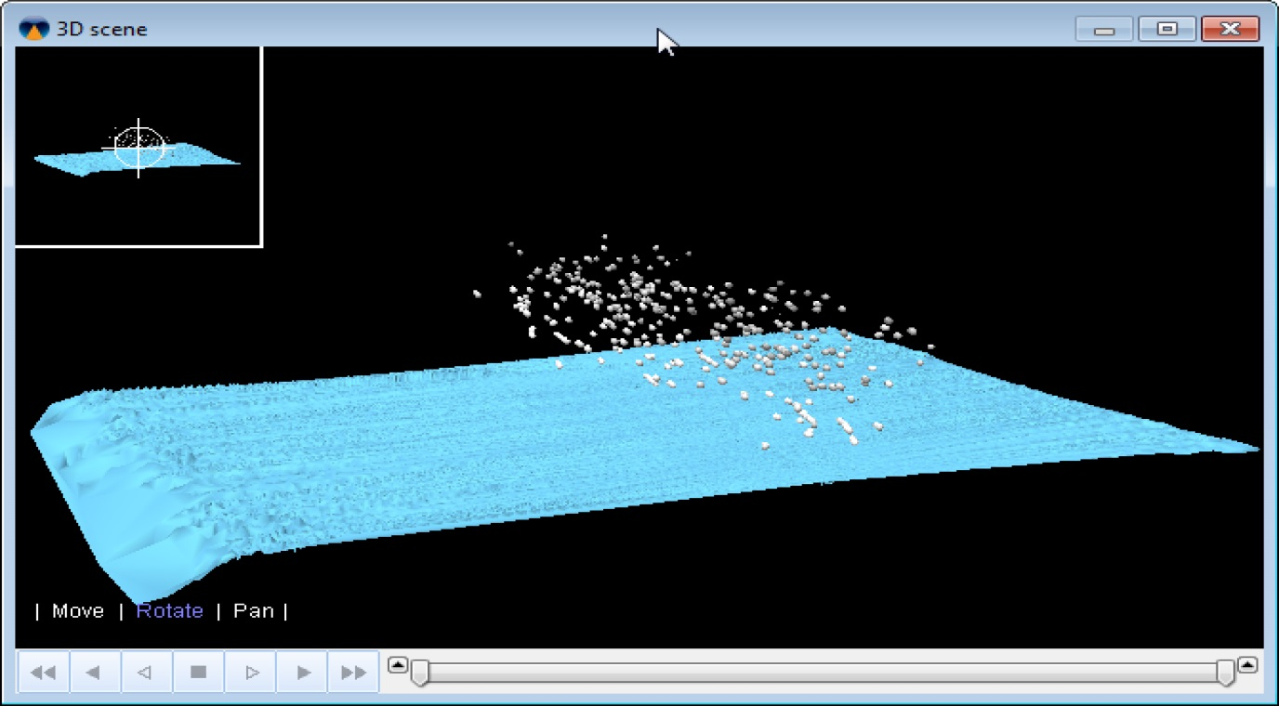
Data products and analysis:
Backscatter
Echoview plot of backscatter data from Reson Multi-beam data in Monterey Canyon- ~900m, near MARS. Resolution capable of detecting targets in 10-100 cm size range. This image shows targets 20-50 m above bottom, across a 300 m swath.

Slide 13
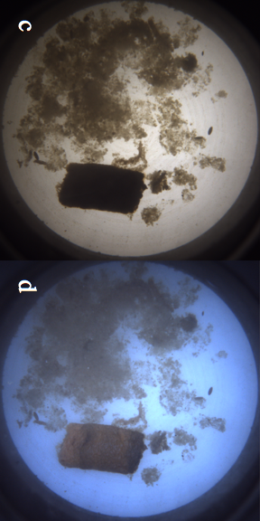
Event triggering by SES
A
Sampling frequency every 4 hr
B

Slide 14
Proposed Schedule
2016:
Calibrate Reson T-20 system, then collect and analyze bio-acoustic data
Demonstrate AUV hibernation features in lab
Identify modifications needed to use Iceberg AUV in demonstration
2017:
Detailed design of AUV
Either modify Iceberg AUV or integrate new platform from in-house and new components
Develop and demonstrate docking capability
Deploy Iceberg AUV at Sta. M during a Pelagic-Benthic cruise to collect a test dataset (optical and acoustic)
2018:
MARS test deployment
Station M deployment Oct/November

Slide 15
Relevance to MBARI
Strategic Plan: Ecosystem dynamics – We are the only research group making long time-series measurements of carbon flux to the abyssal sea floor and its utilization by the benthic community, and by subtraction estimating carbon sequestration. A specific example is the salp bloom study we published in 2014 (L&O 59:745-757).
Technology Roadmap: Problem statement #6 relating water column conditions and variability to the abundance, distribution and activity of organisms. Our time-series research also addresses Problem statement #8, providing insights into the future ocean. Additionally, our collaboration with the integrated time series (ITS) project forms an essential role addressing Problem statement #3 in advancing a detailed quantitative view of the biological pump.

