Slide 1
Jupiter Research Foundation/MBARI collaboration: a feasibility study

Slide 2
‘Informal’ collaboration with JRF: 2014-2015
WG microscope design and applications
  Engineering: image quality, fluorescence detection, flow system (Klimov)
  Science: CANON deployments, cell cultures, image evaluation, suggested improvements to optics, sampling system, applications (Chavez, Scholin, Vrijenhoek labs)
  Interaction led to substantial improvement in microscope from 2014 to 2015
Wave Glider deployment, operation, recovery (Kieft)

Slide 3

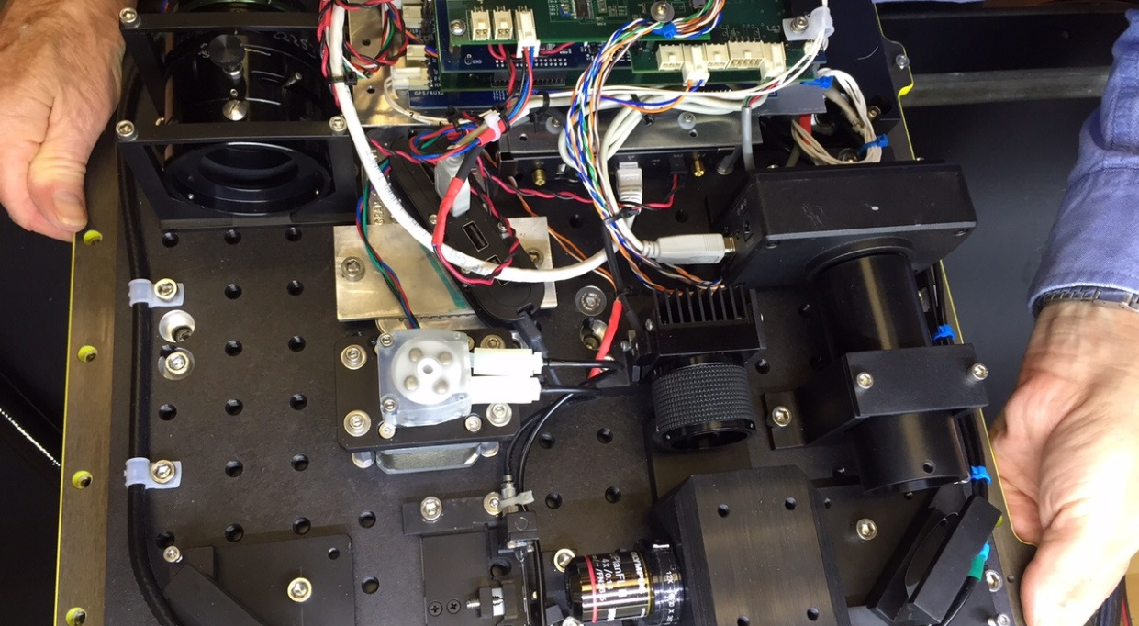
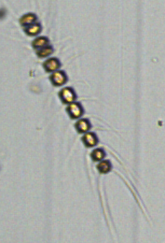
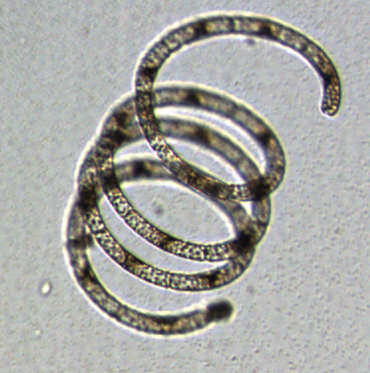

JRF Wave Glider Microscope
Fits in SV2 float payload box, <10 W avg power
Sample pumped from near-surface to flow cell, 1 image/10 sec
2.5 μm resolution, up to 140 μm
Images telemetered, displayed on www within minutes
Notes:
Images of slightly lower quality than commercial units but none integrated into wave glider

Slide 4
What does JRF want
Develop an instrument that has real world application
Work with an institution that can help them prove that the instrument provides quantitative information that is of useful for scientific and management (HAB) purposes

Slide 5
Collaborations
Wave Glider microscope
  Calibration/validation
  Improved optics
  Improved sampling statistics (volume/time)
  Fluorescence capability
  Image analysis (particle statistics, identification)
  Synergy with Cytometer Technology for Autonomous Platforms (901303)
Wave Glider operations
Joint experiments
Engineering challenges (i.e. subsurface sampling)

Slide 6
Feasibility
Explore how the two institutions can “formally” collaborate (CRADA, who does what, etc.)
Use the microscope as a test case
Small level of resources
Chris Scholin and Joe Rizzi to have lunch on Thursday to discuss

Slide 7
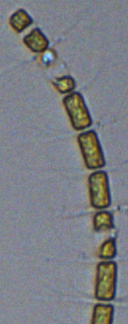
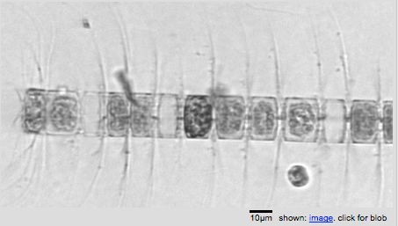
Image comparisons
WG Microscope: 1.3 micron/pixel
Flowcam: 0.55 micron/pixel
IFCB: 0.32 micron/pixel

Slide 8
Image comparisons
IFCB
FlowCam
WG microscope

Slide 9
Image comparisons
IFCB
FlowCam
WG Microscope

