Slide 1
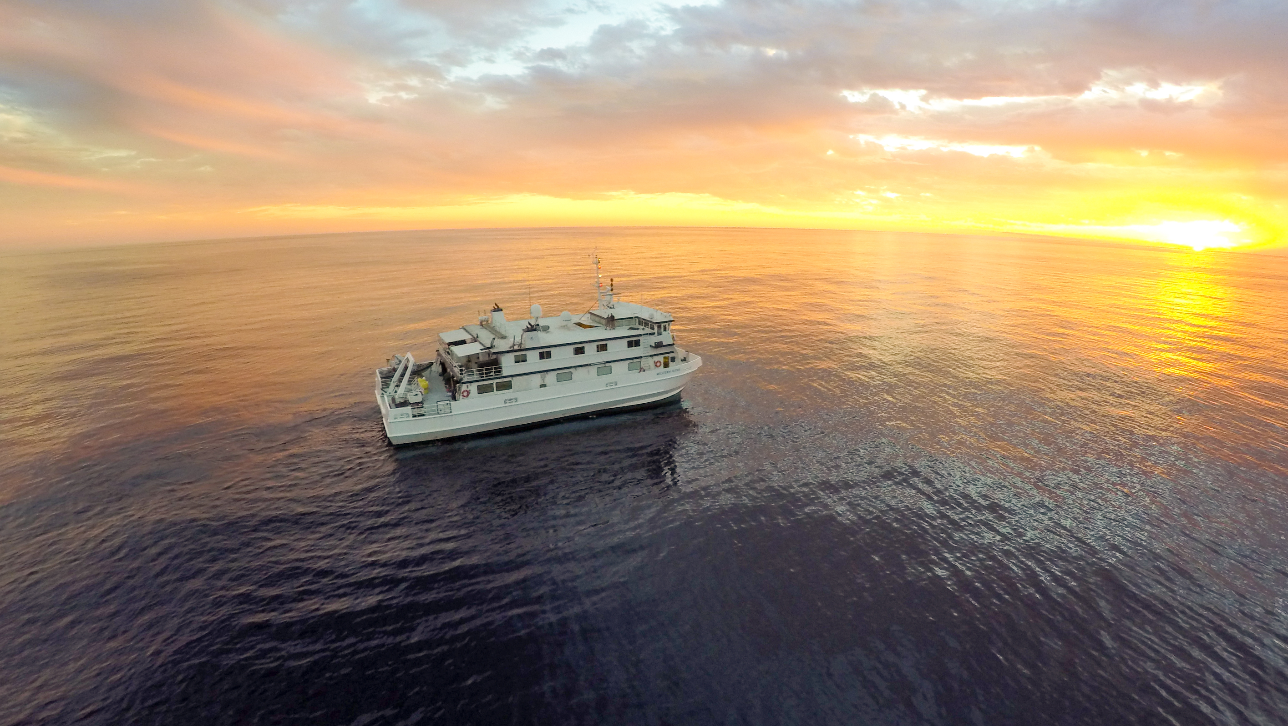
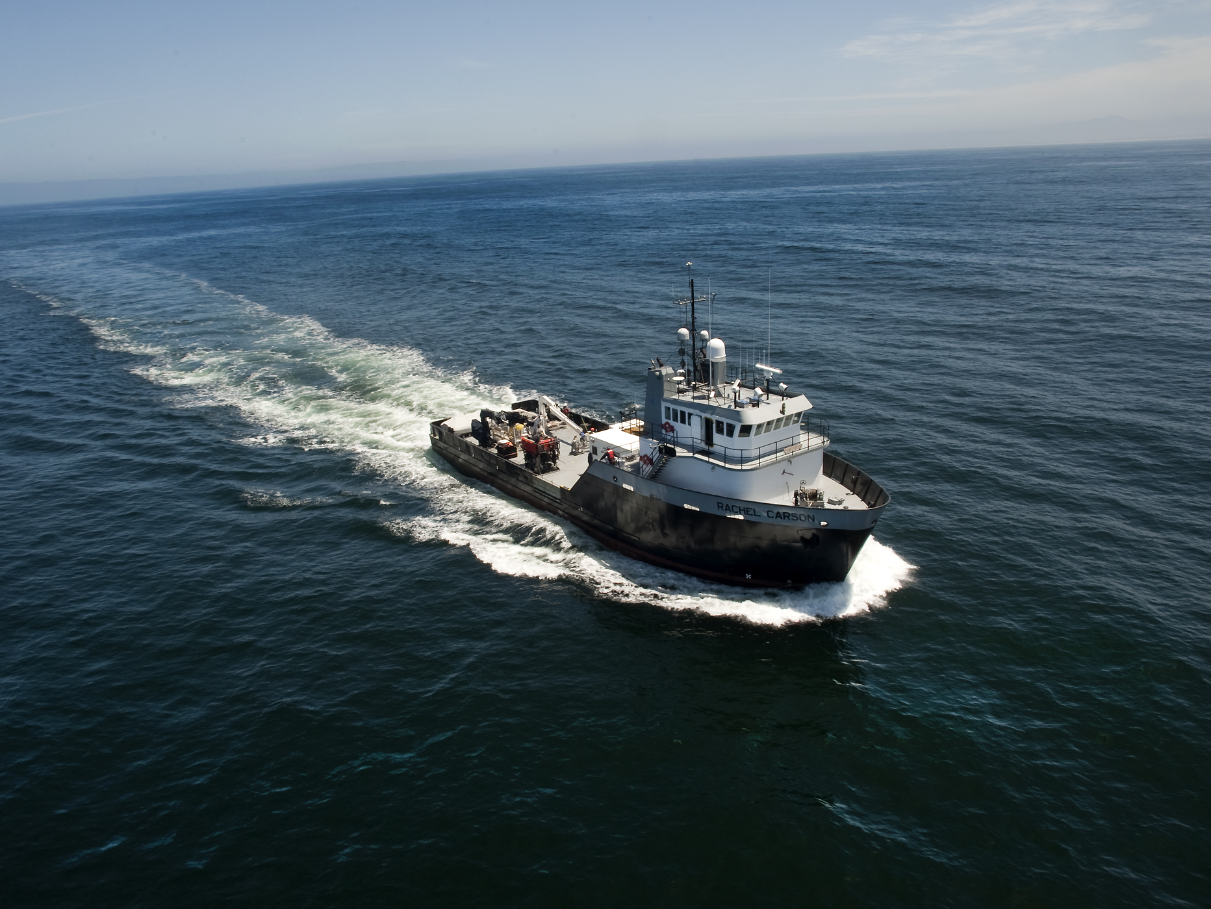
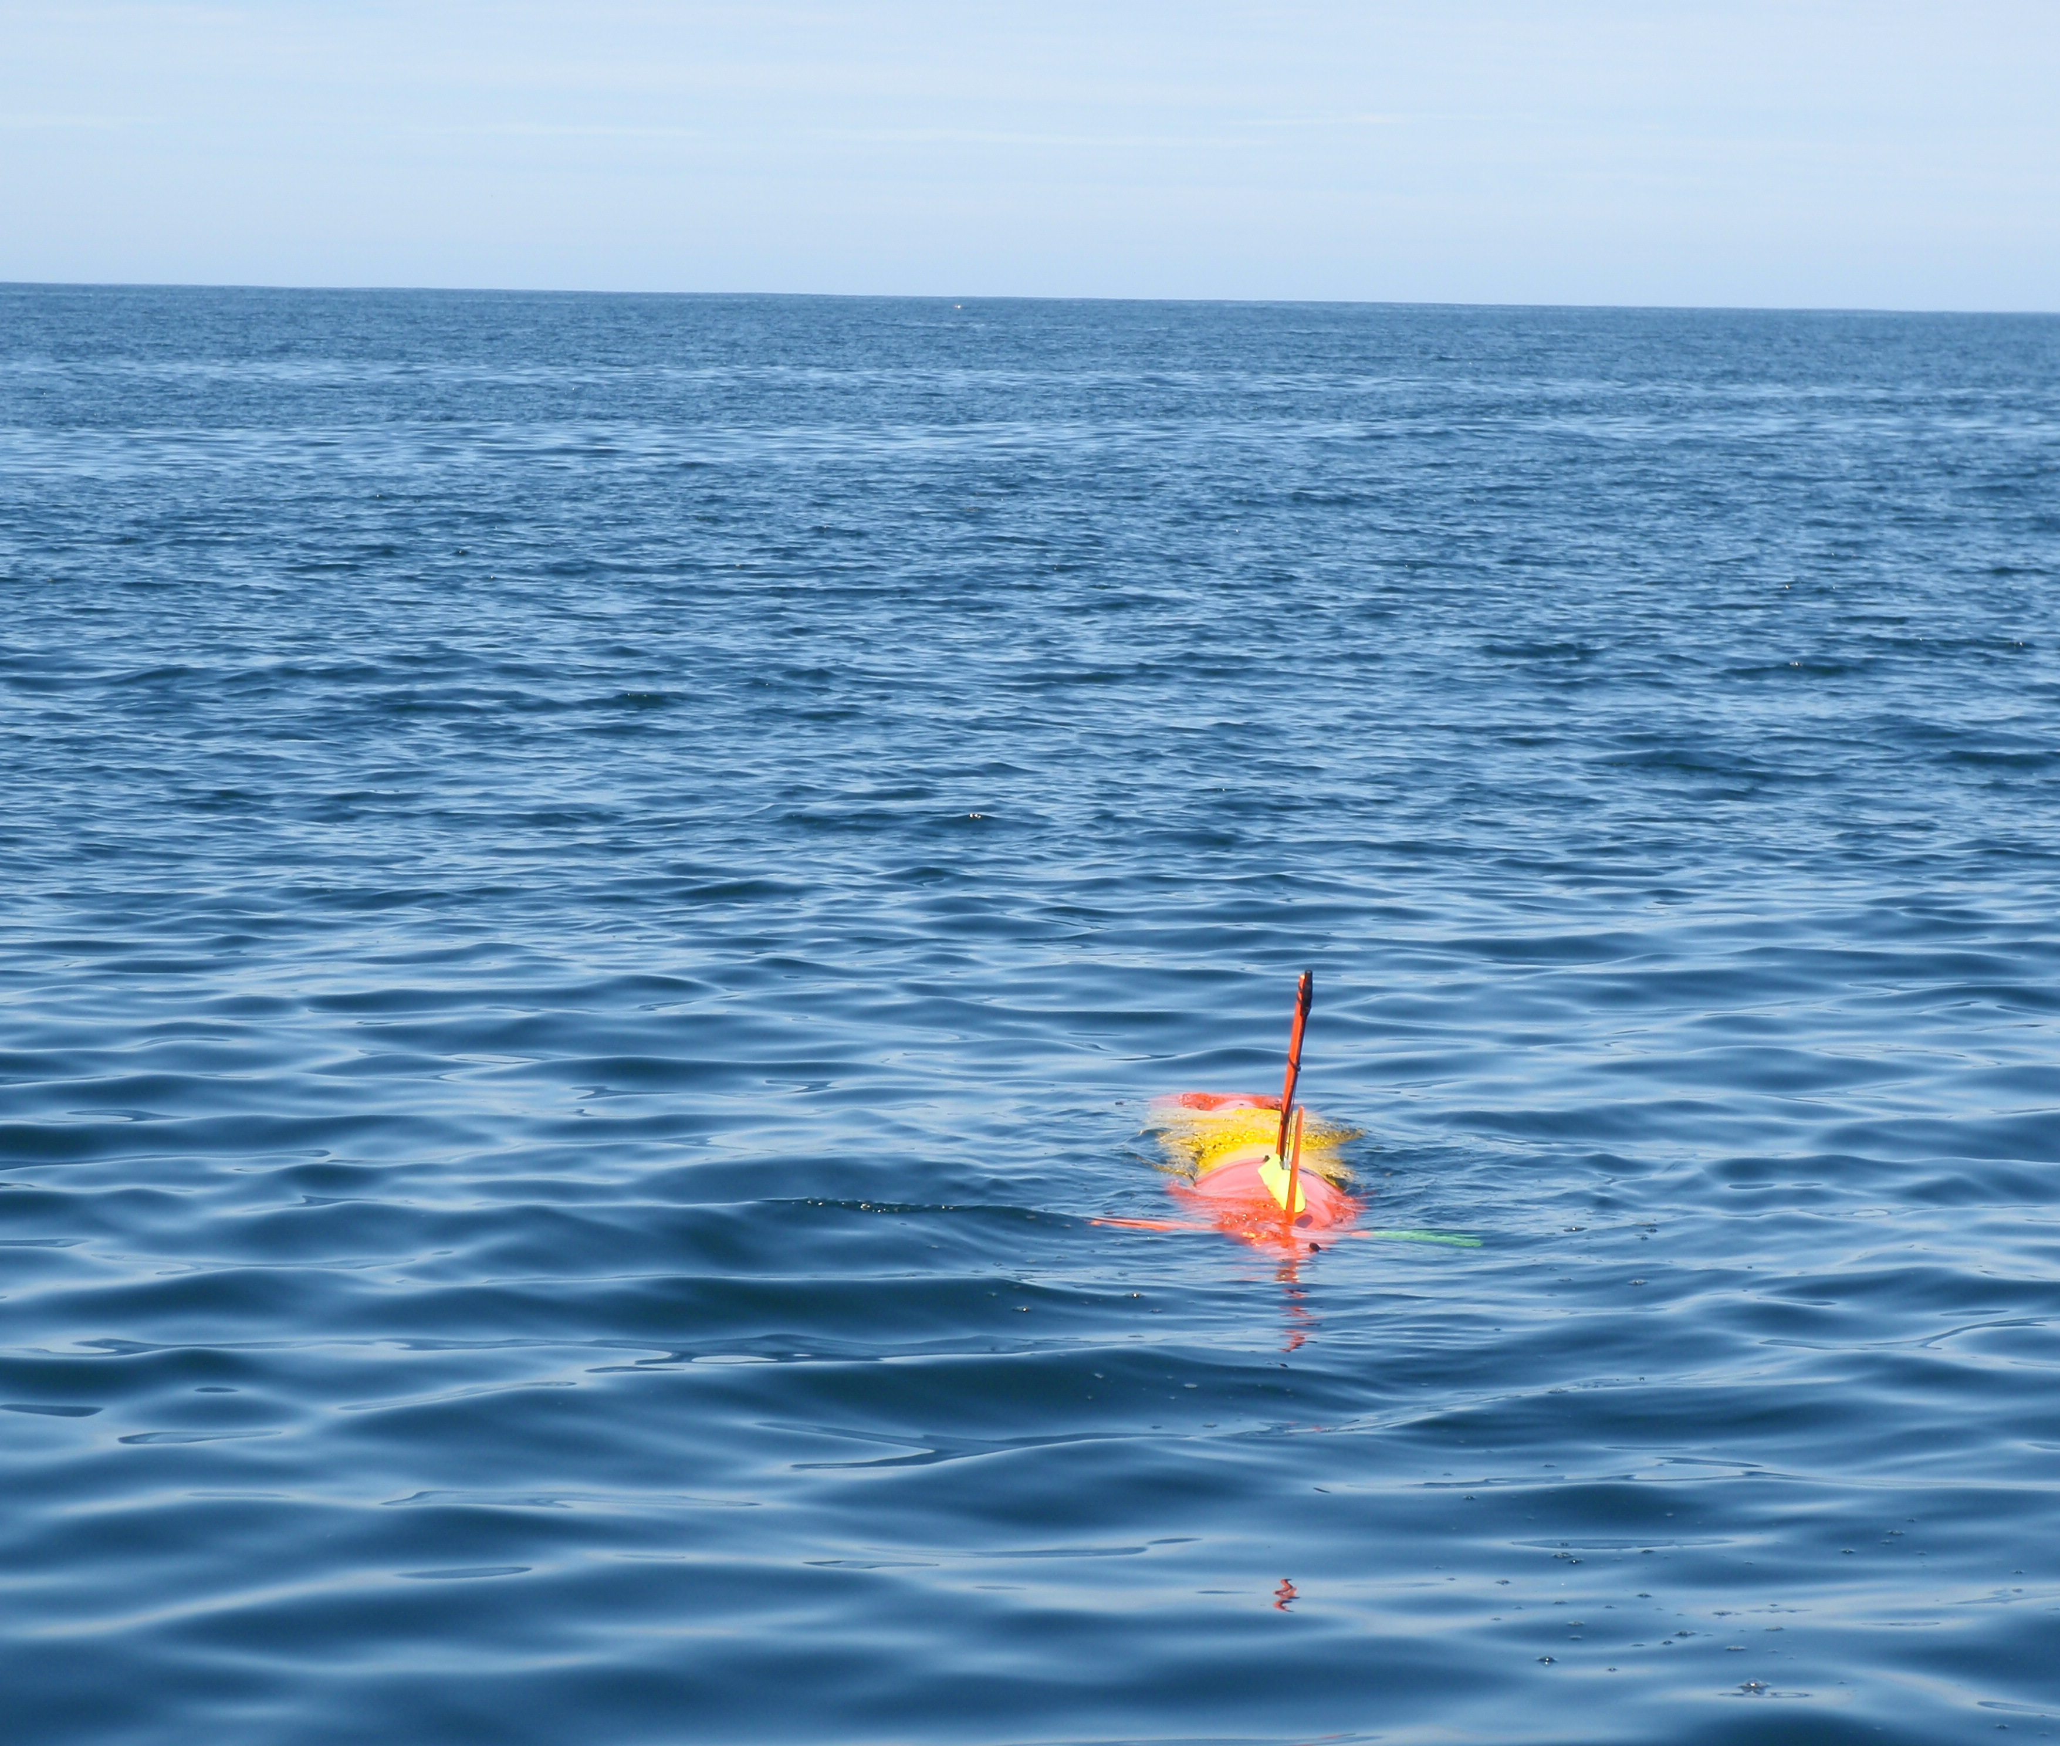
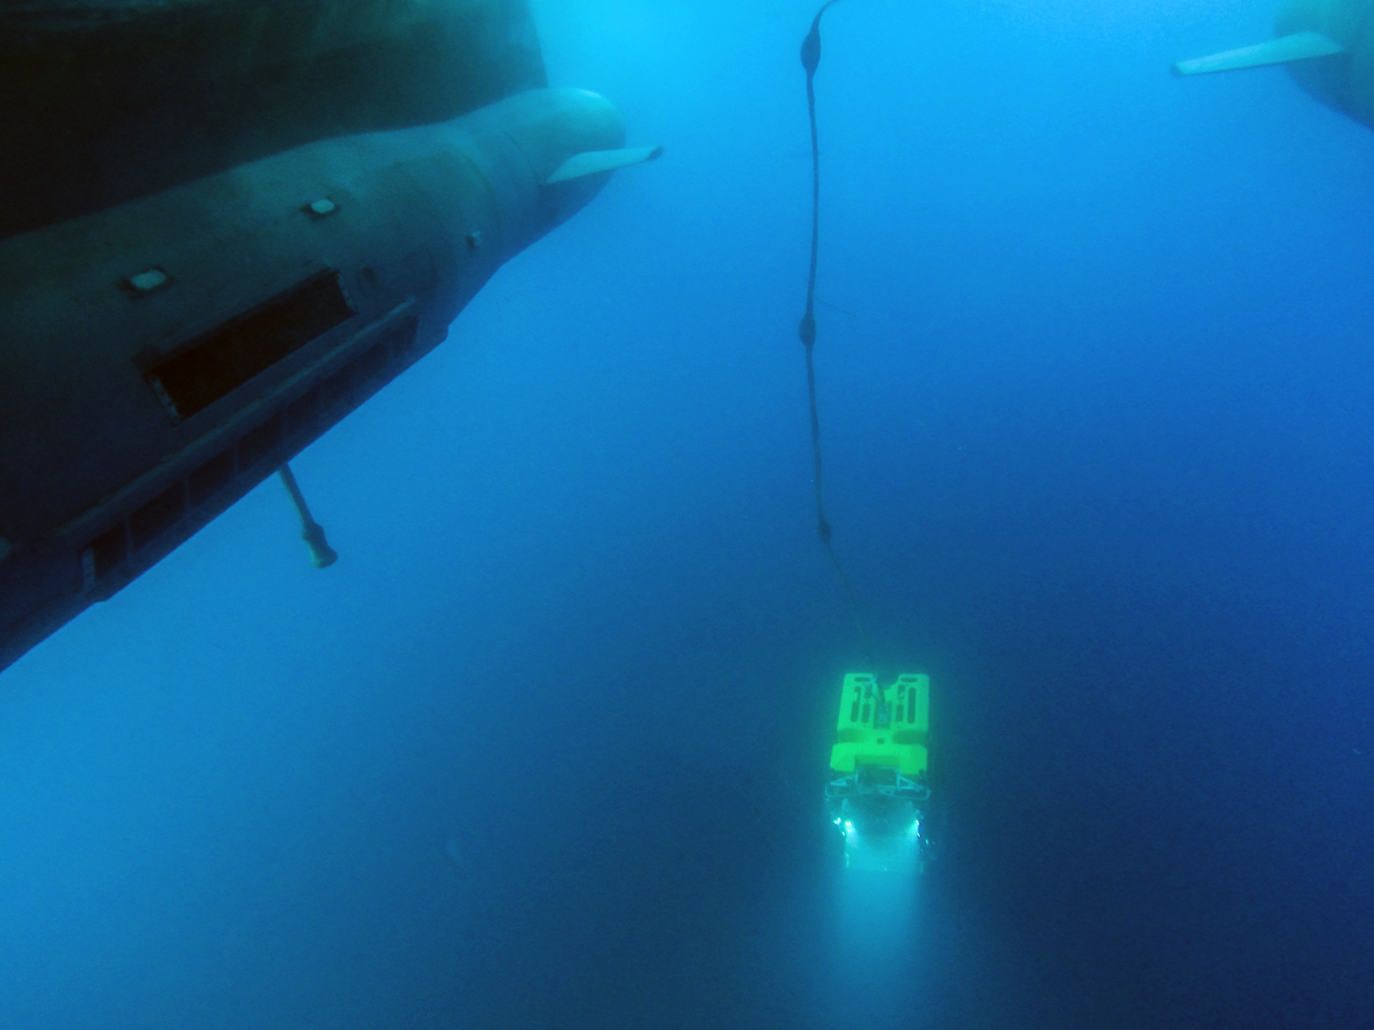
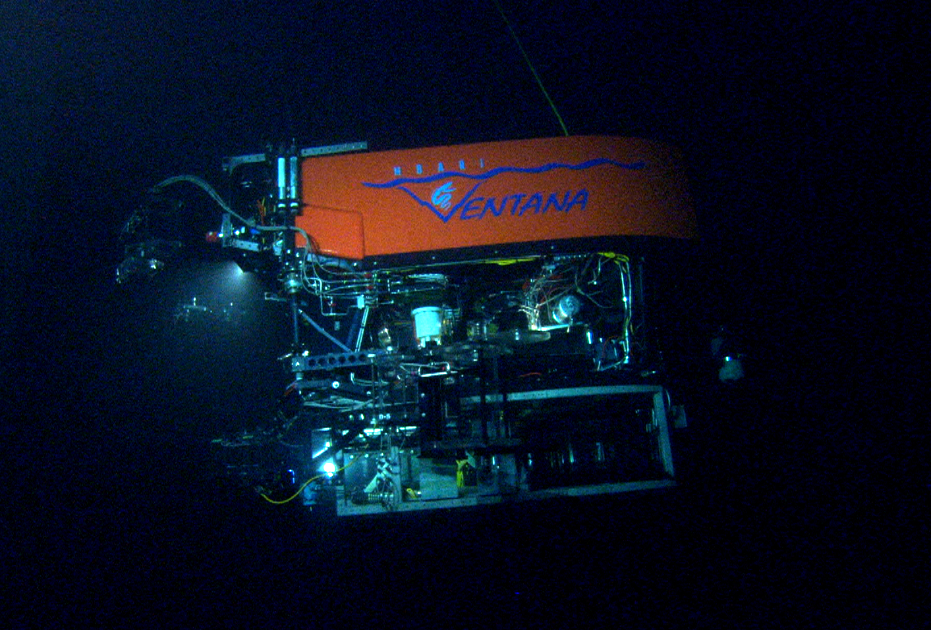
Advancing Outreach at MBARI
2019 MBARI Project Proposal
PI: Heidi Cullen
Project Manager: Susan von Thun
Lead Scientist: George Matsumoto
Lead Engineer: Dave French

Slide 2

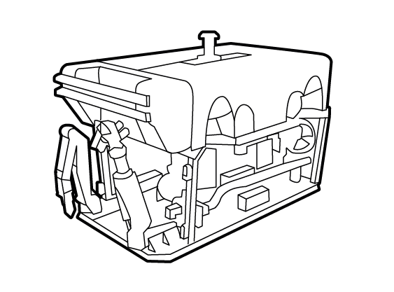
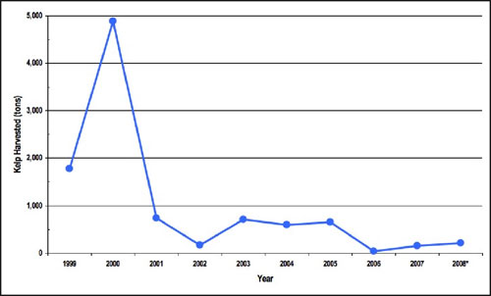

Advancing Outreach at MBARI
The Challenge
The Tech
The Data
The Impact
What’s the grand challenge this work addresses? Why should we care? What makes this work relevant to MBARI?
What engineering & technology is needed to move forward (sensor, platform, ship, de novo R&D)?
What’s the impact? Who are the consumers of the instruments, methods, technology, and data that will be generated?
What data will be generated? How will they be managed?

Slide 3
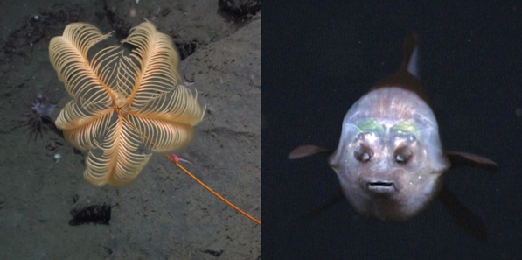
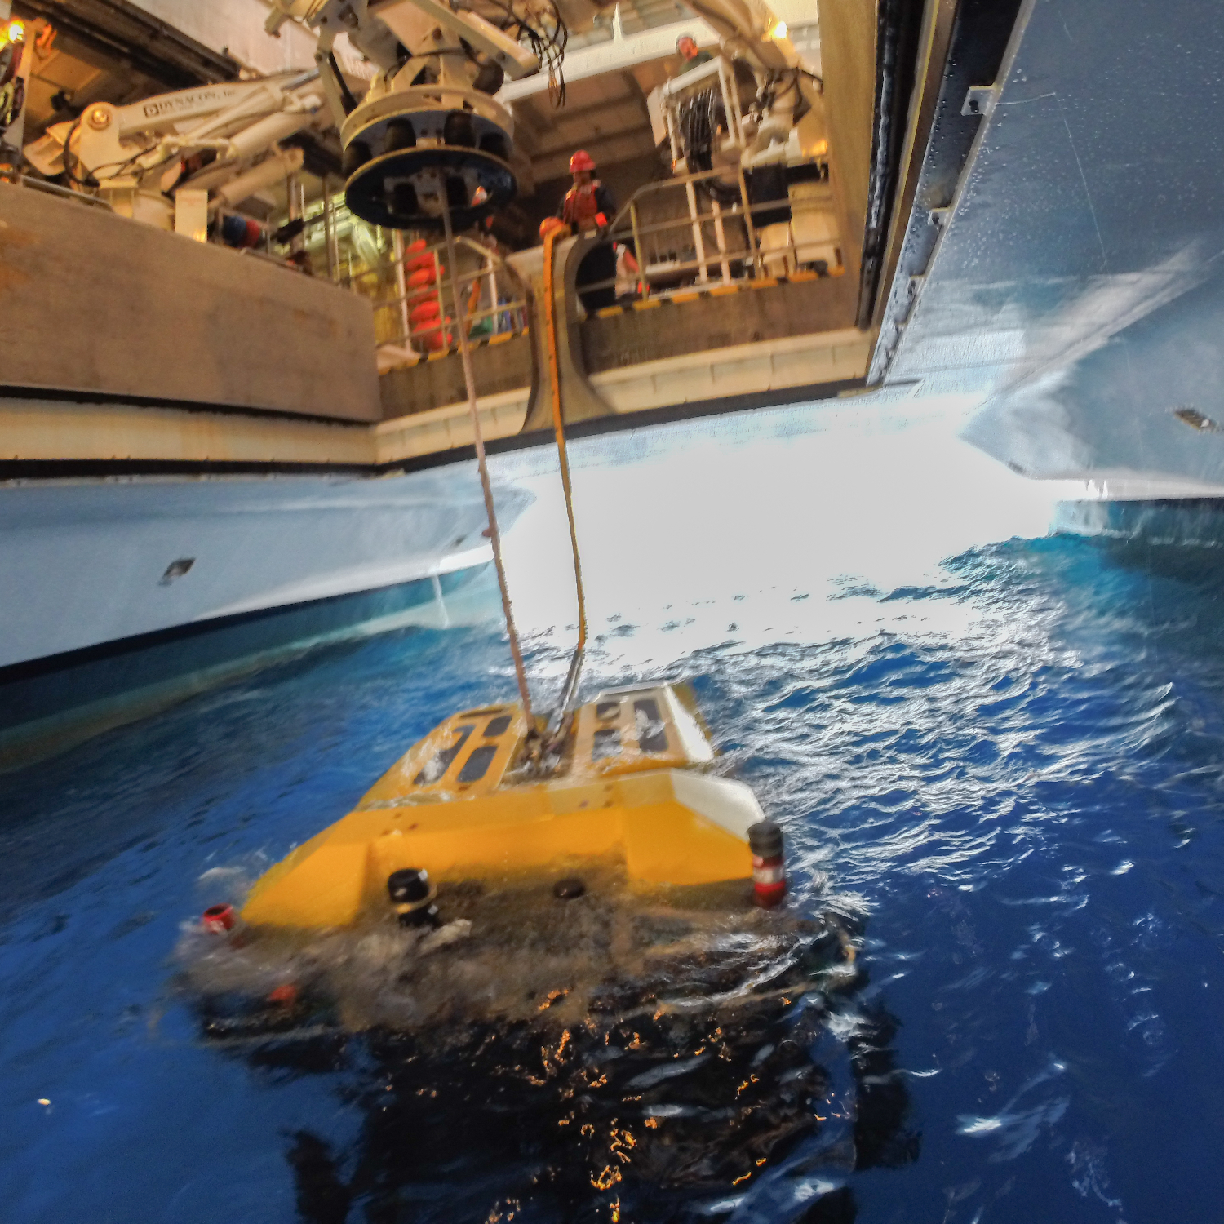
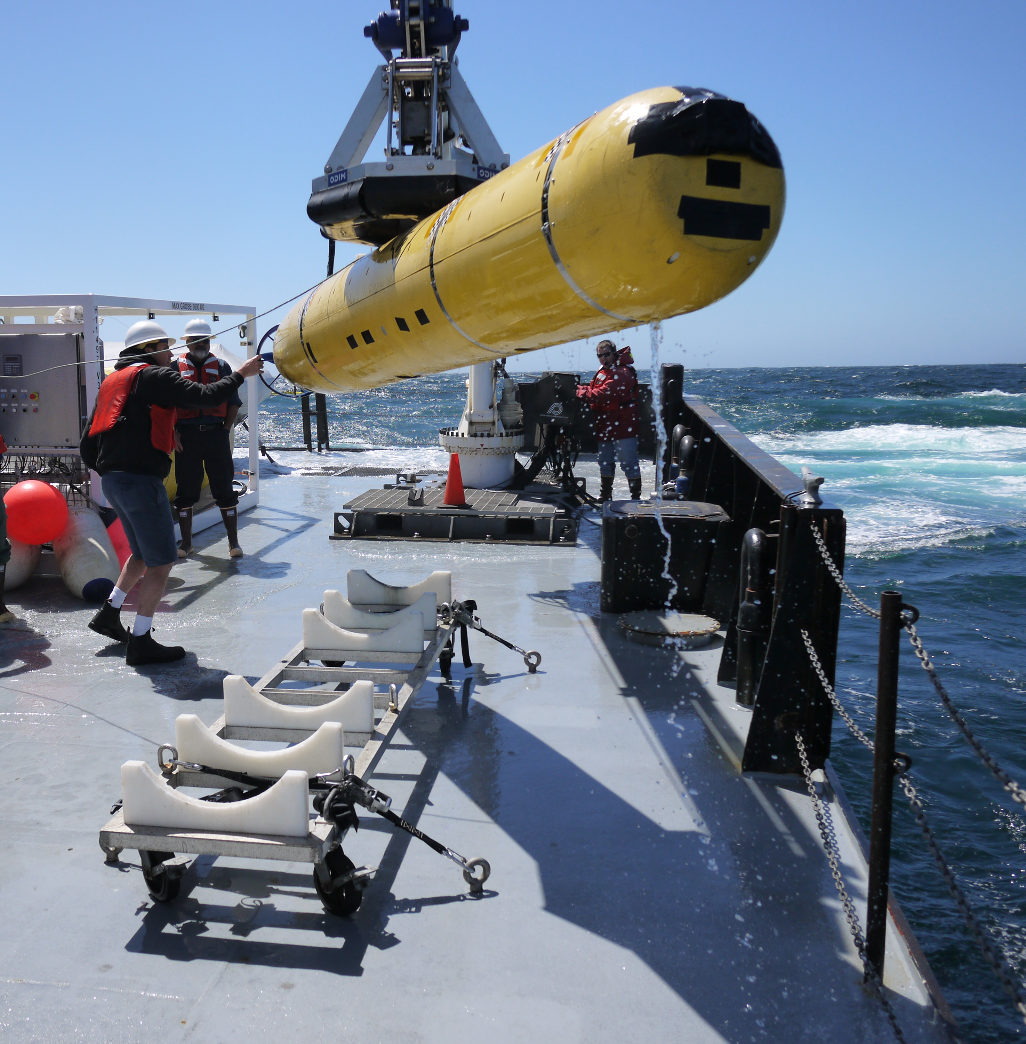
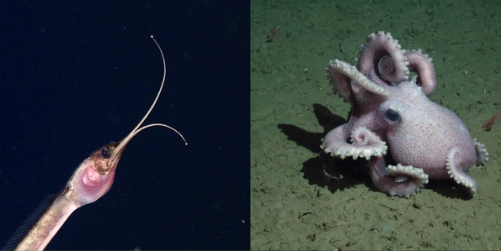
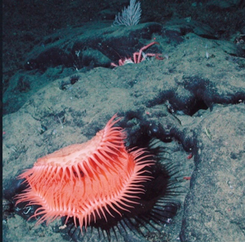
Advancing Outreach at MBARI
Strategically develop content highlighting MBARI’s expertise
Showcase technology and science talent
Powerfully articulate the unique partnership between MBARI and MBA
Reclaim MBARI’s role as a leader in cutting-edge ocean imagery
The Challenge

Slide 4
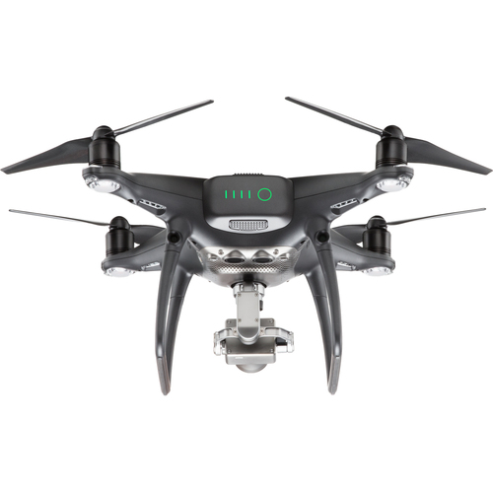
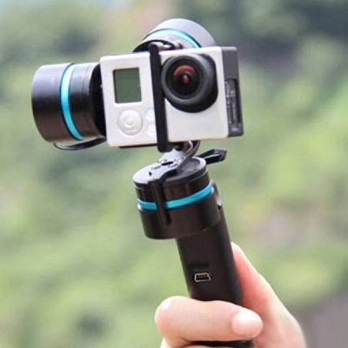
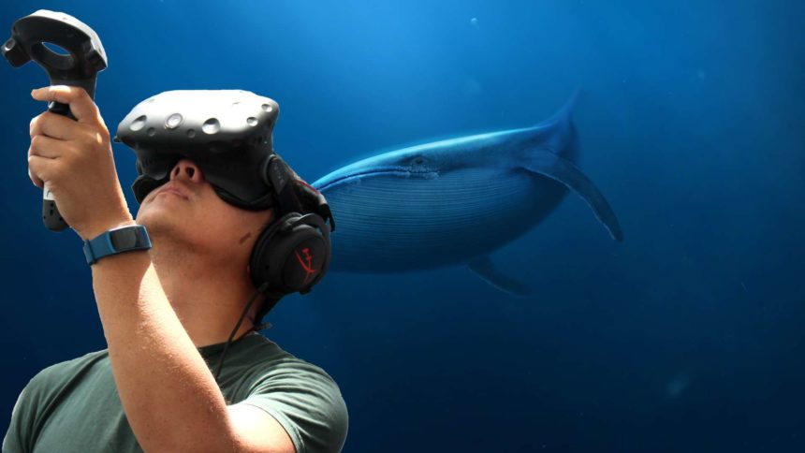
Advancing Outreach at MBARI
Embed ITD staff & MBA video producers on 4-5 Western Flyer and 1-3 Rachel Carson cruises for select topside and underwater footage
Underwater ROV to ROV shots at 900 m depth (possibly rent 4k cameras for Ventana and Doc Ricketts – awaiting estimate).
Purchase key video equipment for opportunistic shots by crew and researchers (scientists at work, ROVs and ships, deep-sea selects footage, aerial shots)
The Tech
Camera
Lens
Batteries
Filters
Gimbal
GoPro
Total < $25k
Collaborating with project team 901902 - Aerial drones for science and marine operations (cost covered by that project)
Collaborating with team 901911 – ROVVR to collect HD stereoscopic video for MBA’s The Deep exhibit as well as MBARI social media.

Slide 5
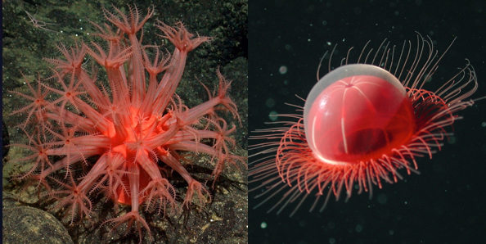
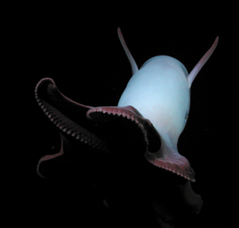
Advancing Outreach at MBARI
A more complete and up-to-date stock footage collection representing MBARI topside sea-going operations and research techniques.
A 2-3 minute co-branded MBARI/MBA video to be used for external talks/web/social that provides overview, history, relationship, expertise.
A 1-2 minute DMO-centered video for external talks.
Educational videos for teachers on alternative careers in ocean science.
Updated virtual ship tours.
High-impact content for all of MBARI’s outreach efforts!
The Data

Slide 6
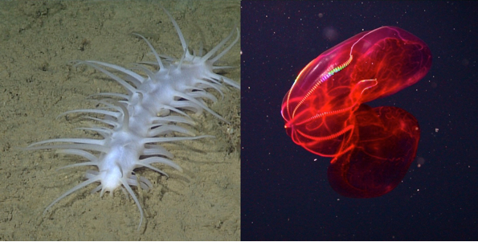
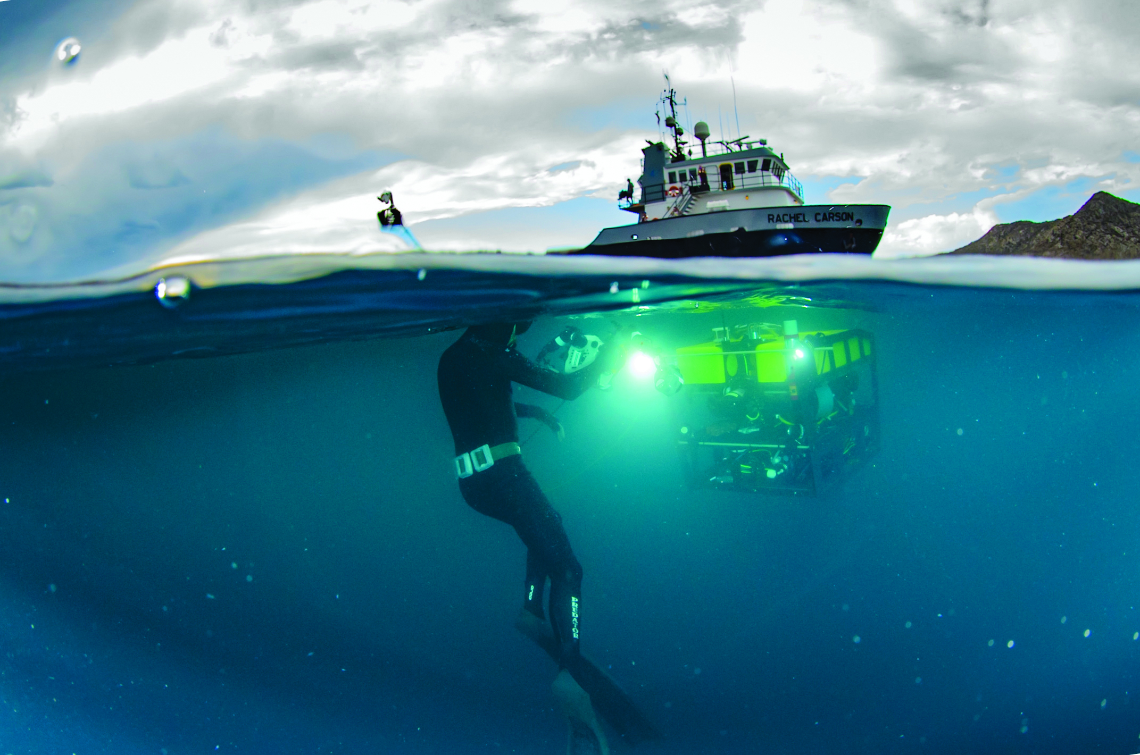
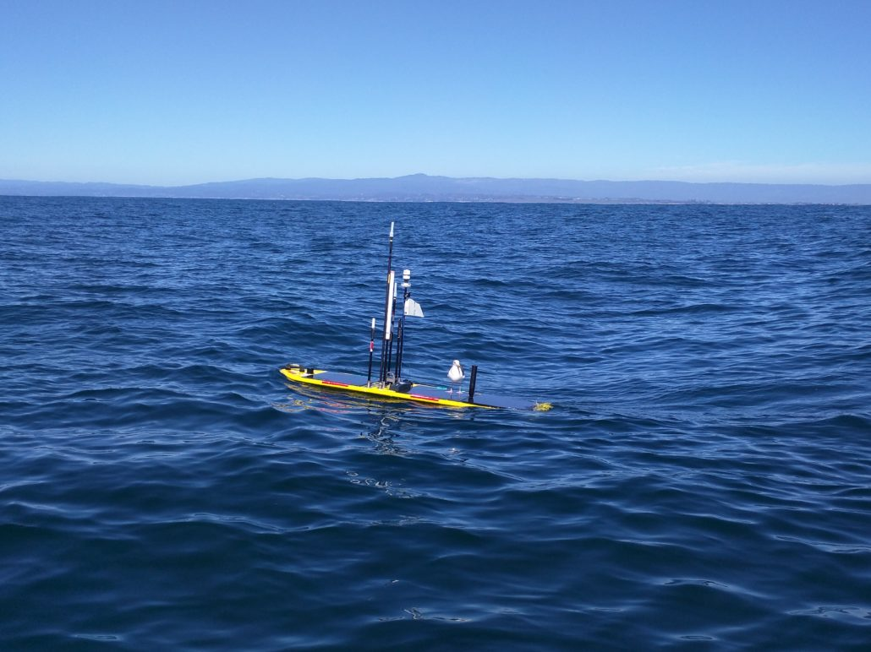
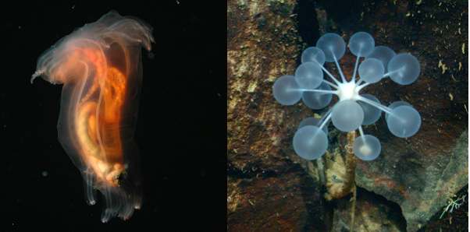
Advancing Outreach at MBARI
The goal is to raise MBARI’s profile by producing high-quality content for use by MBARI and MBA staff across multiple platforms (web, social, YouTube, talks, exhibits).
This will augment our ongoing efforts to connect with the public, educators, environmental agencies, and policymakers.
The Impact

