Slide 1
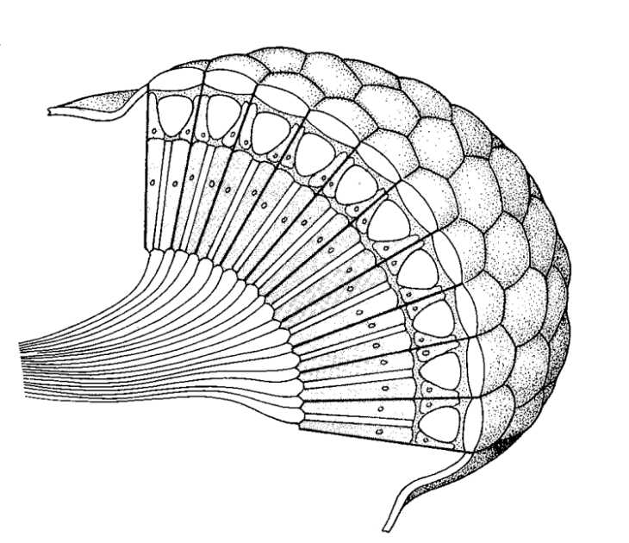
EyeRIS (Remote Imaging System):
A three-dimensional, high-resolution, autonomous particle and flow imaging instrument
2019
© Copyright D G Mackean

Slide 2
Fundamental Problem
What are we trying to do:
  Image 3D particle distributions
  Image 3D fluid flow in situ
  Reconstruct 3D time-varying surfaces
Why do we care:
Understanding 3D fluid physics, particle dynamics, and surface shape/deformations informs wide range of big questions in marine science:
  The biological pump
  The carbon budget
  The health of coral reefs
  Quantification of episodic deposition events

Slide 3
Taking DeepPIV to 3D
DeepPIV is capable of imaging particles in a 2D plane but for 3D flows we need new technology.
This can be achieved with sync’d multi-camera systems but that is challenging to deploy
We propose using a single-camera solution using plenoptic imaging

Slide 4
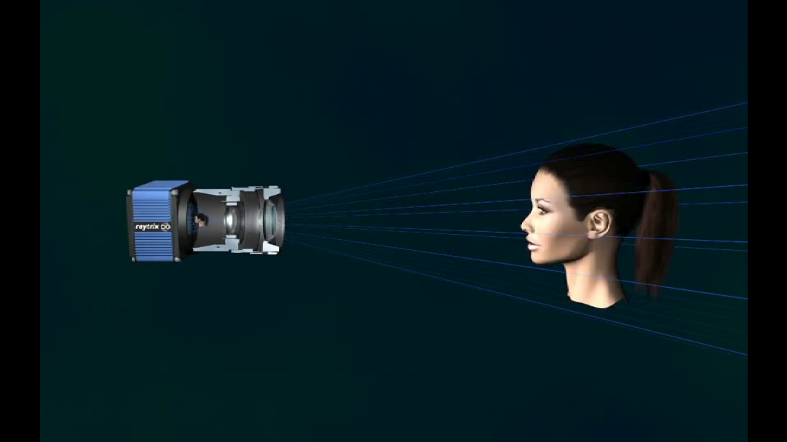
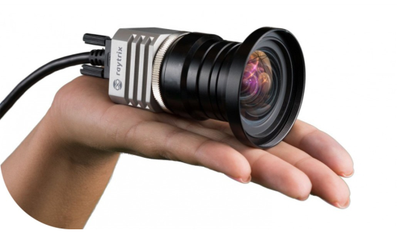
The Technology
Plenoptic cameras: these have a micro-array of lenses that sit in front of the image sensor, enabling one camera to image many different focal planes from different perspectives simultaneously.

Slide 5
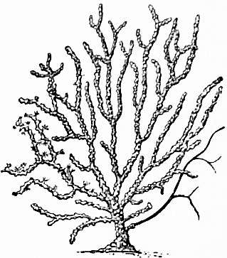
The Concept
TO
ROV
/
AUV
LED Lights
Plenoptic
Camera
GigE to Fiber
Pressure housing with flat port

Slide 6

The State of the Technology
We are currently bench testing a Raytrix camera borrowed from NOAA
Will conduct tank tests prior to Phase 1
Raw Image
Depth Map
3D Reconstruction

Slide 7
Proposed Project Timeline
 | Year 1 | Year 2 | Year 3
Design and build ROV-based EyeRIS (4000 m) | X
Deploy and test ROV-based EyeRIS |  | X
Design and build AUV-based EyeRIS |  | X
Deploy and test AUV-based EyeRIS |  |  | X
Disseminate results |  | X | X

Slide 8
The Data
In years 2 and 3, we expect a maximum of 2 TB/year of data which can be stored on our network share, and be integrated in to M3RS.

Slide 9
The Impact
The proposed instrument would have a broad impact as novel measurements are of value to many areas. Examples include:
Resolving particle/aggregate fields and fluxes towards quantifying the global carbon budget
Feeding ecology of midwater and benthic organisms
Monitoring complex flows that impact health of coral reefs
Understanding fine-scale turbulence throughout ocean’s depths to inform mixing and biogeochemical models
And more…

Slide 10
The good news…
You might not have to pay for this!
A Moore Foundation proposal for this work is pending. A decision should be made by Phase 1.

Slide 11
Questions

Slide 12
Labor Resources
Engineering Resources
 | Year 1 | Year 2 | Year 3
ME | 400 | 300 | 200
EE | 400 | 400 | 300
SE | 200 | 400 | 300
Machine Shop | 250 | 250 | 50
ME tech | 100 | 100 | 50
EE tech | 100 | 100 | 50

Slide 13
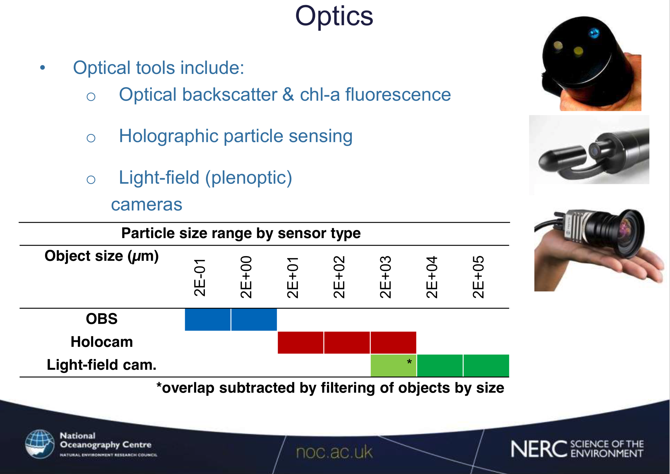

Slide 14
