Slide 1
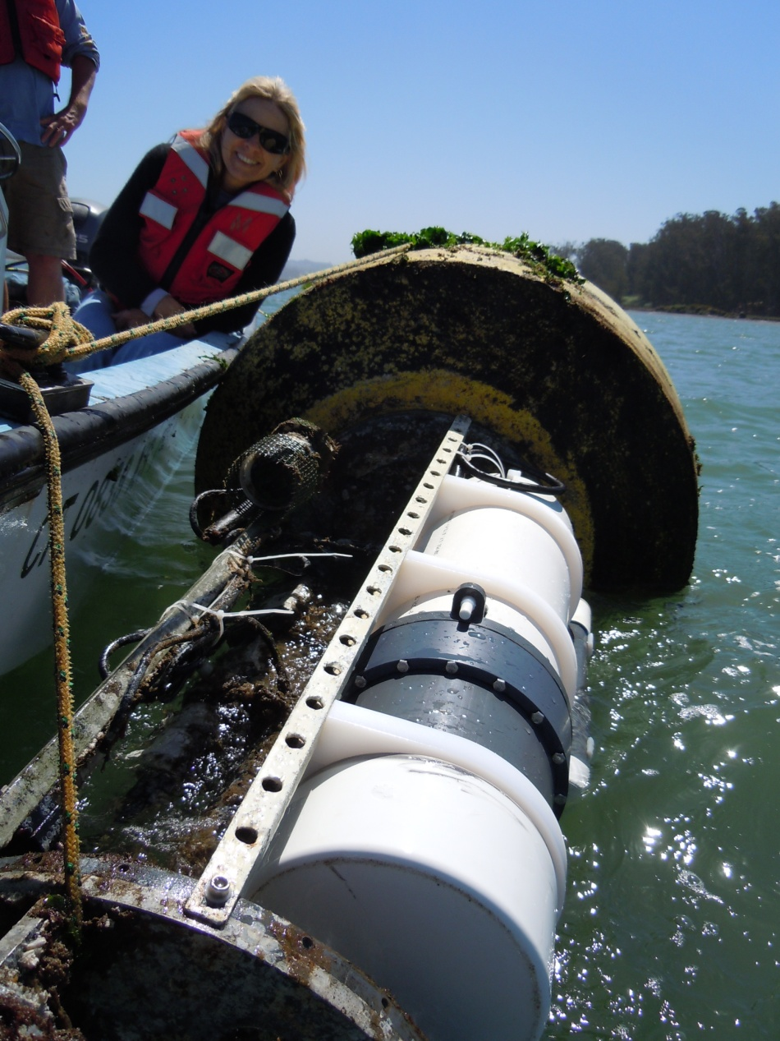
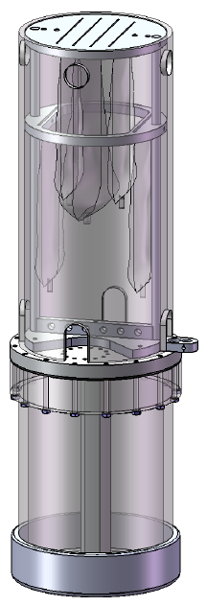
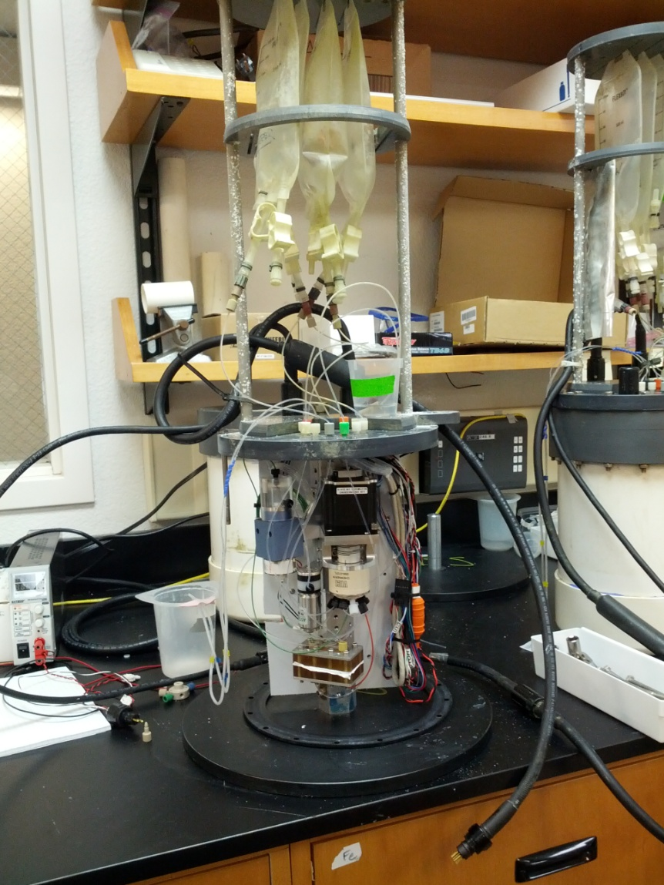
Towards the Commercialization of NH4- and DIC-Digiscan
Ken Johnson
Yui Takeshita
2019 Abstract presentation

Slide 2
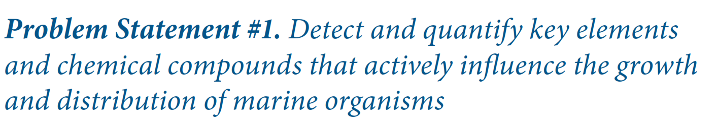
The Problem
Dissolved Inorganic Carbon & Ammonia are Essential Ocean Variables, but are undersampled because of lack of in situ sensing technology
We need more autonomous sensing technology for the community!

Slide 3
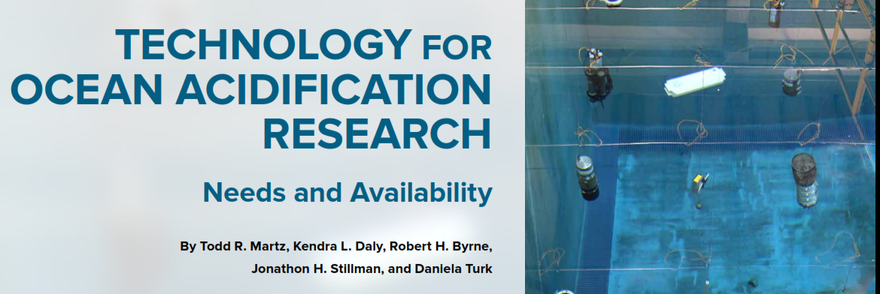
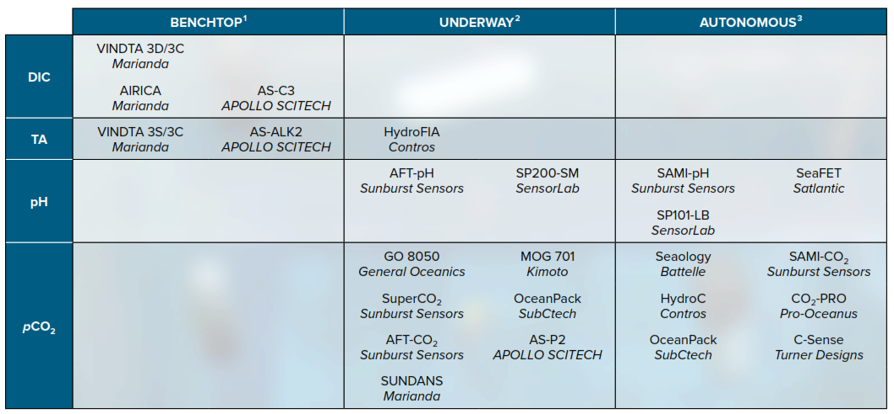
The Problem: DIC
No Available Technology
Bad Combination!

Slide 4

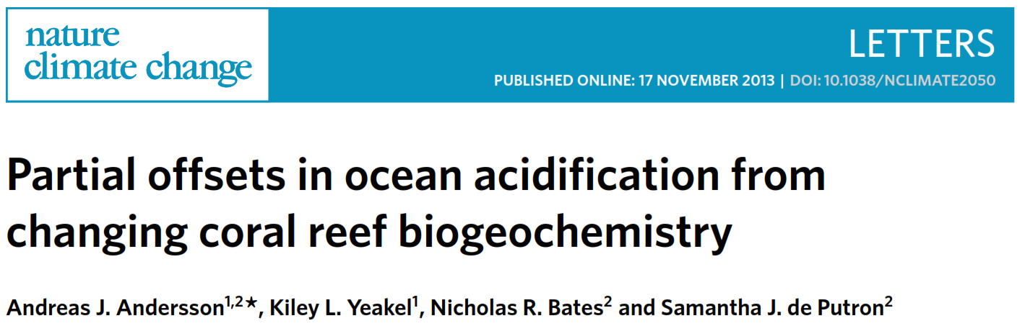
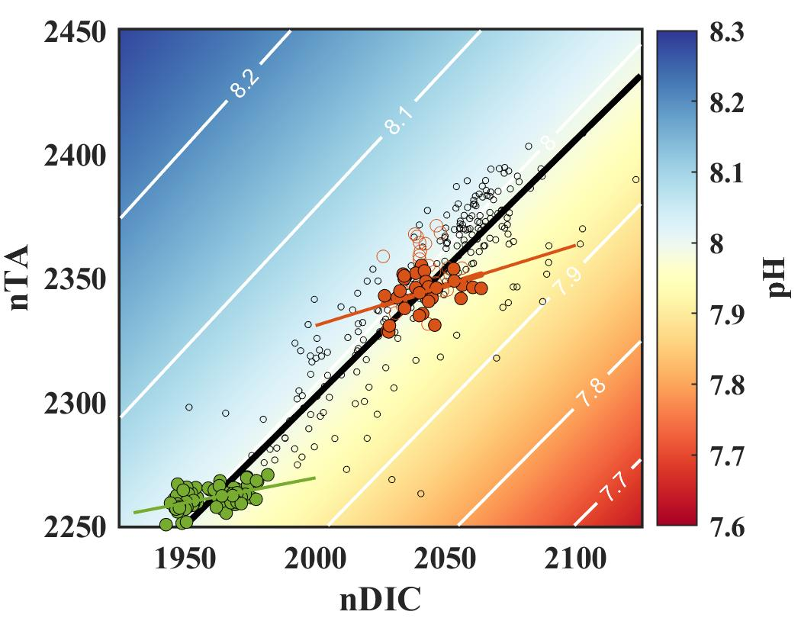
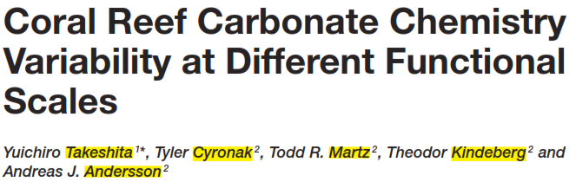
Need DIC sensor to extend study to seasonal – interannual timescales!
Notes:
Explain how being able to autonomously measure TA & DIC will be helpful for coral reef biogeochemistry.

Slide 5
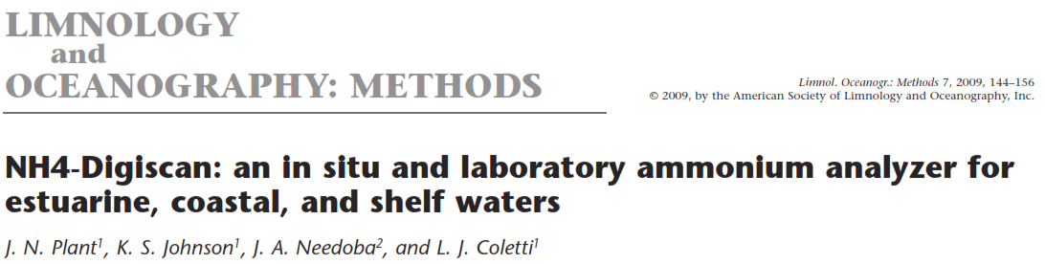
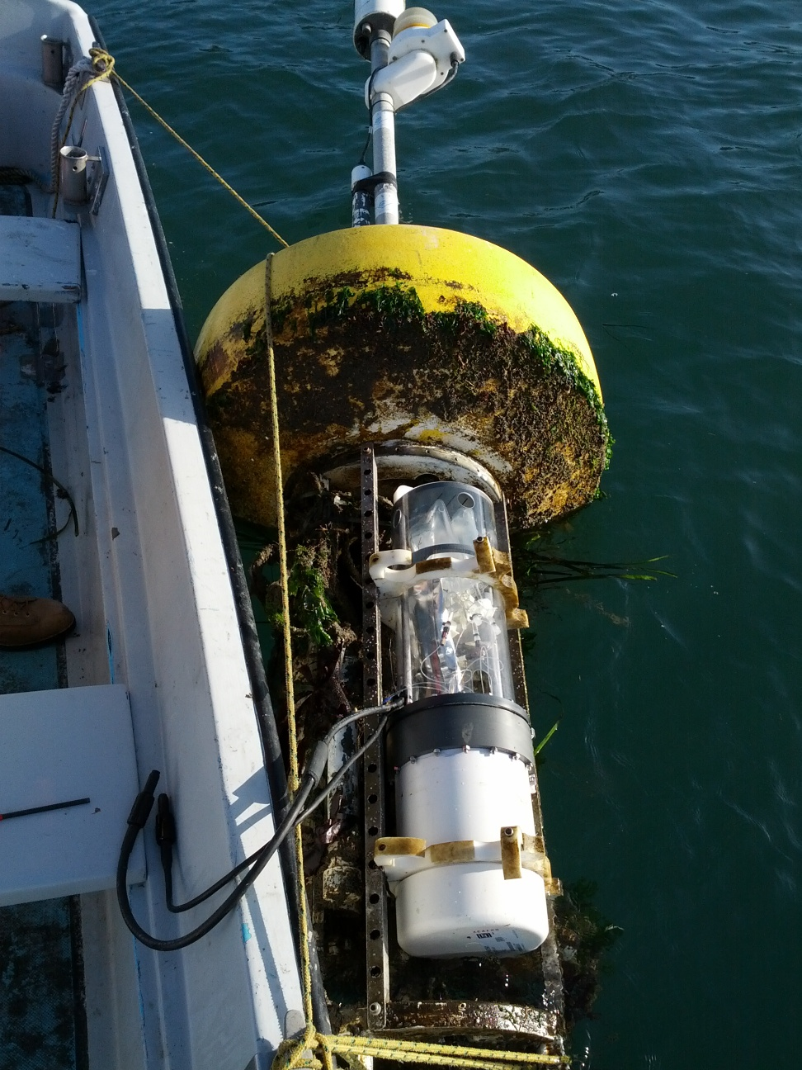
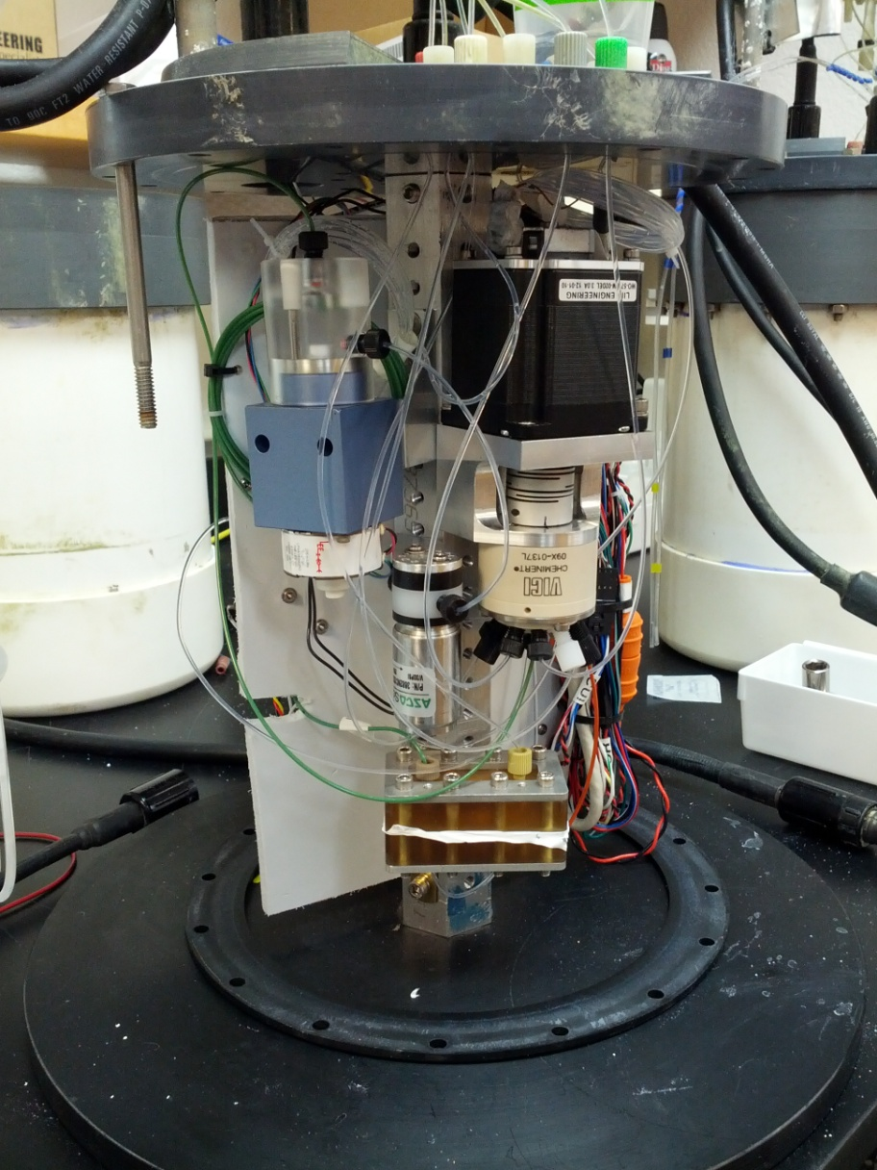
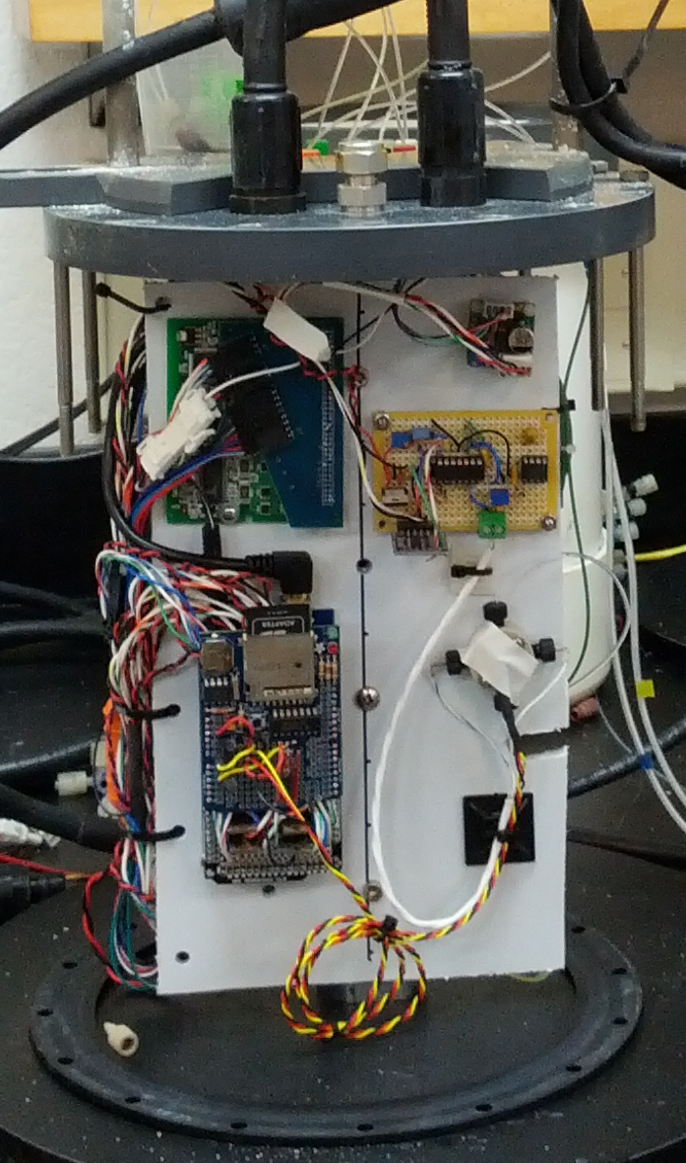
The Tech: Digiscan analyzers

Slide 6
The Tech
Simple wet chemistry in situ using milli-fluidics
Pump In
Can swap these two reagents to analyze DIC!
2 sensors for the developmental effort of 1!
Conductivity Cell
Acid
NH3 NH4+
Sample + Base
NH4+ NH3
Diffusion Manifold
Pump Out
Waste

Slide 7


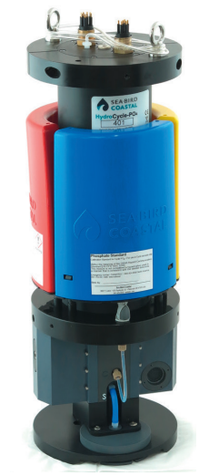
The Tech
Has many components used in Digiscan
Sample intake (pump)
Mix reagents (valves)
ADC
Need to add:
Gas diffusion manifold
Conductivity cell + electronics
Notes:
Ammonium molybdate, potassium antimony tartrate, in acidic conditions, forms a blue phosphate-antimony-molybdate compound. Use absorbance to detect orthophosphate concentrations.

Slide 8
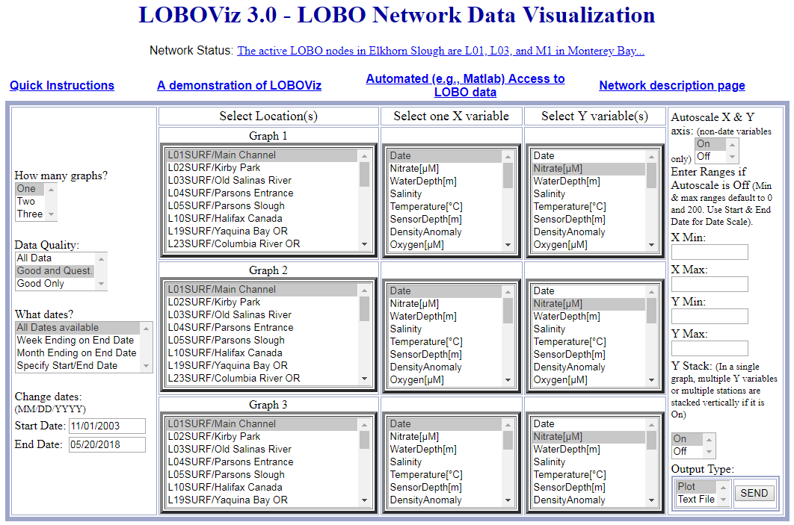
The Data
Data generated by these systems are minimal (MB per deployment).
They will be archived in atlas, and made available to the community through LOBOViz

Slide 9

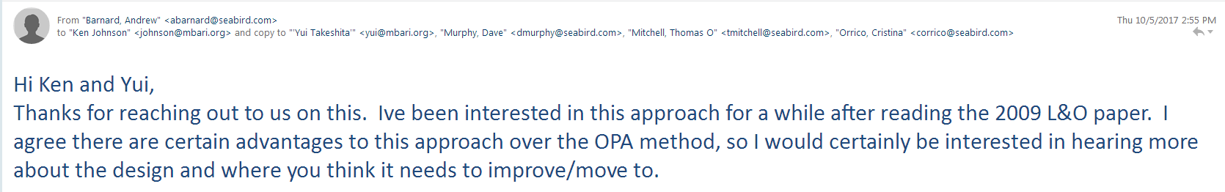
The Impact
Main objective of this project is to license Digiscan technology to
  We are in communication with Andrew Barnard (Chief Technology Officer), and he is interested
Enable carbon/nutrient cycling research on timescales previously not possible (Takeshita has core research need for this sensor)
Aquaculture applications (NH4)
Notes:
Had talk with him at OSM, and he even wanted to fly down to come see the system.
Mike Graham

Slide 10
Requested Resources
Purchase Hydrocycle PO4 system (~20 K)
Scott Jenson
Thom Maughan
Keaton Mertz
Machine shop (housing fabrication)
Paragon (5-10 days)

Slide 11
Time Line
Year 1
  Design new electronics and housing
  Design new milli-fluidic manifold based on Hydrocycle framework
  Test deployment in test tank, L01
Year 2
  Refine performance, continue test deployments locally and opportunistically
Year 3
  Work with Sea-Bird for commercialization

