Slide 1
Plankton taxonomic groups from AUVs
“taxonomic groups” = diatoms, dinoflagellates, picoplankton
Monique Messié & Ben Yair Raanan
(+ Francisco Chavez, Mike McCann, Kevin Gomes, Steve Haddock, Katie Pitz, John Ryan and Yanwu Zhang)
901910
follow-up of 2017 feasibility study 901707

Slide 2
Outline
Relevance
    Why develop plankton proxies?
    Goals & significance
Background
    Feasibility study results
    Bioluminescence proxies
Project
    Overview
    Plans for 2019

Slide 3
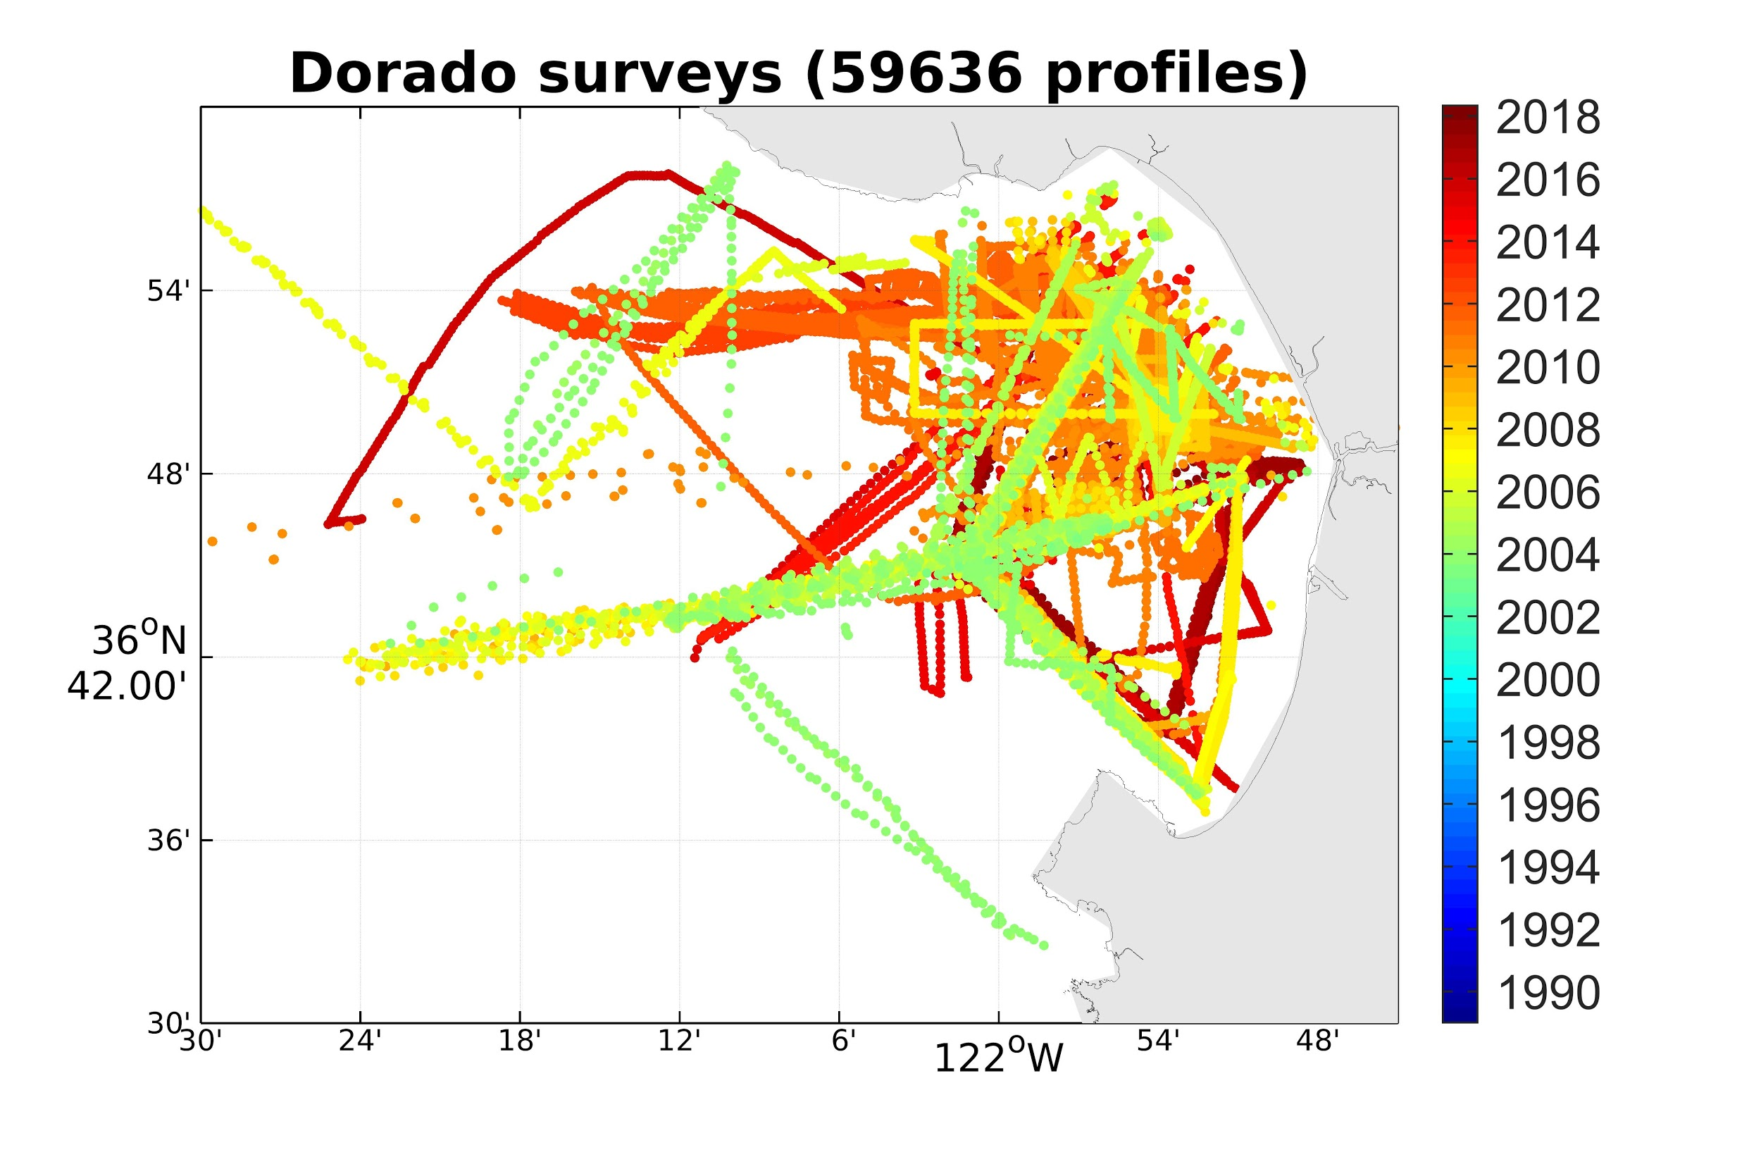
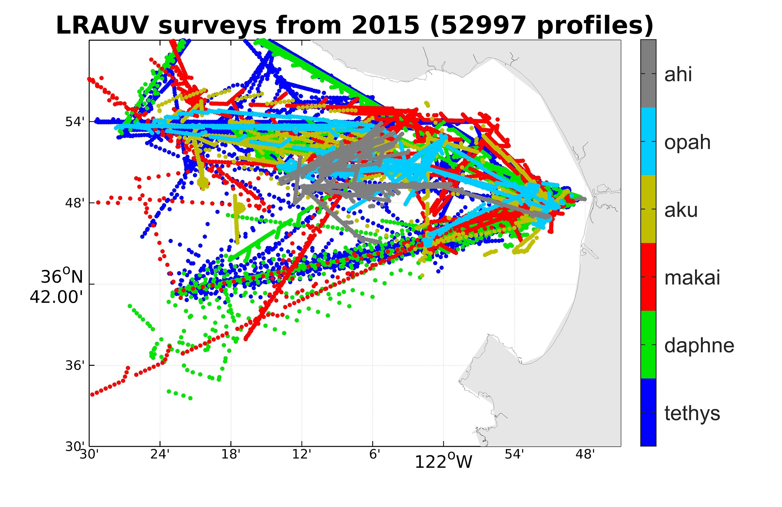
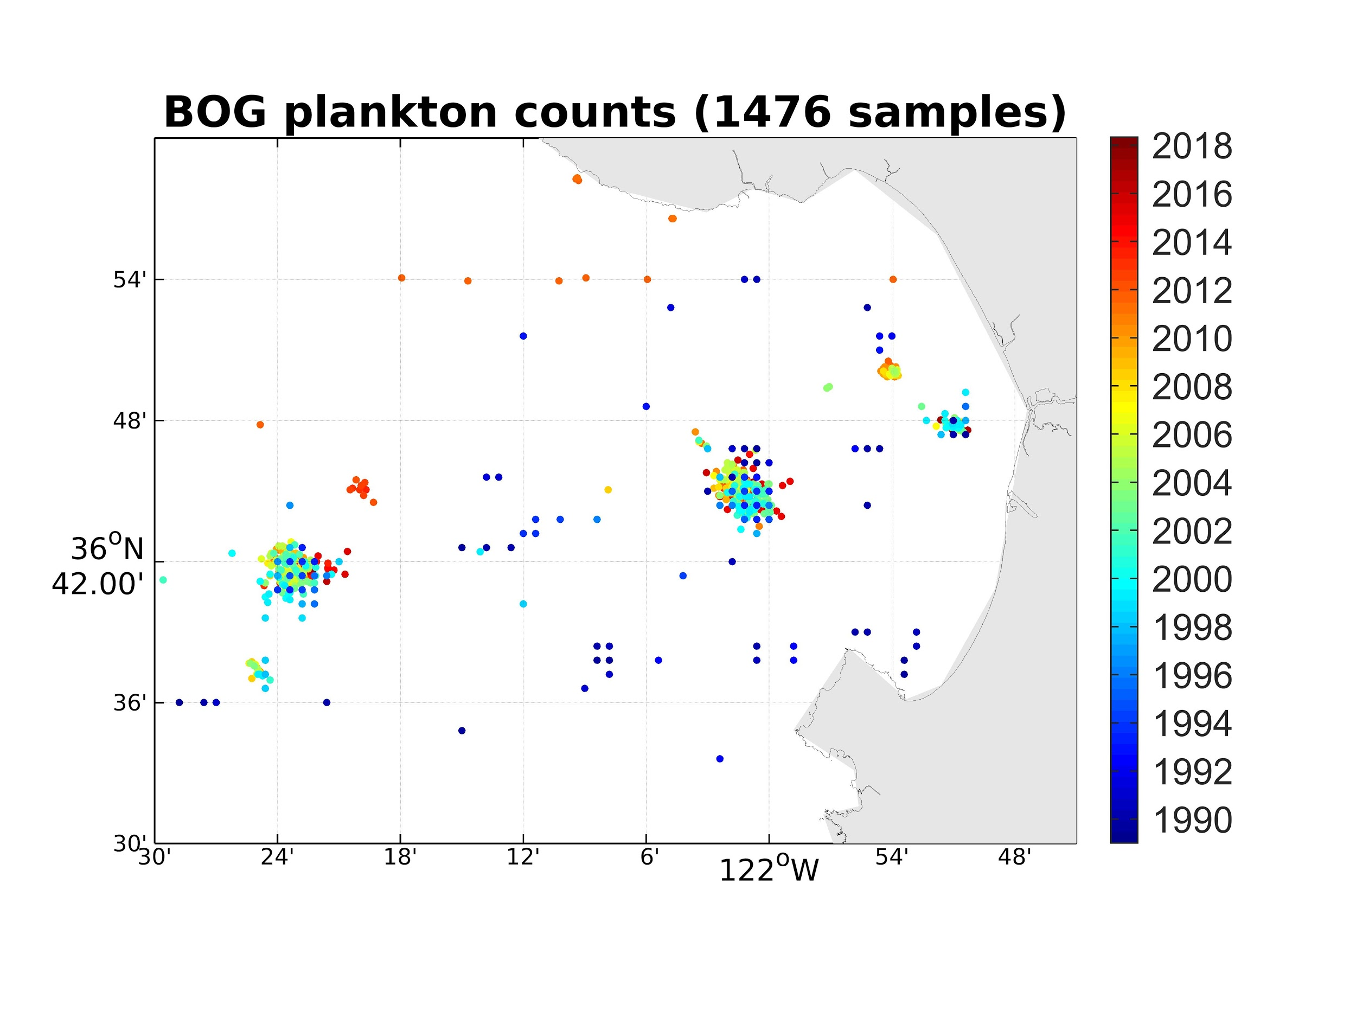
AUVs to increase taxonomic coverage
RELEVANCE
full profiles
almost 2 orders of magnitude more locations
also ships & gliders

Slide 4
Goals & significance
RELEVANCE
Goal: develop proxies for high-level phytoplankton taxonomy (diatoms, dinoflagellates and picoplankton) from biological variables routinely measured by AUVs and gliders (fluorescence and backscatter)
Then decades of ship/AUV/glider proxies can be processed
  unprecedented views of phytoplankton ecology
  inform more advanced targeted sampling

Slide 5
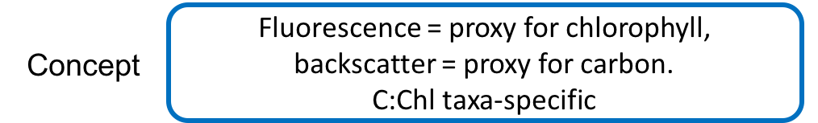
Results from the feasibility study
BACKGROUND
Relationships between phytoplankton taxonomy (BOG samples) and predictors
predictors: fluo/beamc (CTD profiles)
fluo/bbp (M1 mooring, surface)
Questions:
1) Is C:Chl taxa-specific?
1pre) Are samples taxa-specific?
2) Are fluo / beamc/bbp proxies for Chl / C?
3) Can fluo/beamc or fluo/bbp be used to predict taxonomy?
YES
only ~ 50%
YES for fluo,
NOT REALLY for beam-c, ?? for bbp
MAYBE
QC / calibration difficult → small dataset

Slide 6
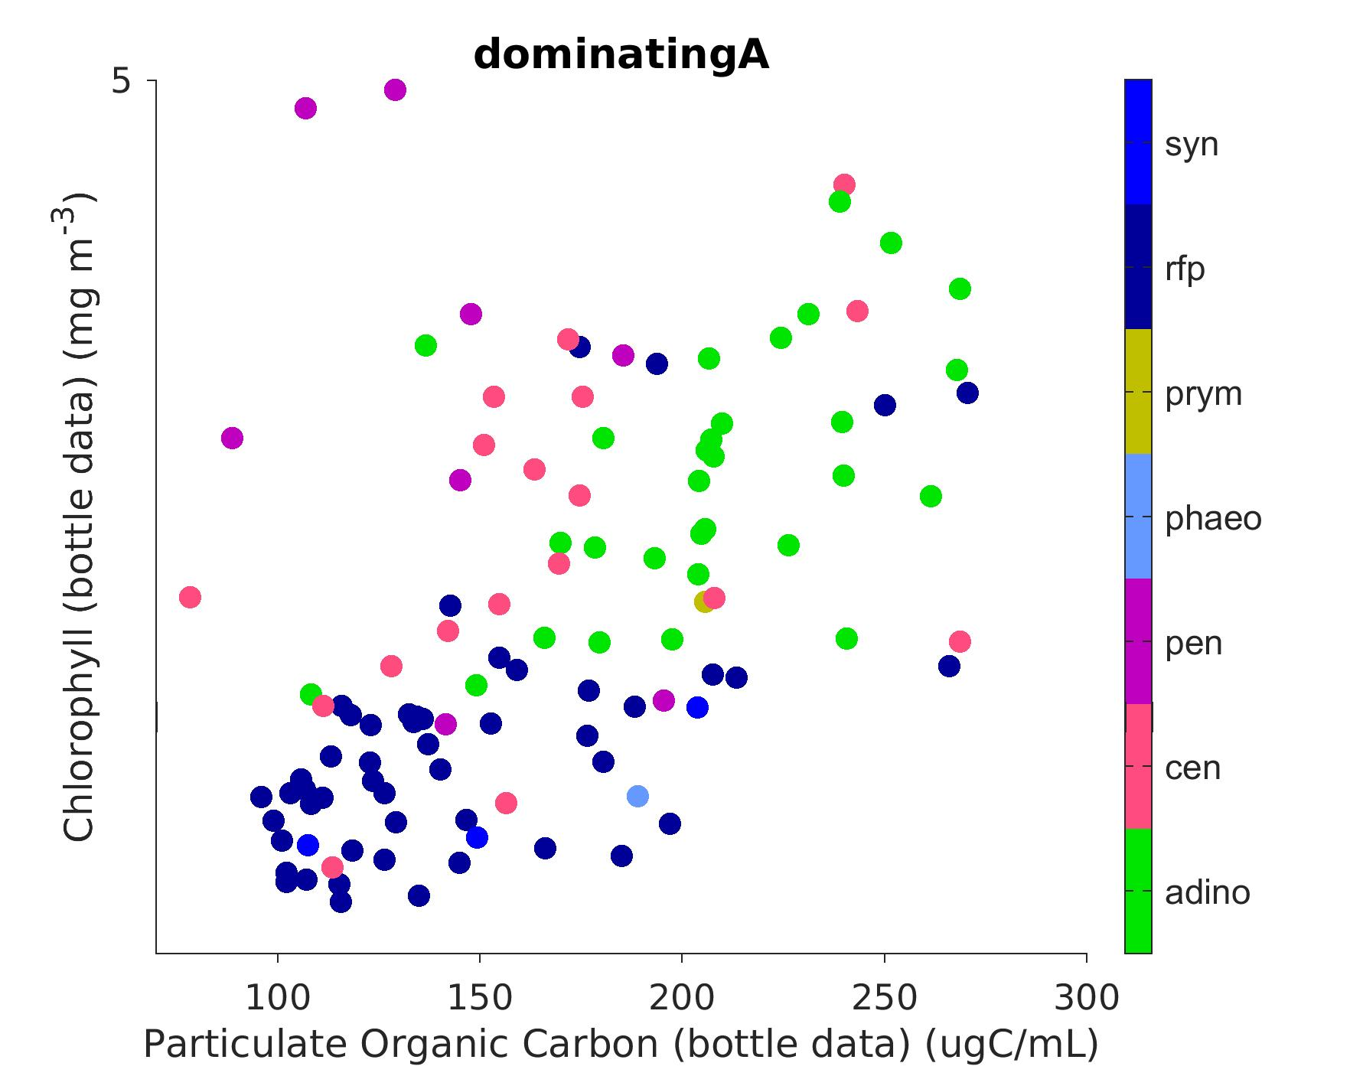
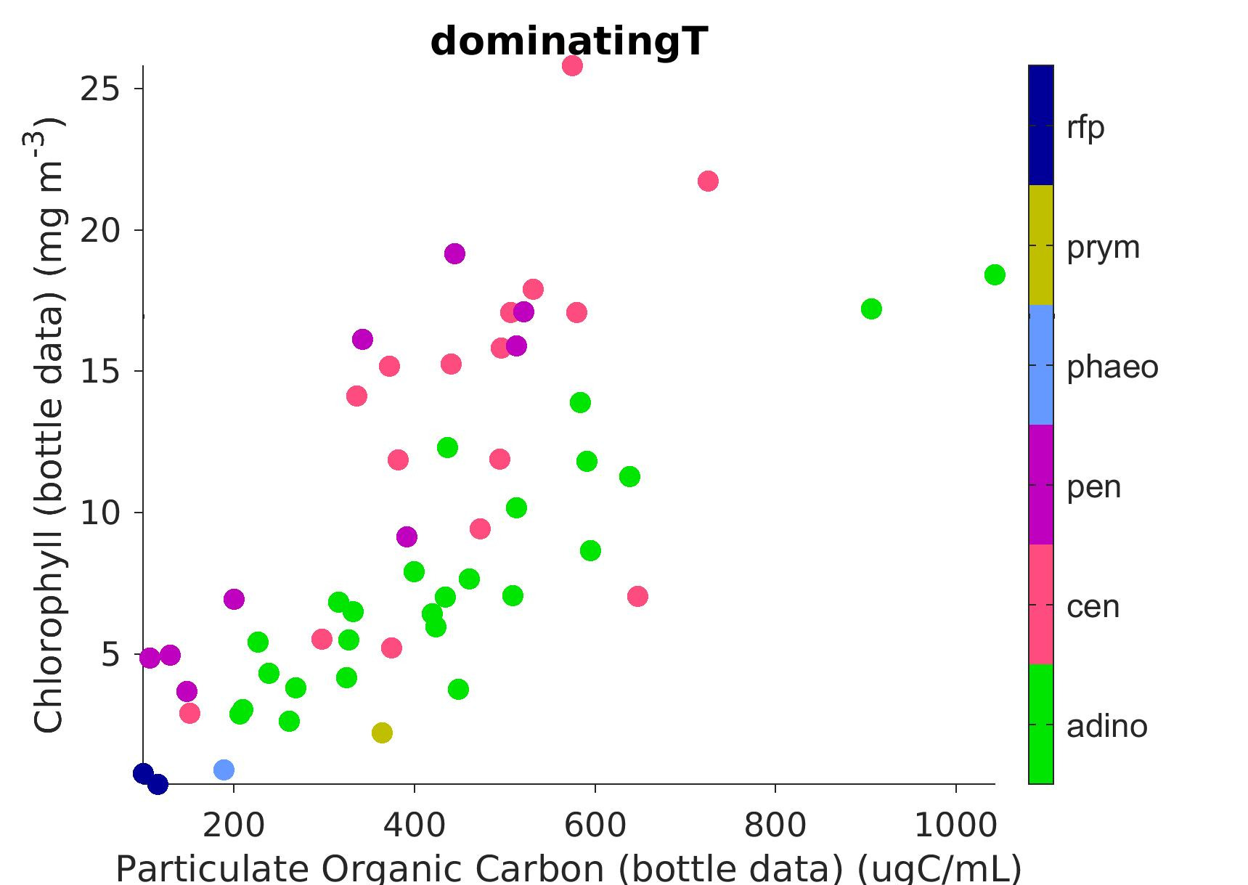
Taxonomy = f° (C,Chl)
BACKGROUND
YES
Dominating = above 80%
Dominating = above 50%
Yaxis = Chl
zoom
Xaxis = POC
(only samples dominated by one group)

Slide 7
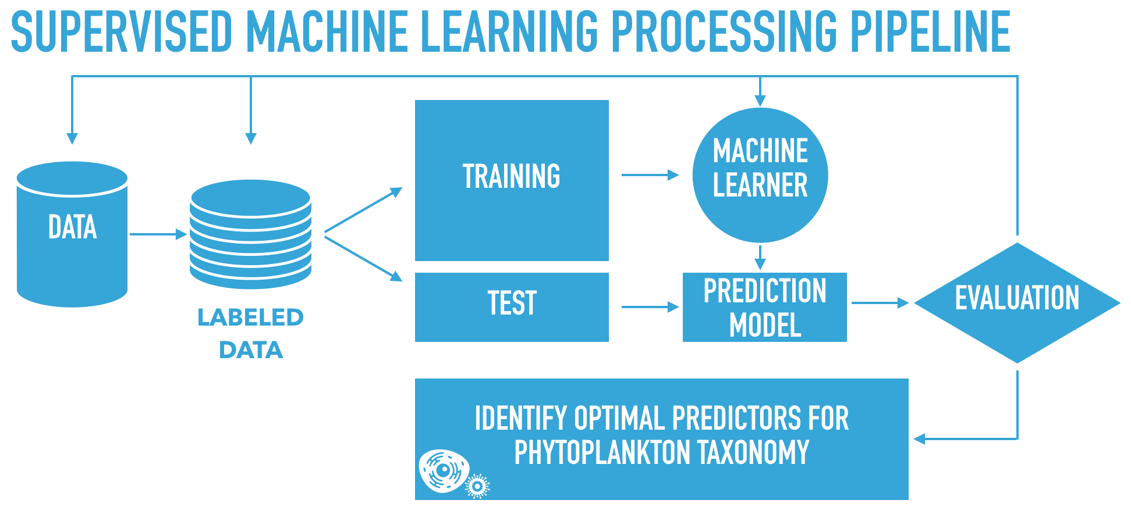
Identifying optimal predictors
BACKGROUND
Automated workflow to investigate the presence/absence and robustness of a relationship between phytoplankton taxa and various environmental predictors

Slide 8
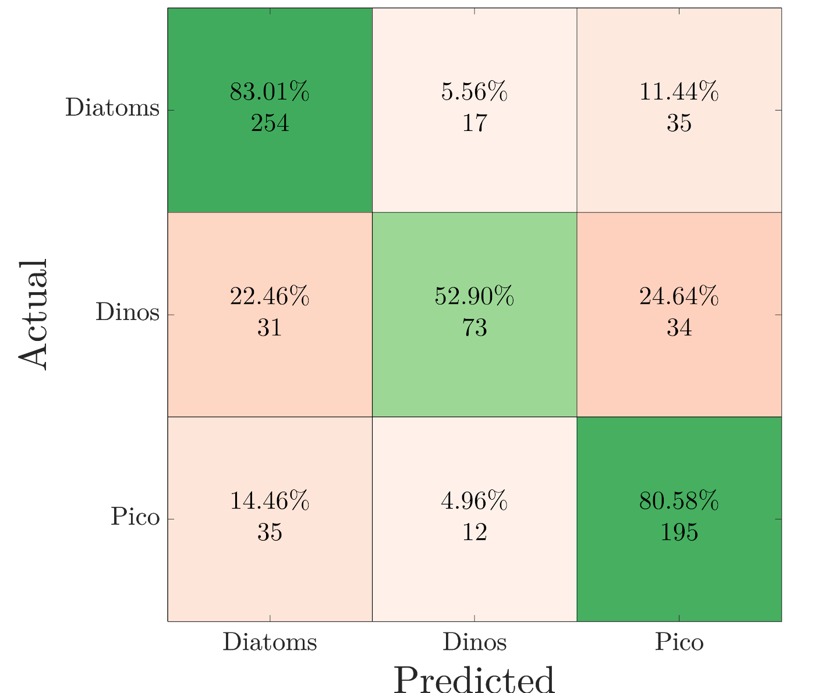
Identifying optimal predictors
BACKGROUND
Confusion matrix (test set)
Best prediction model:
Labels: BOG count observations dominated by single taxon (N=686)
Features:
beamc + fluo
distance from coast
time of year
water temperature
Chl/POC (in situ) relationship does not carry to fluo/beamc mostly because the POC/beamc relationship fails for dinos

Slide 9
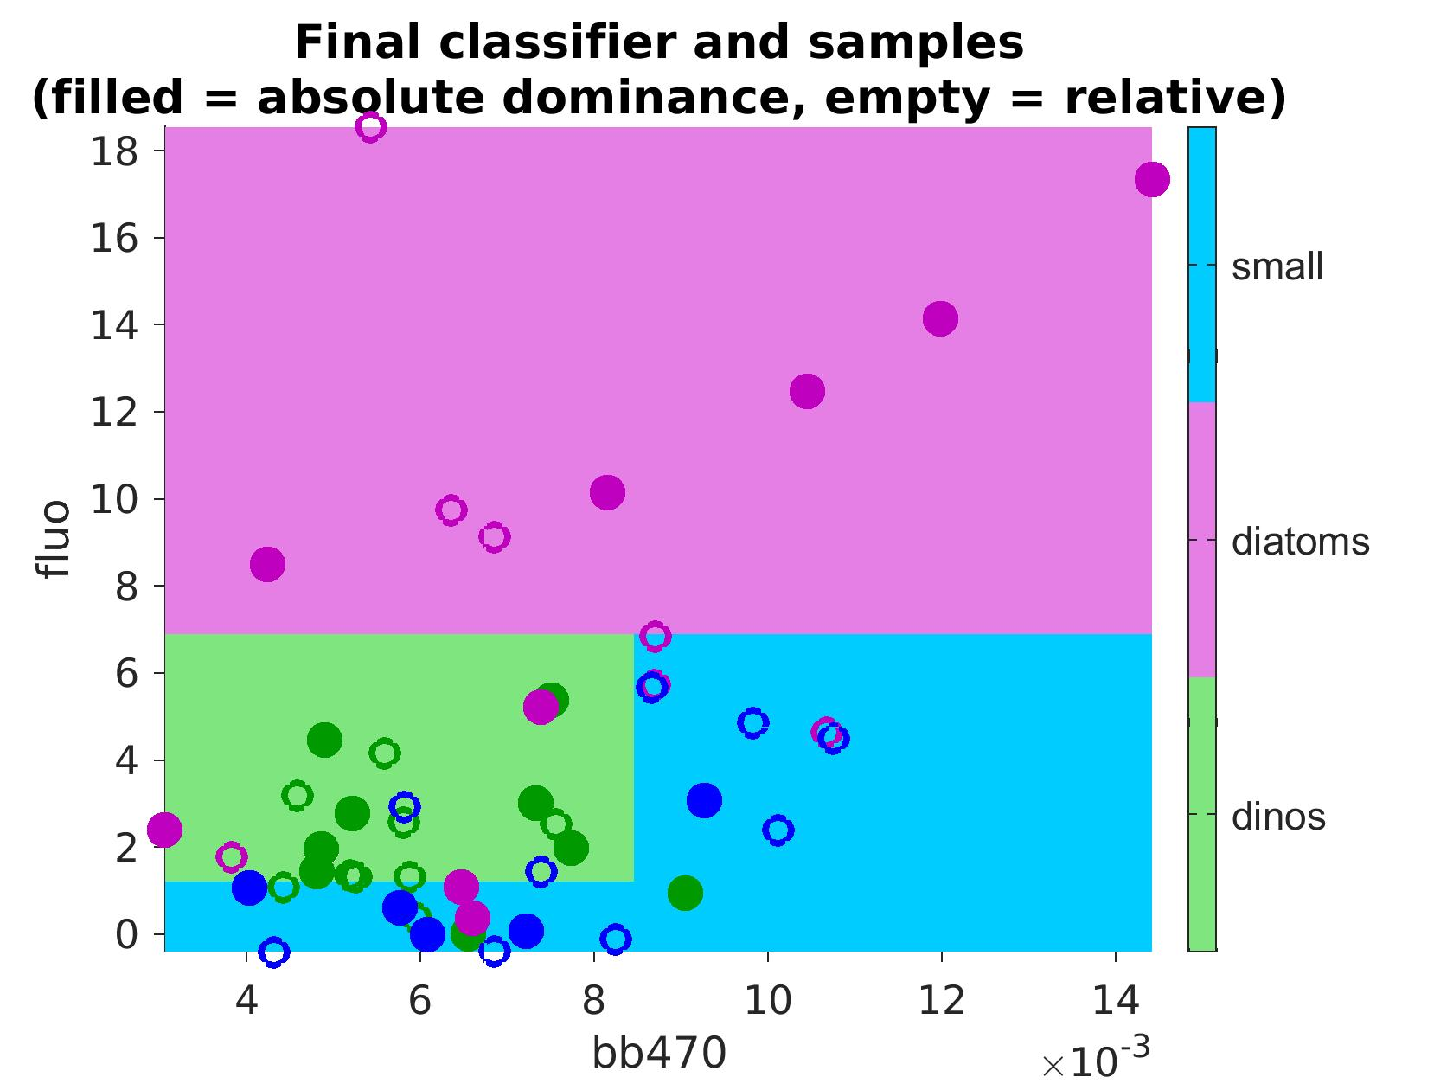
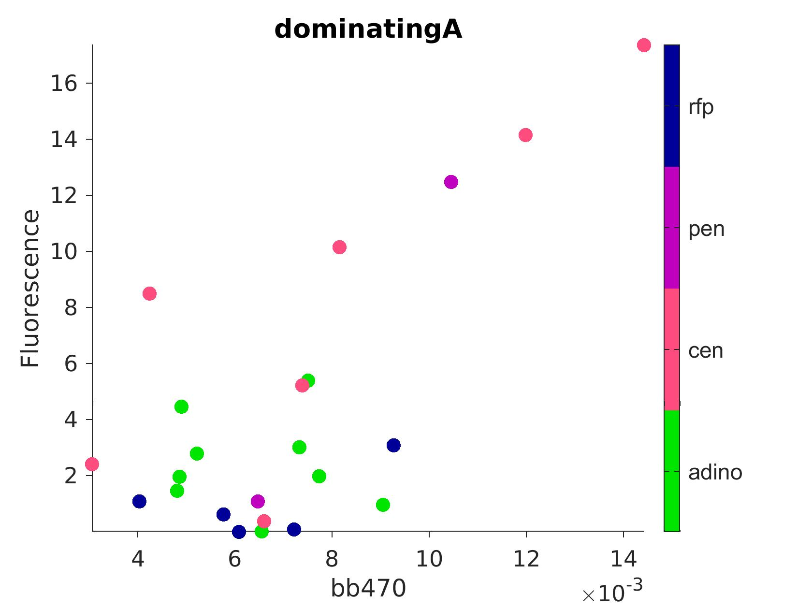
Taxonomy = f°(fluo, bbp)
BACKGROUND
MAYBE
absolute dominance (> 50%)
machine learning tree algorithm succeeds in predicting taxonomy (relative dominance)
relative dominance (highest biomass)
Surface mooring fluorescence
bb470
Zone that should possibly be attributed to diatoms
Mooring surface backscatter (bb470)
Algorithm trained on absolute dominance ( ) and evaluated on relative dominance ( )

Slide 10
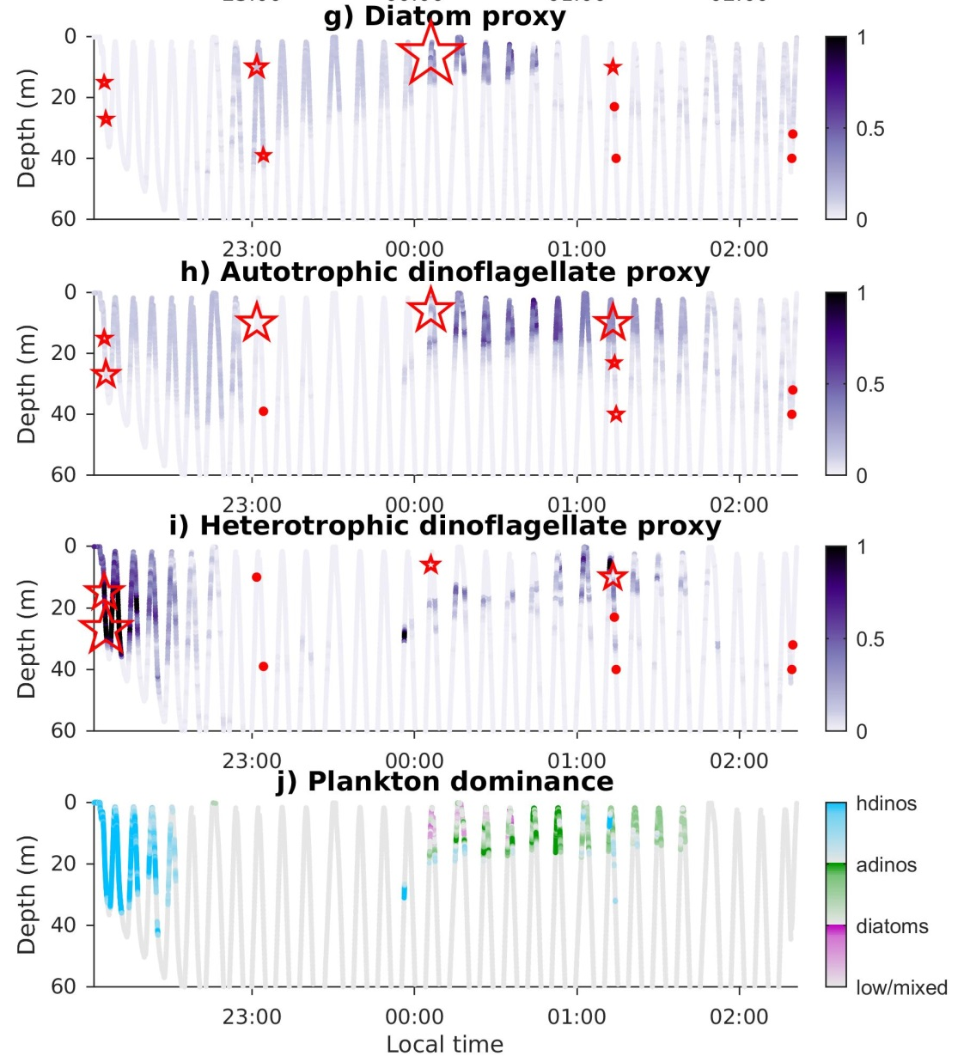
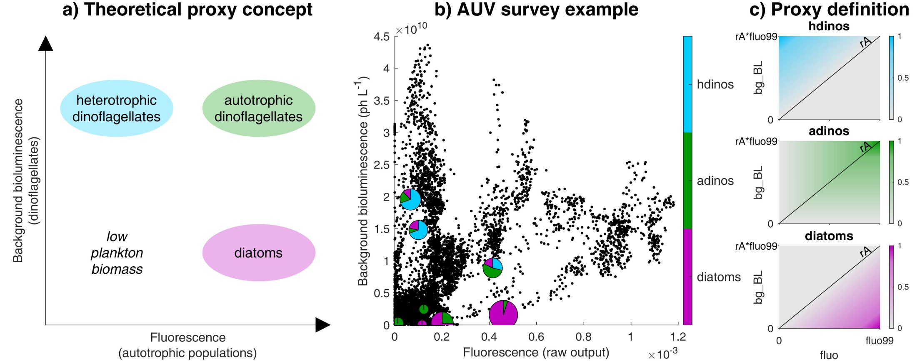
Bioluminescence proxies
BACKGROUND
Project 901103 - Haddock
Messié et al., submitted to Progress in Oceanography
Stars/dots = in situ plankton counts

Slide 11
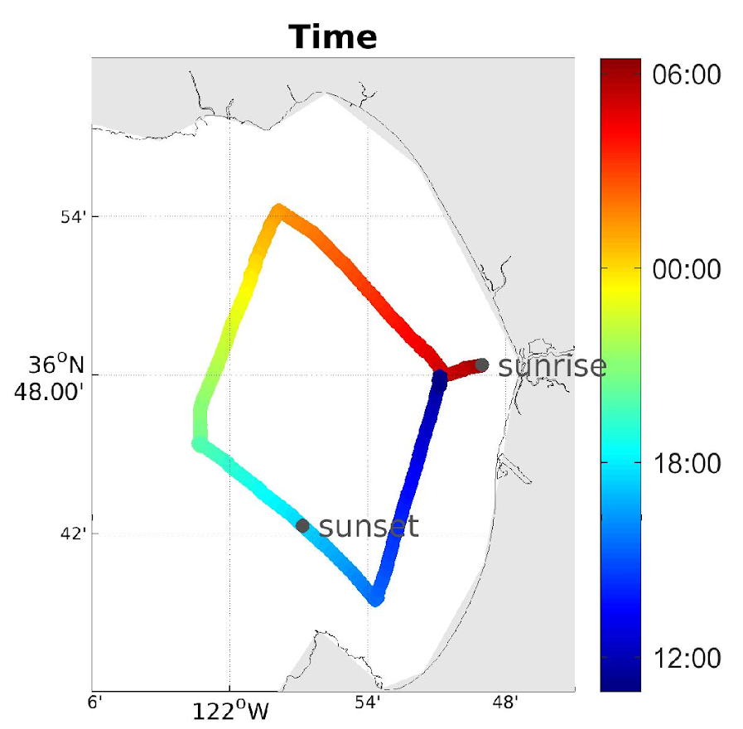
Project overview
PROJECT
At first, focus on the Dorado dataset with 2 paths:
1
Nighttime fluorescence / bioluminescence proxies
supervised machine learning
Fluorescence / backscatter
Dorado diamond dataset:
in situ samples
2
wharf sampling (representative of N & S corners)
eDNA sampling
currently 16 Dorado diamonds

Slide 12
Plans for 2019
PROJECT
First half (w/o Monique)
  Load the entire Dorado dataset into STOQS
  Assess usefulness of LISST-100x dataset
  Establish reproducible workflows through STOQS
Second half
  Generate the bioluminescence labels & load into STOQS
  Work w/ Katie to generate eDNA labels
  Explore supervised ML on 2 sets of labels
  Start investigating diamonds in depth
Future years - refine method and apply to LRAUV & gliders.

Slide 13
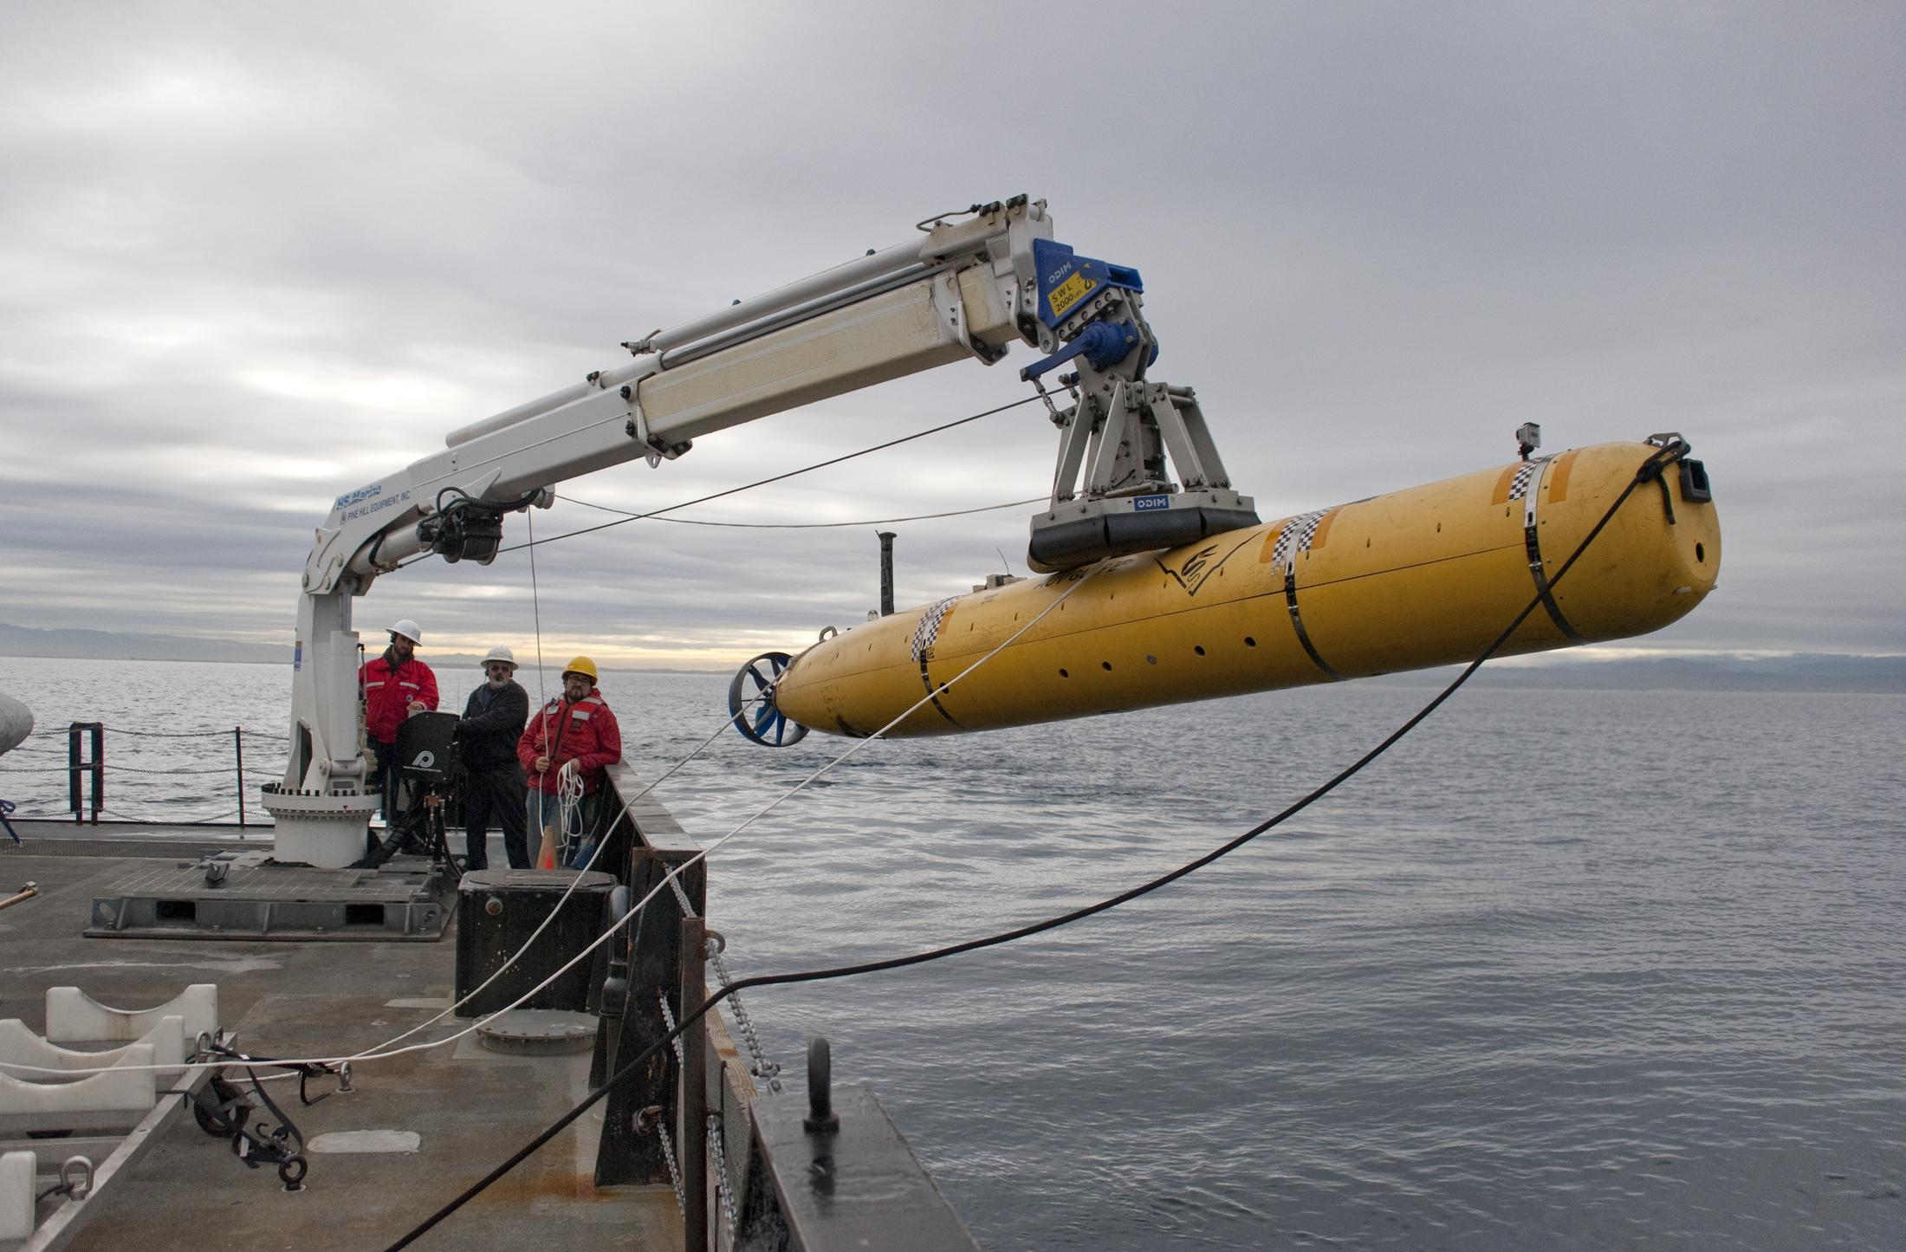
Questions?
Plankton taxonomic groups from AUVs
Project goal: develop proxies for high-level phytoplankton taxonomy (diatoms, dinoflagellates and picoplankton) from biological variables routinely measured by AUVs and gliders (fluorescence and backscatter)

Slide 14
Relevance to MBARI goals
RELEVANCE
Tightly coupled to MBARI research themes
“ecosystem processes” (impacts of phytoplankton types on higher trophic levels and carbon cycle),
“ocean visualization” (abundance & distribution of phytoplankton)
and “exploration and discovery” (new analytical tools)
In support of tech priorities
“taking the laboratory into the ocean” (developing new tools and techniques for identifying, quantifying, and characterizing species),
and “enabling targeted sampling” (real-time characterization of marine organisms and communities).

Slide 15
Bioluminescence proxies
BACKGROUND
Messié et al., submitted to Progress in Oceanography
Project 901103 - Haddock

Slide 16
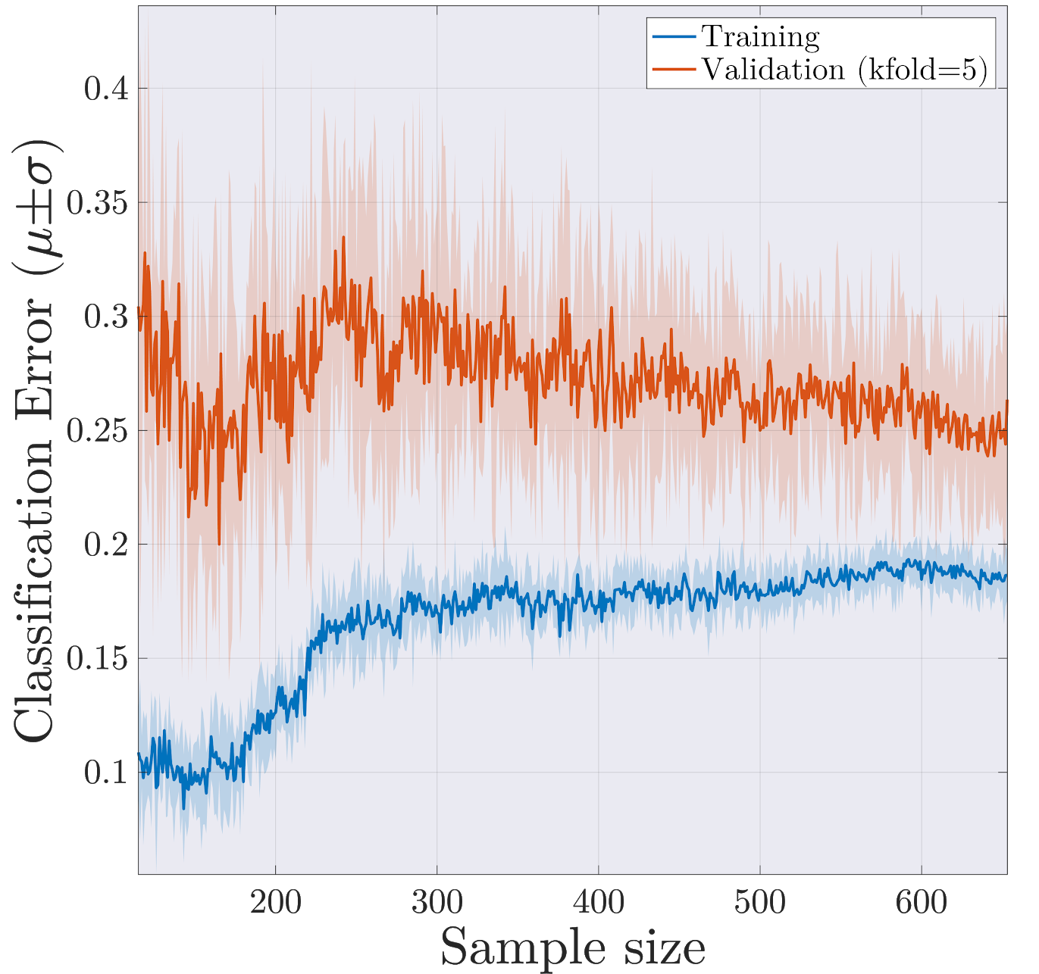
Identifying optimal predictors
BACKGROUND
Learning curve analysis
High bias learning curve:
Training error is still relatively high (15-20%)
A small gap (~5%) between error in training and validation sets.
These results suggest:
Limited predictive power using current feature set
Increasing the size of the training set will likely have minor impact on classification performance

