Slide 1
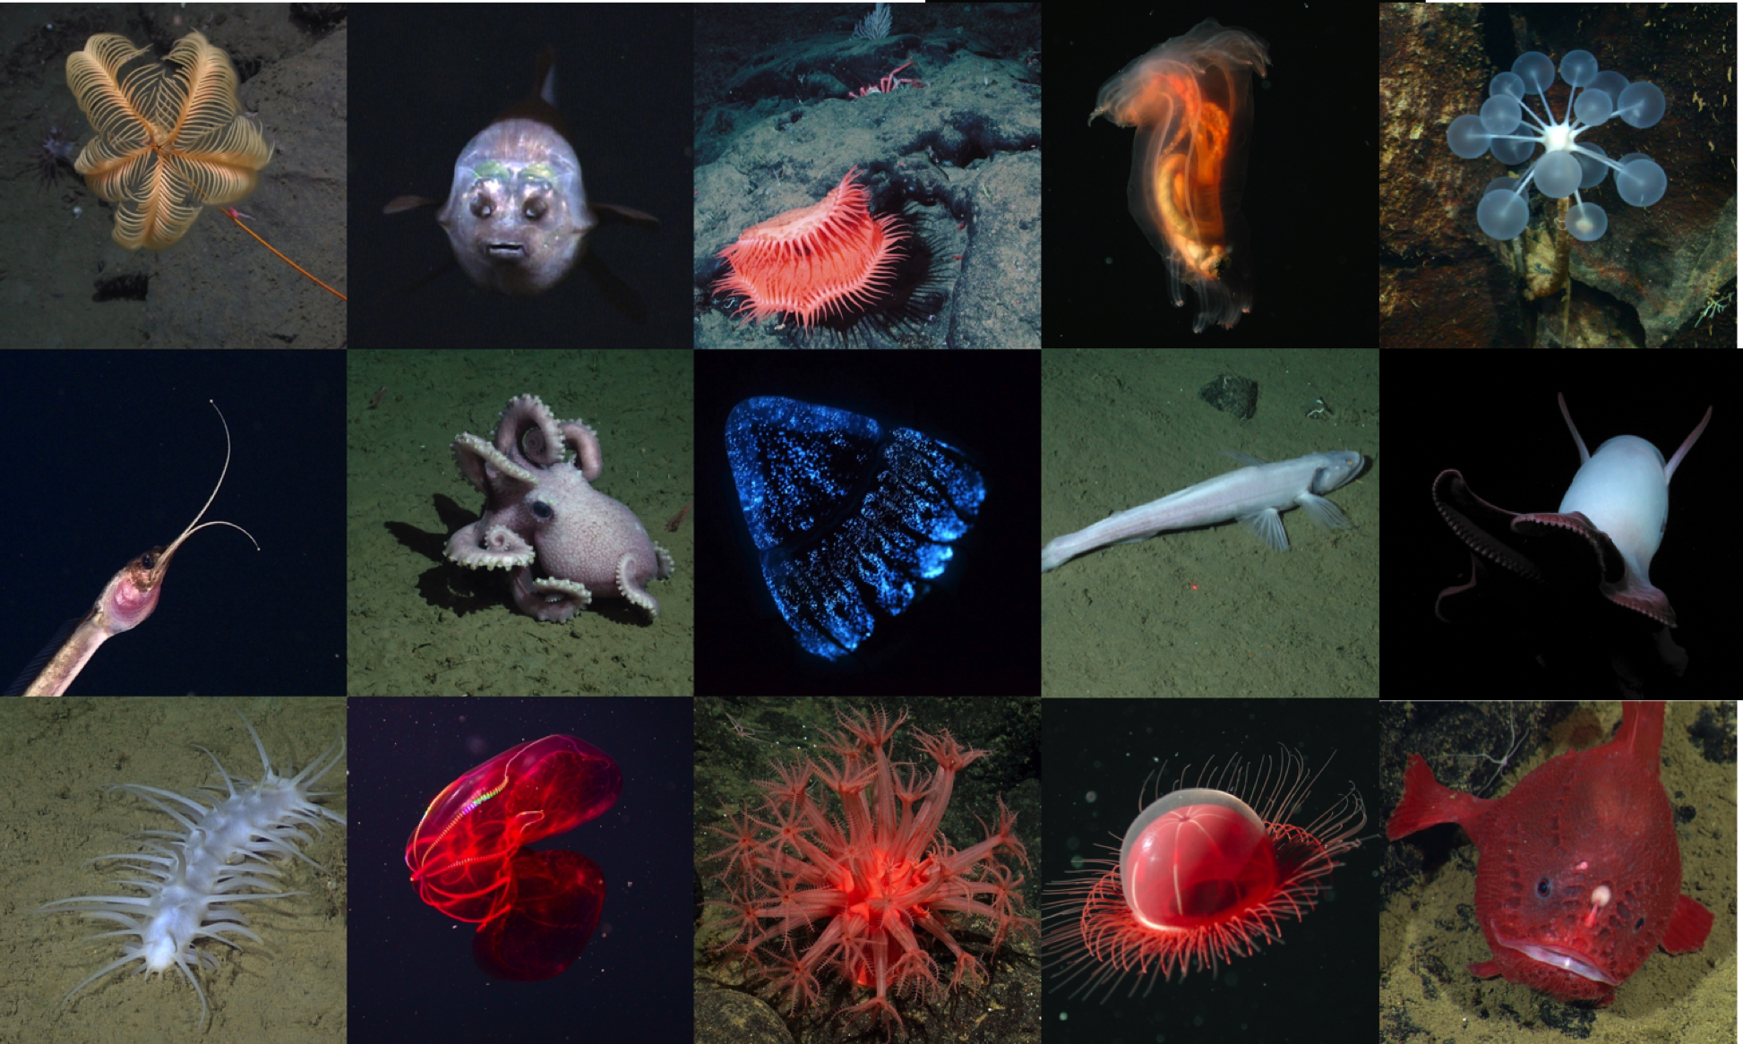
FathomNet
Developing an underwater image training set and algorithms for automated detection and classification using machine learning
Project Team: Lonny Lundsten (PM), Brian Schlining, Ken Smith, Jim Barry, Kakani Katija (PI)

Slide 2
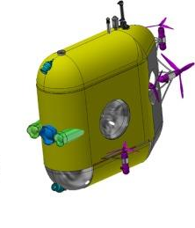
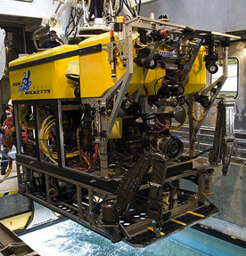
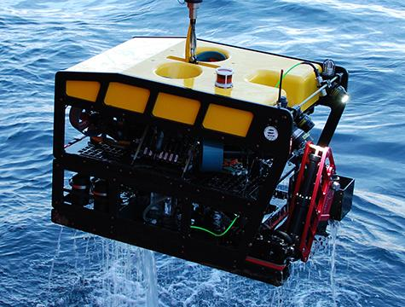
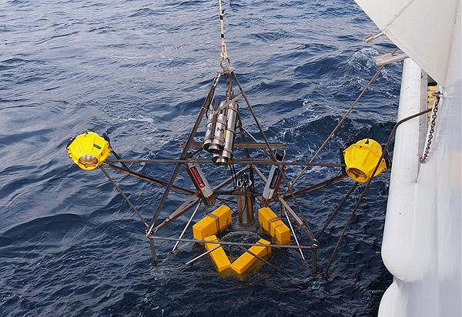
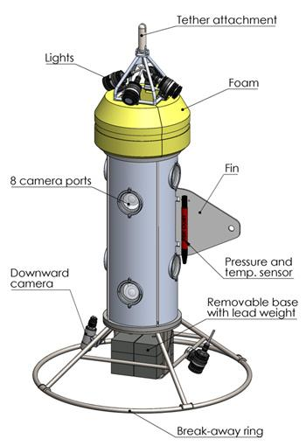
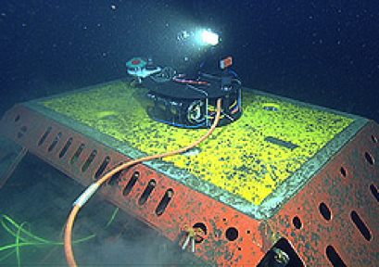
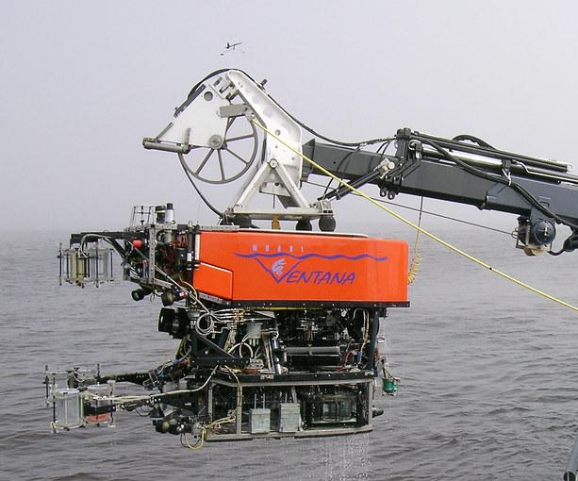
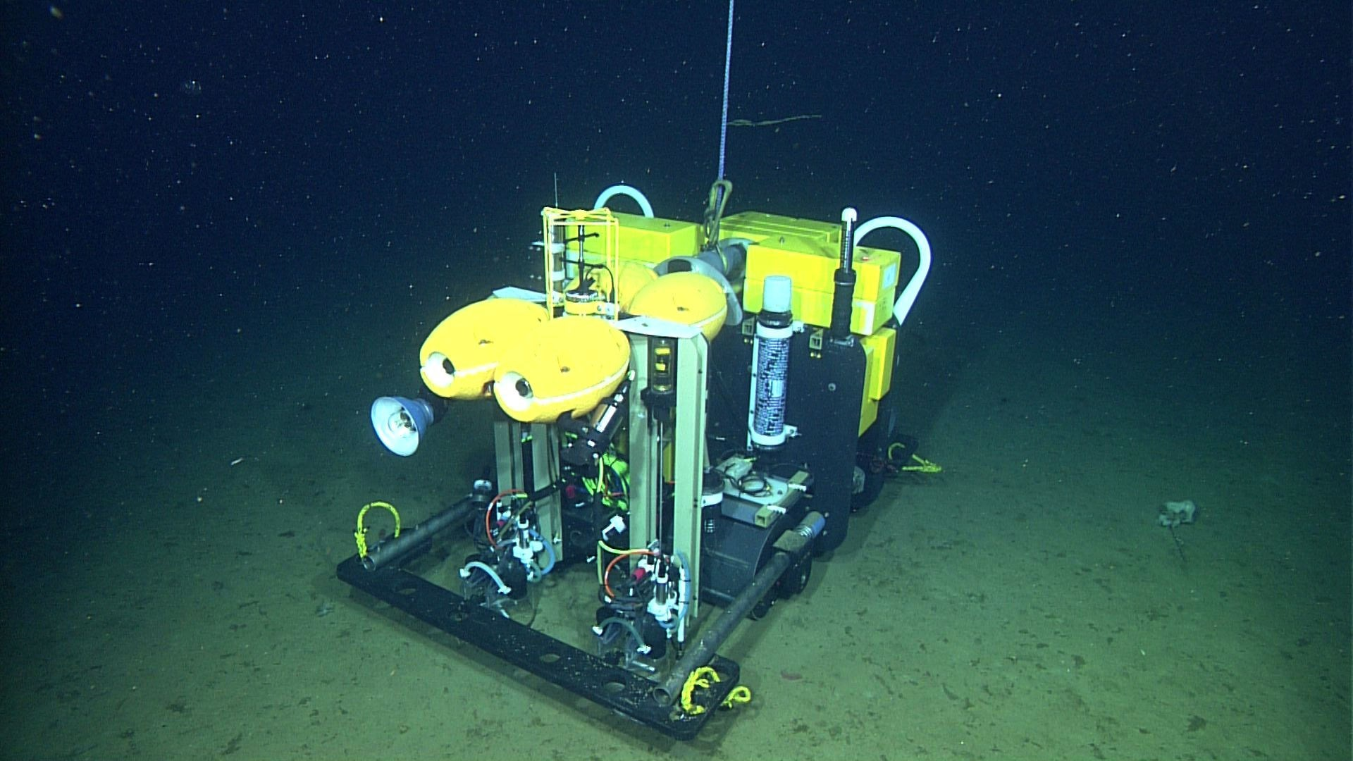
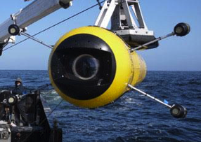
MBARI 2020
Many platforms = lots of video & images and new analysis techniques
Notes:
In 2020 MBARI will have many imaging systems in place

Slide 3
Can FathomNet address this data challenge using machine learning?

Slide 4
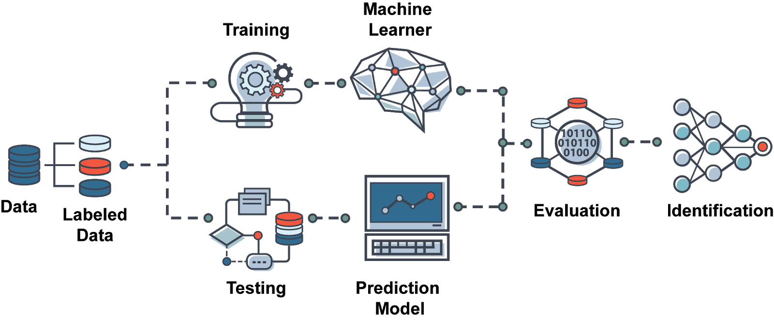
Yes, but we need localized images for model training
The bottleneck that FathomNet will address

Slide 5
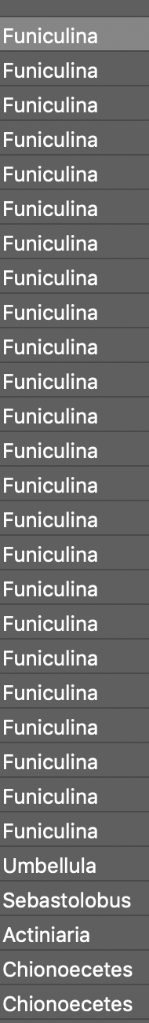
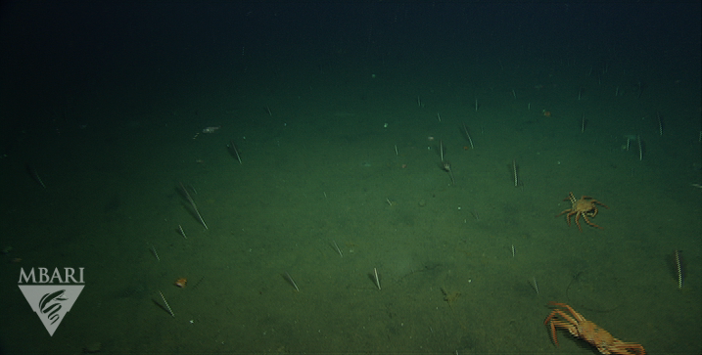
VARS annotations are like this….each image/video frame has a time stamp that relates objects seen with physical data collected by the ROV … but all we know is what was seen in the frame
Notes:
A bottleneck that we’ve identified is the lack of annotated images and video with localization.

Slide 6
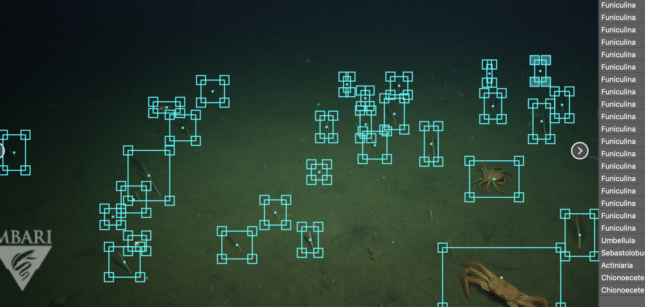
Machine learning model development and training needs localized annotations. E.g., we need to know what the object is (class, concept) and where it is (localization, bounding boxes, segmentation)
Notes:
A bottleneck that we’ve identified is the lack of annotated images and video with localization.

Slide 7
Can we use FathomNet to automate detection of targets in MBARI video data?
Can we use FathomNet to automate detection of targets in external partner video data?
Yes.

Slide 8
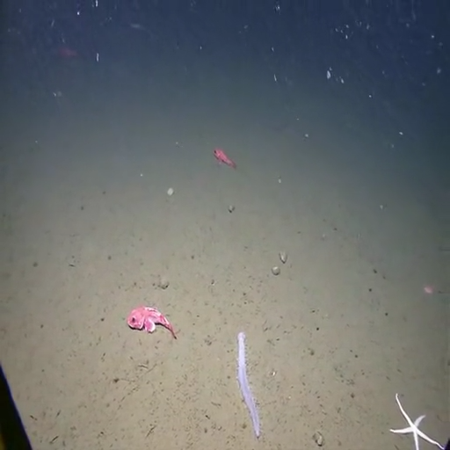
Benthic Animals
NOAA Okeanos footage, identifying Sebastolobus
Notes:
Weakly supervised learning using GradCam++ to generate bounding box proposals

Slide 9
ML Models
ML Model
Zoo
FathomNet
The world
ML morph
The world
ML order
ML family
Proposed labels
ML genus
Framegrabs & Annotations
Verified labels
Video Lab or
Non-
Experts
FathomNet
Staging
VARS
Incomplete labels
Human-in-the-loop
Database
Notes:
Project workflow

Slide 10
FathomNet potential
 | FathomNet (Current) | FathomNet (Future)
Frame grabs | 65,770 | ~1,000,000 (many more with digitized tape archive)
Annotations (without localization) |  | 6,500,000 + (potential localizations)
Classes | 20 Morphotypes 194 Genera | ~40 Morphotypes 374 Genera 846 Species
Images with localizations | 3,000 images, 26,000 localizations | TBD

Slide 11
Project Timeline
 | 2020 | 2021 | 2022
Milestone 1 | Develop FathomNet database architecture | Apply workflow with expert and non-expert validation on all VARS frame grabs (1M)
Milestone 2 | Establish ML workflow for bounding box proposals | Evaluate quality of FathomNet data using gold standard video sets - midwater and benthic transects | Pending video tape archive digitization: Augment FathomNet further using remaining legacy annotations and digital video
Milestone 3 | Establish human-in-the-loop validation pipeline
Milestone 4 | Add additional classification algorithms

Slide 12
Resource Needs
Infrastructure
Image storage and backup (onsite in 2020)
Publicly accessible server (onsite in 2020; later years will leverage external partnerships)

Slide 13
Resource Needs
Internal Engineering
Importing localization data into database
Editing/validating localizations within VARS/web interface
Metadata storage or aggregation
  for quick search and lookup of images and localizations
  database, REST API, Elastic Search, ?

Slide 14
Resource Needs
Staff
Software Engineering = 600 hours
VL Technician = TBD, e.g., 2 people at 50% time or 1500 hours would yield approximately 40k – 45k localized images
Project Management = 100 hours

Slide 15
Data
Data types: frame grabs, metadata (e.g., uuids, localization, annotation, sensor data) in 2020
Quantity: ~1 TB in 2020
Data management: share on Atlas/Titan with access for external collaborators
IP: None. FathomNet is open, using non-embargoed data

Slide 16
FathomNet Impact
Develop an underwater image training set and ML algorithms rivaling other image training sets in terrestrial applications.
Pushes the envelope for MBARI automated image/video classification.
Images/data/models can be used by data scientists to address diverse questions within ocean sciences.
Continue to leverage our external partnerships. In future years disseminating the data via a publicly accessible platform will significantly impact a number of areas:
  Academic - WHOI, MIT Media Lab, UH, Stanford, etc.
  Non-profit - MBA, NGS, OET, The Nature Conservancy, Schmidt Ocean Inst.
  Government - MBNMS (and other marine sanctuaries), NOAA
  Industry

Slide 17
Can we use FathomNet to know and predict what’s in the ocean and where for effective and responsible stewardship?
We think MBARI can and should because of our one-of-a-kind, expertly curated video archive. If not MBARI, then who?
Thanks!

