Slide 1
4K ROV Camera Development Abstract Presentation
May 22, 2019 – Mark Chaffey

Slide 2
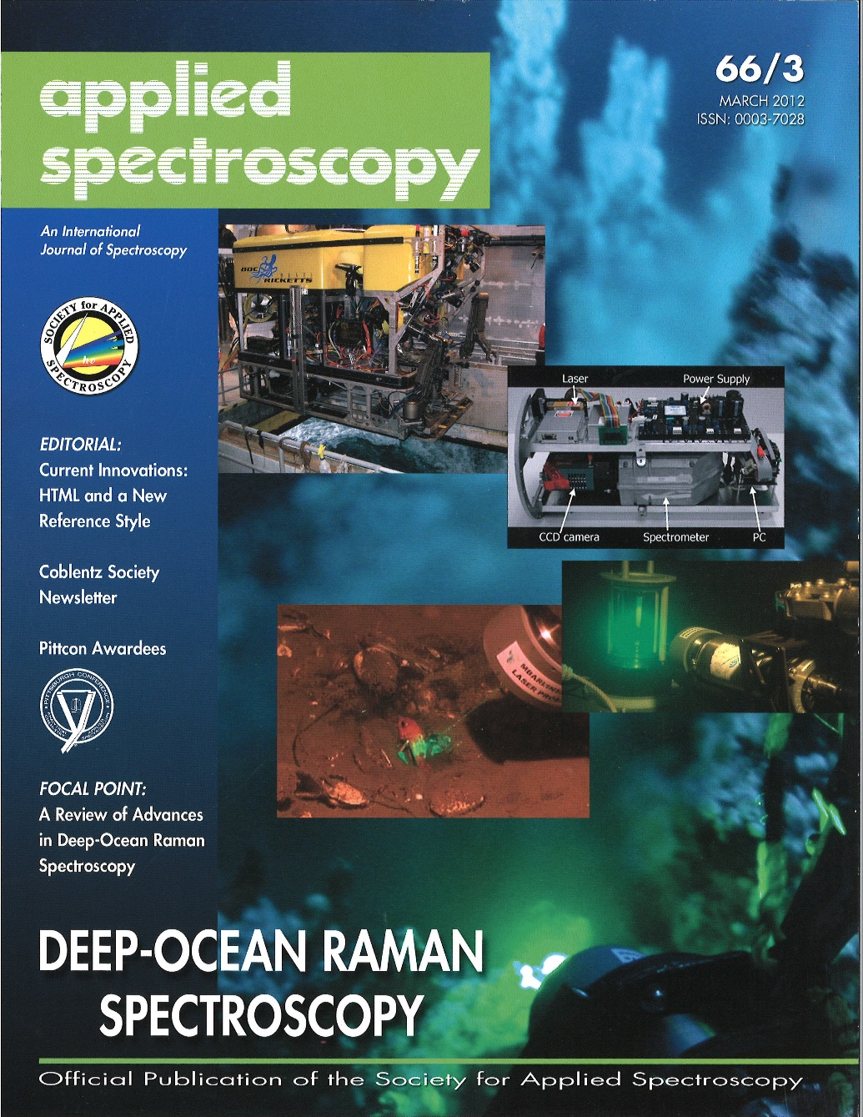



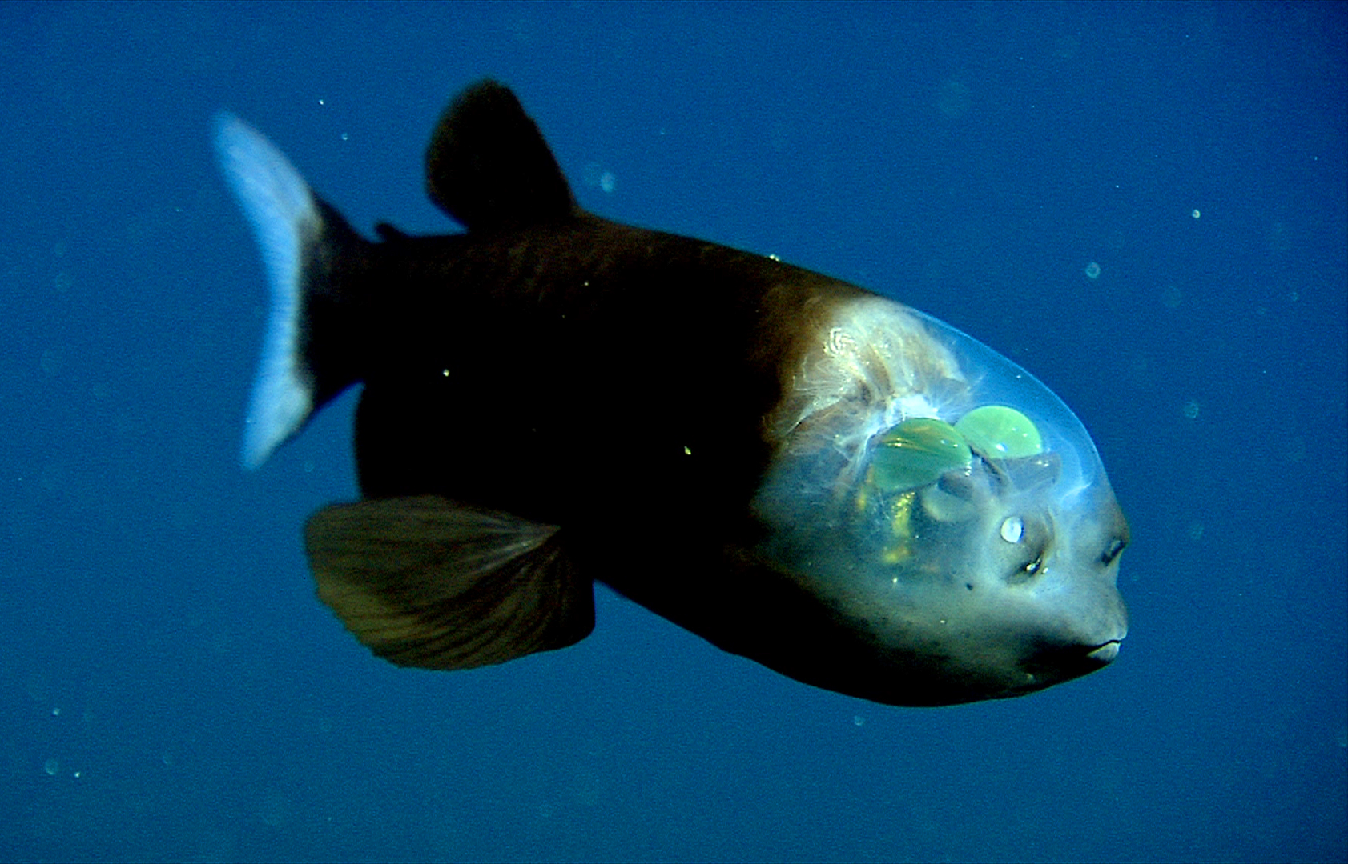
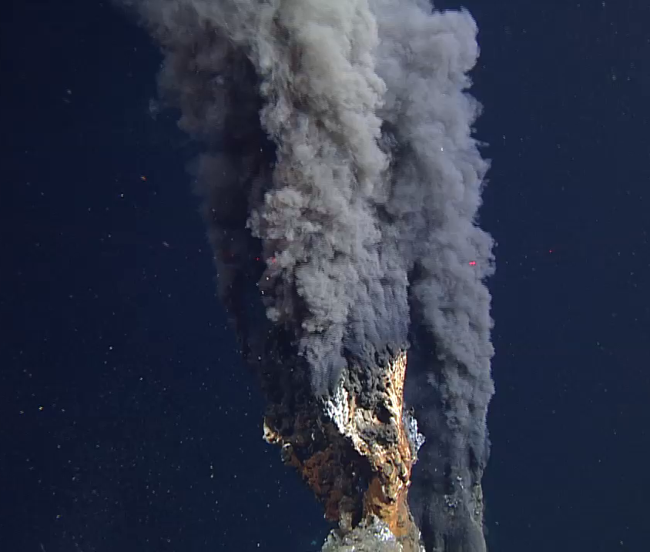
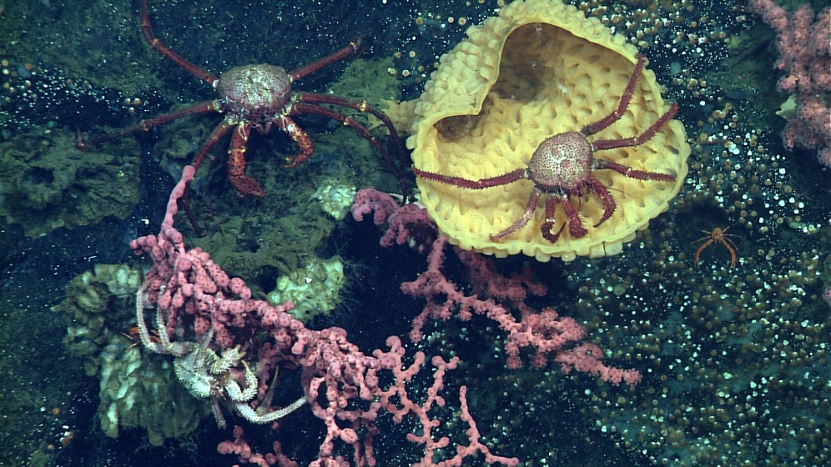
The Importance of ROV Video to MBARI’s Research Mission
Notes:
This is an example of one of the vent chimneys first discovered in the AUV mapping along the Alarcon rise.

Slide 3
How We Got Here – the History of Video Formats at MBARI
4K?
1988
1998
2018 Prores HQ Files 1920x1080 60i
Betacam SP
Analog
1995
2010
Digital Betacam 720x480 60i
1999
2020 +
Panasonic D5 1920x1080 60i
20 years + !!
2020?
Prores HQ Files 4096x2160 60p
4K Video!
Museum of Obsolete Media
Notes:
Museum of obsolete media!

Slide 4
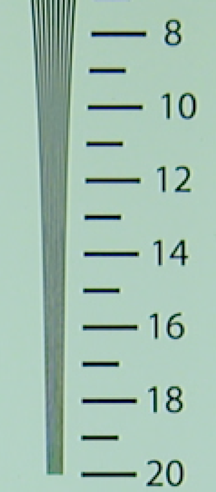
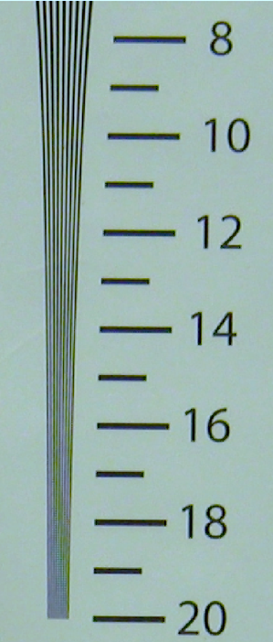
Advantages of 4K Video
i2MAP Test Tank Recordings Horizontal Resolution in Hundreds of Line Pairs/Picture Width
Imaged in 2K
Imaged in 4K
Four times the pixel resolution of current HD.
  Better resolution increases scientific insight.
  Provides high quality images for public outreach and education.
  Allows cropping of images for publication without too much visual degradation.
Images are scanned progressively.
  Eliminates interlace artifacts.
High quality camera modules are now available.
  2/3” 3-chip for excellent depth of field and sensitivity.
  Compact modules suitable for deep housings.

Slide 5
4k Technical challenge of long term data storage
4K video at 60 frames per second (4096 x 2160 60p) is a very large jump in the amount of data.
  Master level Apple ProRes Codec 422 HQ is about 848 Gigabytes per hour.
  Mezzanine level H.264 or H.265 Codec is around 10:1 or 85 Gigabytes/hr.
The MBARI Titan network share system has the capacity to support 4K video acquisition on MBARI’s main vehicles for at least 10 years.
Over a period of time the video data would grow to be by far the largest data share at MBARI.
Are there responsible ways to reduce the 4K total video data volume while preserving the value of video data thereby lowering the resource and capital cost? Yes!

Slide 6
Handling the Data – Annotation Selects 4K Video at Master Level, All Else Mezzanine (H.265?) Only
Video Clip Quality:
Master
Mezzanine
Offsite Backup Tape Archive
848 GB + /hour
All Master and Mezzanine Level 4K Video Files
Master and Mezzanine Level File Capture & write LTO tape (MBARI M3 System)
Temp File Store
Onsite Titan Disk and Tape store
4K Camera
X 2 ROV’s !
Some Master Else Mezzanine Level 4K Video Files
Shipboard
On-shore

Slide 7
Looking Ahead - Video Storage Cost Comparison
Stay with HD vs 20% 4K Selects
1080 60p video
4028 60p video
Pre-2018 D5 Tape Annual Cost
Pre-2018 D5 Tape Annual Cost

Slide 8
Looking Ahead - 2030 Storage Costs with 20% 4K selects

Slide 9
Major High Level Camera Requirements
Image quality
  Resolution
  Contrast ratio
  Color reproduction
Camera controls
  Zoom, focus and iris
  Black and white balance, shutter speed , etc.
Camera size and weight
Camera cost
Camera ease of maintenance
Full Requirements Doc: \\Atlas\ProjectLibrary\901900_MBARI_Advanced_Imaging_Infrastructure\EngineeringDesignDocuments\4KCameraRequirements

Slide 10
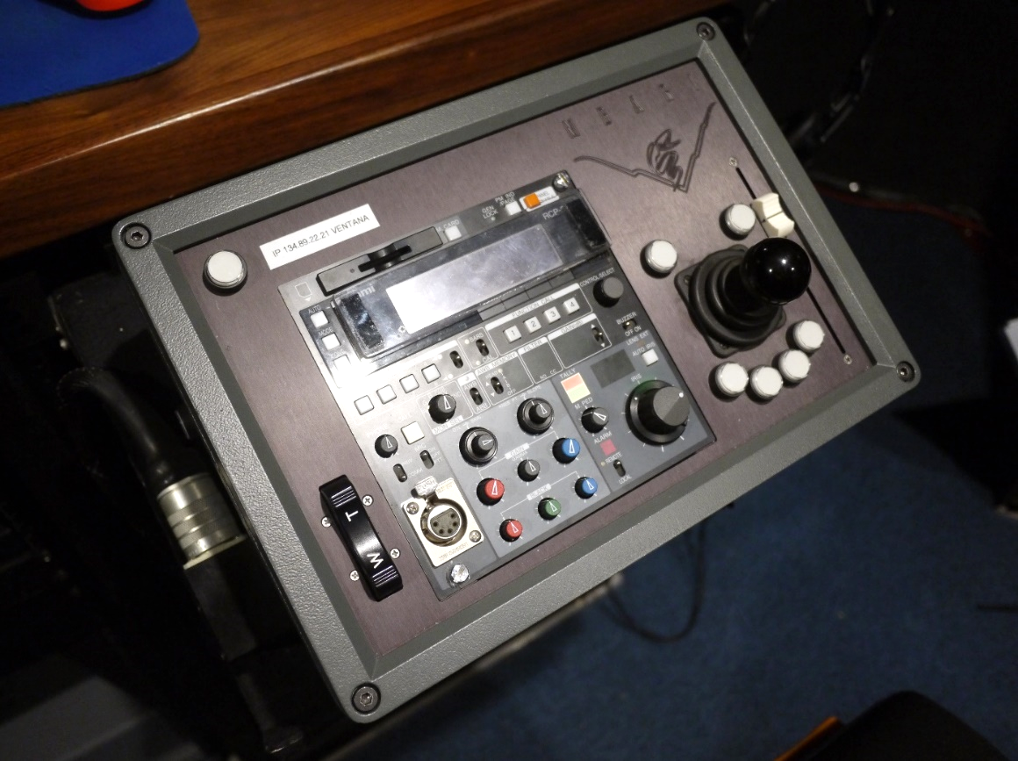
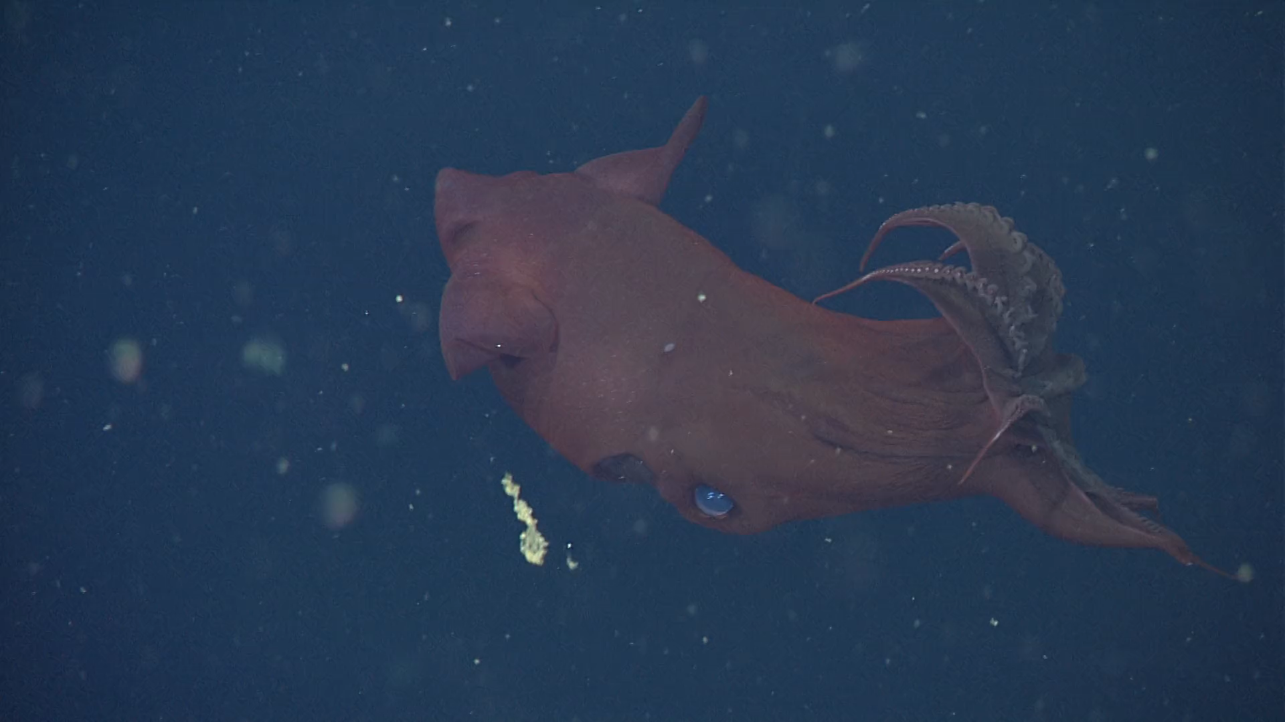
MBARI requirements for our main ROV cameras
MBARI requires professional quality zoom and focus controls!
Focus Position Slider
Pan & Tilt Control
Focus example
Zoom Rate Control Rocker Switch
https://www.youtube.com/watch?v=X8oWnbcLI40
Ikegami RCP
(2,794,882 views)

Slide 11
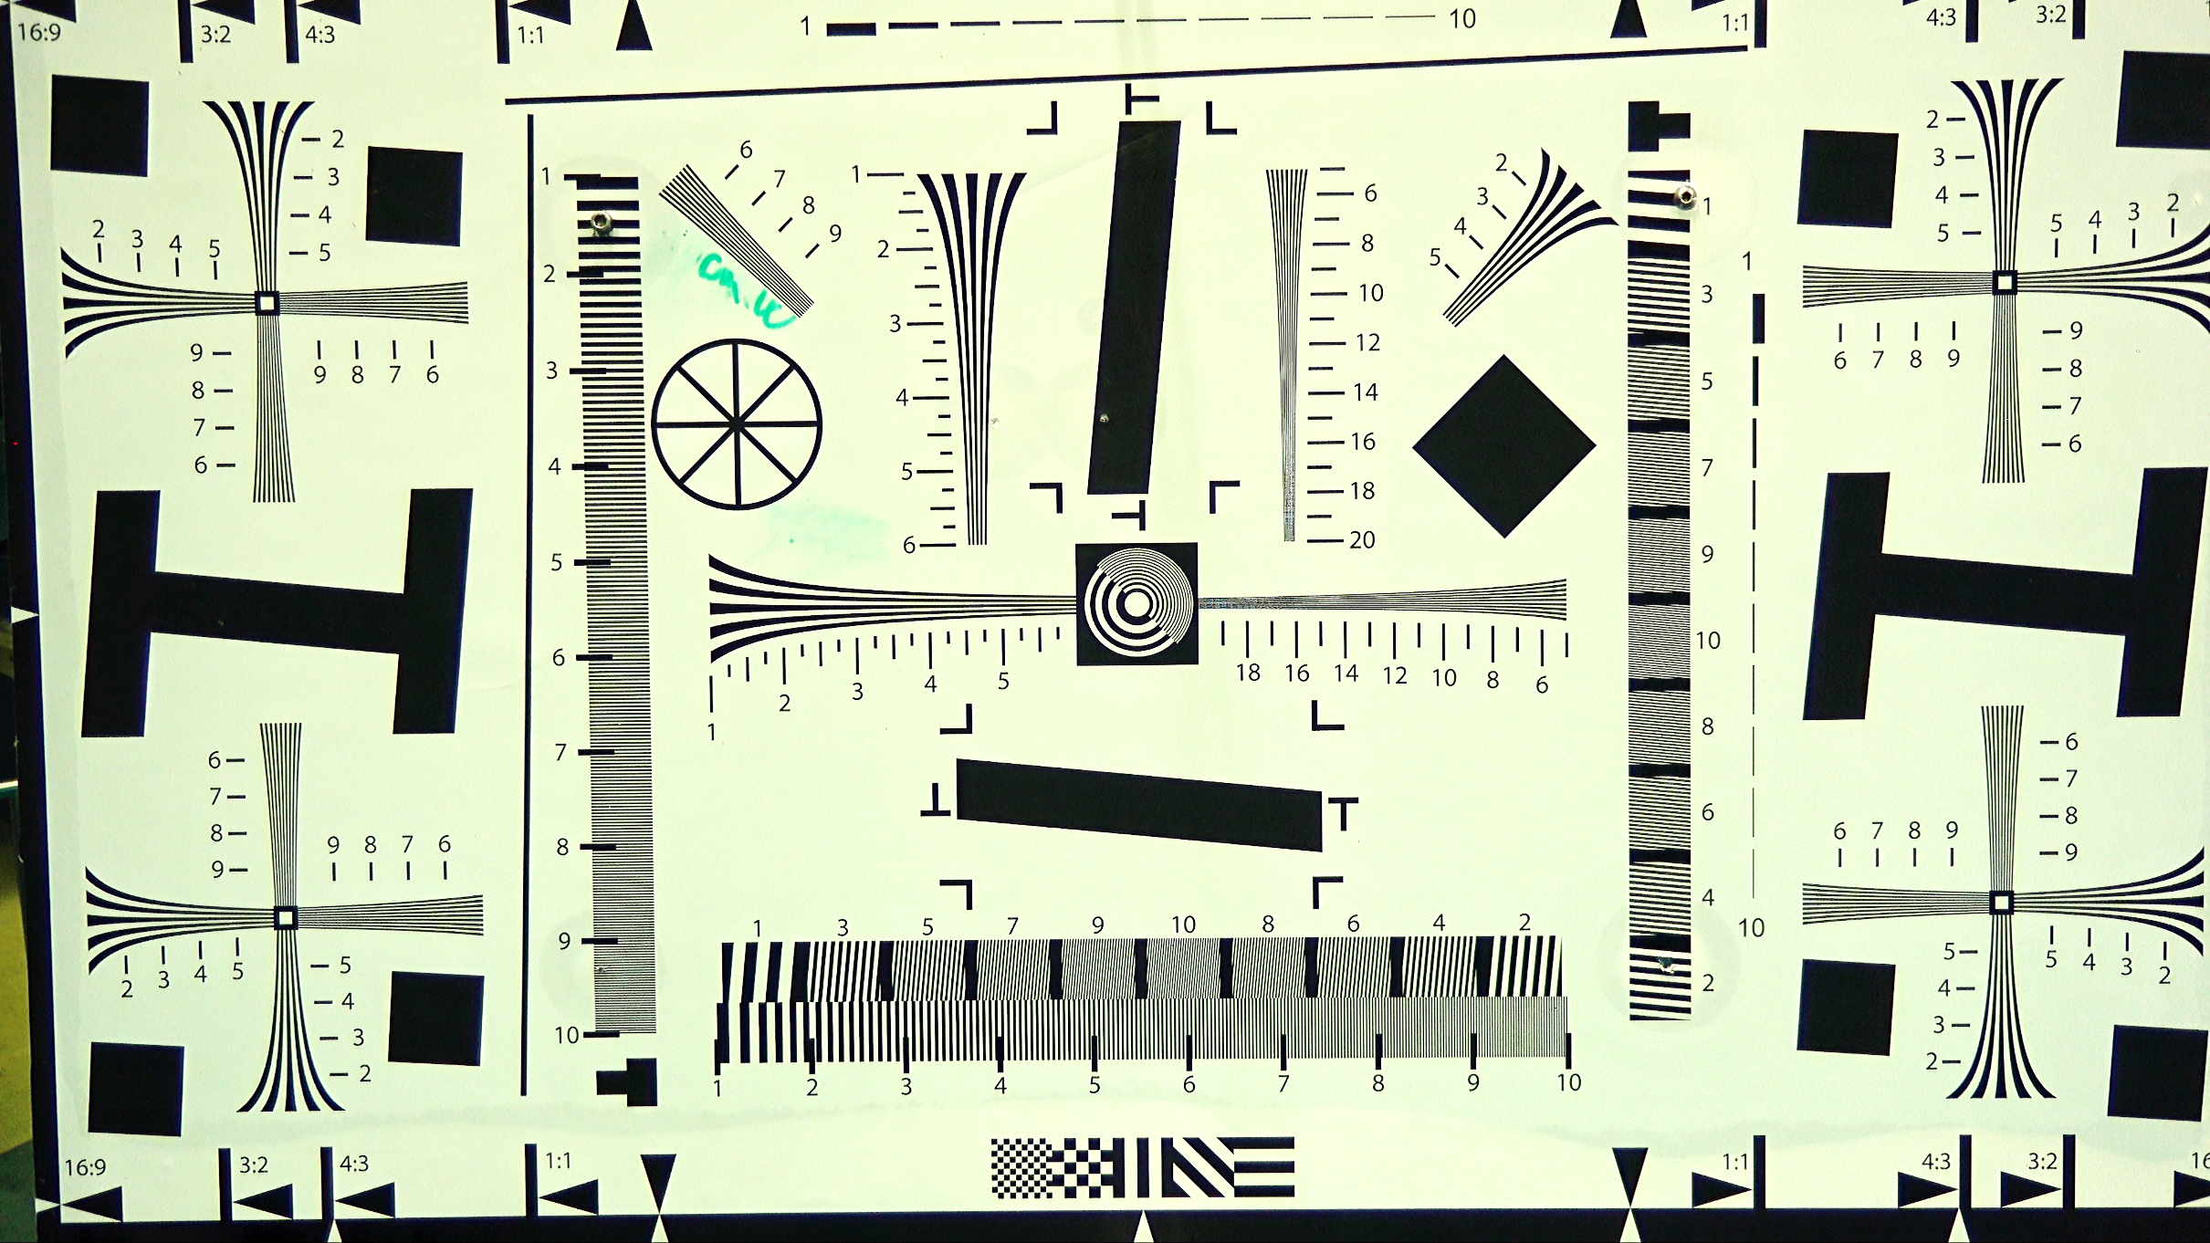
Corner resolution
Line pairs/PW
Chromatic aberration
Center resolution
Geometric distortion

Slide 12
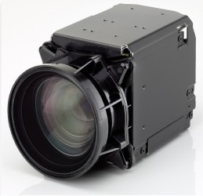



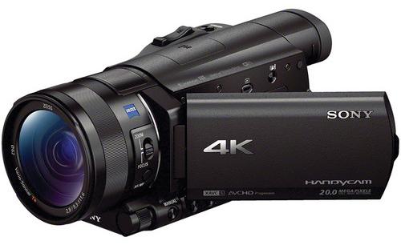


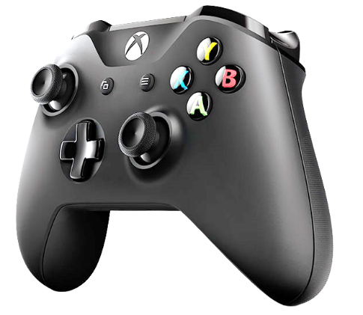
Tests of Commercially Available 4K Cameras
Building Blocks
DSP&L
Sony FCB-ER8550
SubC
Sulis
Sony FDR-AX100
i2MAP 4K
Insite
All commercial cameras tested had very poor lens controls…….

Slide 13
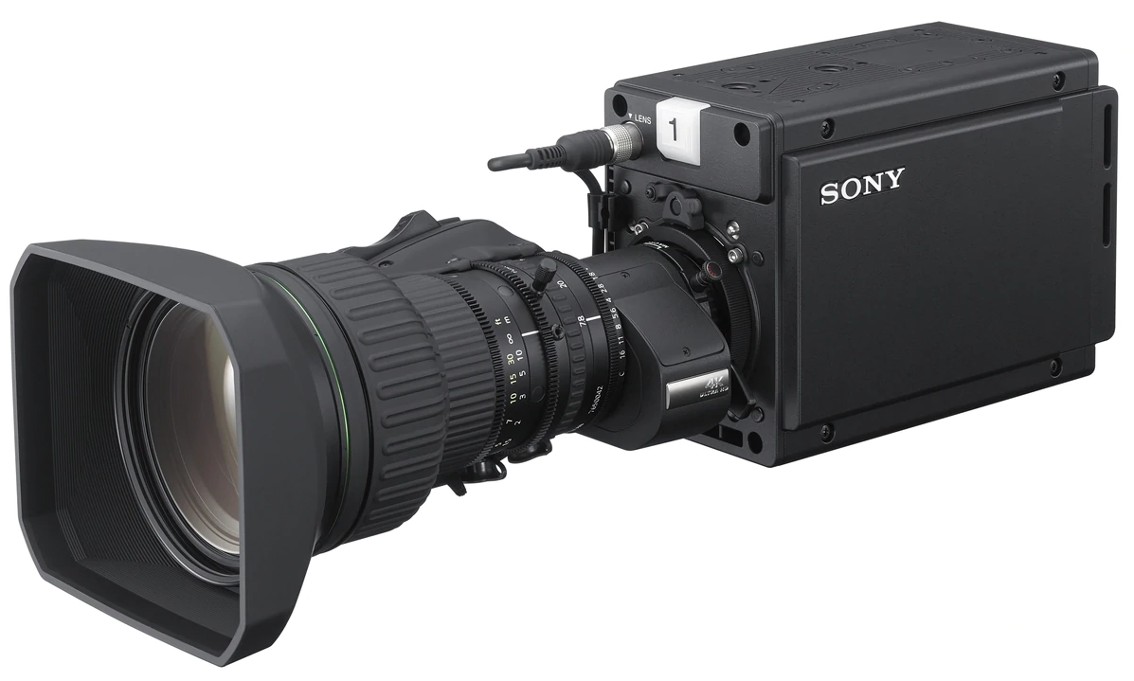
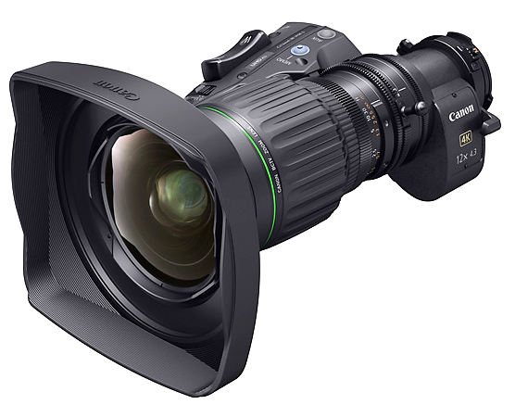
Best Candidate Camera Module
Sony HDC P50
  2/3” 3-Chip CMOS imager
  4096x2160 progressive scanning @ 60 frames/sec.
4K Resolution Lenses – very important!
  Fujinon UA13x4.5 BERA 4K UHD Wide lens with 13x Zoom
  Canon CJ12ex4.3B 4K UHD wide-angle lens with 12x Zoom

Slide 14
Camera Acquisition - Three potential paths forward
Purchase commercial system
  Reward
    Controlled cost
    Easy maintenance and replacement support
    Low MBARI technical risk
  Risks
    Lower quality
    High capital cost
Co-develop with commercial vendor and license our contribution
  Reward
    Maintain high quality
    Shared technical risk
    Easy maintenance and replacement support
  Risks
    Some technical risk
Develop and build in house
  Reward
    Maintain high quality
    Lower capital cost
  Risks
    Technical risk
    Higher engineering time commitment
    Maintenance and replacement support can be more difficult
    Unable to provide systems to outside partners

Slide 15
Camera Progress to Date
Requirements developed and shared with vendors.
Trying to qualify vendors who we are confident can do a good job.
  Sulis camera and Subsea have expressed interest.
  Need to contact additional potential vendors.
The next step is to establish a final vendor list and issue an RFQ and evaluate the response.
Simultaneously continue discussions on co-development.

Slide 16
Conclusions
MBARI invests a tremendous amount of capital and resources on video acquisition, processing and maintaining the video library.
Striving for the highest quality feasible for acquisition increases the value of all subsequent investments.
MBARI is well positioned to once again take a big step forward and be a leader in deep sea video imaging.
Notes:
The higher the quality of the video the more valuable it is for MBARI’s research interests.
In addition the Aquarium is working extensively with video for public education with exhibits, including video walls and a very active YouTube channel. YouTube now depreciates content not in 4K. The aquarium provides MBARI a very active outlet for high quality content. Our access to the deep sea is unparalleled – our imaging should be also.
The truth is in the seeing and we ran an i2MAP transect in 4K resolution in order to not interrupt these presentations we can show it over the lunch break. Thanks to Todd
Finally….

Slide 17
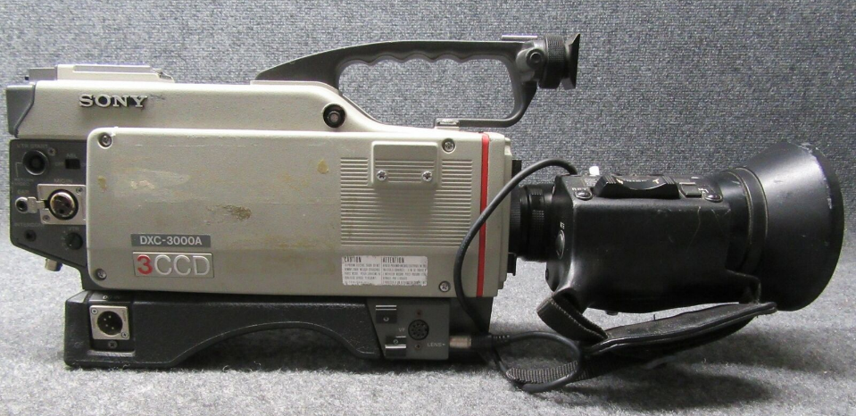
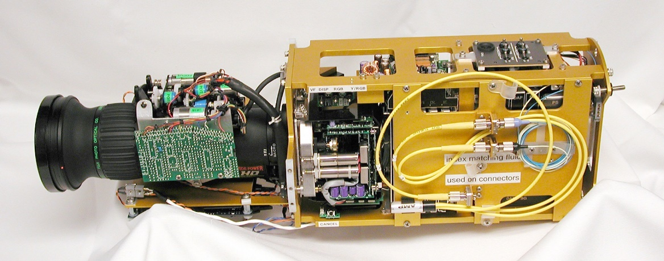
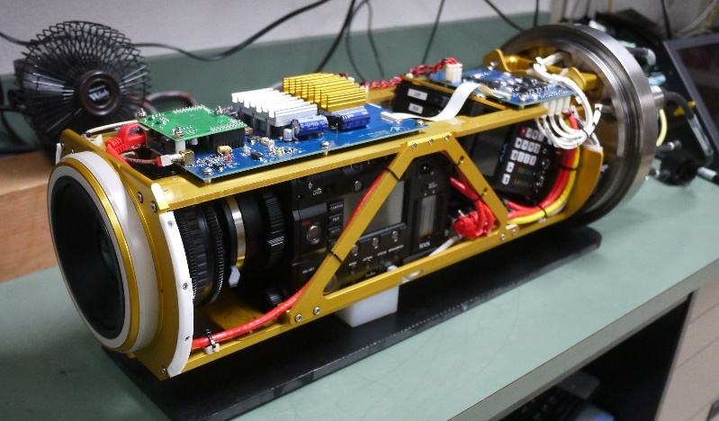
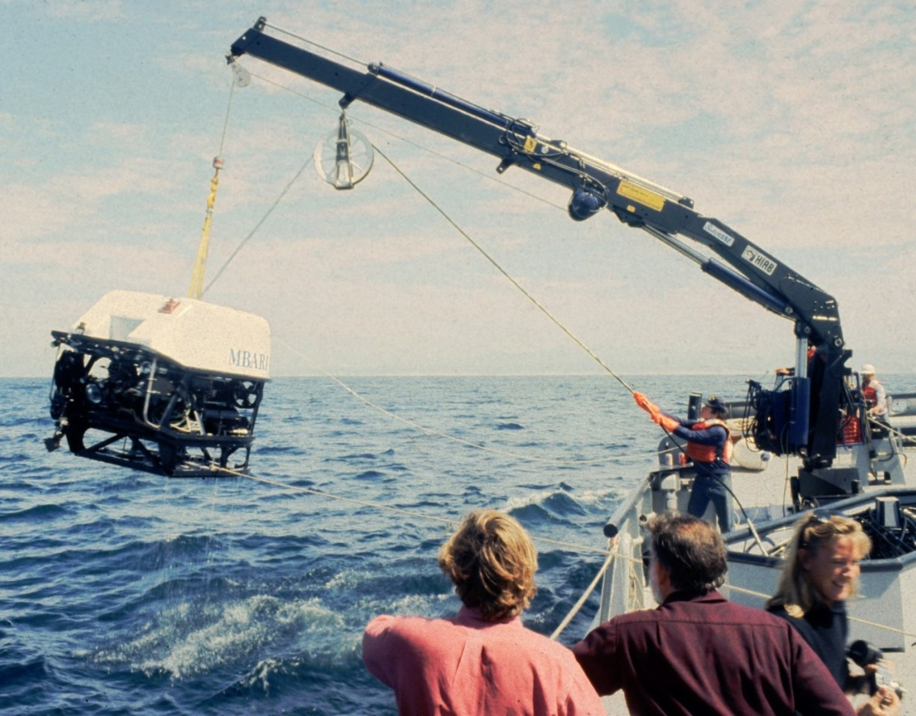
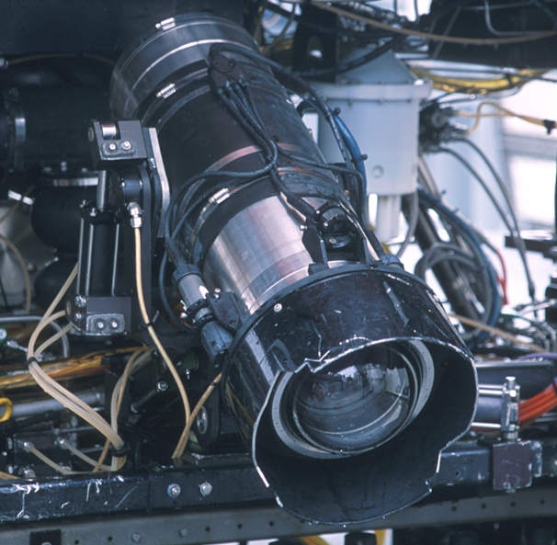
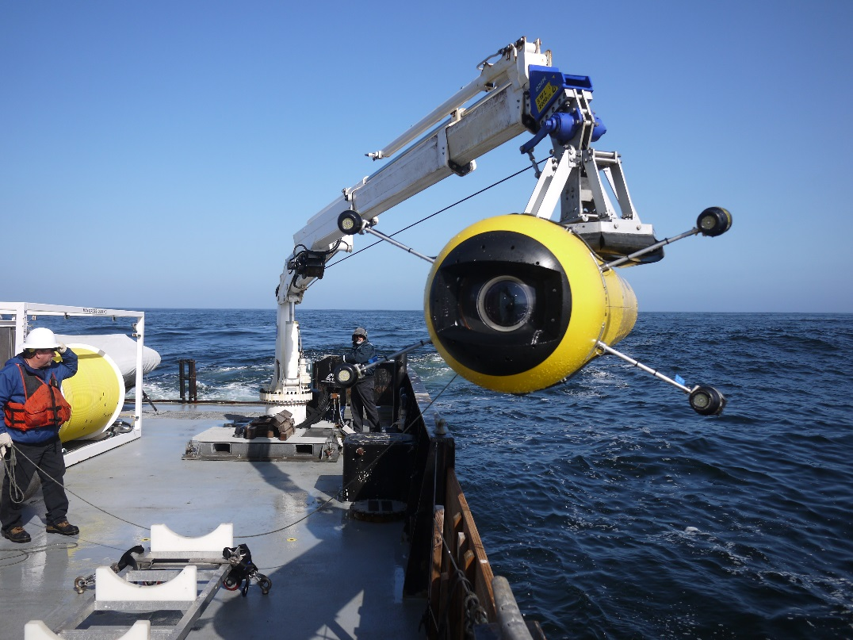
Previous Work ……

Slide 18
End Slide

