Slide 1
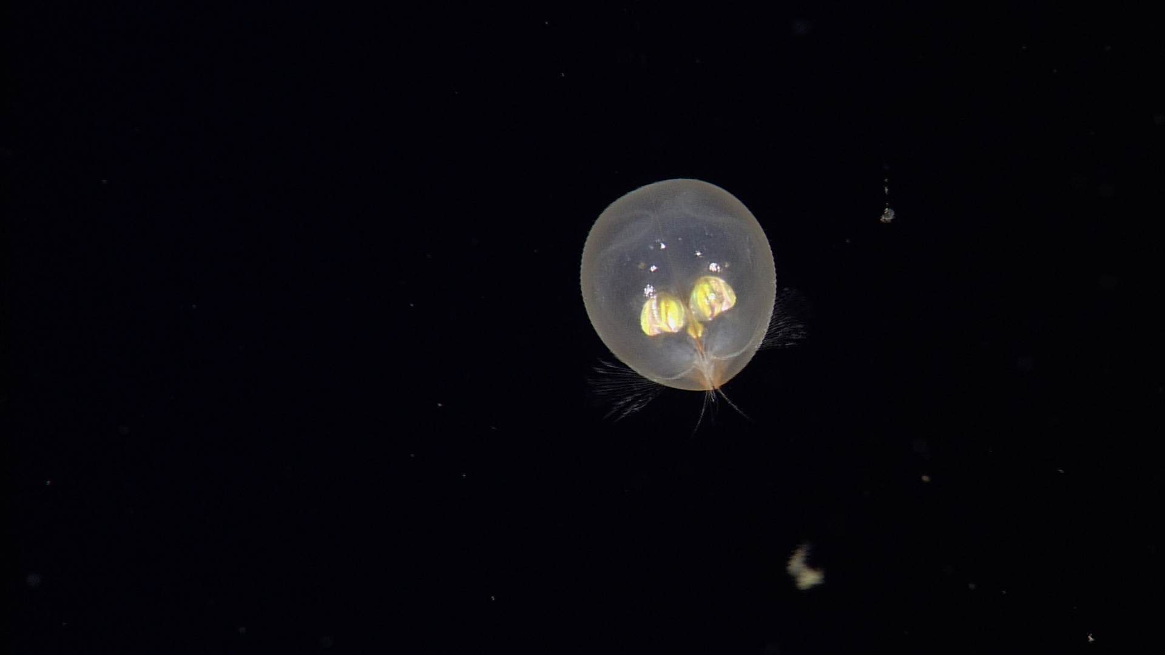
Planktivore:
In-Situ Microscope
Thom Maughan (PM) 22 May 2019
Notes:
‘Plank’ton = the small and microscopic organisms drifting or floating in the sea or fresh water, consisting chiefly of diatoms, protozoans, small crustaceans, and the eggs and larval stages
‘I’ = Image, internet digitized and processed
‘Vore’ = Devour, Eat, Digest

Slide 2
Planktivore: Plankton Imaging and Particle Size Instrument
What: In-Situ Plankton Microscope (10µm to 2cm) with particle size spectra.
  Integrated with MBARI assets: LRAUV, Glider, Profiling float, ROV
Why: Biological Oceanography, imaging primary producers and consumers
  Current imaging methods have a “blind-spot” at critical size ranges
How: Enhanced version of Scripps Zoocam, MBARI engineering and fabrication
Success: MBARI Scientists use the instrument for new insights and discoveries, Tech Transfer to benefit Biological Oceanography
Notes:
Paul Roberts originated the idea, but is full time on EyeRIS

Slide 3
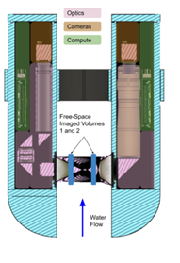
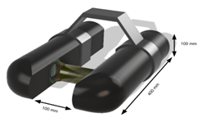
Planktivore at a glance

Slide 4
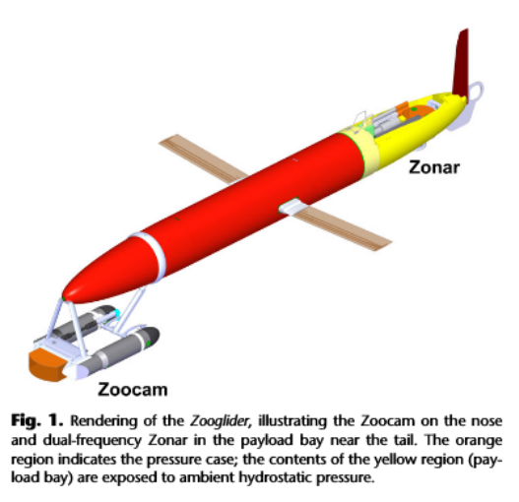
Planktivore: ‘What’
Free-space, free-flow Plankton Microscope for MBARI assets
  New concept originated by Paul Roberts to better utilize the housing volume for extended magnification and illumination modes
  Serial Instrument for LRAUV, Glider, Profiling float, mini-ROV, ROV (2000m)
  Leverages design from field proven Scripps Zooglider / Zoocam (Ohman)
  Designed for persistent deployments, bio-fouling mitigation
  ~$12K cost of build
Two magnification ranges
  10µm to 2cm with real-time particle size stats and automated id
Three illumination modes
  Shadowgraph
  Darkfield
  Holographic

Slide 5
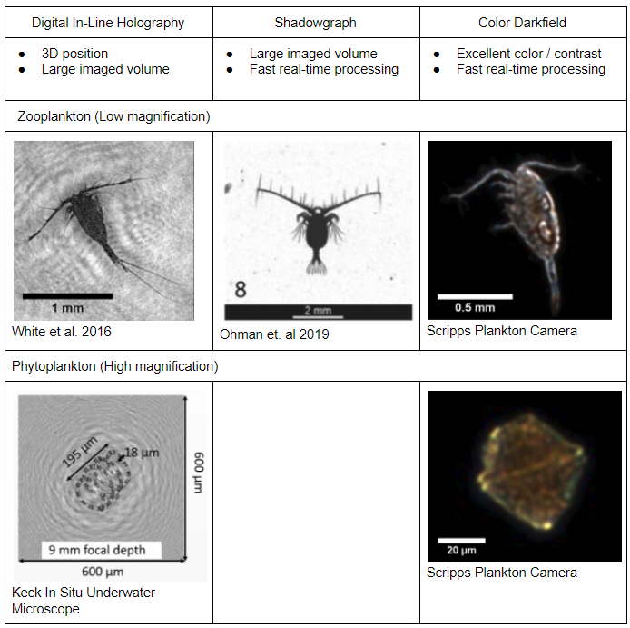
Illumination Modes
Holography
  Pro: 3D position and large imaged volume
  Pro: High resolution
  Con: Dense 3D reconstruction is computationally intensive
  Con: Reconstructed images suffer from speckle noise
Shadowgraph
  Pro: Larger imaged volume than darkfield
  Pro: Fast ROI processing is straightforward
  Con: Smaller imaged volume than holography
  Con: Lower optical resolution than holography
Color Darkfield
  Pro: Excellent color reproduction and high contrast for transparent objects
  Pro: Fast ROI processing is straightforward
  Con: Small imaged volume compared to other methods
Notes:
Holography
Pro: 3D position and large imaged volume
Pro: High resolution
Con: Dense 3D reconstruction is computationally intensive
Con: Reconstructed images suffer from speckle noise
Shadowgraph
Pro: Larger imaged volume than darkfield
Pro: Fast ROI processing is straightforward
Con: Smaller imaged volume than holography
Con: Lower optical resolution than holography
Color Darkfield
Pro: Excellent color reproduction and high contrast for transparent objects
Pro: Fast ROI processing is straightforward
Con: Small imaged volume compared to other methods

Slide 6
Planktivore: ‘What’
Modular and software configurable to optimize for the science usage scenario
  Commercial off-the shelf (COTS) machine vision cameras, USB3, c-mount
    Accommodates ‘machine learning enabled’ camera roadmap
  COTS optics
  Sampling rate and lighting modes are configurable - tradeoff between rate, power consumption, storage, and availability of real-time size spectra.
Embedded ‘HiPP’ aka High Performance Processing:
  Image processing for real time data reduction >1000:1 (ROI detection)
  Particle size spectra
  Automated classification - copepod, marine snow, etc.
  Roadmap to automated species identification
Depth: 2000m housing
Power Consumption
  Software configurable, TBD based on science requirements

Slide 7
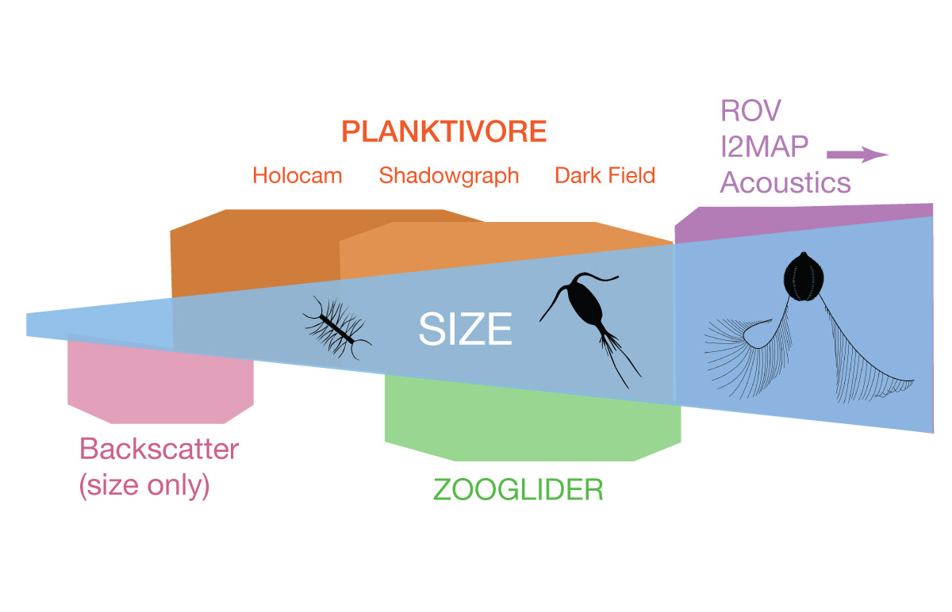
Planktivore: ‘Why’ - Fills the gap between 10 µm to 2 cm
Plankton Imaging Instrument Technologies:
Size | Instrument Technology
< 100 um : | Optical backscatter and fluorescence (LISST or similar VSF methods)
10 um - 1 mm | Planktivore side A: In situ microscopy with 5x magnification
200 um - 2 cm | Planktivore side B: In situ microscopy with 0.5x magnification (Similar to EyeRIS)
100 um - 0.5 cm | Waveglider plankton microscope (SilCam 0.125x)
> 1 cm | In situ macroscopy (i2MAP, mesobot)
> 1 m | In situ acoustic imaging
Notes:
Is there a commercial in-situ microscope available? Not with the magnification range or versatility of illumination. Make vs Buy
CiPics, ISIIS, mini-ISIIS, 4Deep, Sequoia, Zoocam, IFCB - these dont integrate and real-time (Mark Benfield paper on comparison)
Size ranges: planktivore, EyeRIS, I2map, acoustic backscatter
Validating or replacing or complementing Proxy instruments (backscatter, fluorometer, eDNA, biolume)

Slide 8
Planktivore: ‘Why’ - Biological Oceanography
MBARI has perhaps the richest collection of high-resolution underwater imagery of plankton and many other organisms at the macro scale ( > 2 cm).
The ESP provides targeted genomic analyses at unprecedented space-time resolution in situ.
There is a space-time gap between these two data streams that many key ecosystem players inhabit. Below 2 cm and above 10 um there are a host of critical phyto- and zooplankton.
The system we propose to build will fill this gap and provide complimentary high-quality imagery that could offer unprecedented insight in to the interactions of the microscopic plankton world.

Slide 9
Planktivore: ‘Why’ - Biological Oceanographers
Steve Haddock
  Complement to proxy instruments (biolume, fluorescence, water samples, eDNA)
Henry Ruhl
  Porthole, size spectra
  GOOS/ IOOS / CENCOOS - essential ocean variables, planton biomass and diversity
    photogrammetrically defined data quality, closer to the metrology of physcial oceanography
Francisco Chavez
  CANON adaptive sampling
  Time series, hot spots
Jim Barry
  Coral life studies
Ken Smith
  Profiling a Carbon pulse
Bruce Robison
  Nested scale with i2map
Andrea Fassbender
  Microscope integrated with DIC underway system
Kelly Benoit-Bird
  Interested, Complement to acoustical
Kakani Katija Young / Paul Roberts
  Synergies with EyeRIS Engineering
  Possible interest at a later time

Slide 10
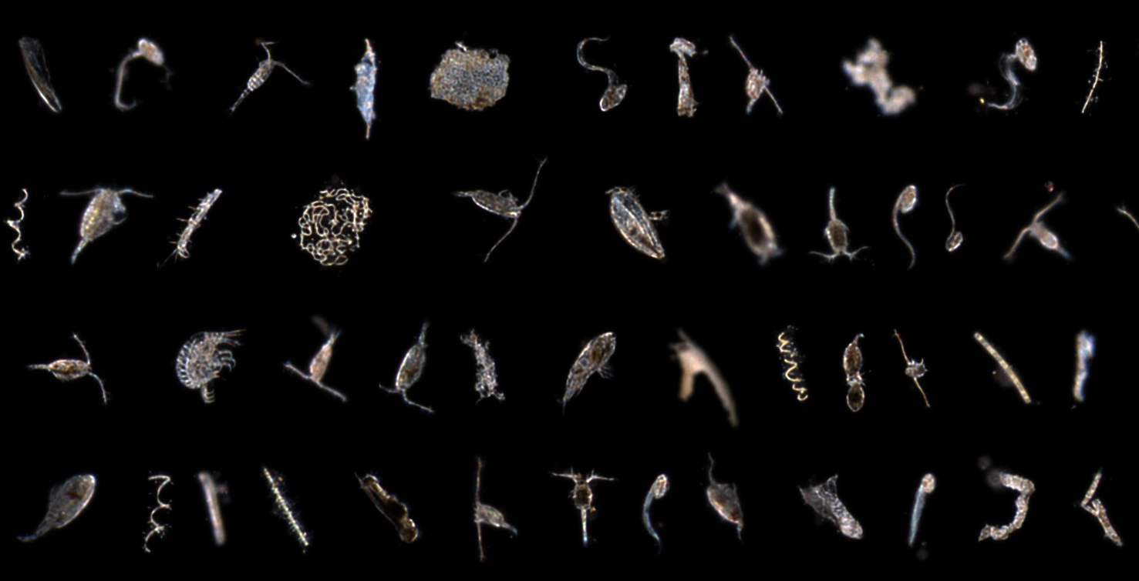
Planktivore: Darkfield Plankton at 0.5x
1 mm

Slide 11
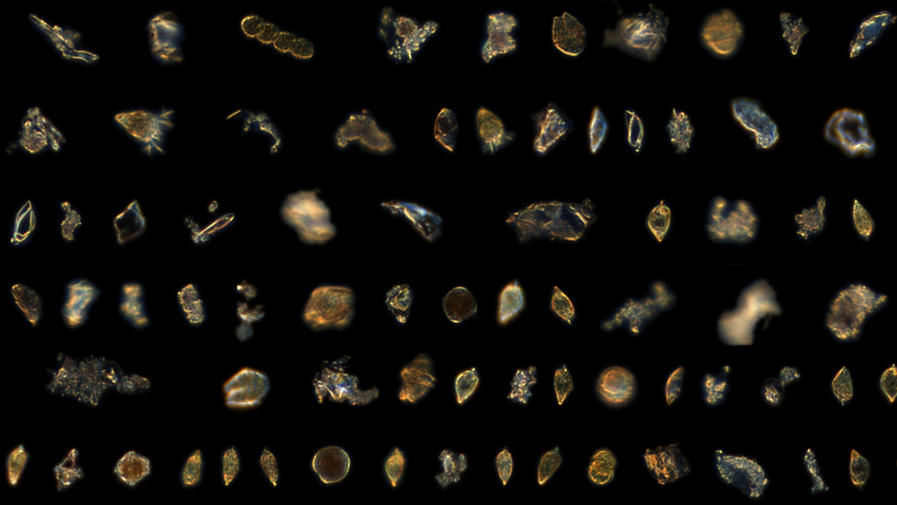
Planktivore: Darkfield Plankton at 5.0x
70 um

Slide 12
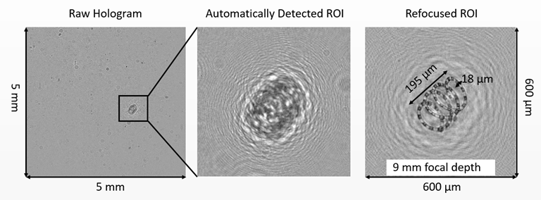
Planktivore: High-Resolution Holographic Water Profiling
Record raw holographic video of phytoplankton during instrument profiles
  Large, 1 ml/s volume sample rate (very good sample statistics)
  High-resolution images (eg: diatom chain)
Keck In Situ Underwater Microscope: http://jaffeweb.ucsd.edu/research-projects/keck-microscope/
Notes:
Serial Instrument:
Usage scenario 1: integrated on LRAUV with instrument driver that provides size spectra and possibly organism classifications - used for dynamic sampling (Yanwu).

Slide 13
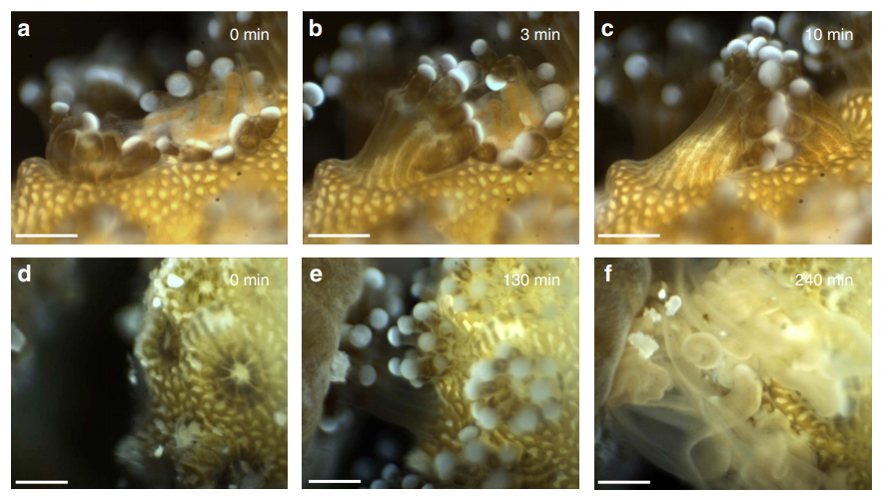
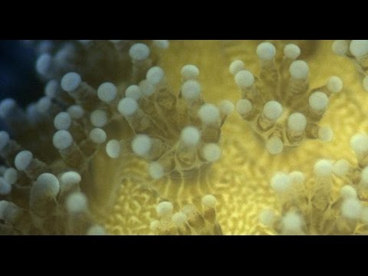
Planktivore: Microscale Coral Imaging
Observe still imagery and video of microscale environment around corals.
  Micro-PTV for studying fluid-coral interactions
  Monitoring sub-surface flow of liquids in coenosarc
  Spatial pattern analysis at the polyp scale
  Interactions between coral species
Mullen et al. 2016 / | DOI: 10.1038/ncomms12093
https://www.youtube.com/watch?v=Gf-cxm-KeK8
Notes:
Serial Instrument:
Usage scenario 1: integrated on LRAUV with instrument driver that provides size spectra and possibly organism classifications - used for dynamic sampling (Yanwu).

Slide 14
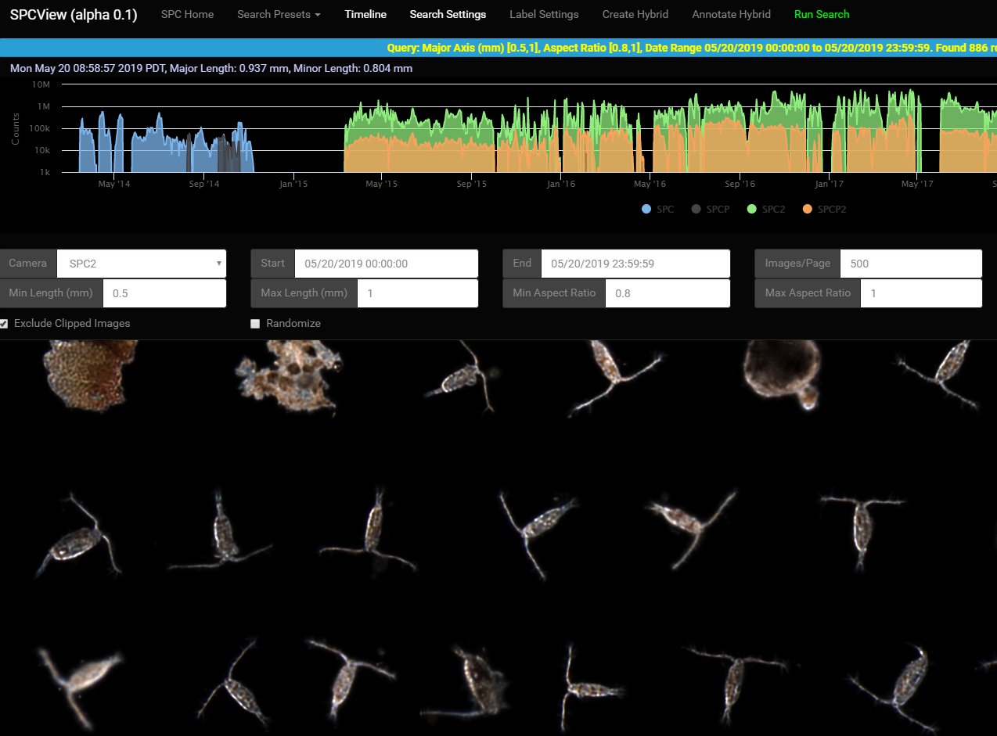

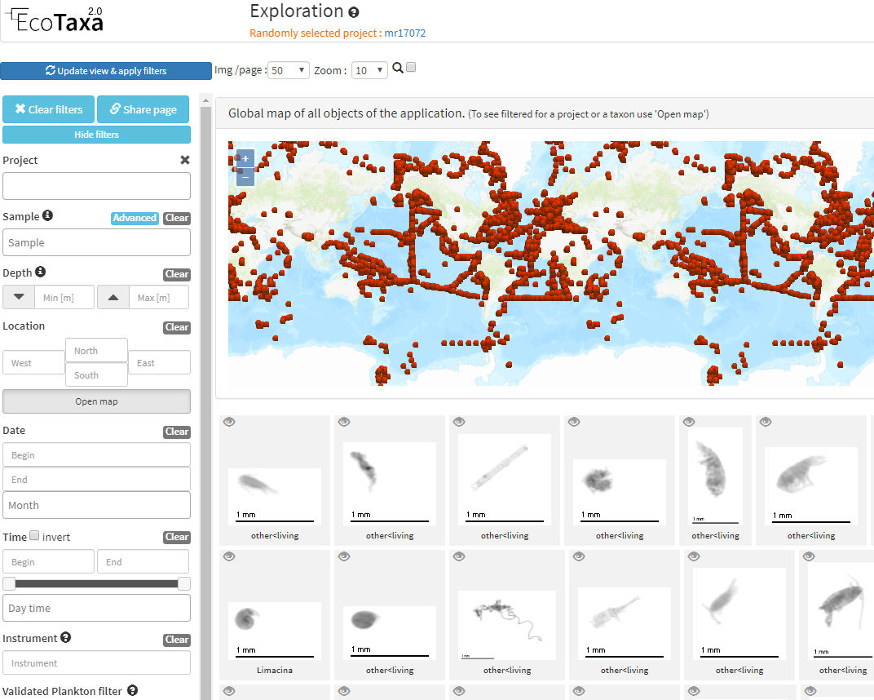
Planktivore: Off-The-Shelf Data Management Options
Scripps Plankton Camera
Open Source, Python/Django/Javascript
Hosts 1 billion images currently
Taxonify
Open Source, Python/Flask/Javascript
EcoTaxa
Closed source?
Supports a range of plankton cameras
Notes:
Serial Instrument:
Usage scenario 1: integrated on LRAUV with instrument driver that provides size spectra and possibly organism classifications - used for dynamic sampling (Yanwu).

Slide 15
Planktivore: ‘Why’ - Image Processing / Data Reduction
Data storage requirements if NO image processing.
  First year 10 TB, First 3 years 60 TB
  At max framerate (limited by USB3 transfer to 2 TB disk) is 1.8 hours
  At 2 Hz with raw 20 MP images and 2 TB disk, it takes 13.8 hours
Image processing ‘on the fly’ for data reduction by saving ROI (1000:1)
  Run for 1800 hours on 2TB storage. Storage stops being the limiting factor!
Image processing for size spectra is an incremental computation step
Machine learning for class identification builds on ROI
Machine learning for species identification builds on ROI
There are some wonderful things happening (<2W) in the hardware and software roadmap in the ‘edge processing space’ !!!
Notes:
ROI is region of interest

Slide 16
Planktivore Block diagram (½)
Illum
Edge processing camera, ex. Firefly
Image
Processor
Machine Vision Camera
Telecentric Optics
usb3

Slide 17
Planktivore: ‘How’
Year 1
  Science use case priorities, Requirements, Design Review,
  Test and Development plan
  Mechanical, Electrical, Optical, Software Engineering to design and fabricate Planktivore
  Waveglider HiPP towbody field deployments, plankton image acquisition
Year 2
  Field trials, basics
  software, intelligent sampling, region of interest
  Intersect ‘edge processing’ smart camera roadmap
  shore-side processing workflow
Year 3
  Enhanced onboard processing, machine learning
  Iteration for additional science use case
  Embellish FathomNet with plankton <2cm
  Tech Transfer

Slide 18
Collaborations
Scripps
  Scripps has a trove of plankton imaging and identification data, techniques and models
  Ohman, Jaffe, Orenstein, Ellen
IBM Almaden
  IBM Almaden (Tom Zimmerman, Simone Bianco) on energy efficient unsupervised machine learning, video analytics for plankton identification
Open Robotics
  Morgan Quigley - ‘edge processing’ hardware design for smart cameras deployed on robots

Slide 19
Thank you!
Questions?
www.mbari.org

