Slide 1
Deep Learning
A mathematical technique to detect or classify patterns in data using multiple levels of representation, where the representations (features) are automatically discovered (learned) from the data.
LeCun, Bengio, Hinton. Deep Learning. Nature 521, 436-444 (28 May 2015) doi:10.1038/nature14539

Slide 2
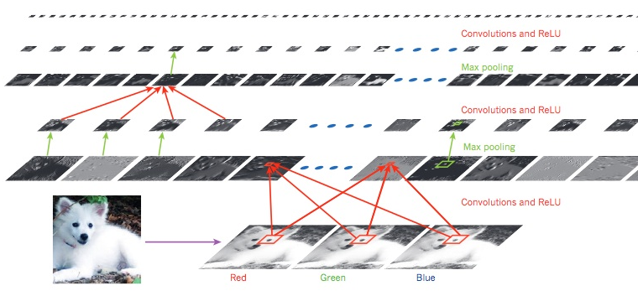
Deep Learning: Neural network
Notes:
Example of a Deep-Learning technique applied to image classification. Here, a convolutional neural network is used to classify an image of an animal correctly as a Samoyed dog, as distinguished from other kinds of dogs or other visually similar species, such as arctic fox or white wolf.

Slide 3
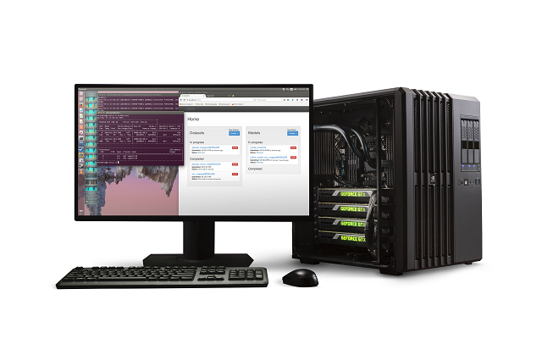
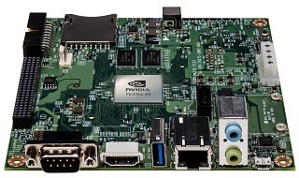
Deep Learning: Convolutional neural networks (CNNs)
DevBox for training
Deploy trained models on embedded platform
NVIDIA Jetson TK1
NVIDIA DIGITS DevBox

Slide 4
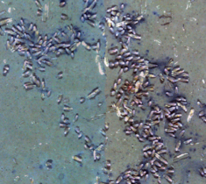
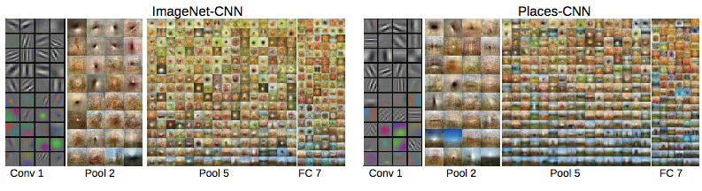

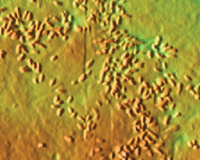
Embedded CNN application
Classify or Detect
Reason
Action
increase image
resolution
slow vehicle
clam
fine sediment
rocky
many clams
rocky slope
Notes:
Fine sediment vs rocky

Slide 5
Video Data
Modernize digital video access to enhance science utilization and institutional data curation.
Constraints:
  Mobile acquisition systems
  Extremely high-quality video > high bandwidth (massive storage requirements)
  Enable timely, customized access
  Scalable, cost-effective solutions
  Evolving technology landscape
Feasibility study: Evaluate opensource deep-learning based classification systems for “An integrated MBARI time-series” project key-species, for overall ocean carbon assessment

Slide 6
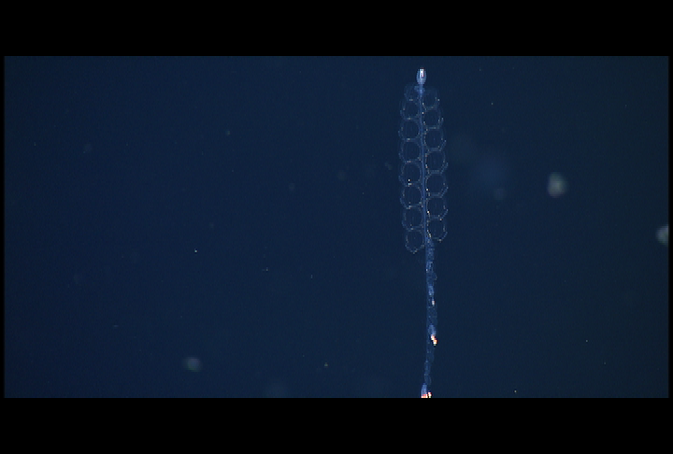

Slide 7
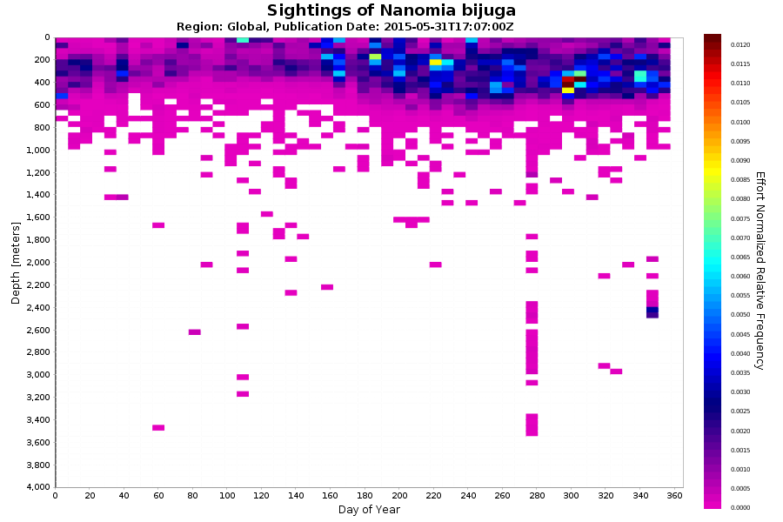

Slide 8
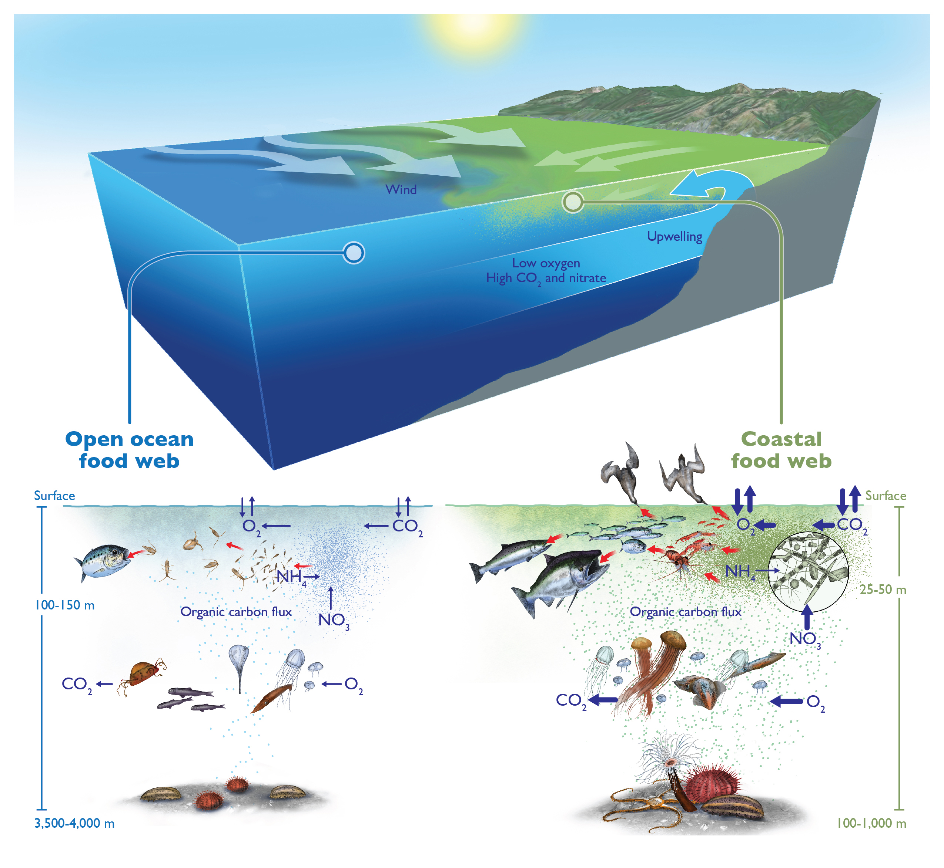
Deep Learning: Convolutional Neural Networks (CNNs)
DevBox for training
Model species distribution, abundance, and biomass
NVIDIA DIGITS DevBox
Assess total organic carbon flux to understand the oceanic ecosystem under changing climatic conditions

Slide 9
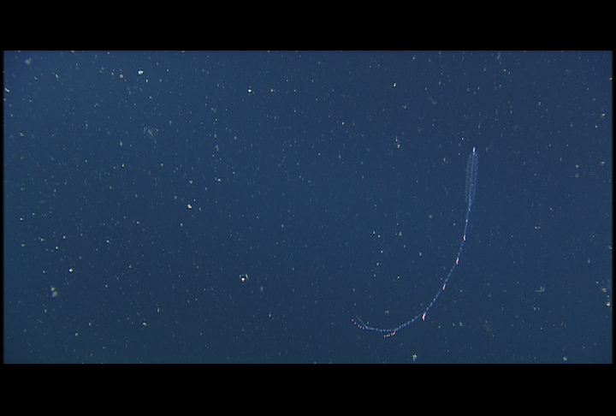
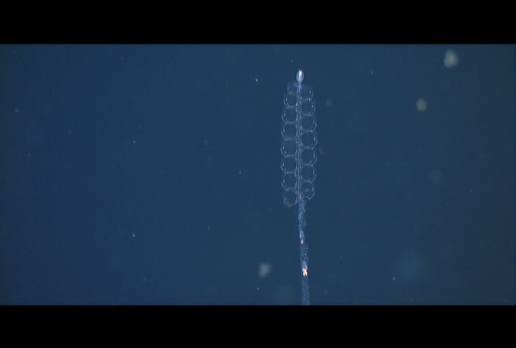
Application
Classify or Detect
Reason
Action
-model the distribution
-assess biomass
-calculate carbon budget
Refine sampling protocol
-many species
-integrated time-series
-correlated environmental data
individual species (e.g., Nanomia bijuga)
Notes:
Future cross cutting technologies that can enable on many fronts. On board embedded in vehicles or for desktop analysis.

Slide 10
Machine Learning Workshop
Progress so far….
What is being planned?
Infrastructure?
Expertise???

