Slide 1


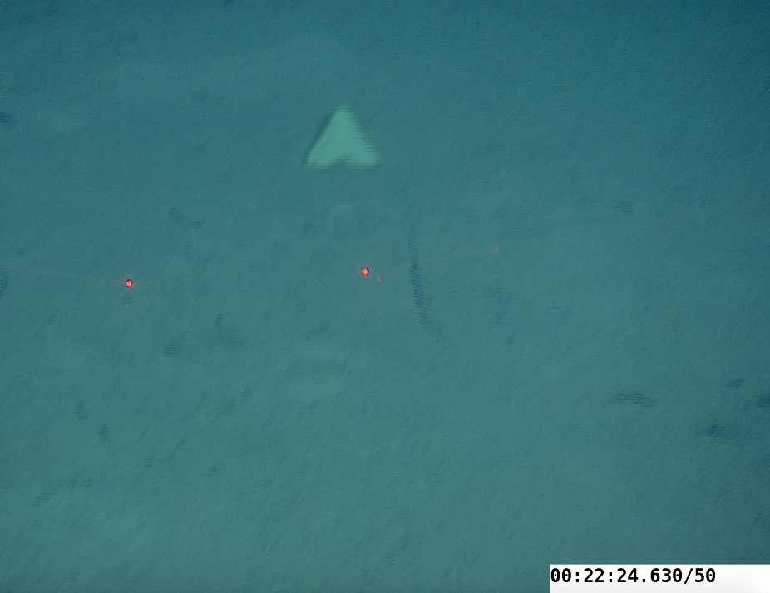
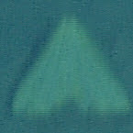
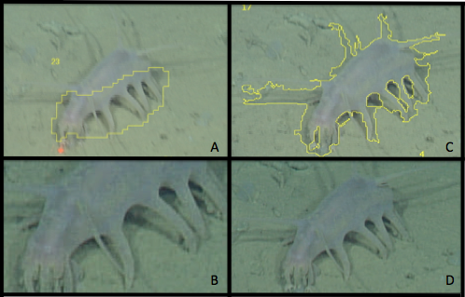
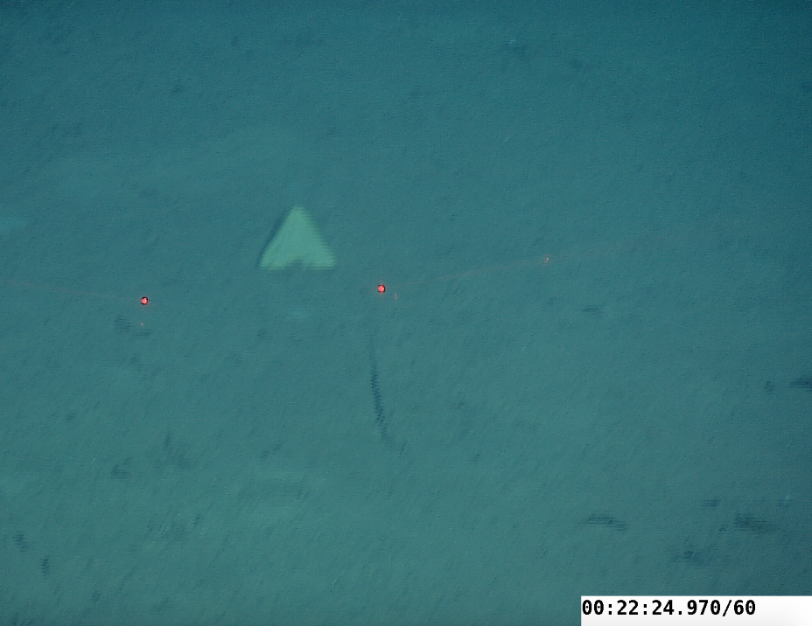
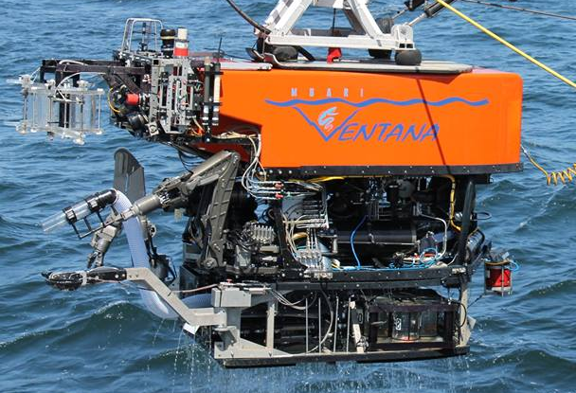
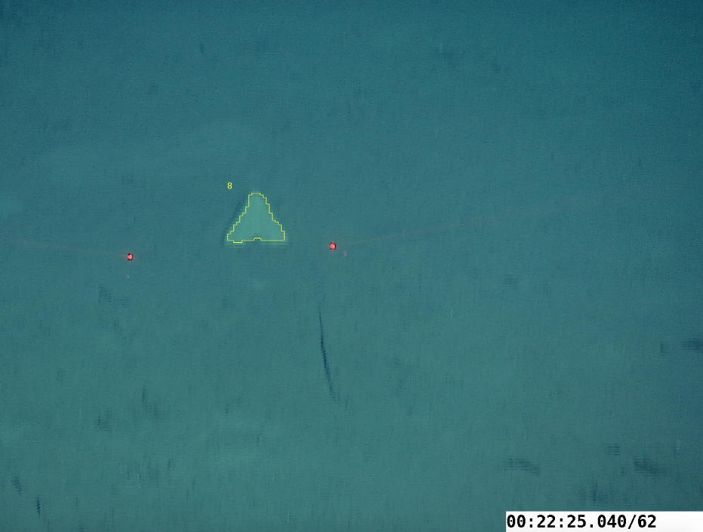
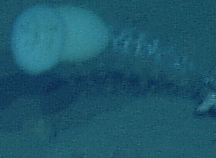
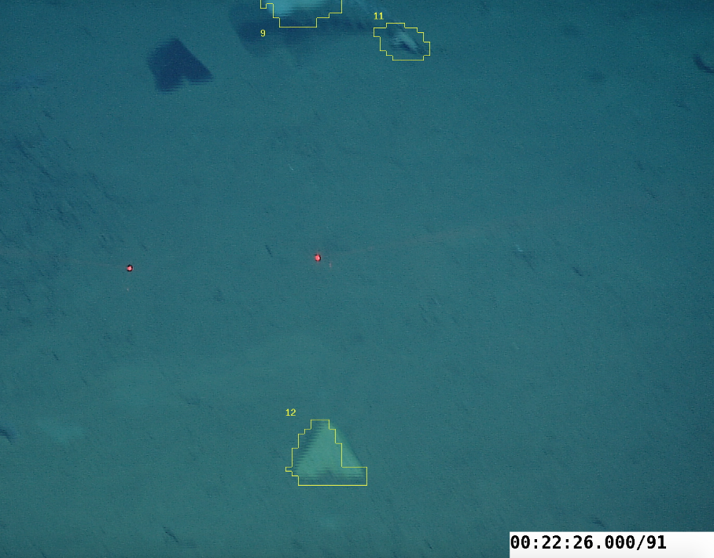
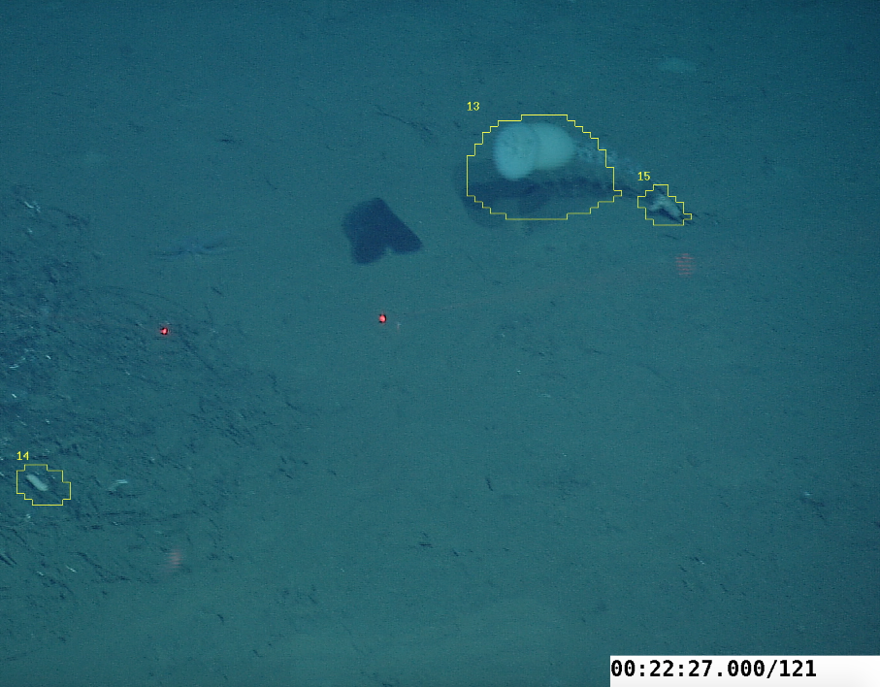
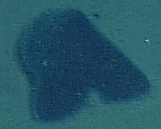
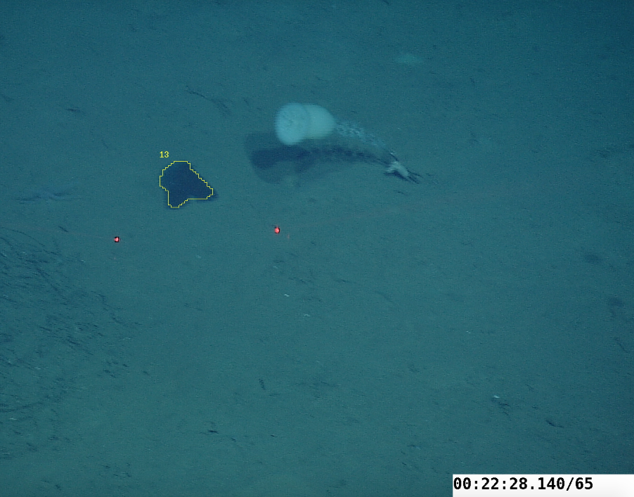
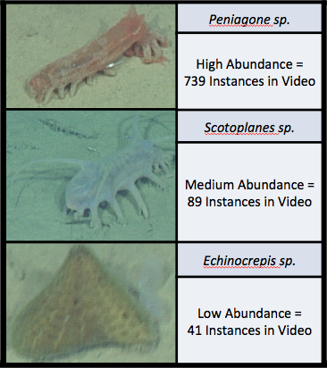
Automated Detection of Deep-Sea Animals
Discussion
Dallas Hollis^{1,2}, Duane Edgington³, Danelle Cline³
There was no detection method that provided the ability to detect all animals without also detecting non-animal events (marine snow, rocks, etc.) Detection algorithms can be fine-tuned to detect objects that were unseen, but there remains a constant battle between increasing detection while attempting to decrease the amount of data and computational power needed for analysis. Moving forward, the images created for the training library could be used for further automation towards classification.¹ With access to greater computing power and a second layer of classification, this method of detection may prove to be very effective in the future for analyzing and classifying large video datasets like the one found at MBARI.
¹ STEM Teacher as Researcher (STAR) program
² California State University, Sacramento
³ Monterey Bay Aquarium Research Institute
Introduction
Results
The Monterey Bay Aquarium Research Institute routinely deploys remotely operated underwater vehicles equipped with high definition cameras for use in scientific studies. Utilizing 22,000 hours of dive video, we have set out to automate the detection and taxonomic classification of deep-sea animals by using saliency-based neuromorphic selective attention algorithms to detect objects of interest within video frames.¹
Saliency parameters were set high in an effort to only crop images of the highest quality. High abundance Peniagone sp. returned enough high resolution cropped images in the first video analyses that no changes needed to be made. The following changes were made to increase detection of the other two organisms.
Hough-Based Tracking
Objectives
High contrast shadowing behind the legs of Scotoplanes sp. is recognized as salient, but the rest of the animal fails to fully segment. The image is then cropped and removes critical identification features. A Hough-based tracking algorithm increases segmentation and returns a cropped image of the full animal as seen in figure 3.²
Convert digital video frames to color images
Analyze images with AVED software for highest saliency to produce cropped images of detected objects¹
Sort salient objects based on taxonomy as seen in Fig. 1
Figure 1. MBARI ROV dive video is analyzed for saliency and objects of interest are automatically cropped out of frame for later review. Photographs courtesy of MBARI. ROV image taken by Dallas Hollis.
Methods
Figure 3. Scotoplanes sp. incomplete segmentation in image A returns the cropped image B. After implementation of Hough-based tracking in C, image D returns fully cropped. Photographs courtesy of MBARI.
Three benthic animals of interest were chosen based on levels of abundance (high, medium, and low), location (Station M, Monterey Canyon), and scientific interest (Integrated Time Series). Videos that contained these organisms in highest numbers (2007 – 2015) were selected for analysis.
Algorithm Tuning
Other minor changes to saliency filters were added to increase detection; increased detection size, added color filters, increased detection frequency from every second to every half second, and cut saliency voltage from 4mv to 2mv.
Table 1. Benthic videos outlined for time analyzed, images generated, and how many were used for the training library. Training library is then broken down by number of images per animal.
References
Acknowledgements
Figure 2. Benthic animals of main focus and associated abundance levels in analyzed videos. Photographs courtesy of MBARI.
1. Edgington, D.R., Cline, D.E., Davis, D., Kerkez, I., & Mariette, J. (2006). Detecting, Tracking and Classifying Animals in Underwater Video. Oceans 2006. doi:10.1109/oceans.2006.306878
2. Godec, M., Roth, P. M., & Bischof, H. (2011). Hough-based tracking of non-rigid objects. 2011 International Conference on Computer Vision. doi:10.1109/iccv.2011.6126228
Thank you to all the staff of MBARI for your support and consistent cookie breaks, fellow summer interns for help with projects and re-writes, George Matsumoto and Linda Kuhnz for their selfless dedication to the intern program, STAR cohort leaders for guidance, and a special thank you to Duane Edgington and Danelle Cline for your patience, advice, and mentorship. Finally, thank you to Kelly McDonald for believing in me as a teacher and challenging me academically.

