Slide 1

Automated Detection and Classification of Deep Sea Benthic Imagery
Nathan Yee
Franklin W. Olin College of Engineering
Mentors
Duane Edgington
Danelle Cline

Slide 2
Outline
My Project
  What is my project?
  How is this relevant?
Machine Learning
  Machine learning
  Deep learning
  Dataset
  Faster RCNN
Results
  Visualizations
  Graphs

Slide 3
My Project
What is my project?
How is this relevant?

Slide 4
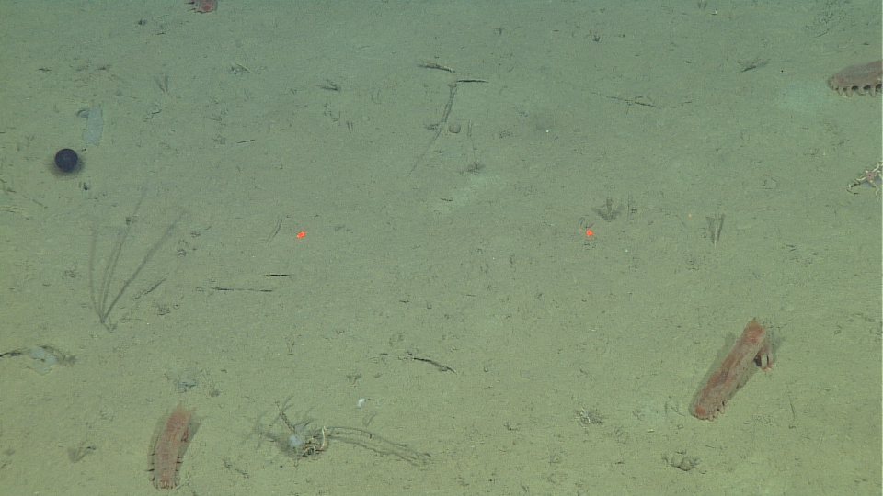
Automated Detection and Classification
Notes:
772_10 34:50

Slide 5
Automated Detection and Classification
Notes:
772_10 34:50

Slide 6
Automated Detection and Classification
Peniagone Sp A
Peniagone Sp A
Benthocodon
Peniagone Sp A
Peniagone Sp A
Notes:
772_10 34:50

Slide 7
ROV Dives
~300 / year
Video Footage
23,731 hours
Automated Detection and Classification
Video Annotators
5.5+ million observations
Quantitative Data
season, location, depth
Oceanographic Research
Video Annotation and Reference System
(VARS)
Publications
~375

Slide 8
ROV Dives
~300 / year
Video Footage
23,731 hours
Automated Detection and Classification
Video Annotators
5.5+ million observations
Quantitative Data
season, location, depth
Oceanographic Research
Video Annotation and Reference System
(VARS)
Publications
~375

Slide 9
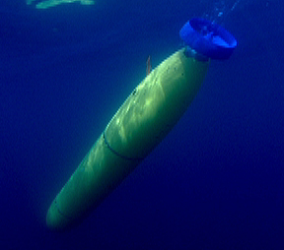
Increasing use of cameras
Autonomous underwater vehicles (AUVs)
Stationary observatories
Environmental impact
Cost and performance

Slide 10
Machine Learning
Machine learning
Deep learning
Dataset
Faster RCNN

Slide 11
Machine Learning
Data driven approach that allows computers to program themselves solve problems
Supervised
  Data (images)
  Annotations (describe what’s in the image)
  Learn model capable of describing new data
Unsupervised
  Data
  Learn model that reveals structure or patterns within the data

Slide 12
Deep Learning
A subfield of machine learning
Supervised learning
  Data and annotations
Excellent at spatially and or temporally related data
Transfer Learning

Slide 13
Deep Learning - Transfer learning
Using models trained on large datasets as our starting point
Requires less time to train new model
Better performance with small datasets

Slide 14
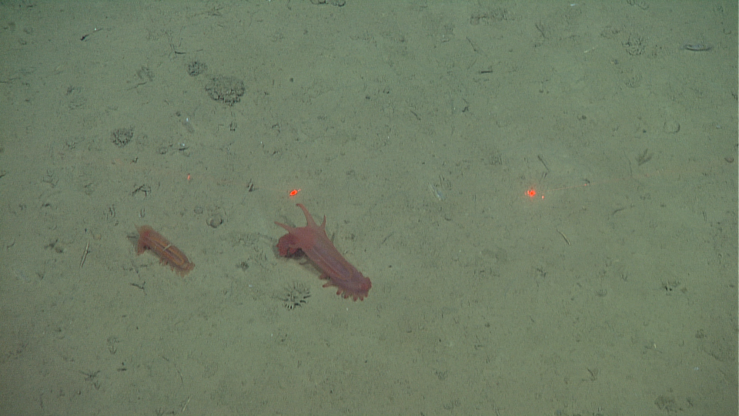
Data + Annotation
<filename>D0443_05HD_00-26-25</filename>
<object>
<name>PENIAGONE_SP_A</name>
<xmin>175</xmin>
<ymin>290</ymin>
<xmax>252</xmax>
<ymax>361</ymax>
</object>
<object>
<name>PENIAGONE_PAPILLATA</name>
<xmin>354</xmin>
<ymin>262</ymin>
<xmax>484</xmax>
<ymax>391</ymax>
</object>
<object>
<name>ELPIDIA</name>
<xmin>363</xmin>
<ymin>365</ymin>
<xmax>405</xmax>
<ymax>401</ymax>
</object>
Notes:
D0443_05HD_00-26-25

Slide 15
Dataset
Train
  7 hours of video
  1,659 images
  17 categories
  3,634 boxes
Test
  2 hours of video
  618 images
  16 categories
  1,077 boxes
Image (frame-grab)
  960x540
  Frame-grab every 5 seconds

Slide 16
Faster R-CNN
State of the art - object detection and classification
Benefits from transfer learning
Fast image processing
  ~ 5-7 images per second
Faster R-CNN: Towards Real-Time Object Detection with Region Proposal Networks
arXiv:1506.01497 [cs.CV]

Slide 17
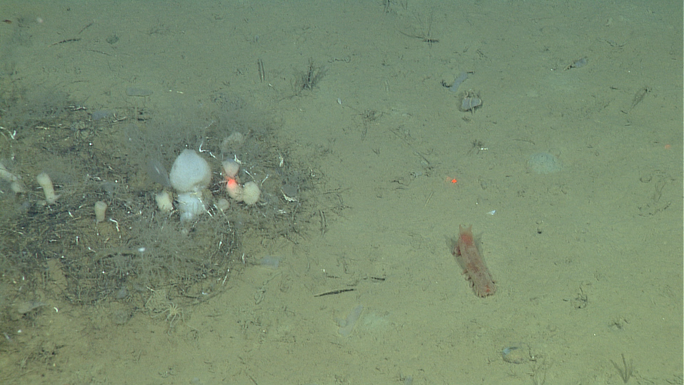
Faster RCNN
Notes:
772_10 34:50
Only have to try and classify objects - leading to many less background mistakes

Slide 18
Faster RCNN
Not Object
Object
Not Object
Not Object
Object
Not Object
Notes:
772_10 34:50
Only have to try and classify objects - leading to many less background mistakes

Slide 19
Faster RCNN
Peniagone Sp A
Notes:
772_10 34:50
Only have to try and classify objects - leading to many less background mistakes

Slide 20
Results
Visualizations
Graphs

Slide 21
Automated Object Detection and Classification
Notes:
772_10 34:50
After trying out various methods and networks, preprocessing and annotation data, etc...

Slide 22
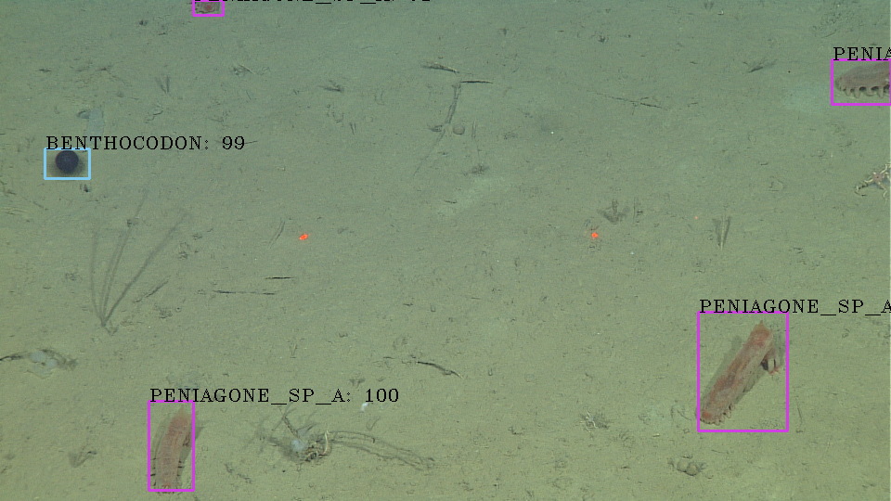
Automated Object Detection and Classification
Notes:
772_10 34:50

Slide 23
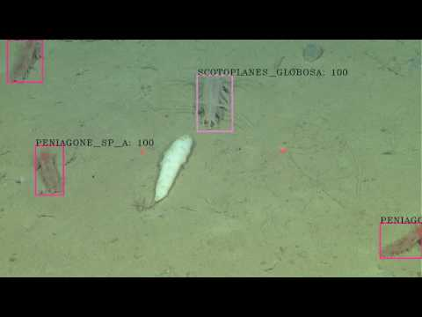
Notes:
Process single frame -> video
Slight angle changes, color shifts, translations in frame
Number of classes scaling
Data scaling
Peniagone vitrae
Benthocodon
Peniagone Sp A and Scotoplanes Globosa

Slide 24
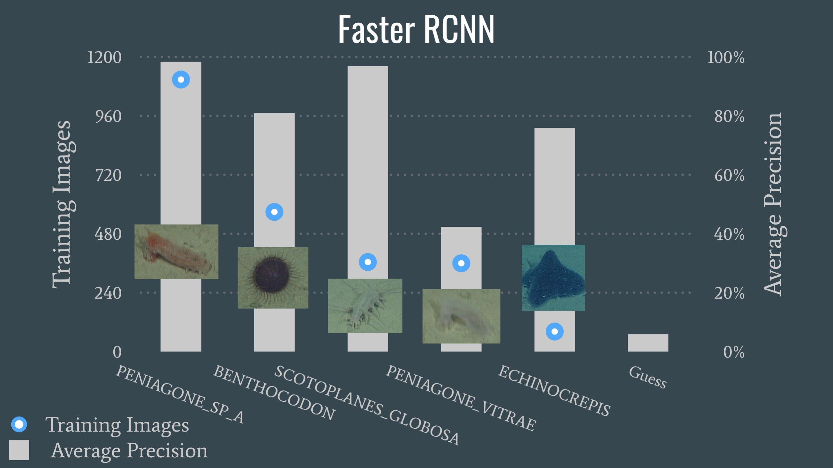
Notes:
85% of predicted ___ are actually ___
(At least 50% IOU with ground truth)
(Only one correct prediction per object)

Slide 25
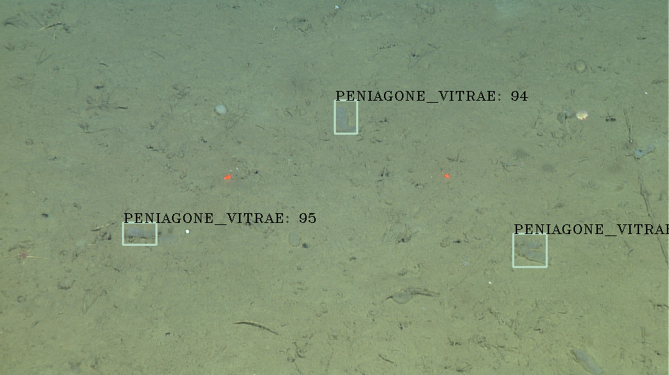


Example of misclassification
Notes:
D0772_10HD_00-08-10

Slide 26
Example of misclassification
Test
Train
Notes:
D0772_10HD_00-08-10

Slide 27
Weaknesses
Time intensive annotation process
Requires consistent annotations
Performs best on similar videos
Training time

Slide 28
Acknowledgements
Packard Foundation
Duane Edgington
Danelle Cline
George Matsumoto
Linda Kuhnz
MBARI

Slide 29
Questions

Slide 30
Appendix

Slide 31
Test Images
test_imgs = {'BENTHOCODON': 286,
'CYSTECHINUS_LOVENI': 40,
'ECHINOCREPIS': 26,
'ELPIDIA': 13,
'FUNGIACYATHUS_MARENZELLERI': 13,
'LONG_WHITE': 3,
'ONEIROPHANTA_MUTABILIS_COMPLEX': 3,
'PENIAGONE_PAPILLATA': 10,
'PENIAGONE_SP_1': 2,
'PENIAGONE_SP_2': 1,
'PENIAGONE_SP_A': 453,
'PENIAGONE_VITRAE': 93,
'SCOTOPLANES_GLOBOSA': 63,
'SYNALLACTIDAE': 5,
'TJALFIELLA': 66,
'bg': 0}

Slide 32
Data Usage
Imagenet Large Scale Visual Recognition Challenge 2017
  1.2 million images
  1000 categories
Me
  1659 images
  17 categories

Slide 33
Strengths
Weaknesses
Benefits from transfer learning
Automatically learns what is background
Classifier scales to thousands of categories
Performance scales with data
Fast image processing
  ~ 5-7 images per second
Time intensive annotation process
Requires consistent annotations
Performs best on similar videos
Training time

Slide 34
Historical Context

Slide 35
Computer vision
Computer vision is computationally expensive
Difficult to get useful results

Slide 36
What has changed in recent years?
Publicly available datasets
  Imagenet, MNIST, CIFAR, COCO, Pascal VOC, etc...
GPU’s
  Cost
  Performance

