Slide 1
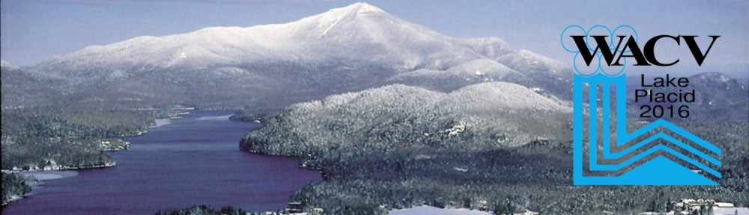
WACV 2016
2nd Workshop on Automated Analysis of Video Data for Wildlife Surveillance
Unsupervised Underwater Fish Detection Fusing Flow and Objectiveness
David Zhang Giorgos Kopanas Chaitanya Desai
Sek Chai Michael Piacentino
SRI International
March 10, 2016
Version 1.4
Notes:
Multi-year program, fish stock assessment.
first phase – fish detection

Slide 2
WACV 2016
Outline
Motion-based detection methods
Deep learning based detection methods
Fusion of Flow and Learning for detection
Performance Evaluation
Future Work

Slide 3
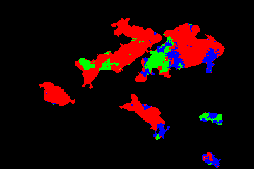
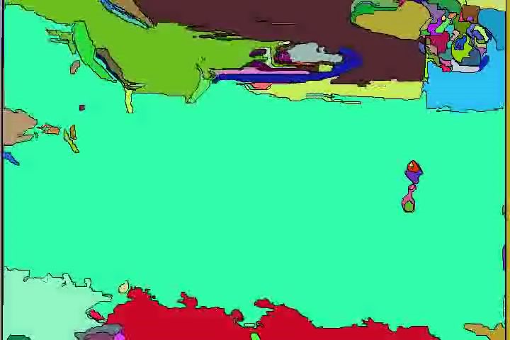
Motion-based Detection
WACV 2016
Frame-to-frame change detection (SRI )
Gaussian Mixture Models(T. Celik, ACM 2010)
Optical Flow (TV-L1, Farneback, Deep flow)
Video segmentation with flow (Grundmann et al, CVPR2010)
False alarms
Low precisions and recall rates
Example of Optical Flow segmentation
Grundmann et al, Efficient Hierarchical Graph-Based Video Segmentation
Notes:
Fish swims under water. So motion based detection is a natural selection.
Noise, camera motion, non-rigid movement of fish body

Slide 4
Classification Using Deep Learning
WACV 2016
Static image classification:
- ImageNet, F. Li, CVPR 2009
- GoogleNet , C. Szegedy et al
Flow based classification:
- Two stream networks, K. Simonyan et al, NIPS 2014
- Two stream CNN, H. Ye et al, ACM ICMR2015
- Very Deep two-stream ConvNet, L. Wang, CVPR2014
- S.T. Features from 3D CNN, D. Tran et al, CVPR 2014
The trained models work for their datasets, don’t yet work well for real-time environment.
The training samples are limited, which were generated by data augmentation methods.

Slide 5
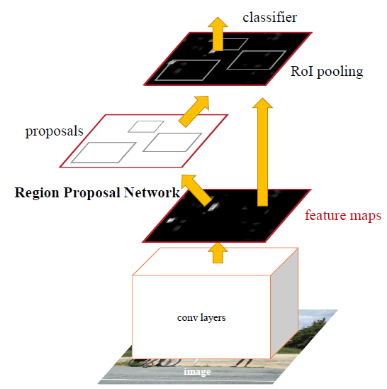
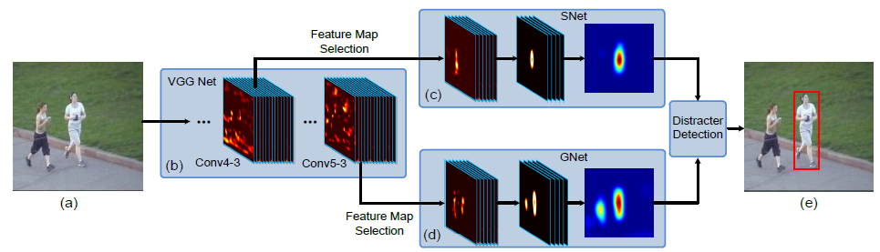
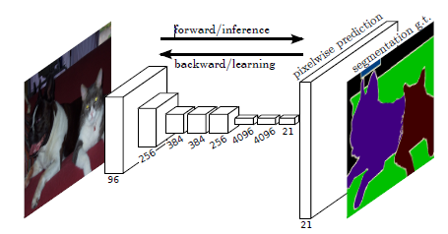
Classification Using Deep Learning
1. R-CNN, R. Girshick, et al. , 2015
2. Faster R-CNN, S. Ren et al., 2015
3. Visual Tracking with Fully Convolutional Networks, L. Wang et al., 2015
4. Fully Convolutional Networks for Semantic Segmentation,
J. Long, et al. 2015

Slide 6
Fusion of Flow Motion and Deep Learning
WACV 2016
Goal:
Online training and detection of underwater fish
Approach:
A. Training:
- Flow segmentation to generate sample candidates
- Region proposals to annotate positive and negative samples
- ~100k samples for training (~10 min video sequence )
B. Classification:
- Input: Fusion of Region proposals and flow segmentations
- Compute confidence scores
- Non-Maximum Suppression (NMS) to remove redundancies
- Output: numbers and locations of detected objects
Contribution:
Use optical flow-objectiveness to annotate samples
Robust unsupervised online training (biased training, no data augmentation)
Fusion of region proposals and flow segmentations
Modified NMS approach to improve performance

Slide 7
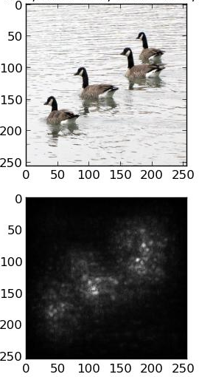
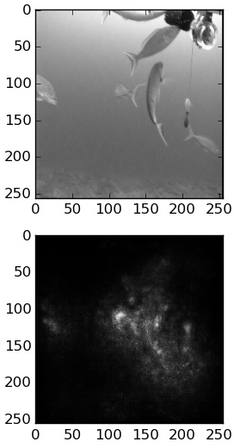
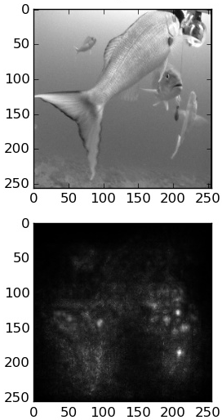
Fusion of Flow Motion and Deep Learning
WACV 2016
Data Annotation
Back-propagation saliency map from CNN does
not provide good segmentation results

Slide 8
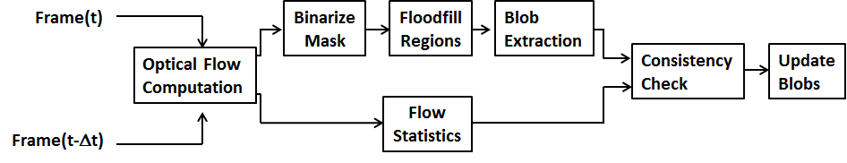
Fusion of Flow Motion and Deep Learning
WACV 2016
Data Annotation
Use moving fish as labels – no human annotations
The object proposals are of more objectiveness than the flow regions
Optical flow based fish segmentation

Slide 9
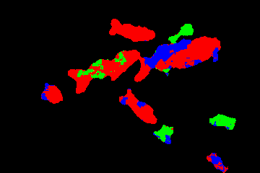
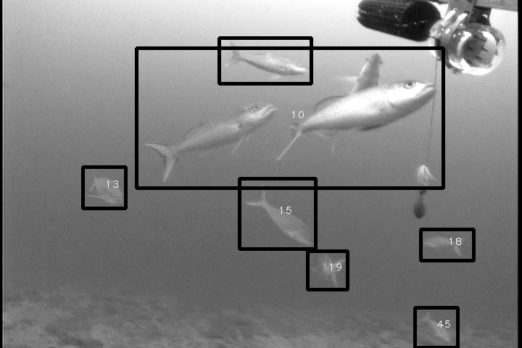
Fusion of Flow Motion and Deep Learning
WACV 2016
Data Annotation
Use moving fish as labels – no human annotations
The object proposals are of more objectiveness than the flow regions
Optical flow segmentation
Optical flow segmentation ROI

Slide 10
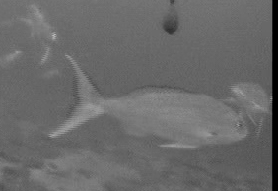
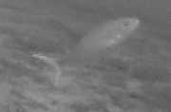
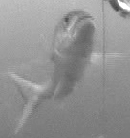
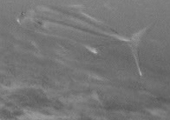

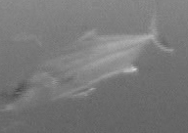
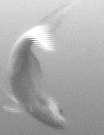

Fusion of Flow Motion and Deep Learning
WACV 2016
Data Annotation
Use moving fish as labels – no human annotations
The object proposals are of more objectiveness than the flow regions
0°
45°
90°
135°
180°
225°
270°
315°
Optical flow based fish segmentation: 8 orientations

Slide 11

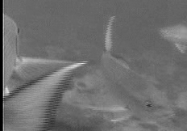
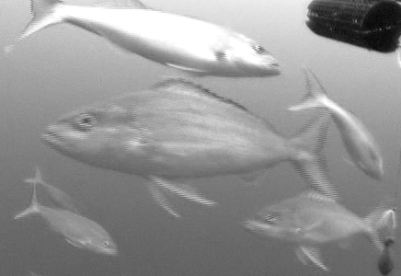

Fusion of Flow Motion and Deep Learning
WACV 2016
Data Annotation
Use moving fish as labels – no human annotations
The object proposals are of more objectiveness than the flow regions
Incorrect segmentations
Non-rigid motion causes incorrect segmentations
Overlap regions merge multiple targets

Slide 12
Fusion of Flow Motion and Deep Learning
WACV 2016
Data Annotation
Use moving fish as labels – no human annotations
The object proposals are of more objectiveness than the flow regions
OpFlow_and_OBJ Overlap > thr, label = 1
Otherwise, label = 0
Objectiveness labeling

Slide 13
Fusion of Flow Motion and Deep Learning
WACV 2016
Training Diagram
Use moving fish as labels – no human annotations
The object proposals are of more objectiveness than the flow regions
Objective labeling on motion selected candidates
Selective
Search
Objectiveness Labeling
frame
CNN
Trained model
Flow
Segmentation

Slide 14
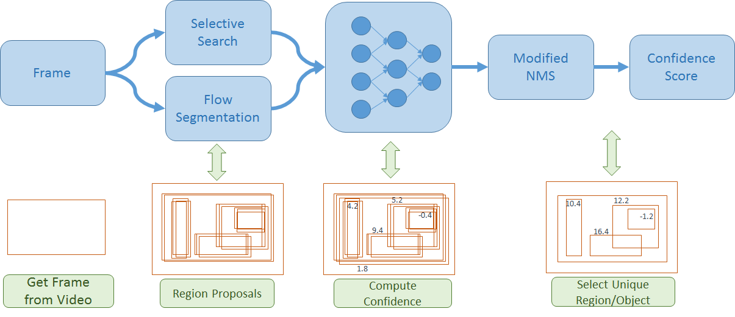
Fusion of Flow Motion and Deep Learning
WACV 2016
Classification Diagram

Slide 15
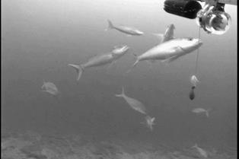
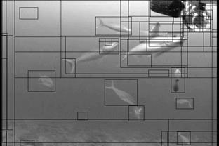
Fish Detection Process
WACV 2016
(a) Raw input
(b) Regions from Selective Search

Slide 16

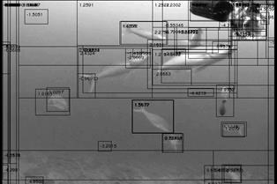
Fish Detection Process
WACV 2016
(c) Fusion of Selective Search and motion flow segments
(d) Confidence scores on the fused regions

Slide 17
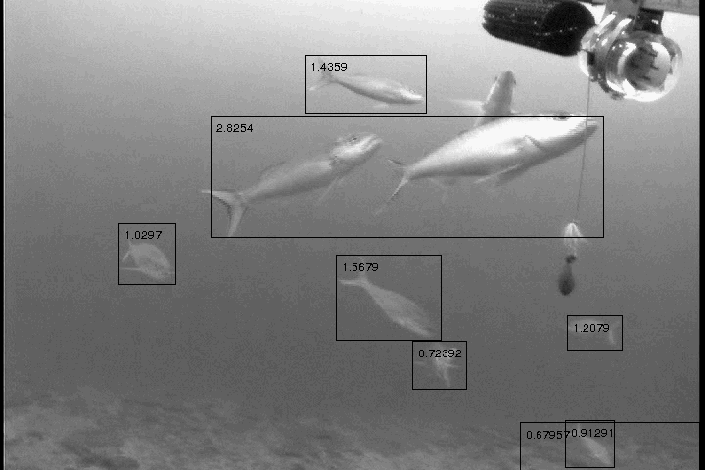
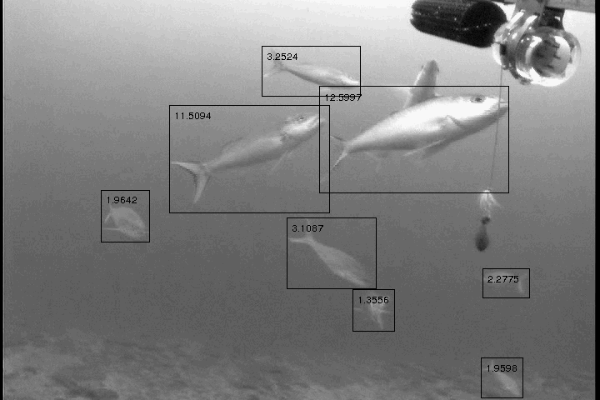
Fish Detection Process
WACV 2016
(e)Thresholding and original NMS
(f) Thresholding and modified NMS.

Slide 18
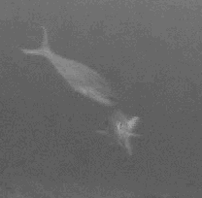

WACV 2016
Modified Non-Maximum Suppression (MNMS)
Region candidates are marked with black, green, red, blue and yellow. The confidence score from the CNN detection is also in this order. The overlap percentage of the green with respect to (black U green) is p1, and that of the blue to (black U blue) is p2, and p2 < p1.
(a) (b) (c) (d)
5 proposed region after negative regions are removed.
Result from original NMS when p2<thr<p1. Black region encloses both fish
Result from original NMS when thr<p2.
The result from our approach (MNMS).

Slide 19
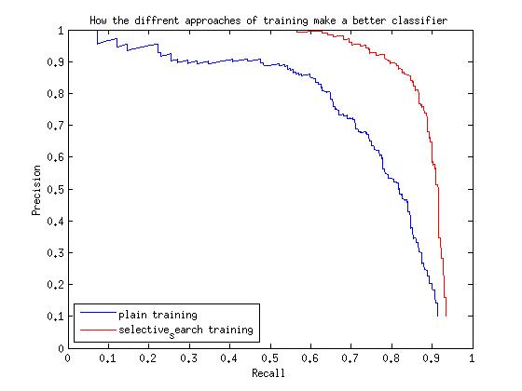
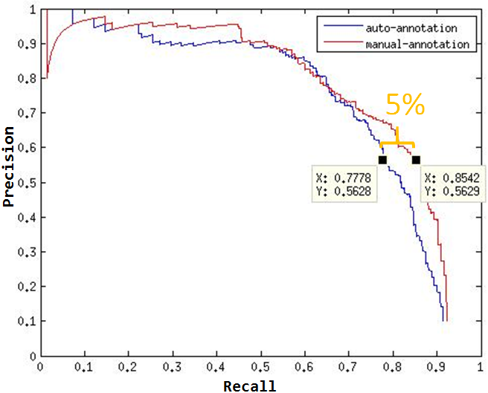
Training
WACV 2016
Input samples from segmentation based on optical flow
Selection and annotation by object proposals
The precision-recall graph compares manual-annotation training with auto-annotation training from the same videos. The small discrepancy of performance demonstrates the value of using auto-annotation in real-time training.
The blue curve is the performance of the classifier using samples from flow segmentations. The red curve shows at least 20% better precision at 80% recall from the classifier that its flow samples are tuned by Selective Search during training.

Slide 20
Classification
WACV 2016
Precision = tp/(tp+fp)
Recall = tp/(tp+fn)
precision
Selective search
+ flow
+ flow+MNMS
recall
Red: Selective Search only
Green: Fusion of Selective search and flow segmentations. Both of them use NMS
Blue: Modified NMS on fusion proposals

Slide 21
Summary and Future Work
WACV 2016
Summary
Unsupervised online fish detection by combining flow segmentation and deep learning
Future Work
- Refined fish detection using tracking: Cluster tracker
- Fish type detection: Class, Family, Genus and Species
Fusion of Video streams and Motion streams – motion patterns
- Temporal Embedding (Ramanathan et al),
- caffe_flow(L. Wang et al),
- C3D (D. Tran et al)
Recurrent Neural Networks (RNN)
Fully connected Neural Networks

Slide 22
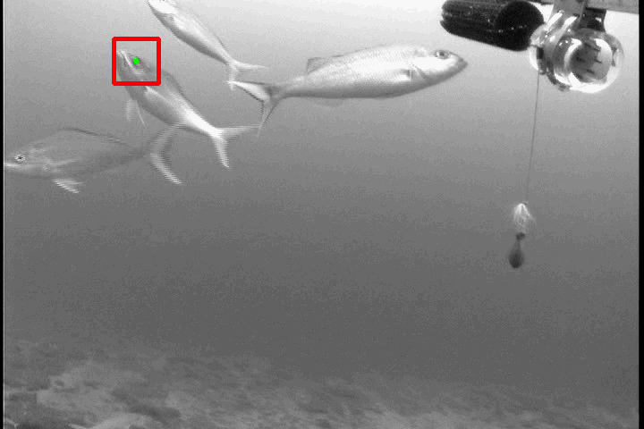
Example of fish tracking: Cluster tracker

Slide 23
Acknowledgement
NOAA (National Oceanic and Atmospheric Administration) and FAU (Florida Atlantic University)
Questions?

