Slide 1
6000m Spherical Ti Pressure Vessel
Design Review
Gene Massion
March 2011

Slide 2
Requirements & Goals
Increase safe working depth to 6000 meters
Same ID = 8.0”
  Approximately same interior volume
  Weight/displacement ration < 1.0
    Current design W/d = 0.95, Glass sphere = 0.41
8 minM connectors + 10 minK
1 ODI connector w/reduced number of minK/M
1 SAE #4 port
Some kind of mounting “tabs”
Minimize number of fastener (goal)
Standard stretch on O-rings (goal)
Reduce 1) machining, 2) casting, 3) pattern costs (goal)

Slide 3
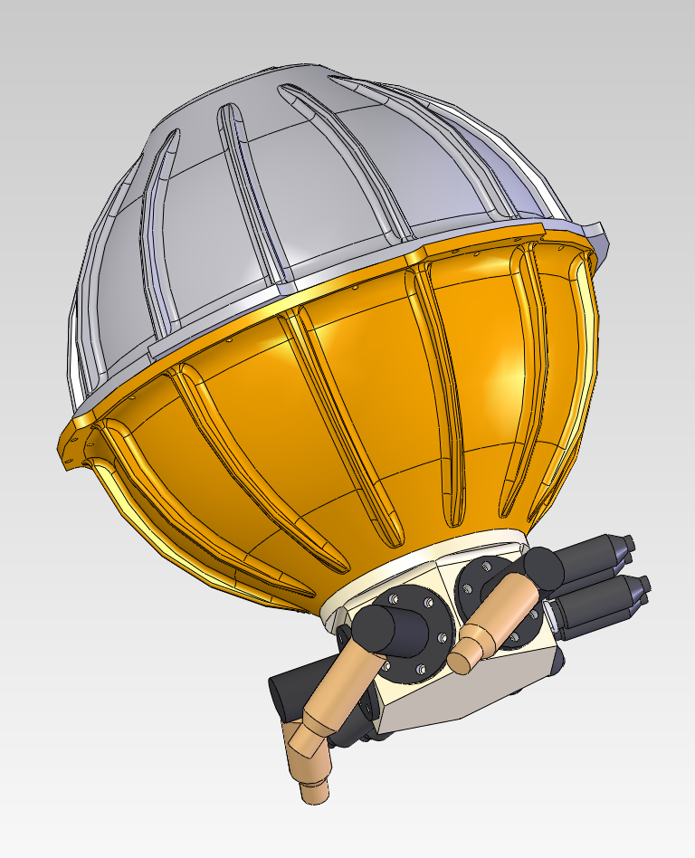
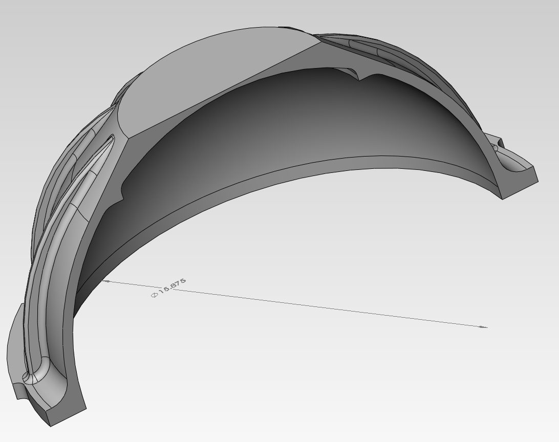
Existing Design

Slide 4
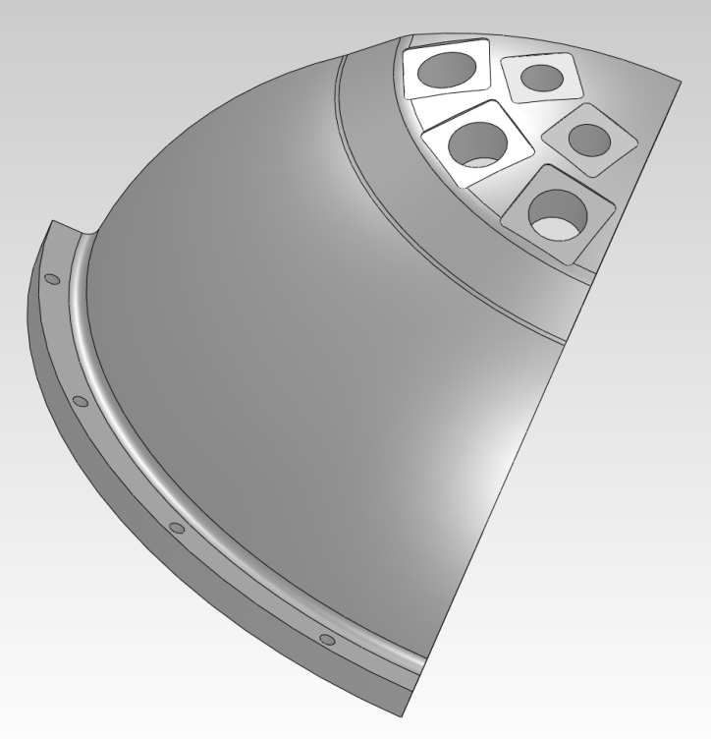
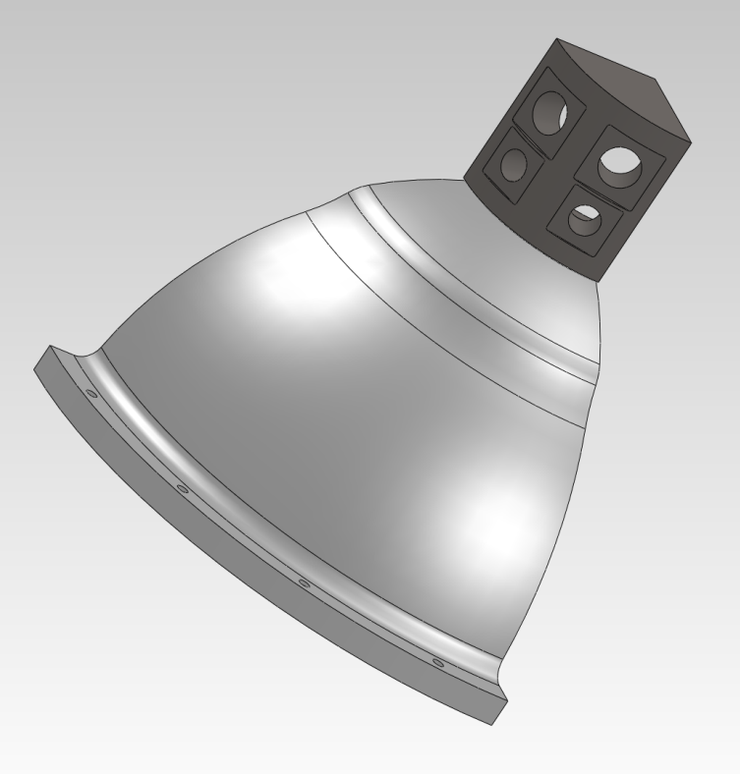
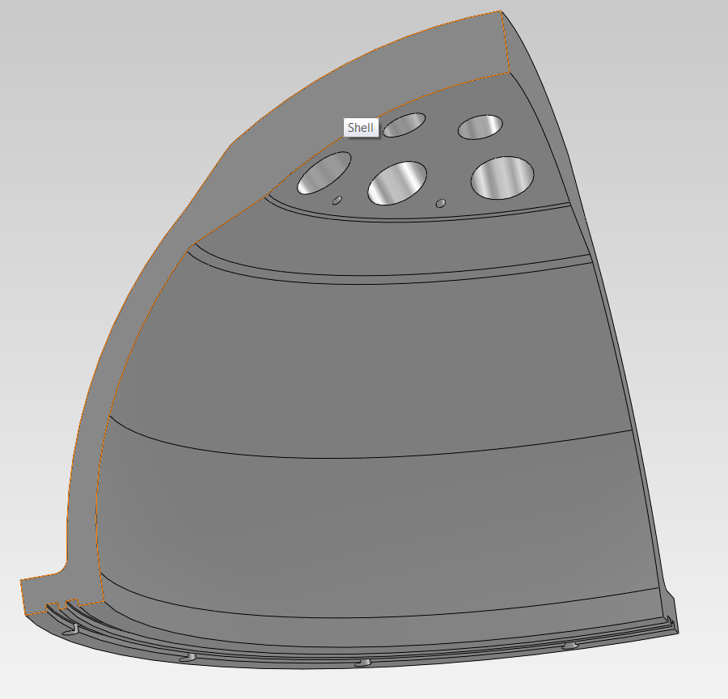
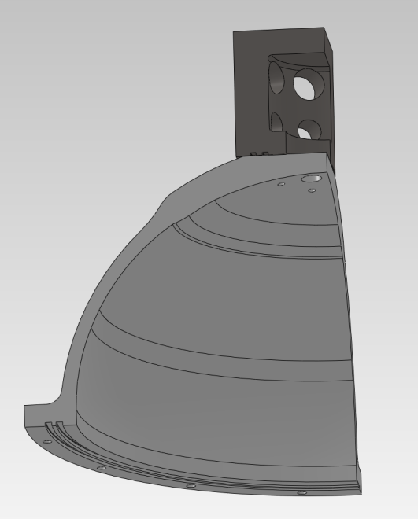
Initial Design Iterations
One piece connectors at “top”
Two piece connector hat at “top”

Slide 5
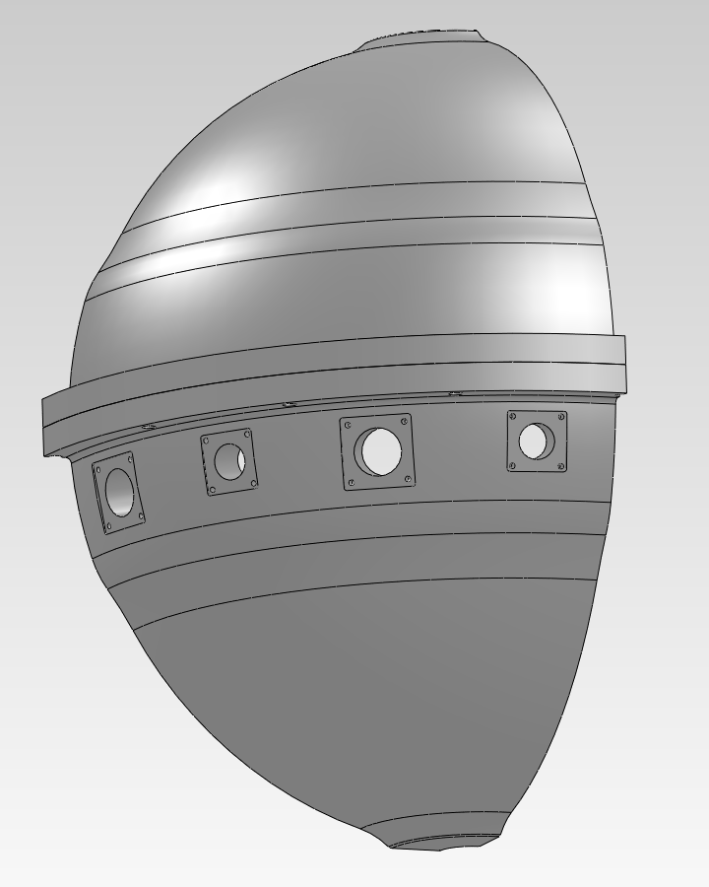
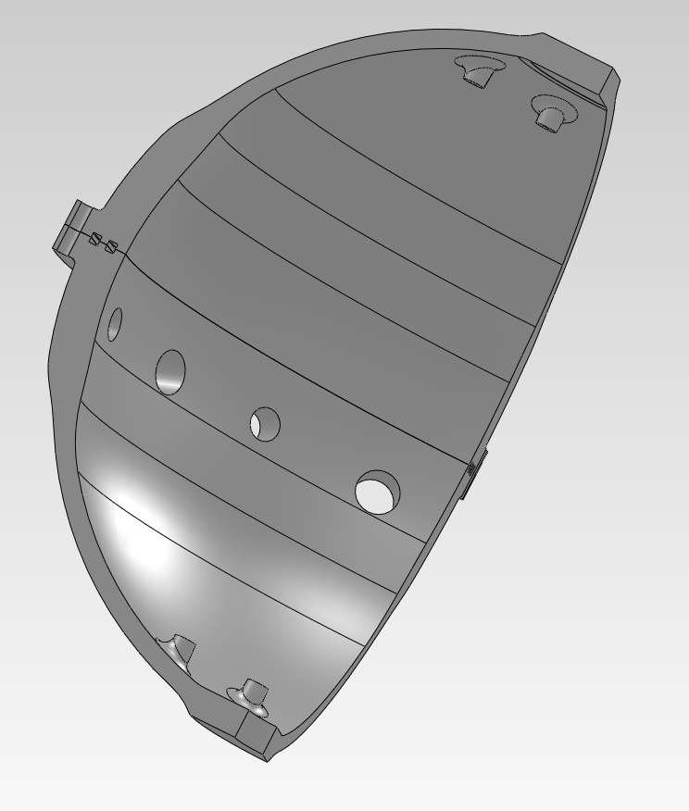
Preferred design
Displacement = 97.3 lbf
Weight/Displ. = 0.93
Wet Weight = -6.34 lbf

Slide 6
Pros and Cons

Slide 7
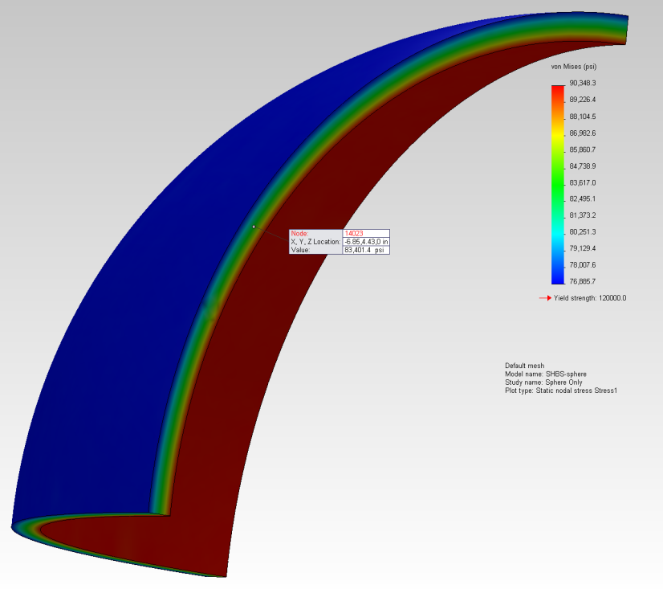

Structural Analysis Roark vs FEA
Note: No significant change in values at finer FEA meshes

Slide 8
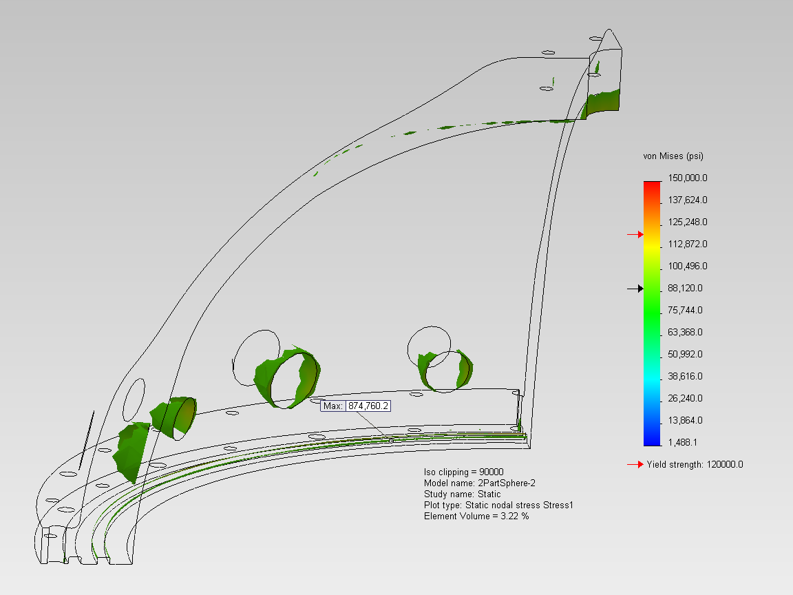

FEA (symmetry at bolt circle)

Slide 9
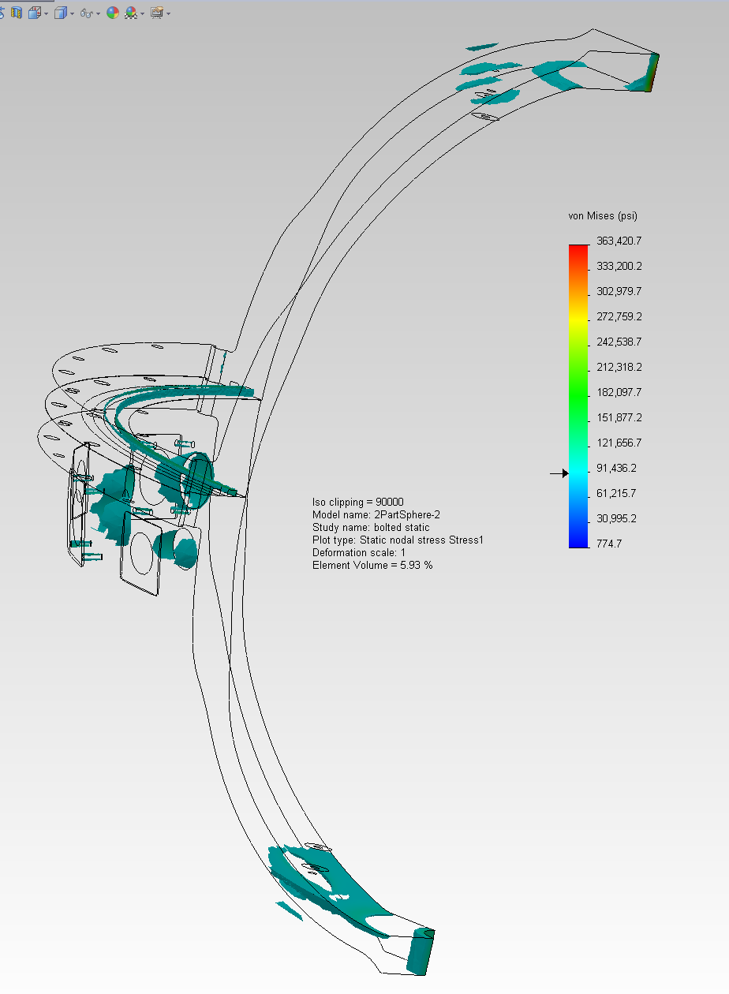
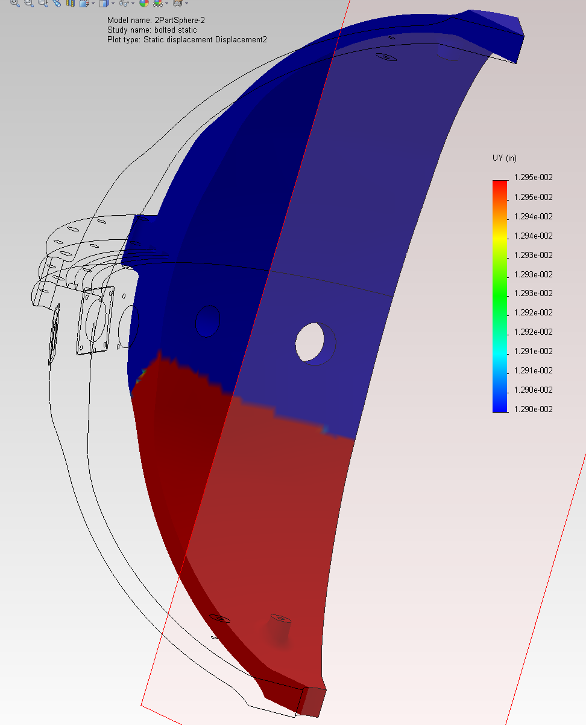
FEA (bolted)

Slide 10
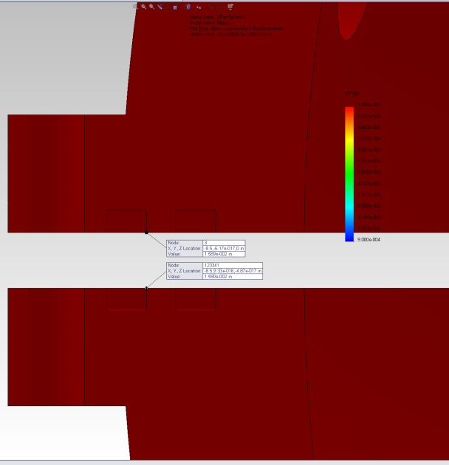
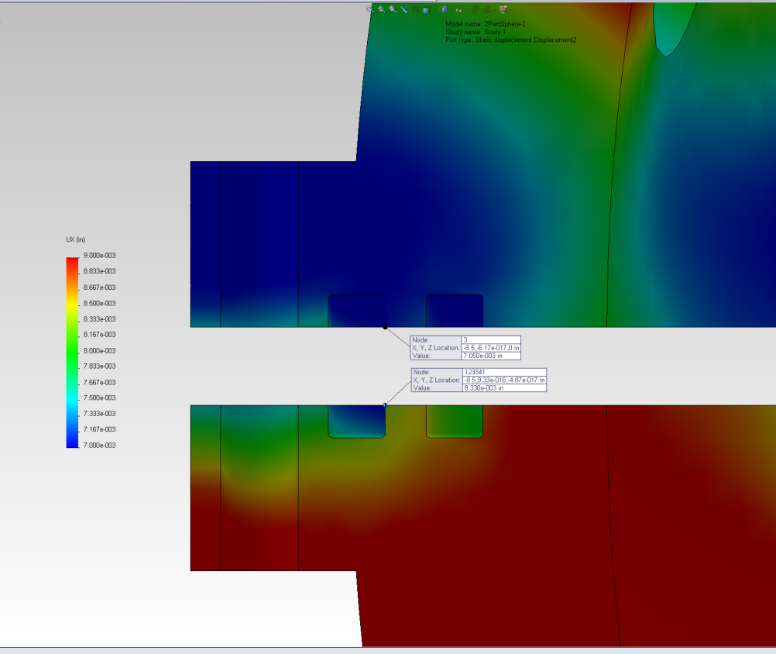
Distortion at O-ring

Slide 11
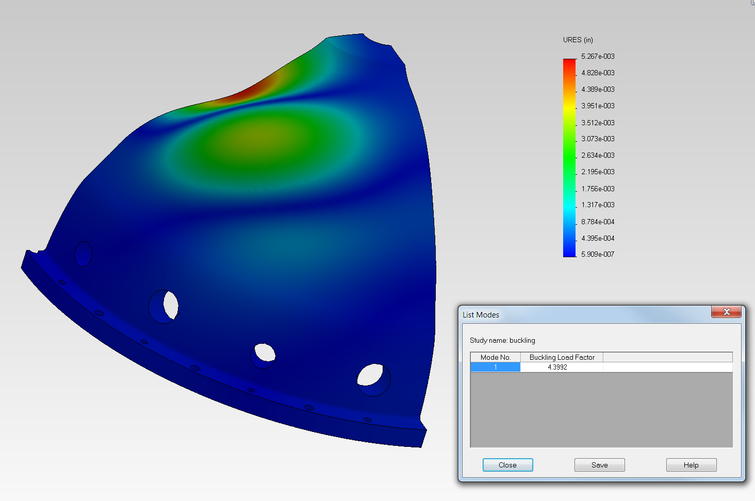
Buckling
1 < BLF
Buckling not predicted. The applied loads are less than the estimated critical loads. Buckling is not expected.

Slide 12
Roark Buckling Calculation

Slide 13
To Do List
Pick a preferred design
Optimize W/D ratio and weight in water
Fix local high stress areas
Make sure connector bores don’t distort unacceptably for proper sealing
Re-do FEA with outer O-ring failure
Equalize bearing pressure at dual O-ring grooves
Work with Oremet Wah-Chang (and Jon) to optimize manufacturability
Generate drawings
Buy 1, 10, 100(?)
Pressure test

