Slide 1
MBARI 6K SPHERICAL HOUSING DESIGN AND ANALYSIS
8DEC11

Slide 2
ASSUMPTIONS
Design depth: 6000 m
Material: Titanium Grade 5 As Cast (6Al-4V Ti alloy)
  Vendor: Wah Chang
  Min yield strength: 120 ksi
    May be increased to 145 ksi w/ solution treating
Target factors of safety: 1.5 on yield, 2.0 on buckling
Qty 4 Seacon MinK connectors on radial surface of bottom hemisphere
Dual face seal o-rings
Internal dimensions provided by MBARI
Flat surface on outer surface on bottom of bottom hemisphere w/ threaded holes for mounting
Internal bosses w/ threaded holes on inner surface of bottom hemisphere for securing chassis
Threaded jack-out holes in flange on bottom hemisphere for disassembly
Two halves are through bolted together through outer flange
All materials exposed to seawater are titanium or titanium alloy

Slide 3
STATUS
Preliminary design is complete and has been reviewed by Wah Chang and MBARI (Gene)
Structural analysis is completed and stresses look acceptable
Resulting weight (dry and wet) of housing has been calculated (no internal components included)
3-D shape files (.step) have been provided to Wah Change for quotation of QTY 1 each of the top and bottom hemispheres on 11/30/11, should have quotes back soon
Detailed design of hemispheres is 90% complete and ready for review
Preliminary assembly drawing is complete and ready for review
A few questions remain to finalize design for critical design review

Slide 4
PRELIMINARY COST ESTIMATE
WAH CHANG (Titanium casting company used for past spherical housings) has provided the following quotation for the two hemispheres:
Top hemisphere: The top hemisphere pattern cost is $8,410. The casting cost is $5,825.
The bottom hemisphere pattern cost is $8,420. The casting cost is $5,925.
Lead time for the patterns is 4 to 5 weeks. Lead time for the castings is 11 to 12 weeks from receipt of the patterns.

Slide 5
QUESTIONS FOR USERS
How much effort to save weight on hemispheres?
Can same pattern be used for top and bottom to save $8400 (pattern cost) and take a small weight increase
Should external ¼-28 UNF ODI connector holes be left in as a utility? For securing? (see next slide)
Should purge/fill port be added to design for testing/backfilling purposes? Prevco (dual o-ring) or Swagelok (single SAE o-ring)
O-Rings and tapped mounting holes on bottom hemi?
MINK connectors FCR or BCR-DO (threaded connector, double bore seal, no mounting screws)

Slide 6
6K SPHERICAL HOUSING ASSEMBLY

Slide 7
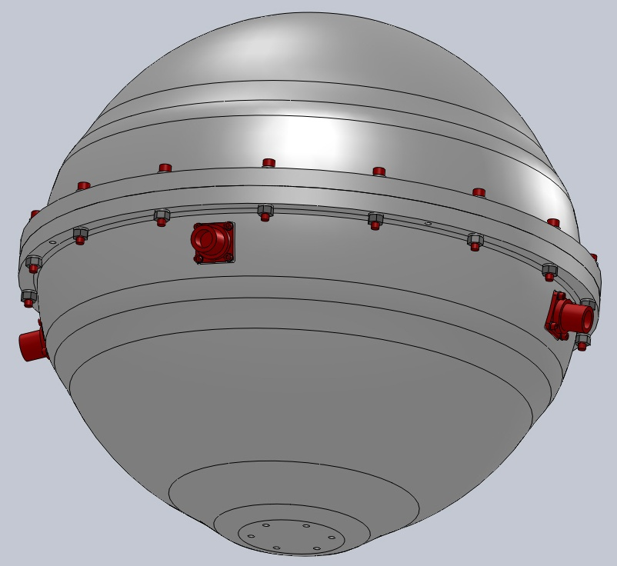
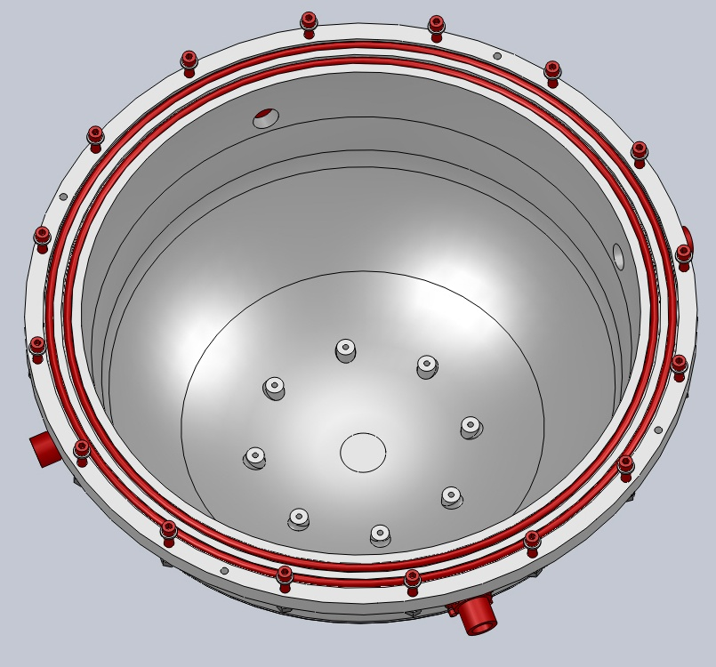
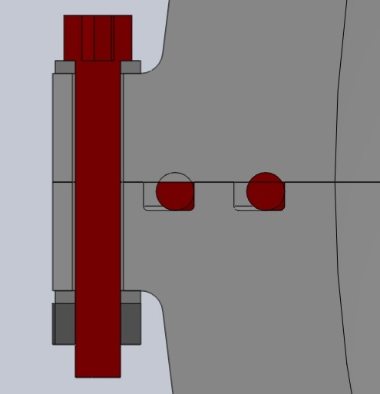
3-D VIEW OF ASSEMBLY FEATURES
4xMinK connectors, evenly spaced
8 tapped bosses for mounting internal chassis
4x ¼-28 threaded holes for mounting
External mounting holes (needed?)
Dual face seal o-rings

Slide 8
STRUCTURAL ANALYSIS
Solid Works Simulator FEA package was used to conduct a finite element analysis of the top and bottom housings
Static linear analysis was used to determine stress levels and distribution in two halves
Linear buckling analysis was used to determine factor of safety on buckling

Slide 9
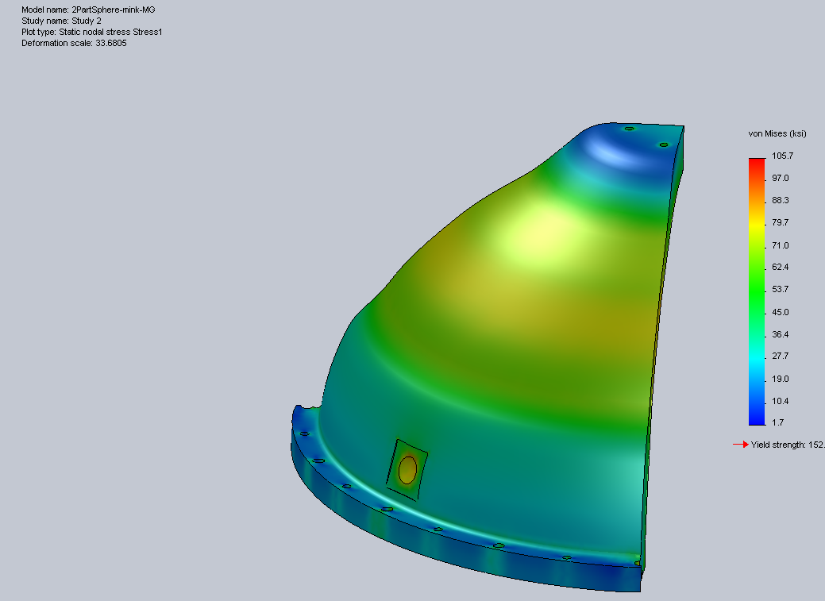
¼ MODEL OF BOTTOM HEMISPHERE
MAX STRESSES IN SHELL WITHIN ALLOWABLE
VERY LOCALIZED HOT SPOT ON EDGE

Slide 10
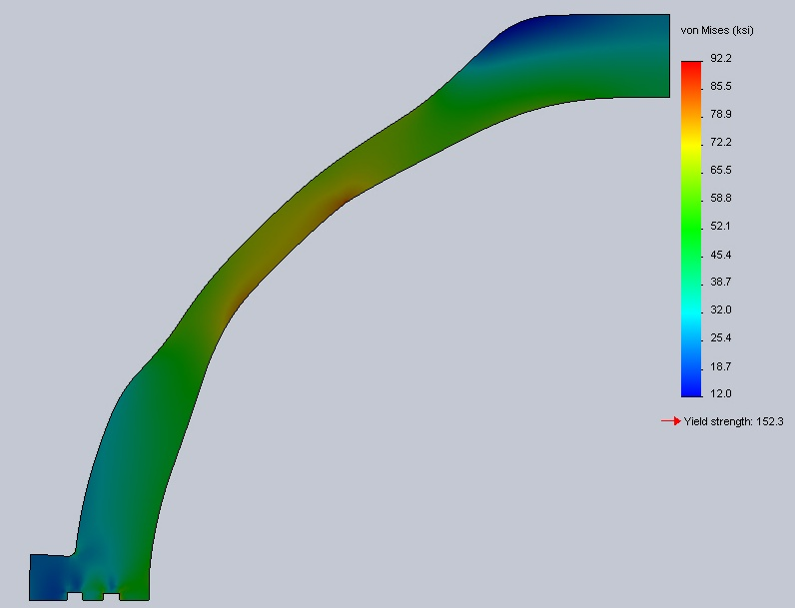
AXISYMMETRIC MODEL STRESSES
ASSUMES 8800 PSI PRESSURE EXERTED ON ALL EXTERNAL SURFACES

Slide 11
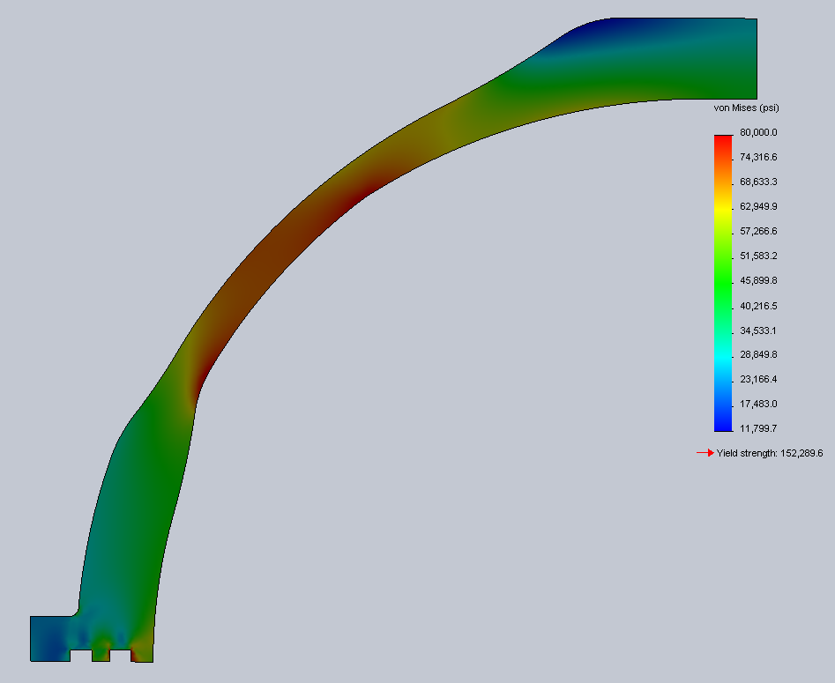
STRESSES WITHIN ALLOWABLE LIMIT
ALL STRESSES IN SHELL BELOW 80 KSI (120 KSI/1.5)

Slide 12
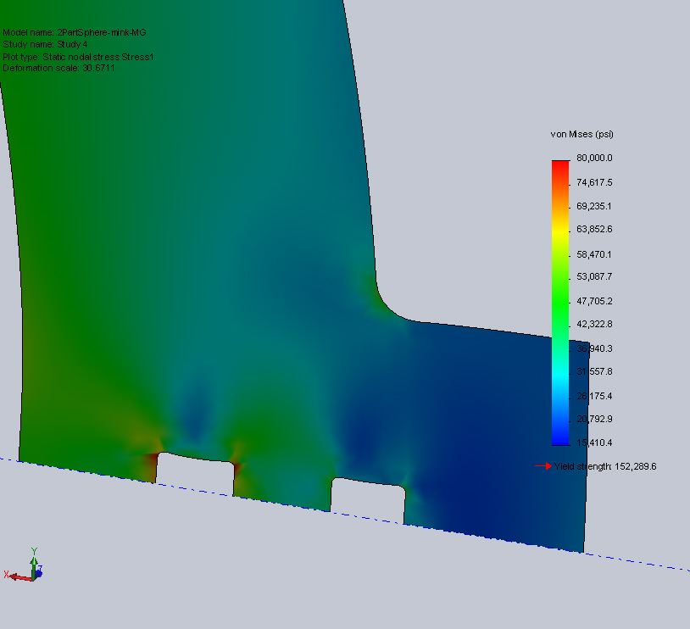
STRESSES IN O-RING TAB AREA
HOT SPOT NEAR FILLET OVER 80 KSI IS VERY LOCALIZED AND NOT SOURCE FOR CONCERN

Slide 13
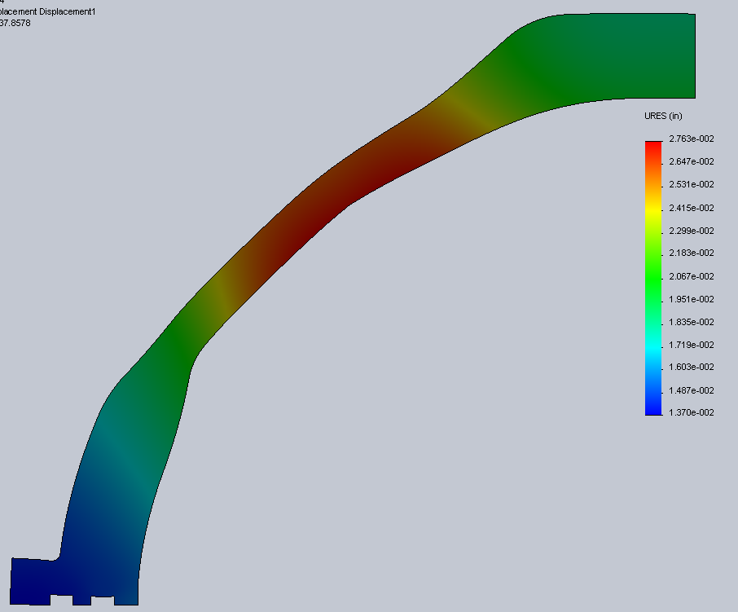
TOTAL DISPLACEMENTS IN AXISYMMETRIC MODEL

Slide 14
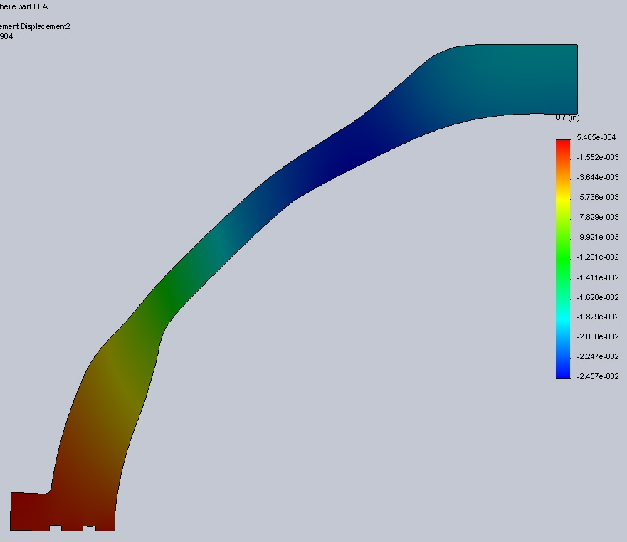
VERTICAL DISPLACEMENTS IN AXISYMMETRIC MODEL
DISPLACMENTS MINIMAL IN O-RING SURFACE AREA

Slide 15
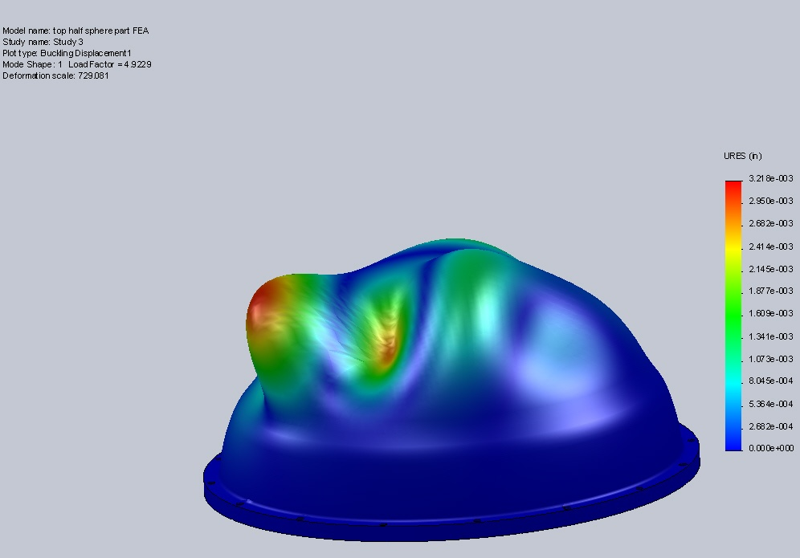
LINEAR BUCKLING ANALYSIS
FACTOR OF SAFETY OF 4.9 ON BUCKLING

Slide 16
ANALYSIS RESULTS
Stresses fall within allowable for hemispheres other than local hot spots that are not excessive
  120 ksi yield/1.5 = 80 ksi
Deformations are within reason especially in the o-ring sealing surface area
Buckling analysis shows a factor of safety of 4.9 on buckling >>2.0

Slide 17
CURRENT WEIGHTS OF HEMISPHERES
Top hemisphere has weight of 49 lbs dry
Bottom hemisphere has weight of 51.2 lbs dry
Total displacement of housing is 113 LBS
Net weight (housing only): -12.8 lbs
Specific gravity: 0.89
Does not include chassis, hardware, connectors or electronics

Slide 18
REMAINING ISSUES/QUESTIONS
Vent purge plug added to one of the hemispheres for vacuum testing, helium leak testing, backfilling w/ nitrogen or other gas prior to installation?
  Recommended plug is Prevco dual o-ring seal titanium vent plug
Verify internal space is sufficient for electronics
Thermal heat sinking if heat buildup is excessive
Is 6000m the maximum possible depth?
  For ROV use, a margin of safety has been used in past for instances where vehicle exceeds depth
  If additional margin is required, some material thickness increase is recommended
What are pressure test requirements?
  Recommend a test to 1.1 x design depth
Other issues/questions?

Slide 19
REMAINING WORK
Review quote from Wah Chang and advise MBARI so PO can be issued
Complete assembly drawing
Complete detailed design drawings for top and bottom hemispheres
Iterate design and analysis if additional depth margin is required or weight savings desired
Test finished assembly at NFESC when completed

