Slide 1
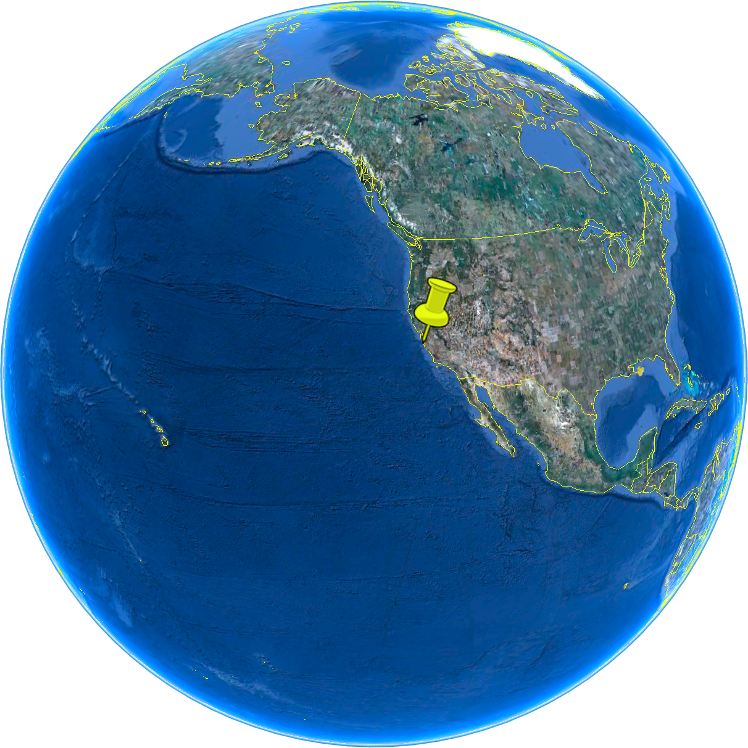
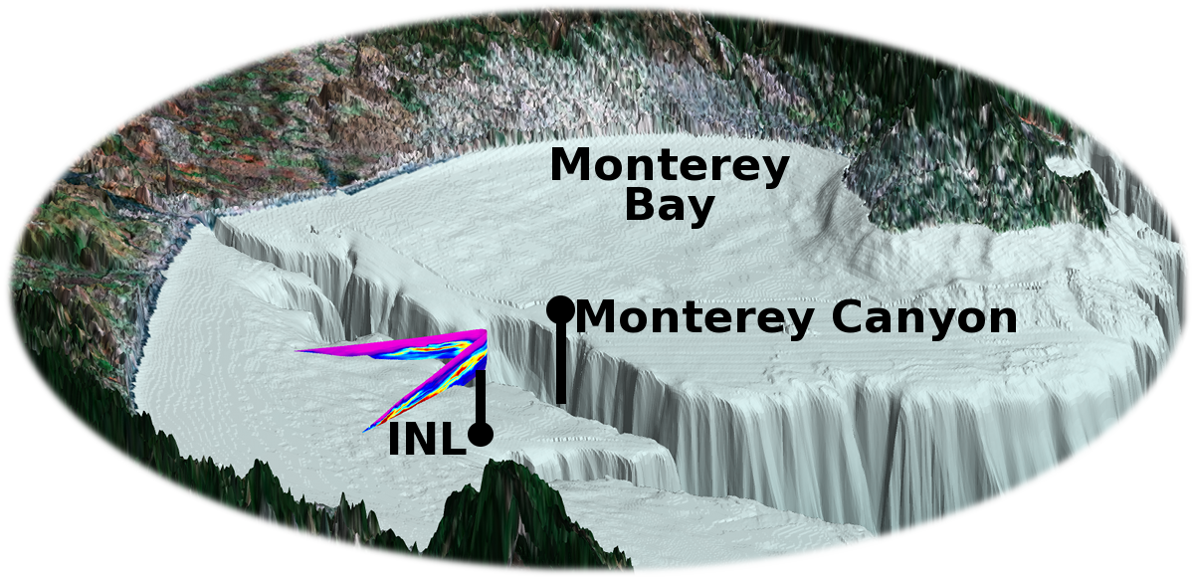
Bottom boundary layer separation
in a density front generated by
canyon-to-shelf transport
J. P. Ryan¹ and E. McPhee-Shaw²
¹Monterey Bay Aquarium Research Institute, Moss Landing, CA
²Moss Landing Marine Laboratories, Moss Landing, CA
View from NW
2012 Ocean Sciences Meeting Salt Lake City Session 142, Oceanic Fronts Abstract ID: 9436

Slide 2
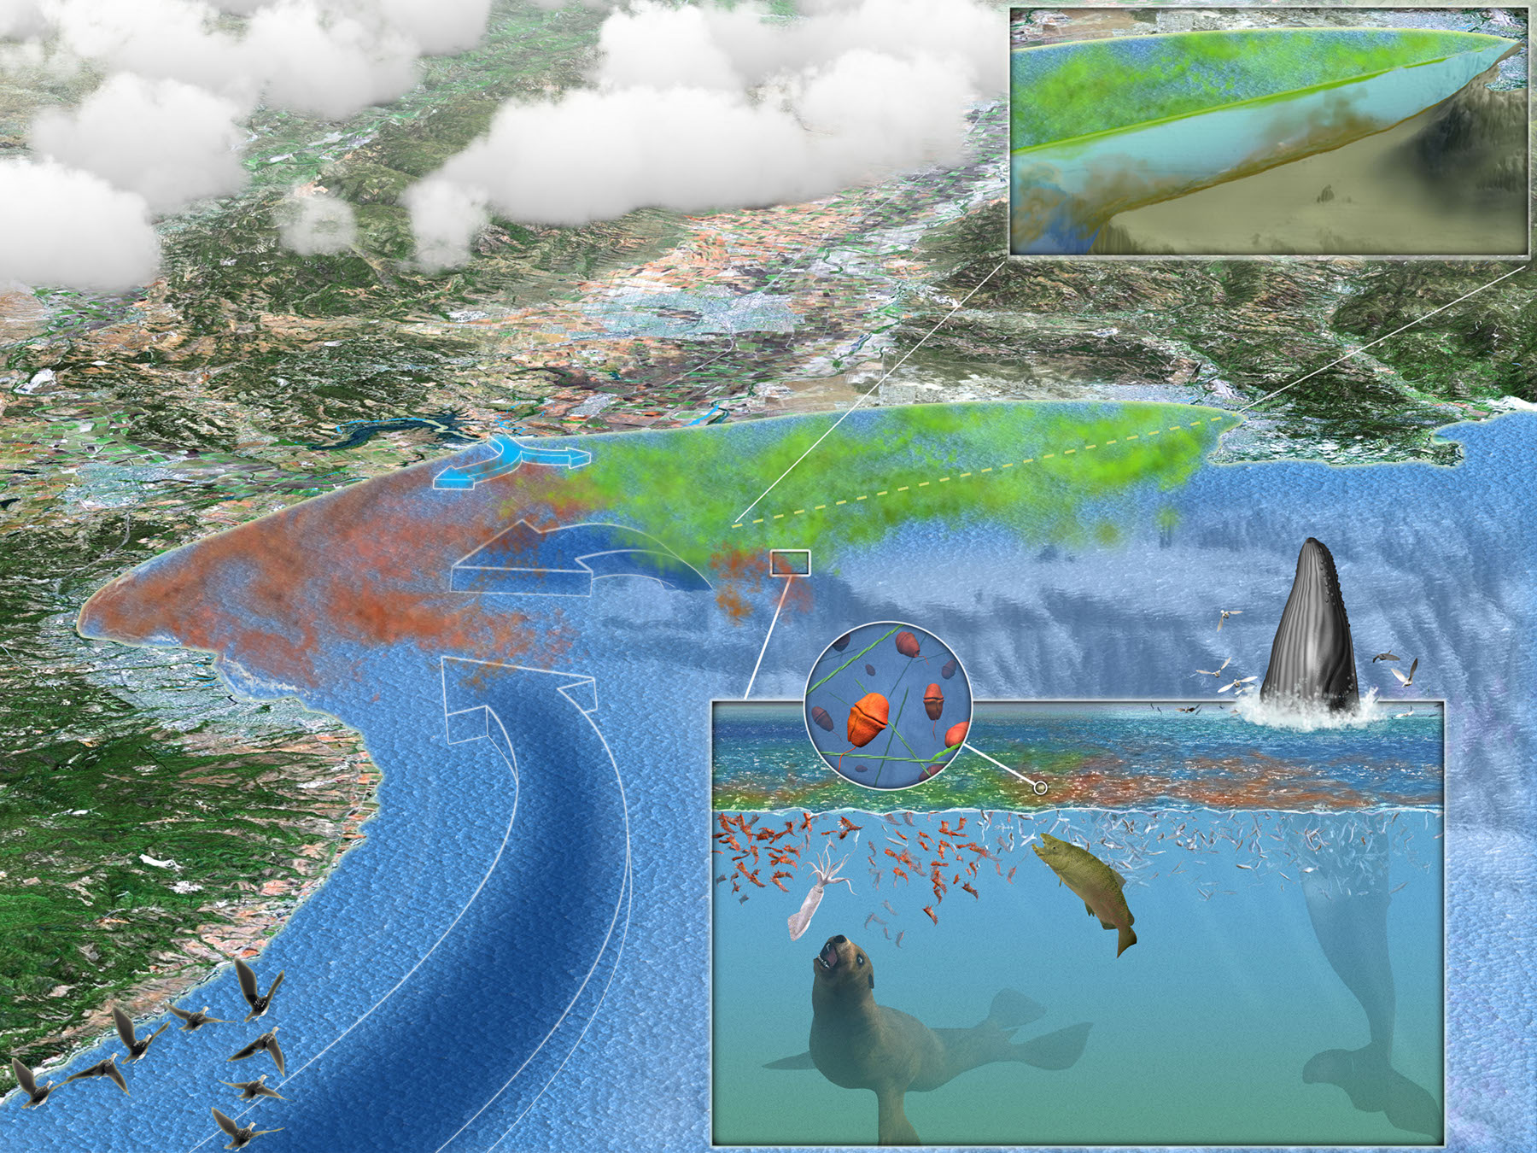
Motivation

Slide 3
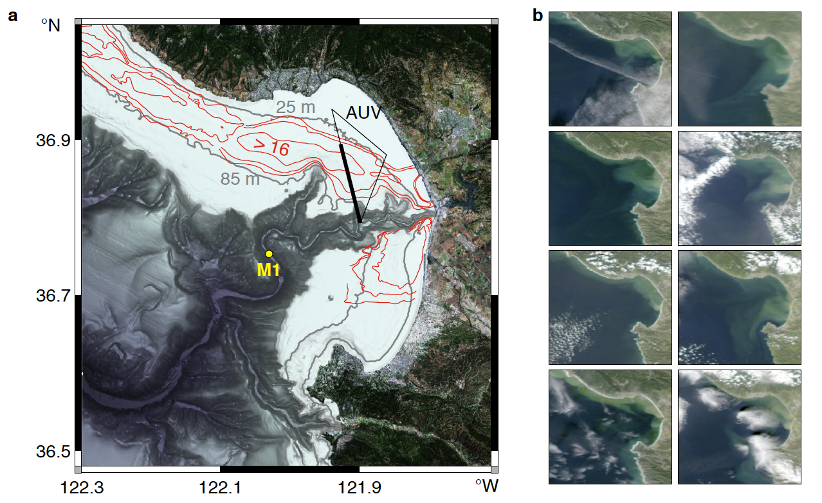
The mid-shelf “mud belt”
Holocene sediment thickness (m)
[Wong and Eittreim, 2001].
MODIS Aqua images of sediment plumes.

Slide 4
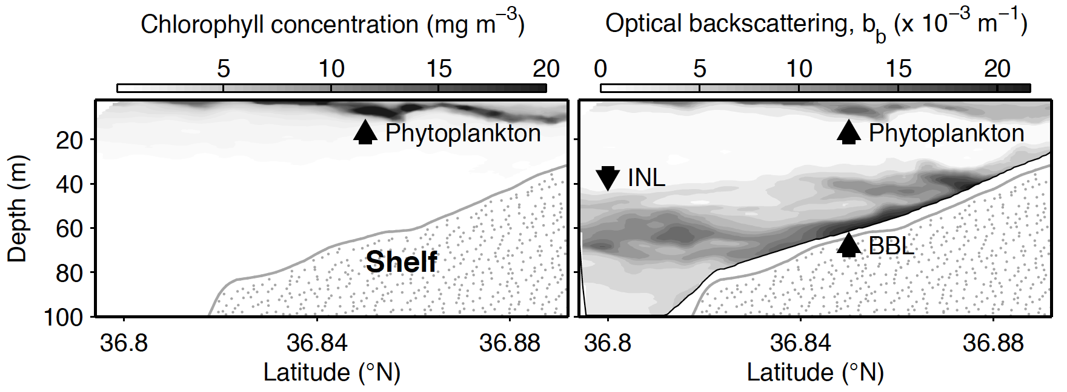
Identifying Intermediate Nepheloid Layers (INLs)

Slide 5
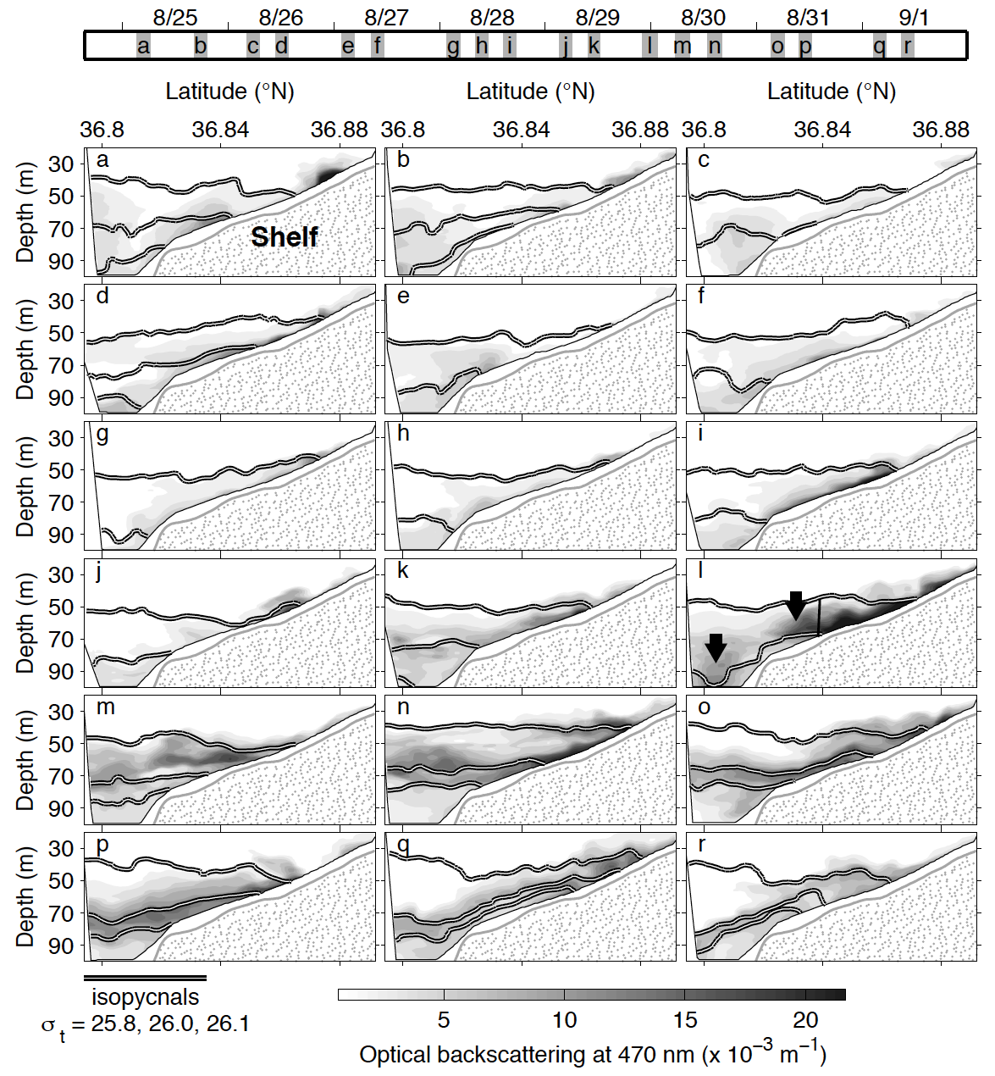
INL Formation
2005

Slide 6
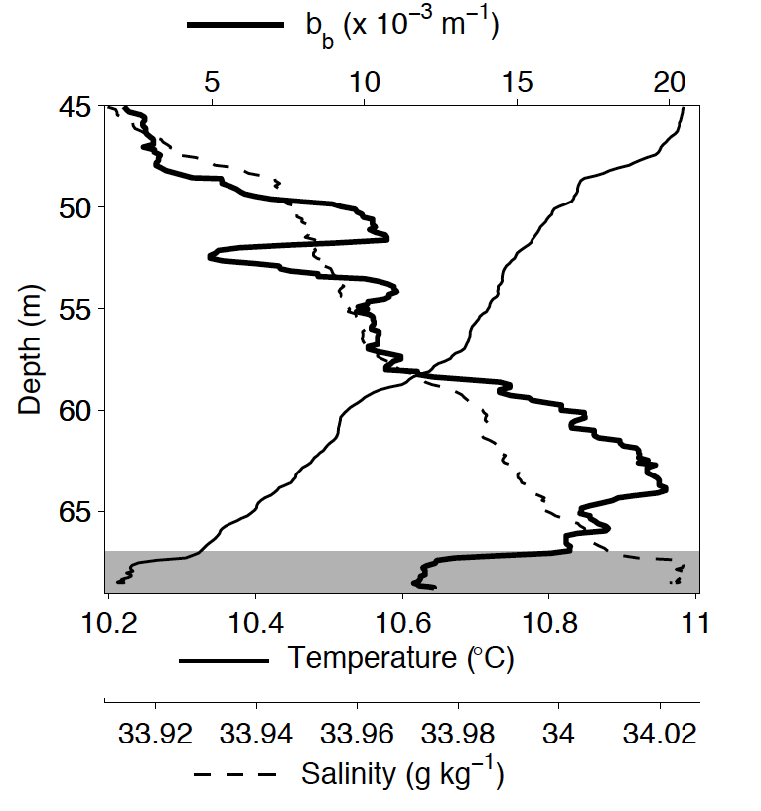
Hydrographic anomaly beneath nascent INL

Slide 7
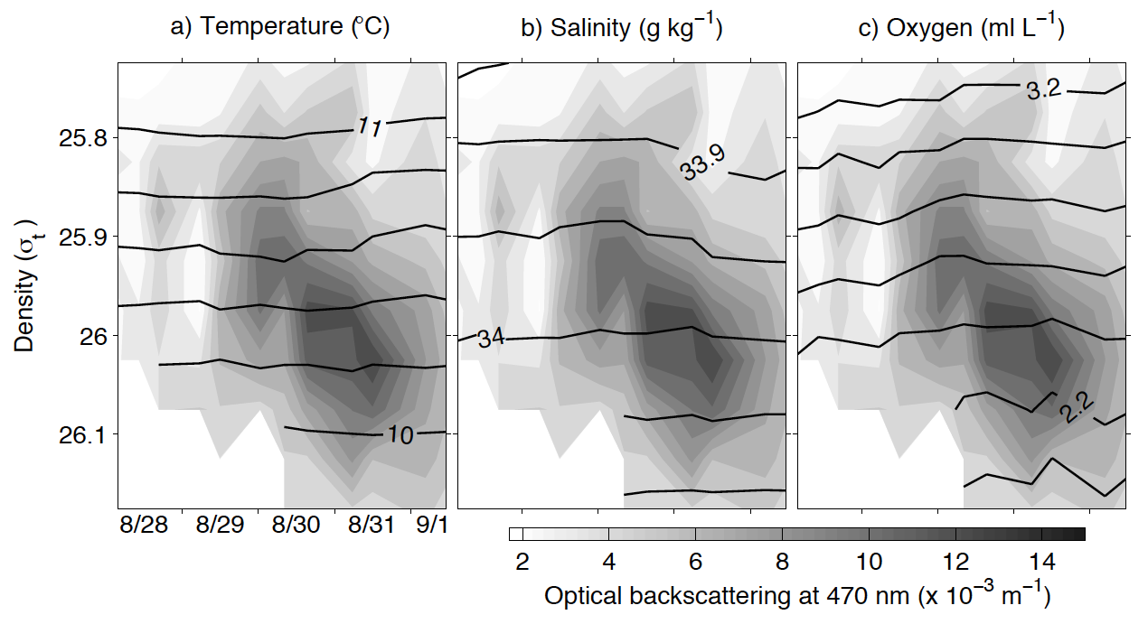
Deep density anomaly and particle sinking

Slide 8
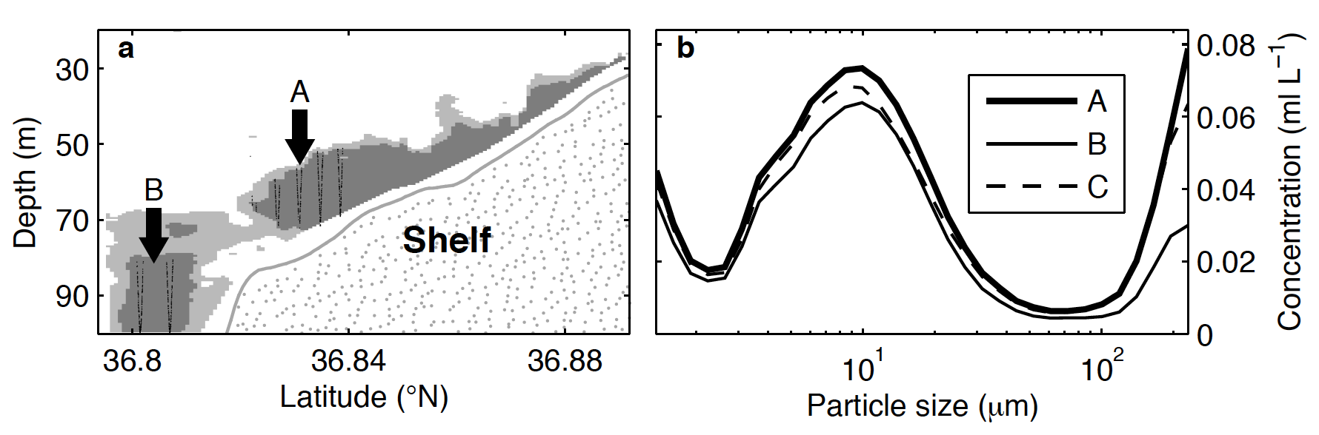
INL Particle Size Distribution

Slide 9
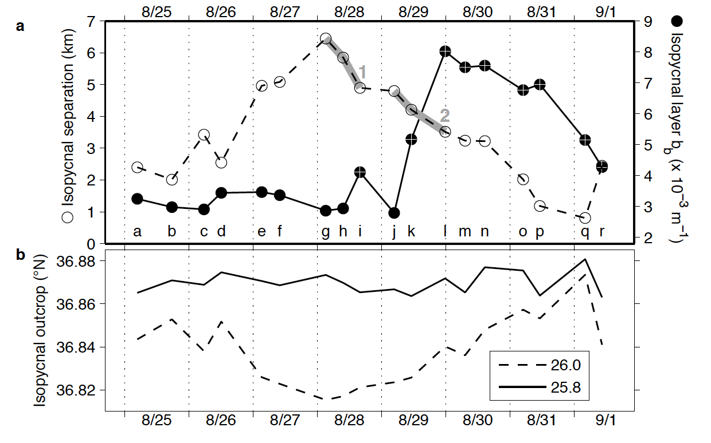
Local signal: lateral compression of isopycnals
Consistent with convergence in the BBL, forced by canyon-to-shelf transport.

Slide 10
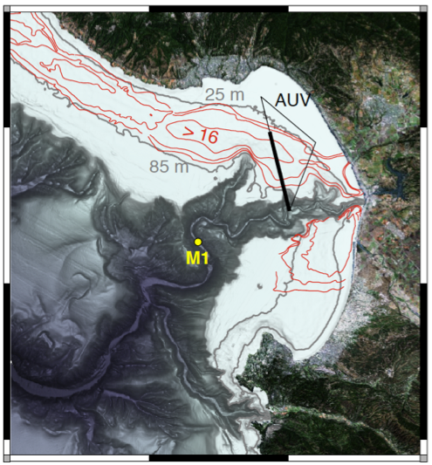
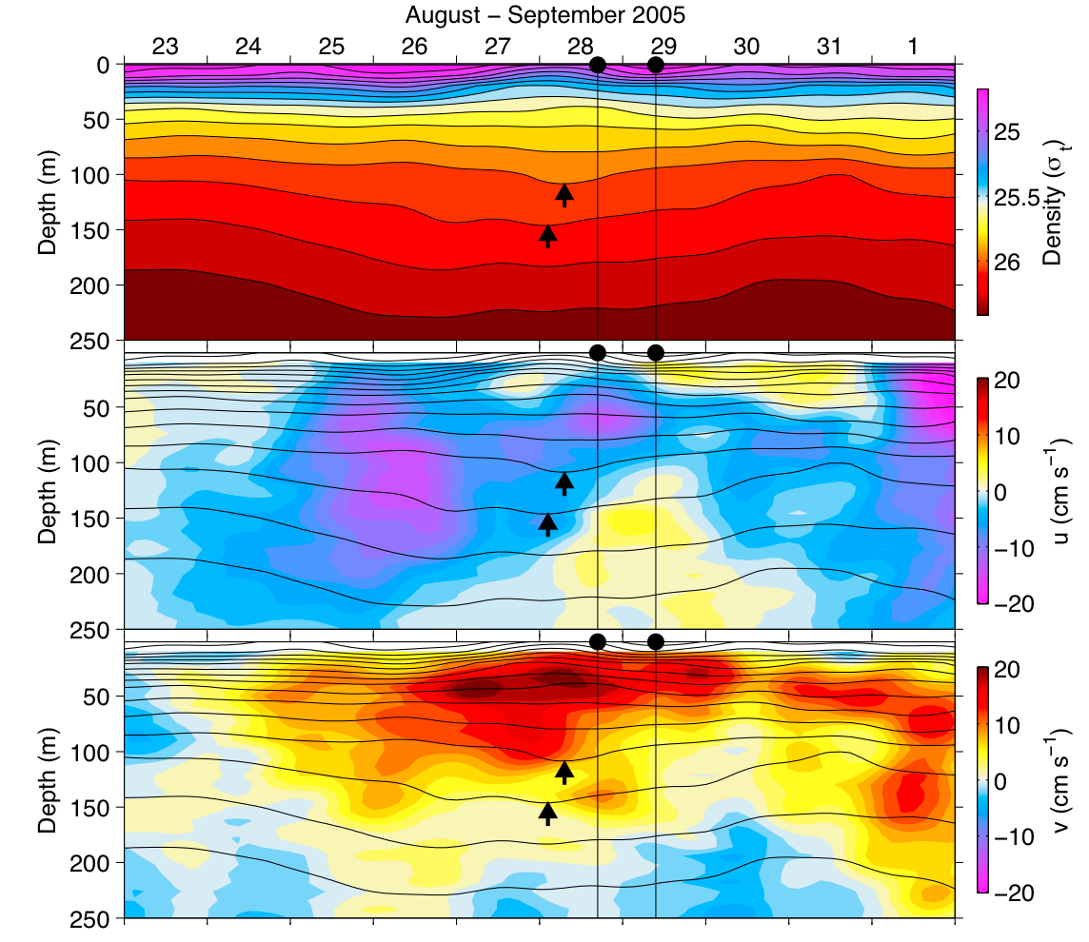
Non-local signal (1)

