Slide 1
CANON Fall Experiment
Draft questions and plans

Slide 2
Science Questions/Objectives
What are the source waters and seed populations for phytoplankton blooms in and out of Monterey Bay?
What are the processes responsible for phytoplankton blooms or lack thereof in and outside of Monterey Bay?
What are the biogeochemical consequences (particulate flux, nutrient regeneration) of phytoplankton blooms or lack thereof in and outside of Monterey Bay?

Slide 3
Technical questions/objectives
Can we identify and trace source water and seed populations for phytoplankton blooms in and out of Monterey Bay?
Can we develop environmental indices that can be used to predict the location and timing of blooms with enough accuracy and speed to be used to trigger autonomous sampling?
Can we develop an information processing and display system that can be used in real time to improve decision making and publication preparation in delayed mode?

Slide 4
Operational Plan
Repeatedly (10 or more times during the course of the month?) deploy drifters and LST along Line B or equivalent. The offshore pair would be occasionally in high chl offshore, the middle in high flow, low chl, the inshore (drifter only, too shallow for LST) in low flow, high chl in association with the ESPs. The drifters would have water collected at the site of deployment and changes in the bottles will be monitored over 1-3 days. The AUVs and ships would follow the drifters and LSTs collecting information in situ for comparison with those contained in bottles on the drifters. Gliders would run fixed grids except for Tex that would follow LSTs to provide location information to shore for navigating the ships and AUVs.

Slide 5
Ships
Western Flyer – PCTD, UCTD, profiling pump, optics
Rachel Carson - PCTD, UCTD, profiling pump, optics
Paragon – LST, Glider, drifter support
Martin – ECOHAB, PCTD, UCTD, optics
Fulmar (?) - PCTD, UCTD, optics

Slide 6
AUVs
Dorado
Tethys
Daphne
U of Porto ?
Other ?

Slide 7
Gliders
Spray Line 67
Spray NPS
Spray NPS
Slocum Teledyne
Slocum UCSC
Slocum UCSC
WG OA
WG Tex

Slide 8
Moorings
M1
M2H
OA1
OA2
ESP 1
ESP 2
Other ?

Slide 9
LST, drifter, other
LST (= Lagrangian sediment trap) 1
LST 2
Stella 1-n (what is n?)
Android 1-n
Floats ?
ROMS-NPZD 3 km
Cowen zoo system ?

Slide 10
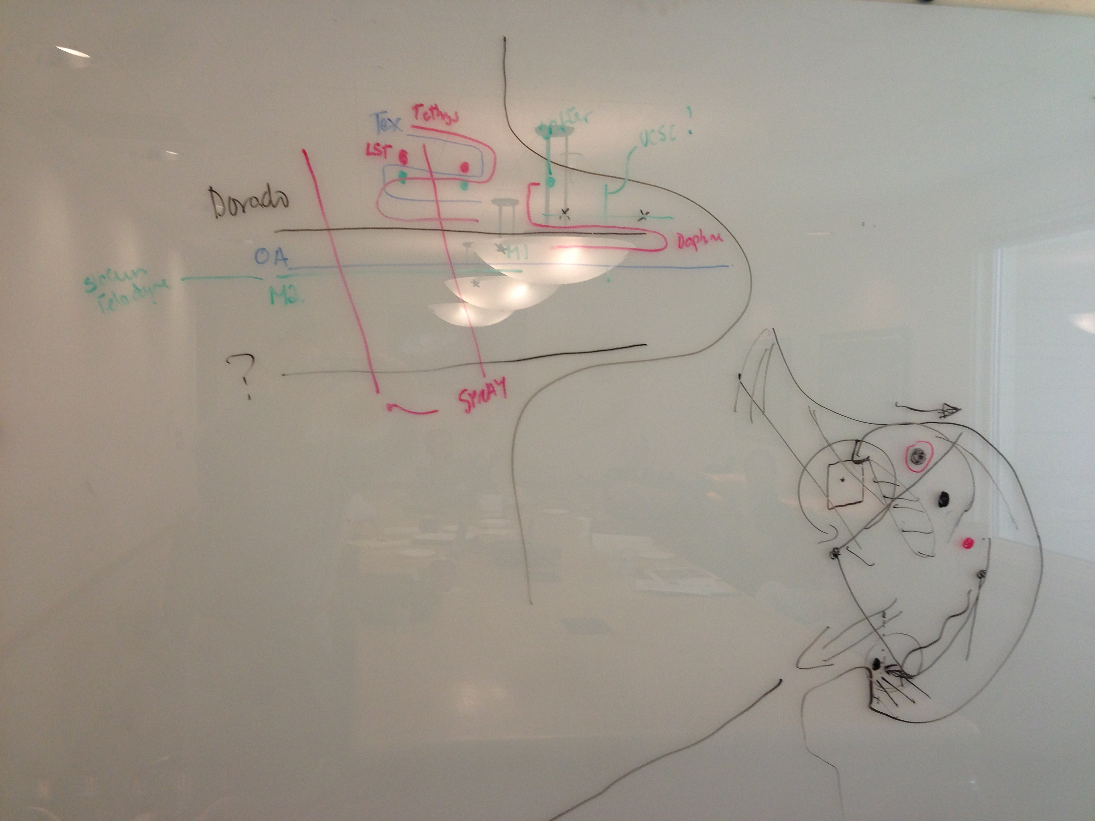
Chavez
Ryan

Slide 11
Working groups and leads (members in parentheses)
Science planning – Ryan (Bellingham, Chavez, Scholin, etc.)
Technical planning – Maughan (Edgington, Rajan, Chavez, etc.)
Autonomous mobile platforms – Bellingham (Wahl, Ryan, Zhang etc.)
Autonomous drifting platforms – Smith (Sherman, Chavez, Wahl, etc.)
Data analysis – Messie (Ryan, McCann, Bellingham, Chavez, etc.)
Samples – Pennington (Blum, Smith³, Kudela, Preston, Zhang, etc.)
Data management – Gomes/Michisaki
Responsibility of lead to develop a list (questions, platforms, products, data, samples), a means to answer/produce/distribute, analysis, organize team, etc.

