Slide 1
Manta
Bundle store
message
message
dtnsend
dtnrecv
Test 1: send to and receive from Manta localhost (“loop-back” test)

Slide 2
Manta
MacBook Pro
Intermittent Ethernet link
Bundle store
Bundle store
message
message
dtnsend
dtnrecv
1. User issues message via dtnsend while Ethernet cable is disconnected
2. User receives message via dtnrecv when cable is plugged in
Test 2: exchange messages between Manta and MacBook via intermittent Ethernet link

Slide 3
RF link
MacBook Pro
Manta
Bundle store
Bundle store
message
message
POE
dtnrecv
dtnsend
POE adapter
2. User receives message via dtnrecv when radios are switched ON
1. User issues message via dtnsend while radios are OFF
Test 3: exchange messages between Manta and MacBook via intermittent RF link

Slide 4
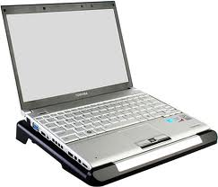
Intermittent RF link
Radio
Bundle store
CTD data
Manta
CTD driver
POE adapter
RS232
Laptop retrieves CTD data when RF link is up
CTD
Test 4: Instrument telemetry transfer between Manta and MacBook via intermittent RF link

