Slide 1
Preliminary
Design Review
System Overview
SANDY/SCOOP
Meteorological Ocean Buoy

Slide 2
Agenda
Scope Review/Requirements Review
New Features
Concept of Operations
Risks to SANDY/SCOOP
SANDY/SCOOP 3m Mounting, Assembly and Payloads
Overview Camera/AIS, MET sensors
Processing, HUB Controller & Power Requirements
SANDY/SCOOP Costs Estimates
Test Plan for Project
Q & A

Slide 3
Scope Review
Recapitalize NDBC's offshore buoys in Atlantic, Caribbean and Gulf of Mexico
Improved ocean observations for hurricane forecasting
Improved reliability of observations and communications
Decrease costs of O&M
Will meet the current observing capabilities of NDBC’s hurricane buoy network
Add real time reporting cameras and subsurface temperature profile capability on each buoy to measure ocean heat content.
This project is the development, complete documentation and transition to operations, and the production of new systems for deployment at the 20 buoy stations in the summer of 2015

Slide 4
Requirements Review
Products will be based around self-contained ocean observations “payloads” that can be deployed in a number of ways:
- mounted on, rather than integrated into existing NDBC legacy buoy platforms
- mounted in new standard families of “host” buoy floats
- mounted on towers or structures at C-MAN sites
- mounted on ships of opportunity
Fully complete drawings & documentation
New operational payload for the entire weather buoy network
Same form factor will be developed for TAO and DART applications
One person should be able to lift and carry a payload.
Interconnection between payloads and special “remote” sensors should be wireless (although MET sensor unit can be mounted on a mast extending from payload housing, for example).
An auxiliary power payload that can be connected via waterproof cables & connectors to extend the life of an OBS payload is allowed – goal should be minimum 1 svc year life.
Initial mounting of payloads on legacy buoys through FY 14 can include buoy “hopping” and even pulling buoys on-deck, if necessary, or attaching to existing buoys that can be deployed as “host” surrogate floats.

Slide 5
Requirements Review page 2 (PDR)
MET
  WSPD, WDIR, BARO, ATMP, WTMP, RH
  Sampling rate, range, resolution, and accuracy in accordance with current NDBC capabilities
  Sensor height may be lower than current standards
WAVES
  3-Axis Angular Rate, Accelerometer and Magnetometer Inputs
  Sampling rate, range, resolution, and accuracy in accordance with current NDBC capabilities
OCEAN
  Ocean Temperature, Conductivity, Pressure
  Number of depths (up to 10) should be configurable
  Data collected from each depth should contain all of the measurements for the highest resolution and accuracy
CAMERA / AIS
Images and health measurements
Vessel data
HOUSEKEEPING
  System health and errors
  Property/serial number
  Engineering data and archived data messages
  FUCTIONALITY
  Each individual payload can be carried by one person
  Payloads leave the NDBC site as sealed, tested units that are not opened in the field
  Payloads hosted on legacy buoys must be completely independent and not electrically connected in any way to the buoy systems /components

Slide 6
New Features SANDY/SCOOP
Gen-II Camera System
AIS Receiver
XML formatted message
10 minute MET packages
Distributed Processing
Eliminates parameter tables
Wireless Communication
Rechargeable Lithium-ion battery technology
Lighter weight and modular
Ocean Temperature to 150 meters
  Thermistor String: Temperature
  Seabird SBE37IM sensor (CTD)
Auxiliary Equipment Payload- Allows reimbursable customers to directly interface with limited NDBC engineering development time

Slide 7
CONCEPT of OPERATIONS
Lab will build and fully test each payload at SSC
Complete Buoy Package shipped together
  Payloads: Camera/AIS/MET, Power, Waves/Ocean, and Auxiliary Payload (undefined equipment)
  Each container will contain all tools, instruction, and PPE for assembly
  Container designed to house the Payload or Payloads
No station will be hopped for repair or sensor replacement, the entire buoy will be replaced
Start of Leap Frog Service
  Assemble stations on spare 3m hull
  At Power up:
    Hub coordinator audits end devices and reports a system configuration message
    Enter deployment mode
  Deploy at mooring site
MCC
  Assign station ID based on IMEI #
  Configures MCC data base for the station
  All site specific parameters are configured remotely
Recovered Hulls are cleaned, and next SANDY system installed

Slide 8
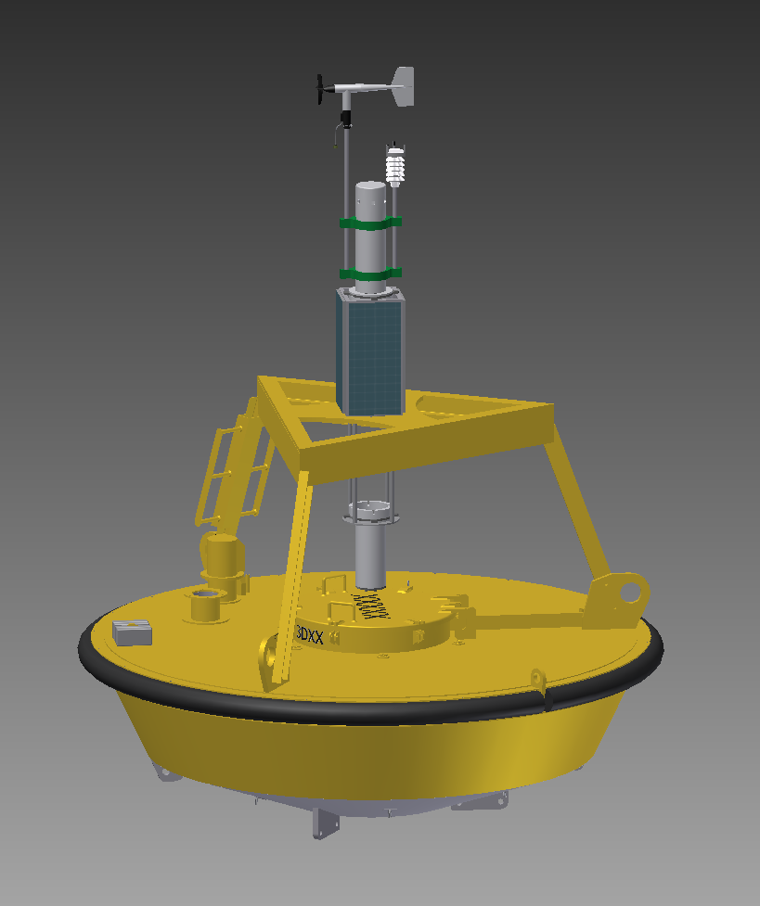
3m Installation
Bridge frame is attached to existing 3m mast after top portion of mast is removed
Waves module suspended approx 4” above attach to get close to center of buoyancy and still allow for heat content and surface temperature cables to exit
Wind sensor is approx 3m from water line

Slide 9
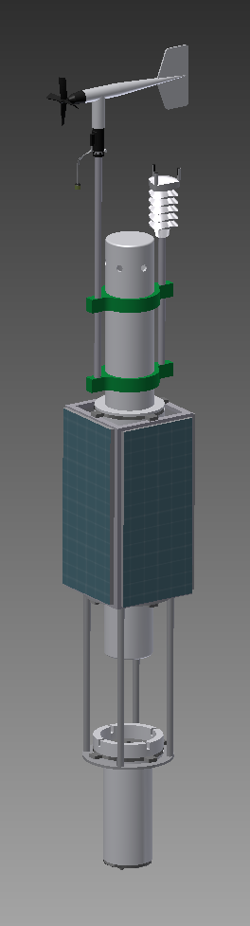
Hurricane Sandy Assembly
Stacked design that can easily be broken down into individual payloads for shipping
Layout carries over nicely to Phase 2
Total Length: 10 ft (approx)
Total Weight: 120 lbs (approx)
MET/Camera/AIS Payload
Power Payload
Auxiliary Payload
Standoff Frame
Waves/Ocean Payload

Slide 10
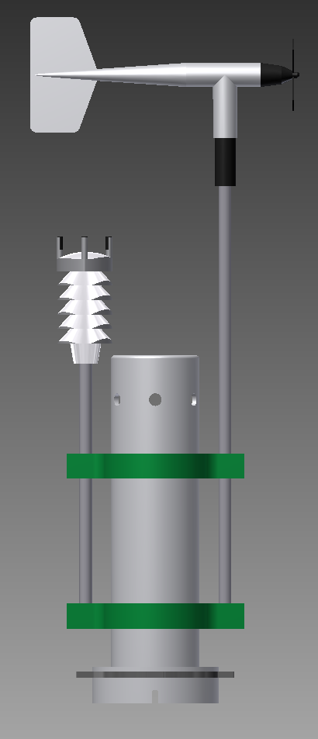
Camera/AIS/MET Payload
Split tube design with camera/AIS portion separable to make independent unit
Tube Material: Clear Acrylic with either paint or a “skin” applied with cutouts to allow internal inspection without opening
Length: 4’-6” (approx)
Weight: 30 lbs (approx)
RMY Wind Sensor
All-N-1 Sensor
Camera/AIS Components
MET Components
Power/External Sensor Connectors

Slide 11
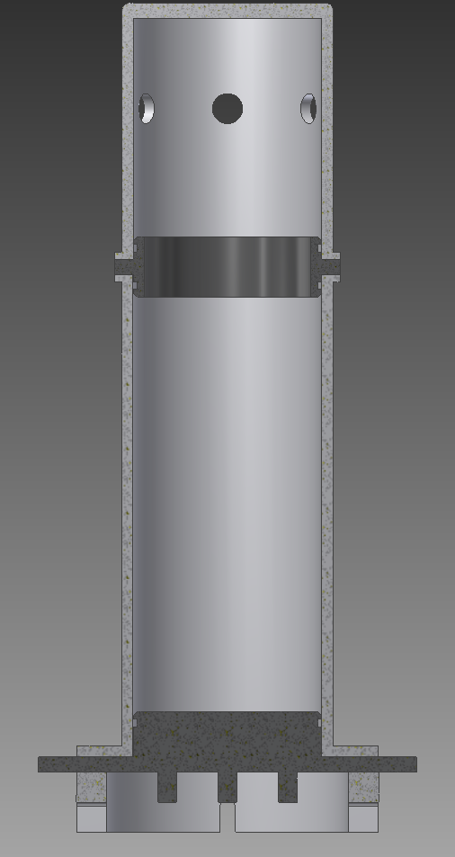
Camera/AIS/MET Payload
ANT
ANT
O-ring seals at interfaces
Camera Chassis will mount from the top down
MET Chassis will mount from the bottom up
MET Chassis will be equipped with a location for an antenna to be used if it is stand-alone weather
Tube: 7” diameter x 24” long (approx)
Cameras
Modem
AIS ANT
SM
SM
Tube Junction
ANT
SM
Barometer
Modem
Comp
Comp
SM
SM
Connector Interface

Slide 12
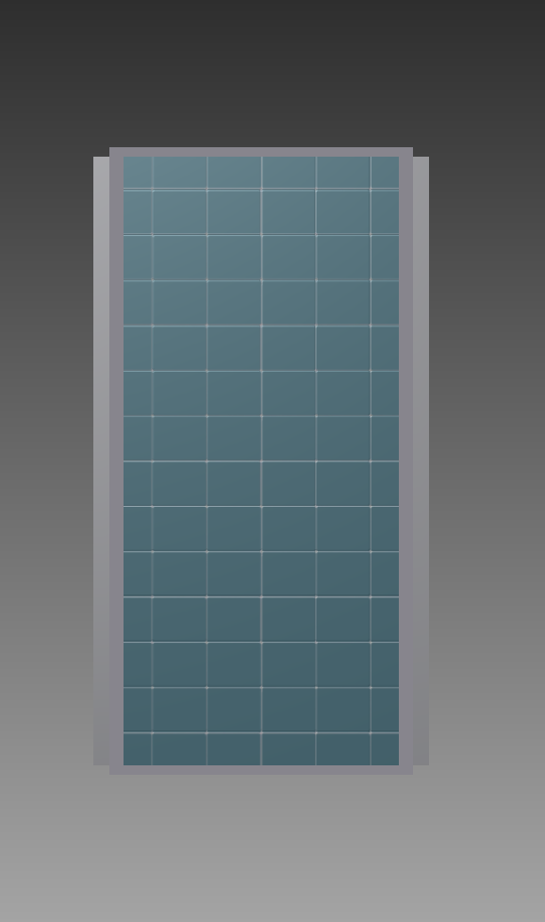
Power Payload
Four 30W solar panels
Aluminum Space Frame
Panels will ship flat but can be adjusted to an angle prior to deployment
Battery housing and controller housed internal to space frame
Dimensions: 14.5” SQ x 27” long (approx)
Weight: 60 lbs (approx)
Connector Interface
SM
Batteries
Connector Interface

Slide 13
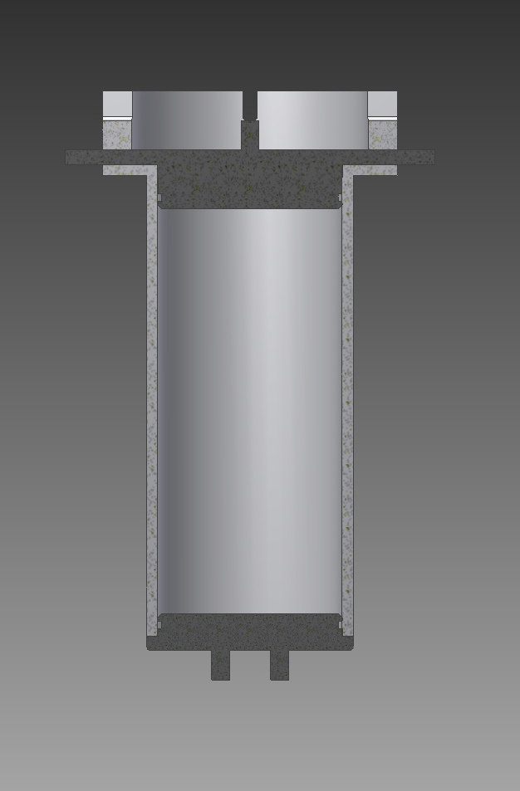
Waves/Ocean Payload
Tube Material: Clear Acrylic with either paint or a “skin” applied with cutouts to allow internal inspection without opening
Tube: 7” diameter x 16” long (approx)
Weight: 15 lbs (approx)
Connector Interface
IM Modem
Thermister Interface
SM
SM
Waves Processor
Waves Sensor
Connector Interface

Slide 14
Auxiliary Payload
Tube Material: Clear Acrylic with either paint or a “skin” applied with cutouts to allow internal inspection without opening
Tube: 7” diameter x 16” long (approx)
Weight: 15 lbs (approx)
Connector Interface
SM
Connector Interface

Slide 15
Camera / AIS System Overview
Camera
  360 degree image capture and storage every 5 minutes
  Transmit one image every hour
  Camera will have a new mode to transmit images as they are taken.
AIS
  Range is 17 miles assuming 100 ft ship antenna height.
  AIS receiver on for 1 minute every 30 minutes.
  Transmits raw NMEA messages
  NMEA decoded for a vandalism event
Details in Day 2 PDR Presentation

Slide 16
MET System Overview
MET
  All-in-One MET – Vaisala WXT520/Gill Instruments MetPak/Other
    Wind speed & direction
    Barometric Pressure
    Air Temperature
    Relative Humidity
    Rain (Vaisala WXT520 only)
  Onboard Compass Chip – Invensense MPU-9150 or STMicroElectronics LSM303DLHC (3 axis magnetometer)
Extended MET
  Wind speed & direction – RMY 05103 or 05108
  Barometer – Setra Model 270 or RM Young 61302V
  Onboard Compass Chip – Invensense MPU-9150 or STMicroElectronics LSM303DLHC (3 axis magnetometer)
Hub Coordinator
  Iridium Modem – Model 9602
  Iridium/GPS Antenna
Details in Day 2 PDR presentation

Slide 17
MET Sensor Pros & Cons
All-In-One MET
Device | PROs | CONs
Vaisala WXT520 | Lower power than Gill Relatively small and light weight Has rain measurement (possibly extra capability) | Meets NDBC accuracy, but not as well as Gill MetPak
Gill Instruments MetPak | Accuracy is better than Vaisala. Specifically; barometer is 0.5 hPa better, air temperature is 0.6°C better | Higher power than Vaisala WXT520 Higher cost than Vaisala WXT520 (by $450) Consists of two separate components Low Air Temp range -35°C instead of -40°C
3-Axis MEMS Magnetometer (Compass)
Device | PROs | CONs
Invensense MPU-9150 | Might serve as wave sensor AND compass | Appears to be a few milliamps higher power than LSM303 chip.
STMicroElectronics LSM303DLHC | Lowest power | Compass only function (e.g., not waves)

Slide 18
Extended MET Sensor Pros & Cons
Anemometer
Device | PROs | CONs
RM Young 05103 | Many in existing NDBC inventory | Known to fail in extreme conditions
RM Young 05108 | Tougher design than 05103 | Not as accurate at low wind speeds
Barometer
Device | PROs | CONs
Setra Model 270 | Many in existing NDBC inventory | Would require a DC/DC converter or other special power supply May require small mods to SM analog circuit.
RM Young 61302V | About $350 less then Setra Less power in analog mode. But would require SM input resistor mods to use in analog mode. Can be configured for analog or serial outputs Could potentially be used in legacy weather systems if Setra inventory depletes | New MEMS type sensor. Long term performance not known, but expected to be good.

Slide 19
MET Processing
Measurement | Top of Hour MET | Additional METs
Wind Speed Average Maximum Three (3) Second Gust Minute of Maximum Three (3) Second Gust Maximum One (1) Minute Gust Minute of Maximum Three (3) Second Gust | 10 min | (5x) 10 min
Wind Direction Average Wind Vane Average Raw Compass Average Corrected Compass Average | 10 min | (5x) 1 min
Air Temperature Average | 10 min | (5x) 10 min
Relative Humidity Average | 10 min | (5x) 10 min
Station Barometric Pressure Average | 1 min | (5x) 1 min
XML Message Size in Bytes (Approximate) | 407 | (5x) 407

Slide 20
Extended MET Processing
Measurement | Top of Hour MET | Additional METs
Wind Speed Average Maximum Three (3) Second Gust Minute of Maximum Three (3) Second Gust Maximum One (1) Minute Gust Minute of Maximum Three (3) Second Gust | 10 min | (5x) 10 min
Wind Direction Average Wind Vane Average Raw Compass Average Corrected Compass Average | 10 min | (5x) 1 min
Station Barometric Pressure Average | 1 min | (5x) 1 min
XML Message Size in Bytes (Approximate) | 371 | (5x) 371

Slide 21
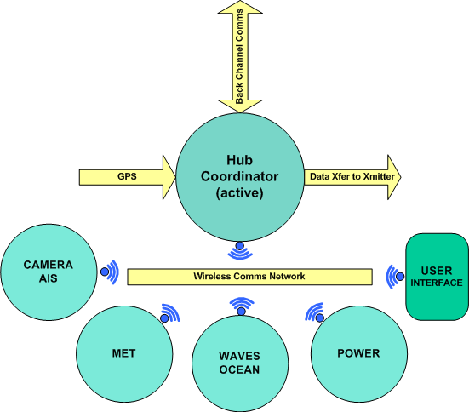
Hub Coordinator
Functionality
  Master Clock (GPS)
  Primary Hub/Iridium Transmitter paired with MET
  Secondary Hub/Iridium Transmitter paired with CAMERA/AIS
  Communicates wirelessly with other modules and user interfaces
  Registers System Configuration Devices
  Monitors System Health
  Stores XML Messages
  Packet Builder for MET, WAVE, OCEAN, Housekeeping , and Health data messages
  Provides Back Channel Access via the Iridium Transmitter

Slide 22
Payload Communications
Iridium
  Iridium SBD is used for MET and AIS data
  RUDICS used for image data
  Iridium security can be implemented for back channel access restrictions
Short Range Wireless
  Payloads will use 802.15.4 wireless for all communications
  All SM will transmit periodic “beacon” that contains status info
  Wireless packets will be encrypted with AES-128
  Wireless Audits provide network awareness

Slide 23

Waves Overview
Power & Data
DDWM (Today)
GX1
CF2
Payload
Repackage
New Sensor Lower Power
GX1
CF2
SM
Parallel Effort
Power
Repackage reduces risk on data quality.
New design by CY2015 to lower power impact
Iterative field test needed for new sys.
MPU-9150
(new Chip)
Gumstix
Processor
SM
Power

Slide 24
Waves Processing
DDWM core processing does not change
Add a few new health stats & fix minor bugs
Use XML format
GX1
Sensor
Spline
Process
GOES Format
NOW
Sensor Data
2K Samples
Wave Data
WP9 message
GX1
Sensor
Spline
Process
XML
Format
SCOOP
Sensor Data
2K Samples
Wave Data + new stats
Wave Data Msg

Slide 25
Ocean System Overview
Measures:
  Sea surface temperature (conductivity optional)
  Ocean temperature profile (conductivity & depth optional)
Sensors
  Sea Surface Temperature: Seabird serial sensor (CT or T) – like TAO
  Ocean temperature profile: up to 9 positions with 4 possible configurations
    Seabird IM with up to 9 CTD sensors
    Seabird IM with up to 9 T sensors
    Seabird IM with up to 9 sensors; combination of either CT, T, or CTD
    Thermistor string with up to 9 temperature measurement positions

Slide 26
Ocean Sensor Pros & Cons
Device | PROs | CONs
IM (CTD) (Jamestec) | Proven mechanically good system from TAO experience. Provides best measurement for “Science and researchers”. If a sensor fails during integration and test, or early in deployment, it can be replaced. Known good performance. Technicians familiar with system and sensors. | Very expensive Requires installing lithium batteries in the field (does not meet project requirement)
IM (T) (TAO) | Proven mechanically from TAO experience. Provides good temperature measurement for modelers Deploy longer than CTDs ;reduced effect from biofouling Batteries do not have to be removed for shipment. One sensor can be replaced relatively easy Known good data performance. Technicians familiar with system and sensors. | Less expensive than CTDs, but still more than ThermArray
Thermistor Array (New Approach) | Provides a good enough temperature measurement (0.07°C) for “Modelers” Much less expensive than IM temperature sensors (≈ $15K less) No batteries to install in the line. | Deployment and survivability are unknown. May require more test and development cycles to perfect (like our experience with TAO IM system) Not viewed as a good solution from “Science an researcher” point of view due to reduced accuracy, no conductivity and no depth measurements. If a sensor fails, it cannot be replaced. Must replace the entire array. If cut, entire line could be lost

Slide 27
Ocean Processing
Measurement | Serial T/CT MET | Serial T/CT Depth 1 | Inductive T/CT/TD/CTD Depths (2 – 10) | Thermistor String Depths (2 – 10)
Temperature | 1 Sample / 10 Minutes | 6 Samples / Hour | 6 Samples / Hour | 6 Samples / Hour
Conductivity | 1 Sample / 10 Minutes | 6 Samples / Hour | 6 Samples / Hour | N/A
Depth | N/A | N/A | 6 Samples / Hour | N/A
XML MET Message Size in Bytes (Approximate) | 159 to 181 / 10 Minutes | N/A | N/A | N/A
XML Ocean Message Size in Bytes (Approximate) | N/A | Included in Depths (2-10) | 857 to 2097 / Hour | 857 to 919 / Hour

Slide 28
Power System Overview
Supplies all power for Camera/AIS/MET, Waves/Ocean, and Auxiliary Payloads
Measures
  Health of Power System monitored by Smart Battery Chargers
  Passes Health Data to Hub Coordinator
Components
  4 Solar Panels
  12 SMBus Smart batteries
  2 SMBus Charge Controllers
  1 Smart Module

Slide 29
System Power Requirements
Functional Module | SCOOP | 3M
Basic Met | 0.552 | n/a
Extended Met | 0.166 | 2.98
Hub Controller | 0.414 | n/a
Meteorological Total: | 1.2 | 2.98
Waves | 1.32 | 1.32
Ocean | 0.03 | n/a
Oceanographic Total: | 1.35 | 1.32
Camera | 1.97 | n/a
AIS | 0.003 | n/a
Camera\AIS Total: | 1.973 | n/a
TOTALS | 4.6 | 4.3
Notes:
Power Requirements for each payload/module: Camera/AIS, MET, Waves/Heat.
Power Requirements for total SCOOPS system.
Comparison to 3M buoy.

Slide 30
Road to Solar Power
Initially, power team set out to design a primary only power system
  Using the same battery pack for each payload (logistics & operations)
  Same mounting plates and method for each payload
  Lithium or Alkaline battery technologies to achieve a deployment span of 18 months(12 months of service, 6 operational flexibility)
Requires a large number of batteries:
  7 Lithium battery packs per buoy, total 280 lbs of batteries, or
  17 Alkaline battery packs per buoy, total 680 lbs of batteries.
The most viable option is primary Lithium-ion batteries
  280 lbs of lithium per buoy would face shipping restrictions.
  Generates 280 lbs of Lithium battery waste per year per buoy.
Batteries would occupy valuable buoy real-estate, requiring the future buoy design to be larger.
For the reasons above, we decided to take a serious look at the solar option.

Slide 31
Low Latitude vs. High Latitude Solar Array
Recommend having 2 different power systems
  Low Latitude Solar Power System for use everywhere but Pacific Northwest and Alaska
  High Latitude Solar Power System where needed to be designed at a later date. Possible solutions could involve a combination of a primary reserve, or larger panels, or more secondary batteries.
Prevents having to oversize solar charge system to support region(s) with special needs
Less Batteries needed for Low Latitude Solar Power System
Higher Battery reliability due to less deep cycling of batteries
Smaller Solar Panels needed

Slide 32
Auxiliary Payload Overview
Functional purpose is to support new sensors and external customers
Provides data without interfering with operational system software
Sensor access via Smart Module RS-232 serial and/or analog port
Provides 12 volts/ 2 amperage power to sensor if needed

Slide 33
SANDY / SCOOP Cost Estimate
Payload | Major Equipment | Cost Estimate | Notes
Camera/AIS | SM (2), 9522B Iridium Modem, Antenna, Gumstix, camera (6), AIS receiver, AIS antenna. | $5610 | Price does not include secondary transmitter and battery pack used in Gen-I camera systems
MET | SM (3), All-In-One Sensor, RM Young Anemometer, Barometer, Iridium Modem, Compass(2) | $8534* | * Highest cost case based on sensor selection
Power Module | Solar Lithium System Lithium Primary 3M Power System | $3,350* $24,913 $8,050 | **One time $18,000 engineering development fee. **Price estimate included the cost of :Solar Panels, Batteries, Cables, Power Control Unit, Assembly, and Testing

Slide 34
SANDY / SCOOP Cost Estimate
Payload | Major Equipment | Cost Estimate | Notes
Waves / Ocean | CF2 Boards, GX1 sensor SM (2), IMM Board, Thermistor Array Board, Enclosure | $5,450 | Cost includes both IMM and Thermistor controller installed
Temperature Profile String | Seabird Serial CT Thermistor String Seabird IM CTD Seabird IM T sensor | $3,500 $3,525 $61,813* $20,125* | 1 Serial CT Sensor 9 T Measurements 9 IM CTD sensors 9 IM T sensors *Reoccurring cost for sensor cleaning and re-calibration
Total Cost per Station | Camera/AIS, MET, Waves Solar/ Lithium , Ocean - Thermistor String (9) and Serial CT(1) | $29,969 | Lowest Cost Labor not included Does not include hull cost
Total Cost per Station | Camera/AIS, MET, Waves Primary/Lithium Ocean - CTD (9) IM Line and Serial CT(1) | $109,820 | Highest Cost Labor not included Does not include hull cost

Slide 35
SANDY/SCOOP Testing
All Testing will follow a documented test plan for the project with
  Individual tests captured in ETPs.
  Production and Integration testing captured with NDBC procedures
Unit Level Testing will be conducted on all equipment
  Sensors Power System
  Payloads Communications
  Shoreside interface IM interface verified
  Magnetic Transmission strength,
  Water intrusion
Integration Testing
  End-to-end with other systems
  Swap-out verified
  Back channel commands verified
  Heading verification performed on several hulls for repeatability
Field Test
  Measurements compared to a reference station
  Robustness of the system and survivability
  Endurance testing

Slide 36
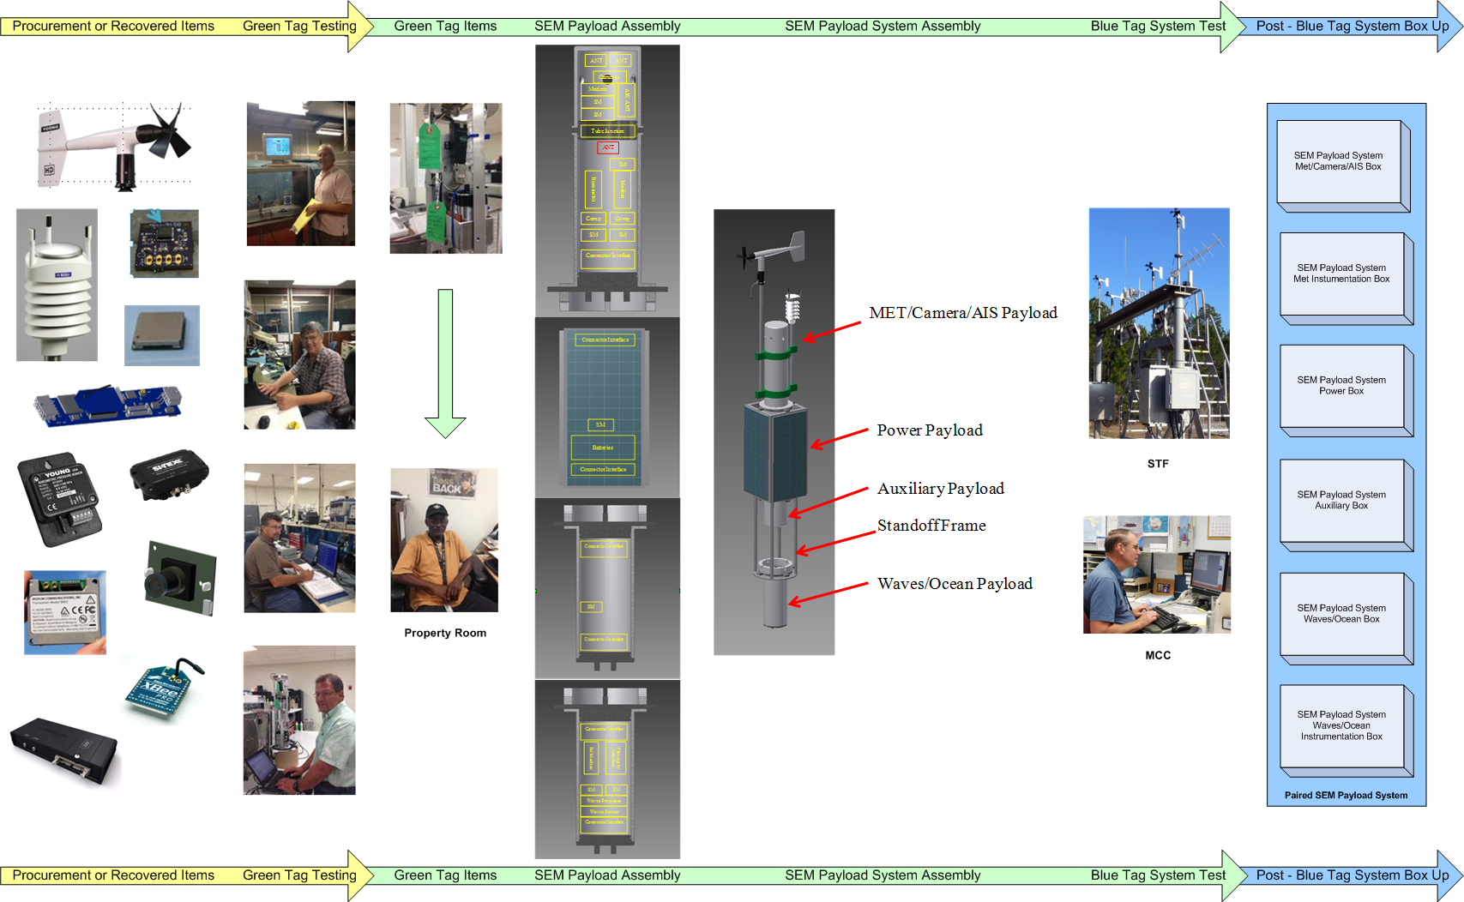
Engineering Lab Testing

Slide 37
SCOOP Documentation Tree

Slide 38

Q & A

