Slide 1
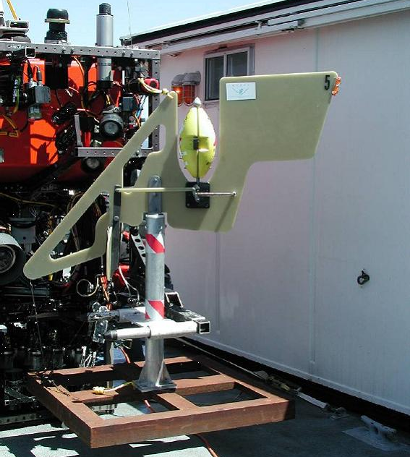
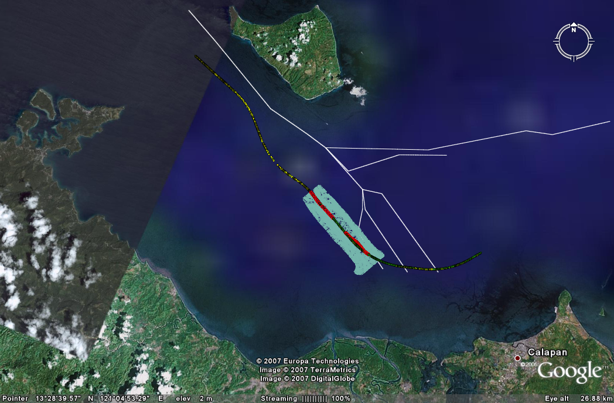
STED Self Triggering Event Detectors – Early Satellite Warning of Turbidity Current Event
Legend
Legend
Legend
EPA
Unit of measure
Legend
Legend
Legend
Legend
Legend
Legend
Legend
Legend
Lubang Fault Zone
Aglubang Fault Zone
1 Footnote
2 Footnote
3 Footnote
4 Footnote
5 Footnote
Source: Source
1
* Footnote
Source: Source
Notes:
Recommendation:
The riser support clamp drawings should be checked to identify where these items are located or, the items should be removed from the asset list to simplify the inspection process.

